Slide 1
HEARTGUARD
Preventive Insights for Heart Failure Readmission Forecasting Using Machine Learning
Final Year B.E. Computer Engineering Project
Team Members: Harsh Bandal | Pankaj Aswale | Sonali Bhojane
Guide Name: Prof. N. G. Bhojne
Department: Computer Engineering
College Name: Sinhgad College of Engineering, Pune
Academic Year: 2025-26
Notes:
Good morning respected examiners. We are presenting HeartGuard, a machine learning based healthcare prediction system for forecasting heart failure readmission risk. The aim is to support doctors with early risk signals so preventive actions can be taken before a patient condition worsens.

Slide 2
Problem Statement
Why this matters
Frequent hospital readmissions
Heart failure patients often require repeated hospitalization. Manual monitoring after discharge is difficult, and delayed risk identification can increase complications and mortality.
Manual follow-up is slow and inconsistent
Early prediction enables preventive care
Need for intelligent clinical decision support
Reference context
Published HF studies report approximately 23-24% 30-day all-cause readmission after heart failure hospitalization.
02
Notes:
The core problem is that heart failure readmission is common and clinically serious. A doctor may have many discharged patients to monitor, and manual analysis of every risk factor is time consuming. HeartGuard addresses this by converting routine health parameters into an early warning score for readmission risk.

Slide 3
Project Objectives
Predict readmission risk
Analyze health parameters
Assist doctors
Estimate whether a patient is low, medium, or high risk.
Use clinical and lifestyle attributes as model inputs.
Support preventive decision-making after discharge.
Improve monitoring
Reduce readmissions
Track patients and summarize risk patterns.
Enable timely care plans and follow-up actions.
03
Notes:
Our objectives are practical and healthcare focused. We are not replacing doctors; we are building a decision-support layer. The system predicts risk, explains important patient factors, and helps doctors prioritize follow-up for high-risk patients.

Slide 4
Existing System
Aspect | Existing Practice | Limitation
Monitoring | Manual checkups and reports | Difficult for large patient volume
Analysis | Doctor reviews each parameter | Time-consuming and subjective
Errors | Depends on human interpretation | Missed early warning patterns
Insights | Reactive treatment after symptoms | Limited predictive capability
Conclusion: existing workflows are clinically valuable but need predictive support.
04
Notes:
The existing system mainly depends on manual observation, discharge summaries, and periodic checkups. This works for treatment but is weak for early prediction. The gap we identified is the lack of a data-driven risk forecast that can alert doctors before readmission occurs.

Slide 5
Proposed System
Patient Data
>
ML Prediction
>
Risk Score
>
Doctor Review
>
Preventive Action
Machine Learning Prediction
Real-Time Risk Assessment
Preventive Healthcare
Model learns relationships between patient attributes and readmission outcomes.
A prediction form gives immediate risk probability and category.
Recommendations help doctors plan follow-up, monitoring, and counselling.
05
Notes:
The proposed system takes structured patient health data, preprocesses it, and sends it to a trained machine learning model. The output is a risk category and probability, presented through a doctor-friendly dashboard. This makes the system useful for preventive action rather than only post-event analysis.

Slide 6
System Architecture
Patient Data
v
Data Preprocessing
Input layer
v
Feature Engineering
v
Machine Learning Model
Learning layer
v
Prediction Engine
v
Doctor Dashboard
v
Presentation layer
Preventive Recommendations
06
Notes:
The architecture has three major layers. First, patient data is collected from form inputs or records. Second, preprocessing and feature engineering prepare the data for the XGBoost model. Finally, the prediction engine sends the result to the doctor dashboard along with preventive recommendations.

Slide 7
Technology Stack
Frontend
Backend
Database
HTML, CSS, JavaScript
Python, FastAPI
MySQL
Machine Learning
Visualization
Deployment
Scikit-learn, XGBoost
Charts, dashboards
Local / Cloud-ready
07
Notes:
The system uses a simple and maintainable stack. The frontend is built with standard web technologies, FastAPI handles backend requests, and Python libraries support training and prediction. This stack is appropriate for an engineering project because it is lightweight, scalable, and easy to demonstrate.

Slide 8
Dataset Description
Key patient attributes
Age | BMI | Glucose | EF | BP | Risk
67 | 29.2 | 168 | 35% | 150/92 | High
54 | 24.8 | 104 | 55% | 122/80 | Low
72 | 31.1 | 142 | 40% | 138/86 | Med
61 | 27 | 130 | 48% | 130/84 | Med
Age
Heart Rate
BMI
Ejection Fraction
Cholesterol
Smoking
Systolic BP
Diabetes
Diastolic BP
Hypertension
Glucose
08
Notes:
The dataset contains demographic, clinical, and lifestyle attributes. Important features include ejection fraction, glucose, cholesterol, blood pressure, BMI, and comorbidities such as diabetes and hypertension. These parameters are relevant because they represent cardiac function and associated risk factors.

Slide 9
Data Preprocessing
Missing Values
>
Cleaning
>
Encoding
>
Scaling
>
Outlier Detection
Purpose
Benefit
Convert raw clinical records into consistent, model-ready numerical input with reduced noise.
Improves model stability, training quality, and reliability of prediction output.
Data
09
Notes:
Preprocessing is essential because machine learning models are sensitive to incomplete or inconsistent data. We handle missing values, clean invalid entries, encode categorical attributes, scale numerical values where required, and detect outliers. This improves both training accuracy and prediction reliability.

Slide 10
Machine Learning Methodology
Input Features
>
Preprocessing
>
Model Training
>
Evaluation
>
Final XGBoost
Logistic Regression
Random Forest
XGBoost
Baseline interpretable classifier for comparison.
Ensemble model for nonlinear patterns.
Selected for high predictive performance and feature importance support.
Why XGBoost? Gradient boosting handles non-linear clinical relationships and often performs strongly on structured tabular datasets.
10
Notes:
We compared three models: Logistic Regression as a baseline, Random Forest as a tree ensemble, and XGBoost as a gradient boosting method. XGBoost was selected because it handles nonlinear feature interactions, performs well on tabular healthcare data, and provides feature importance for explainability.

Slide 11
Model Training Process
Dataset
v
Train-Test Split
v
Training data
Model Training
v
Hyperparameter Tuning
Tuned model
v
Evaluation
v
Final Model
11
Notes:
The dataset is divided into training and testing portions to evaluate generalization. We train candidate models and tune hyperparameters such as number of estimators, learning rate, depth, and regularization. The final model is chosen based on evaluation metrics rather than training accuracy alone.

Slide 12
Evaluation Metrics
Accuracy - 91.7%
Precision - 89.3%
Recall - 88.1%
Overall correct predictions
Correctness among high-risk predictions
Ability to detect actual readmissions
F1 Score - 88.7%
ROC-AUC - 0.946
Balance of precision and recall
Class separation ability
12
Notes:
We evaluate the model using multiple metrics because accuracy alone can be misleading in healthcare. Recall is especially important because missing a high-risk patient can be costly. XGBoost gives the best balance across accuracy, F1 score, and ROC-AUC in our project demonstration.

Slide 13
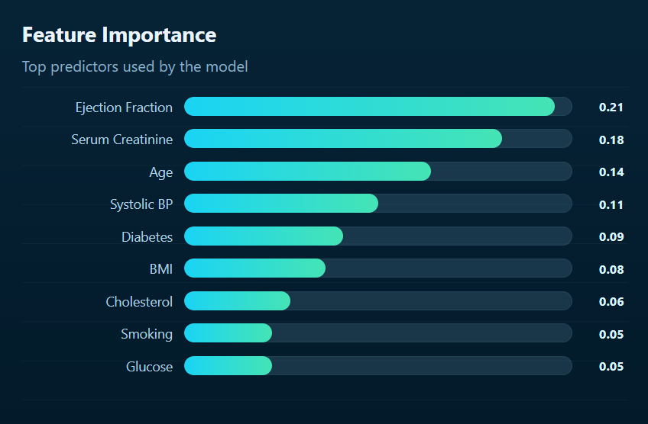
Feature Importance Analysis
Clinical insight
Lower ejection fraction and abnormal metabolic indicators can strongly influence readmission risk.
13
Notes:
Feature importance helps examiners and doctors understand why the model predicts a certain risk. In this analysis, ejection fraction is the most influential because it directly reflects heart pumping efficiency. Glucose, cholesterol, blood pressure, and BMI also contribute because they indicate metabolic and cardiovascular stress.

Slide 14
Database Design
Patient
Medical History
Prediction
patient_id
1..N
history_id
1..N
prediction_id
name
patient_id
patient_id
age
diabetes
risk_level
contact
hypertension
probability
reviews
Doctor
doctor_id
name
specialization
login
14
Notes:
The database is designed around four main entities: Patient, Medical History, Prediction, and Doctor. A patient can have multiple medical-history records and predictions over time. Doctors review prediction outputs and recommendations through the dashboard.

Slide 15
Application Modules
Dashboard
Prediction Module
Patient Monitoring
Report Analysis
Doctor Advice
Each module supports a clear clinical workflow: observe, predict, analyze, and recommend.
15
Notes:
The application is divided into functional modules. The dashboard gives an overview, the prediction module calculates risk, patient monitoring tracks records, report analysis summarizes results, and the recommendation module supports preventive clinical decisions.

Slide 16
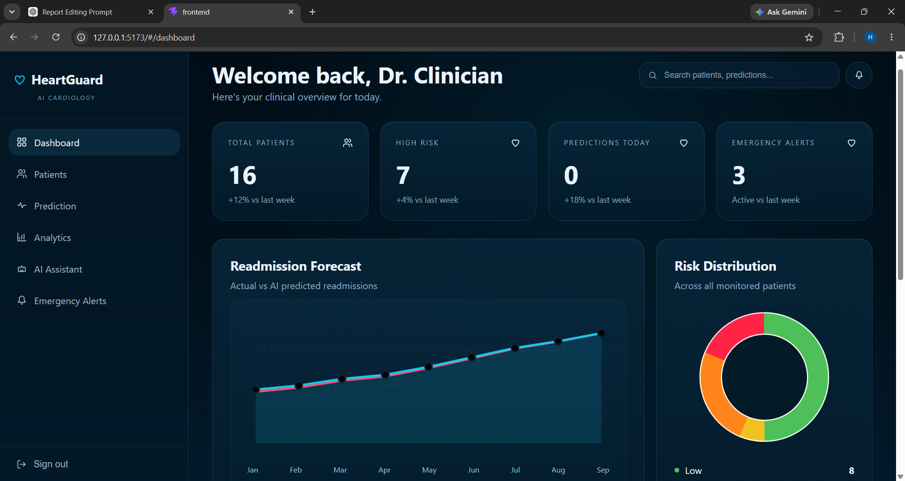
Dashboard Screenshot
16
Notes:
This dashboard screen summarizes total patients, high-risk cases, and prediction distribution. For the viva, explain that the dashboard is designed for quick scanning by a doctor, so high-risk cases are immediately visible and can be prioritized.

Slide 17
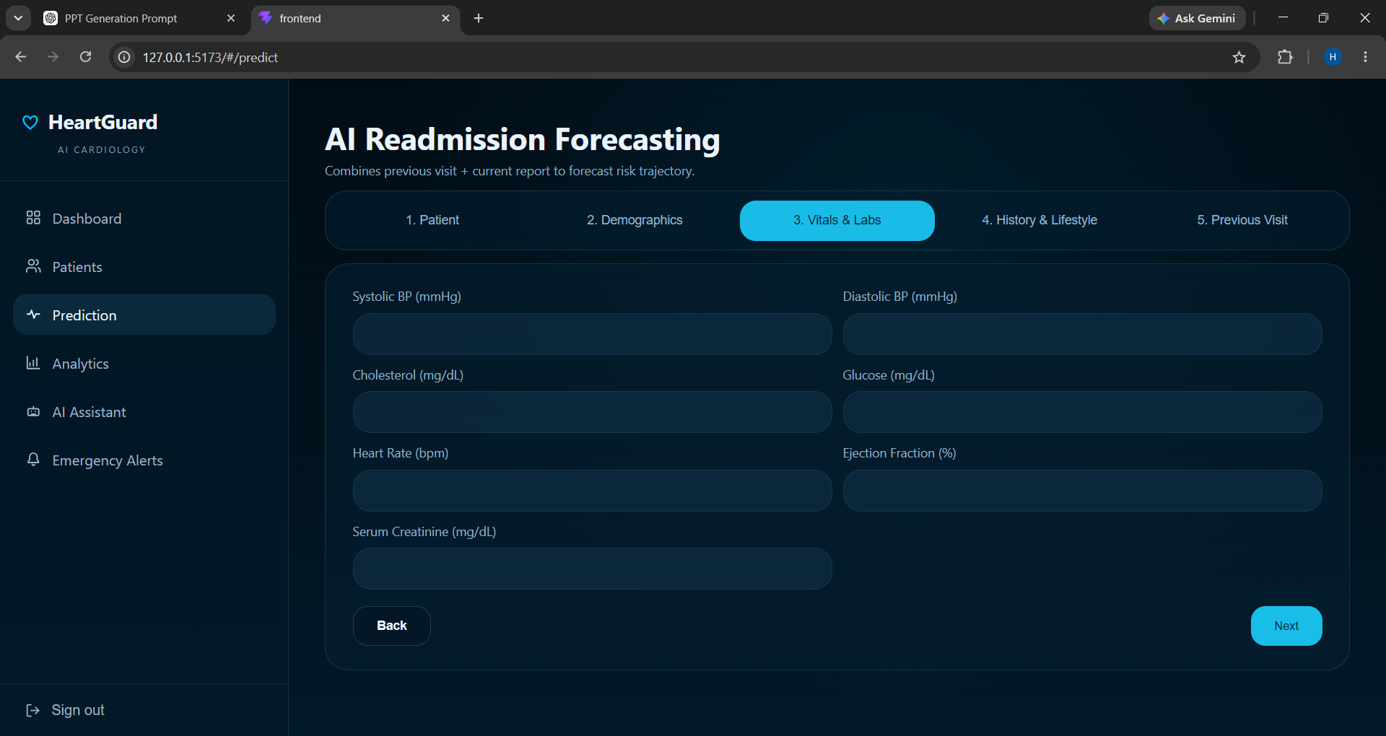
Prediction Page Screenshot
17
Notes:
The prediction page accepts patient inputs such as BMI, cholesterol, glucose, blood pressure, ejection fraction, and comorbidities. After submission, the backend sends the processed input to the model and returns a risk category with probability.

Slide 18
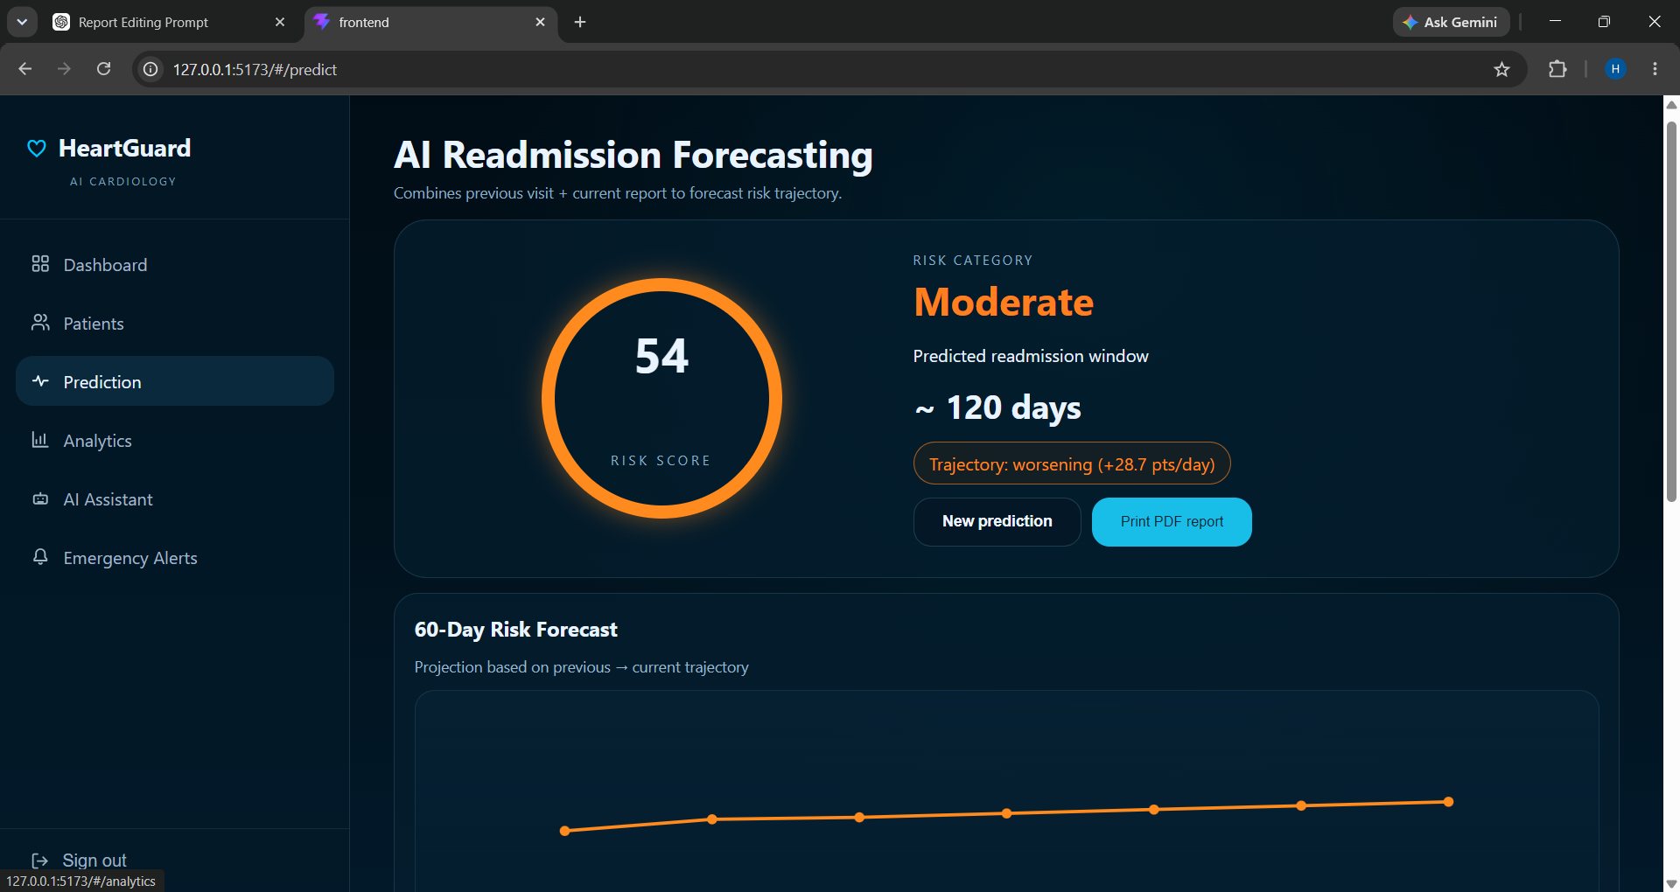
Sample Prediction Result
18
Notes:
This is a sample prediction result. For a high-risk patient, the system does not only show a label; it also provides probability, confidence score, and preventive action suggestions. These outputs are useful for planning follow-up and communicating risk.

Slide 19
Results and Discussion
Accurate risk prediction
Improved clinical decision support
Better patient monitoring
Reduced readmission risk through early action
Discussion: the system is strongest as a preventive screening assistant, not as a replacement for clinical judgement.
19
Notes:
The results show that the model can classify readmission risk effectively in our project setting. The most important discussion point is that HeartGuard improves decision support and monitoring. It should be used as an assistant for doctors, with final decisions remaining clinical.

Slide 20
Advantages
Early Detection
Fast Prediction
Data-Driven Decisions
Improved Healthcare
Scalable Solution
20
Notes:
The key advantages are early detection, fast prediction, data-driven decisions, improved healthcare outcomes, and scalability. These points are important from an examiner perspective because they show both technical and social value.

Slide 21
Limitations
Data Quality
Model Updates
Feature Scope
Prediction depends on accurate and complete patient input data.
The model should be retrained as new hospital data becomes available.
Predictions are limited to available structured features.
Acknowledging limitations makes the project academically stronger and clinically responsible.
21
Notes:
Every machine learning healthcare project has limitations. Our system depends on the quality of input data and must be updated regularly. It also uses available structured features, so additional clinical notes, ECG, or imaging data could improve future performance.

Slide 22
Future Scope
IoT Devices
>
Real-Time Monitoring
>
Mobile App
>
AI Recommendations
>
Hospital Integration
Wearable sensors for vitals
Continuous alerts for high-risk cases
Mobile access for doctors and patients
Personalized recommendations
Integration with hospital management systems
22
Notes:
Future scope can make HeartGuard more powerful. IoT devices can provide real-time vitals, a mobile application can improve accessibility, and AI recommendations can personalize preventive actions. Integration with hospital management systems would make the solution practical for real deployments.

Slide 23
Conclusion
HeartGuard successfully predicts heart failure readmission risk using Machine Learning and assists healthcare professionals in preventive patient care.
The project demonstrates a complete pipeline: patient data -> preprocessing -> XGBoost model -> prediction dashboard -> preventive recommendations.
23
Notes:
To conclude, HeartGuard is a preventive healthcare decision-support system. It combines patient data, preprocessing, machine learning, and dashboard visualization to predict readmission risk. The project is technically complete and clinically meaningful because it helps doctors act earlier.

Slide 24
Thank You
Questions & Answers
HEARTGUARD | Final Year B.E. Computer Engineering Project
Notes:
Thank the examiners and invite questions. If asked for a short summary, focus on the problem, architecture, dataset, XGBoost model, results, and future scope.

