Slide 1

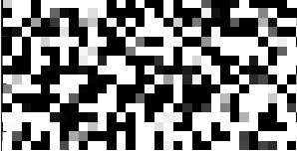

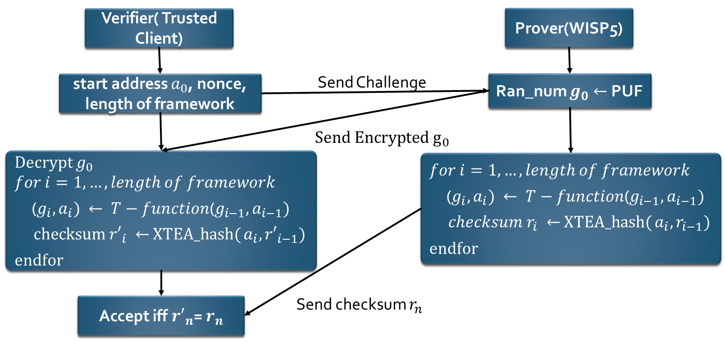
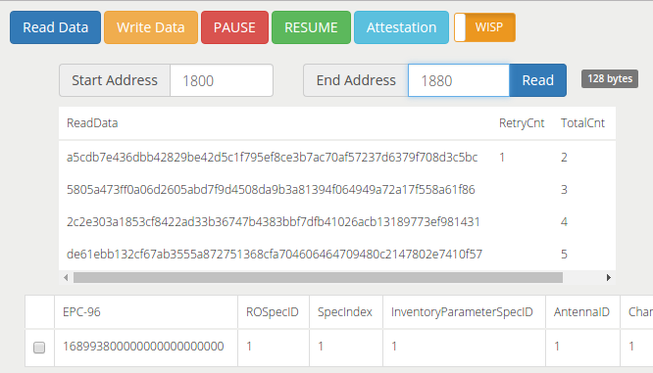
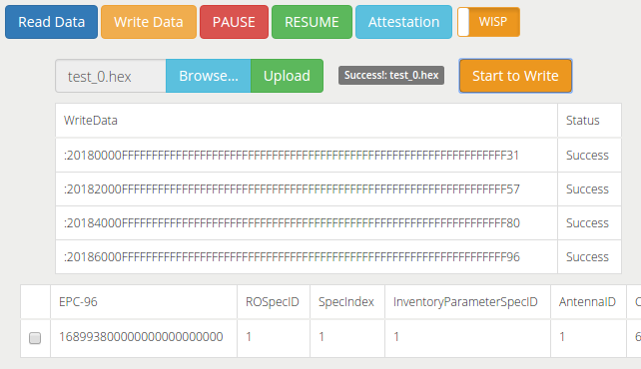

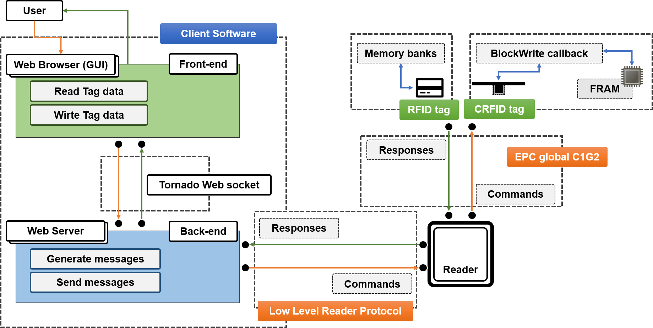
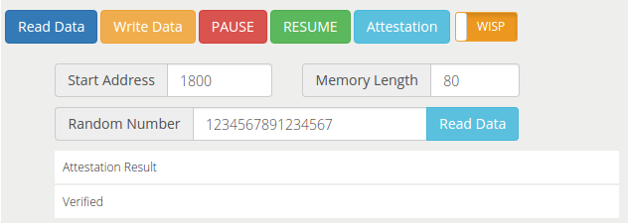
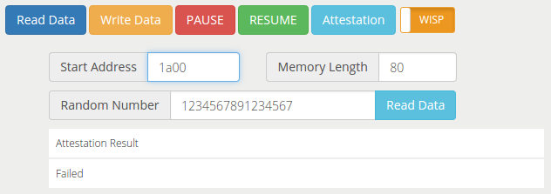
Crypto4RFID : Building Secure Computational RFID tags
Sangyeol Kim, Yang Su, Jingwen Shan, Yuanzhong Xia (a1689938, a1697562, a1700051, a1700831) @student.adelaide.edu.au
Supervised by Damith Ranasinghe, Michael Chesser, Yang Su
^{School of Computer Science}
^{Hash Function}
^{Fingerprints using SRAM}
^{Introduction and Motivation}
We found and studied 10 secure (until Sep. 2017) lightweight block cipher algorithms: AES128, Camellia, CLEFIA, LBlock, LEA, PRINCE, SEA, SIMON128, SPECK128 and XTEA; and we constructed 30 hash functions using Merkle-Damgard, Matyas-Meyer-Oseas and Miyaguchi-Preneel based those studied block cipher functions. Then using our optimization technologies, the speed performance can achieve an improvement of at least 10%.
We mainly work on optimizing the hash functions. As usual, we have three main ways to optimize these algorithms:
Compiler optimization: we studied different optimization levels of Texas compiler, GNU gcc compiler and LLVM Clang compiler.
High-level language optimization: rewrite original algorithms using 8-bit and 16-bit operations specifically for MSP430.
Low-level language optimization: manually inlining function calls, unfolding loops and using MSP430 specific instruction set to replace some standard library functions.
Computational RFID tags are generally batteryless, RF-powered computing and sensing systems built on (CRFID) RFID technology. The CRFID provides the limited resources of its devices that is difficult to implement a traditional ciphers and implementing security services that is extremely challenging.
Crypto4RFID project supports to strengthen the security services by verifying between an RFID reader and CRFID with Hash function, Attestation, and SRAM-based PUFs.
We use the power-up state of SRAM to identify different tags from each other. By measuring each chip’s unique initial SRAM state, a database can be built at client side. Then when a tag connects to the client, we can get it’s SRAM read authenticate it if it has a match in the database.
^{System Overview}
These 2 pictures represent part (64B) of the memory map of 2 chips at the same address, which is enough to support the authentication. The pure black squares stand for the stable bits that are always 0, and the pure white squares stand for the stable bits that are always 1. The gray squares are the changing bits. With the lighter of shade, the probability of this bit to be 1 is higher. Generally, the reads from same chip have about 80% bits stable, reads from different chips have more than 50% bits different.
Database
WISP5
ID (6ef331c)
SRAM
(2KB data)
FRAM
(64KB data)
.
.
.
Start address, round count
Checksum
^{Attestation}
Start Address, Round count
Checksum (hash result)
Only when checksum verified
^{Client Software}
ID (6ef331c)
SRAM
(2KB data)
FRAM
(64KB data)
INVENTORY
CHALLENGE
More Actions
Using SRAM PUF to generate 64-bit pseudo-random number
Client Software? Client software can make the communication between a reader and CRFID tag using Low-Level Reader Protocol.
The software-based attestation relies on challenge-response protocol to check the integrity of the memory states of a remote device.
Using t-function to select some of random addresses in the whole FRAM for hash function to generate checksum
.
.
.
Query ID
Expect same checksum (hash results)
PC Client
<Read WISP data>
<Write WISP data>
Software-based attestation scheme
^{Reference}
Verification procedure succeed: the memory content is the same as expected
Verification procedure failed: the memory content has been changed
1) Security, Koenig. 'What Is A Stream Cipher?'. Information Security Blog | Koenig Solutions Limited. N.p., 2015. Web. 17 Nov. 2015
2) Aantjes, Henko, Amjad Y. Majid, Przemyslaw Pawelczak, Jethro Tan, Aaron Parks, Joshua R. Smith, Akshay Uttama Nambi SN et al. "Fast Downstream to Many (Computational) RFIDs." Proc. IEEE 54 (2016): 1-12.
<System architecture>

