Slide 1
Task 4: Dashboard Design
E-Commerce Sales Dashboard Summary

Slide 2
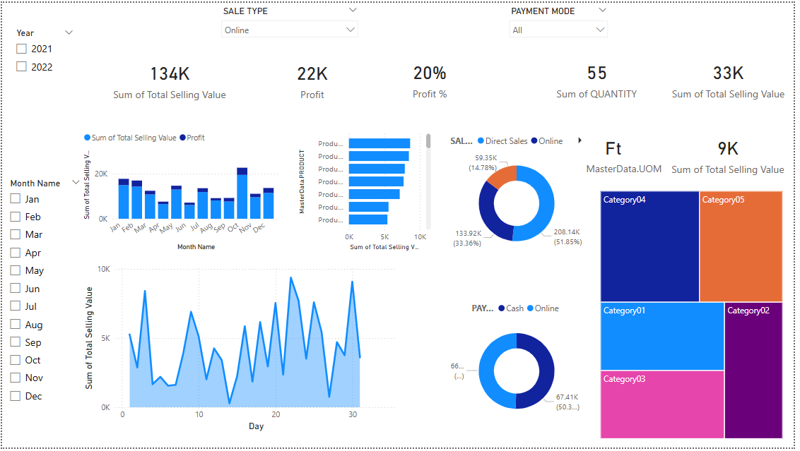
Dashboard Screenshot

Slide 3
Implementation Steps
Get Data: Import e_commerce_data.csv into Power BI
Data Preparation: Clean and transform in Power Query
Use Power Query Editor to:
Remove blanks and errors
Rename columns for clarity
Change Order Date to Date type
DAX Measures: Total Amount, Profit, Quantity, Avg Order Value

Slide 4
(Cont.)
Design Layout: KPI cards, charts, slicers, bookmarks, Time Analysis, Category View, Top Products
Interactivity: Quarter buttons, category slicer, Hover Tooltips, Category Dropdown
Formatting: Dark theme, consistent fonts and colors
Publish: Export to Power BI Service or PDF/PPT

Slide 5
Key Insights
Total Sales: 134K
Profit: 22K
Profit %: 20%
Quantity Sold: 55 Units
Top Categories: Category04, Category05
Sales Split: 51.85% Online, 14.78% Direct
Payment Modes: Near even split between Cash & Online

Slide 6
Best Practices
Clear KPIs at the top for quick overview
Filters and bookmarks for interactive analysis
Clean layout with strong color contrast
Tooltip-rich visuals for better user experience
Modular design for easy scalability

Slide 7
Deliverables
Dashboard_pic.png — Visual of the dashboard
Task4_Summary.pptx — Presentation with dashboard insights (This File)
README.md — Documentation

