Slide 1









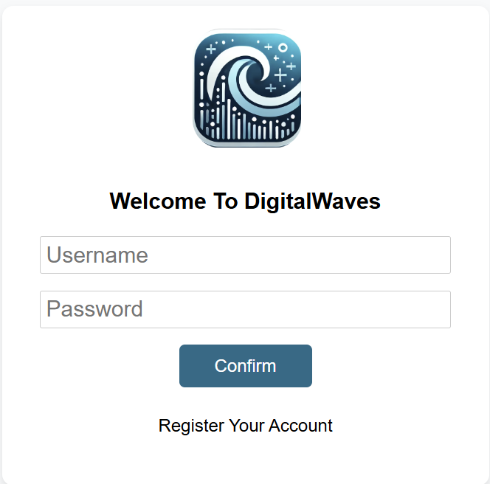
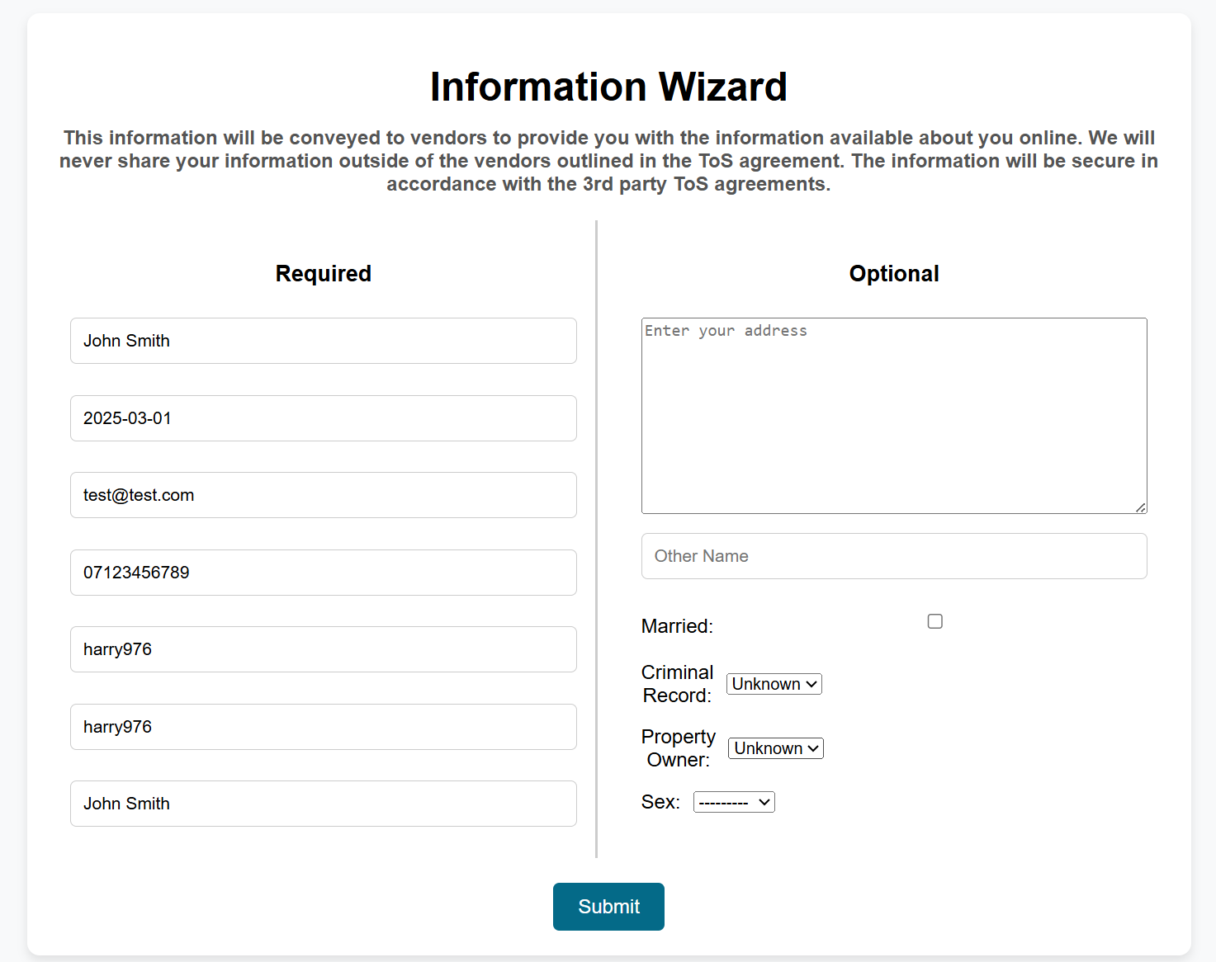
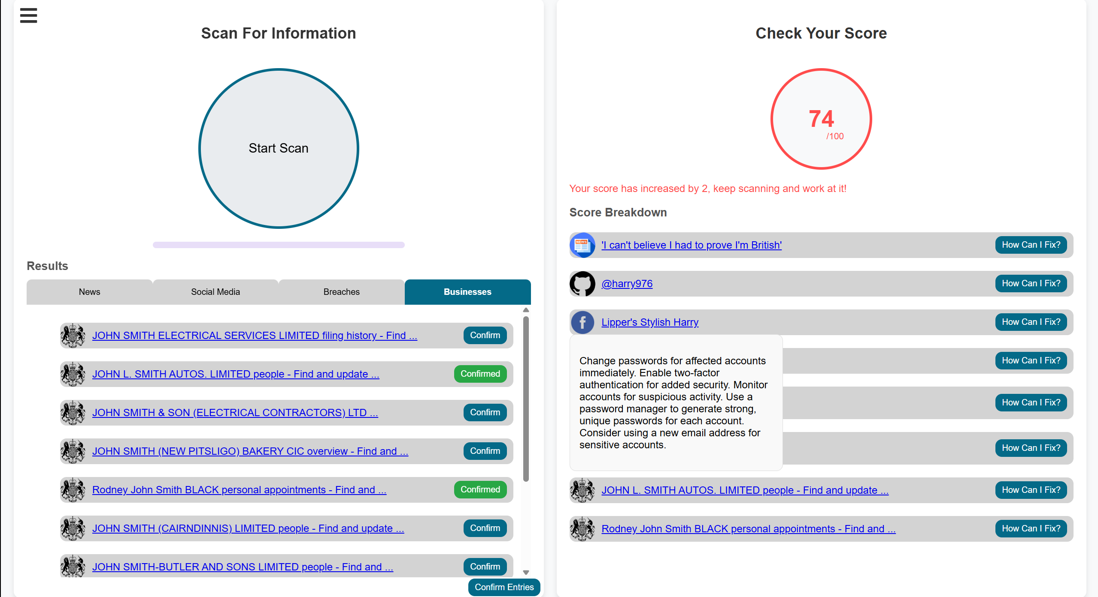









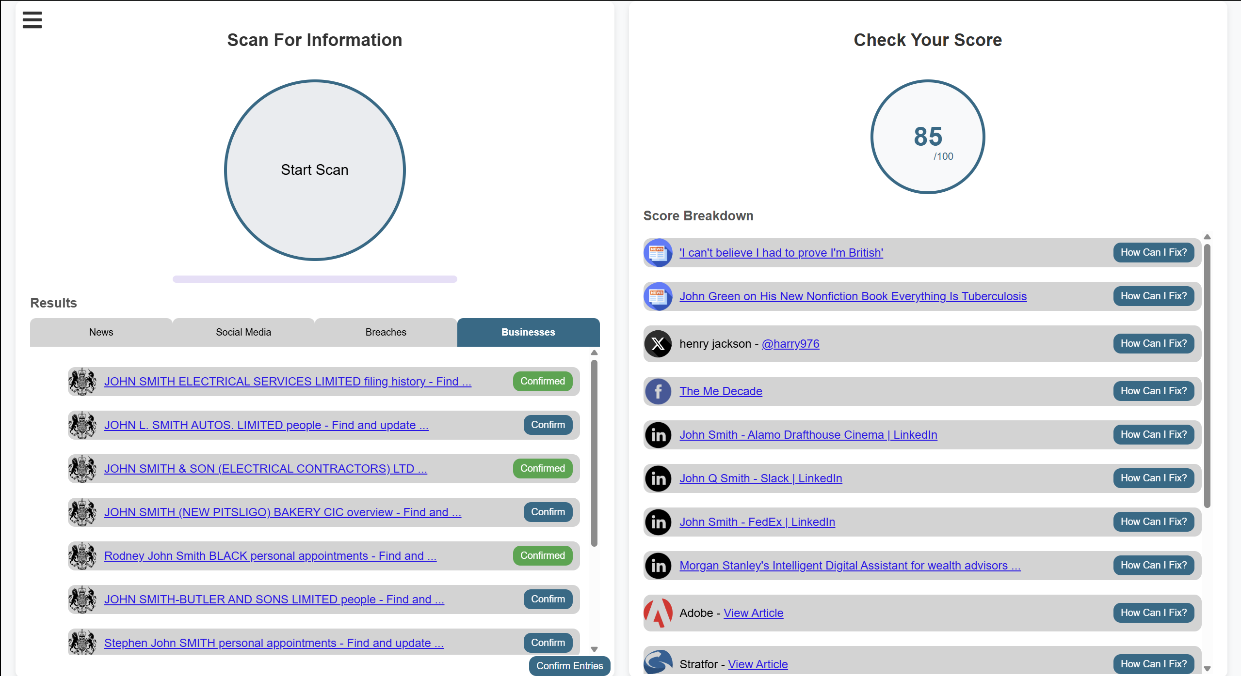











DigitalWaves Digital Footprint Tracker
The Problem
With 1.7MB of data being generated every second by the average internet user, tracking your digital footprint can be frustrating. Complicated methods and mean non-technical individuals have increased risks of personal information about them being available freely online, leading to dangerous outcomes such as identity theft, fraud and impersonation.
Next Steps
Incorporate LLMs into advice system
Possibility to deploy on public-facing web server
Option for users to add additional APIs
Incorporate more data sources and Custom Search Engines
The Solution
DigitalWaves is a locally run web app. It allows the user to input and edit their information via a simple form and scan for matches.
The process is made simple, by automating requests to APIs from popular information sources and presenting this in a user-friendly fashion. The user can select relevant links and review these along with a score and helpful tips on how to reduce their digital footprint.
Features
Accounts system for multiple users
API connections for data collection
Option to confirm relevant links to handle false positives
Dynamic scoring system for users to track progress over multiple uses
Relevant links presented to users with helpful tips on how to improve their digital footprint
Harry Ormandy
Computer Science (Cyber Security)
harry.ormandy@students.Plymouth.ac.uk

