Slide 1
Embedded Systems Team - 22
MULTI AGENT SMART BRICKS
Smart Surgery Tray
Mohammed Ibrahim Bin Faisal | Rushil Grover | Harry Aadith | Hershi Jaiswal
Faculty and Mentors
Dr. Kavita Vemuri - Faculty Head | Ranapratap - Mentor | Adeeb - TA
Notes:
Introduce the team and project. One line: autonomous ESP32 bricks that snap together into a self-organising surgical tray that tracks instruments.

Slide 2
Problem Statement
Design a set of electronic bricks that communicate with neighbouring bricks
and change their behaviour depending on how they are assembled. The first
step can be communicate to count presence within a range.
Each brick is an autonomous agent that:
• Detects neighboring bricks
• Exchanges information
• Makes local decisions
• Contributes to the overall system behavior
Our Solution
Autonomous ESP32 'Smart Bricks' forming a modular, self-organizing tray.
Expected outcome: real-time instrument accountability with minimal failure
Notes:
Retained surgical instruments are a never-event with serious patient harm. Counting today is manual and verbal. Our answer is a tray that counts for itself. Land the expected outcome: real-time accountability.

Slide 3
Motivation
Clinical Hazard
Retained surgical instruments pose severe risks to patient safety.
Manual Error
Counting relies on manual human checks under high stress and fatigue.
Our Solution
Autonomous ESP32 'Smart Bricks' forming a modular, self-organizing tray.
Expected outcome: real-time instrument accountability with minimal failure
Notes:
Retained surgical instruments are a never-event with serious patient harm. Counting today is manual and verbal. Our answer is a tray that counts for itself. Land the expected outcome: real-time accountability.

Slide 4
Motivation
Existing Work and Gaps
Why Modular Bricks?
Smart ORs explore RFID tool cabinets
Bulky sensors on tools hurt surgeon ergonomics and sterilization
Nurses and technicians do manual verbal / whiteboard counts before, during and after long, high-stress surgeries
Distributed peer-to-peer compute: no single point of failure
Passive RFID tags: no battery-powered electronics on instruments
Tray shape adapts to the procedure by re-arranging bricks
Notes:
Existing smart-OR work focuses on RFID cabinets. The gap is the tray itself. Sensors on instruments hurt ergonomics and sterilisation, so we keep tags passive and put the intelligence in the tray. Modular peer bricks avoid a single point of failure.

Slide 5
Our Proposed Solution
Centralized Wi-Fi
→
Direct low-latency ESP-NOW peer-to-peer communication
Active tool electronics
→
Passive RFID tags seated in custom brick indents
Magnetic compass heading
→
Aligned-start gyro yaw; no magnetic reference used
Face Detection
IR sensors on all four sides
2D Layout Solver
Grid rebuilt automatically
Live Dashboard
Wi-Fi page, no router
Feedback
RGB LED, buzzer, haptics
Notes:
Three design choices: mesh instead of a central hub, passive tags instead of active tool electronics, and gyro-based relative orientation instead of a magnetic compass (no dependence on the magnetic environment). Then the four headline features.

Slide 6
System Architecture
Smart Bricks
ESP32 + RFID, 4 IR, IMU. Identical firmware
ESP-NOW P2P
Peer telemetry every 250 ms, Wifi channel 1
Gateway Brick
Lowest UID auto-elected. Hosts hotspot + /api/state
Web Dashboard
192.168.4.1. Live cards + 2D layout
→
→
→
One firmware image: IDs and brick numbers are assigned automatically
Offline: join Wi-Fi Smart Surgery Tray, open the page, no internet needed
Notes:
Same firmware on every brick. Bricks broadcast telemetry over ESP-NOW; the brick with the lowest hardware ID elects itself gateway and hosts the Wi-Fi hotspot and dashboard. No router, cloud or server.

Slide 7
Sensors Used and Hardware
Microcontroller | ESP32 DevKit V1 (ESP-NOW + Wi-Fi AP)
Instrument tracking | MFRC522 RFID reader + passive tags (top-facing)
Face detection | 4 IR obstacle sensors (N / E / S / W)
Orientation | MPU9250-class IMU: accelerometer + gyroscope (I2C)
Feedback | RGB LED, active buzzer, 6 mm ERM vibration motor
Enclosure | Modular 3D-printed bases, instrument slots, diffuser caps
Notes:
Per-brick hardware. RFID faces up to read instrument tags, IR faces sideways to detect neighbours, IMU gives rotation. All pins are on the standard ESP32 DevKit V1.

Slide 8
Pin-out Diagram
GPIO 4 RFID RST
GPIO 23 RFID MOSI
GPIO 5 RFID SS
GPIO 19 RFID MISO
GPIO 16 RGB red
GPIO 18 RFID SCK
ESP32
30-pin DevKit V1
same on all bricks
GPIO 17 RGB green
GPIO 27 Buzzer
GPIO 25 RGB blue
GPIO 34 IR north
GPIO 26 ERM gate
GPIO 35 IR east
GPIO 21 IMU SDA
GPIO 32 IR south
GPIO 22 IMU SCL
GPIO 33 IR west
Notes:
Identical wiring on every brick, all signal GPIOs 35 or below. Left side: RFID reset/select, RGB LED, motor gate, I2C to the IMU. Right side: RFID SPI, buzzer, four IR inputs.

Slide 9
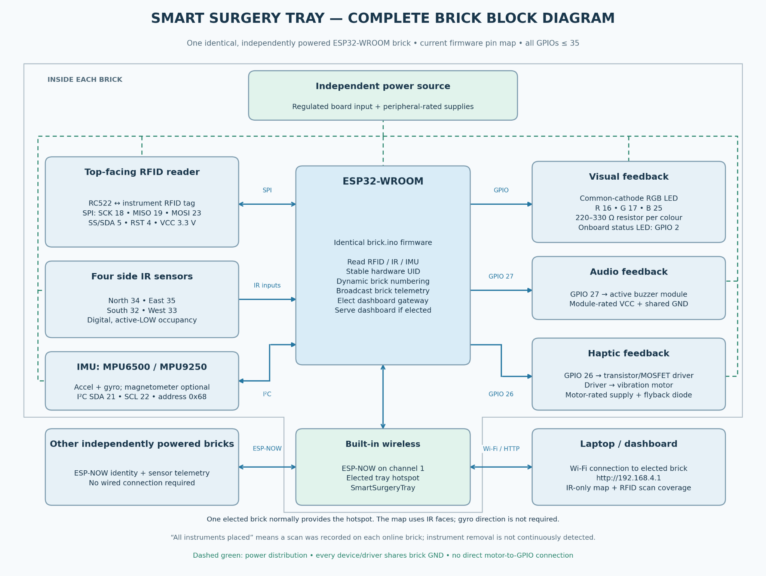
Notes:
Identical wiring on every brick, all signal GPIOs 35 or below. Left side: RFID reset/select, RGB LED, motor gate, I2C to the IMU. Right side: RFID SPI, buzzer, four IR inputs.

Slide 10
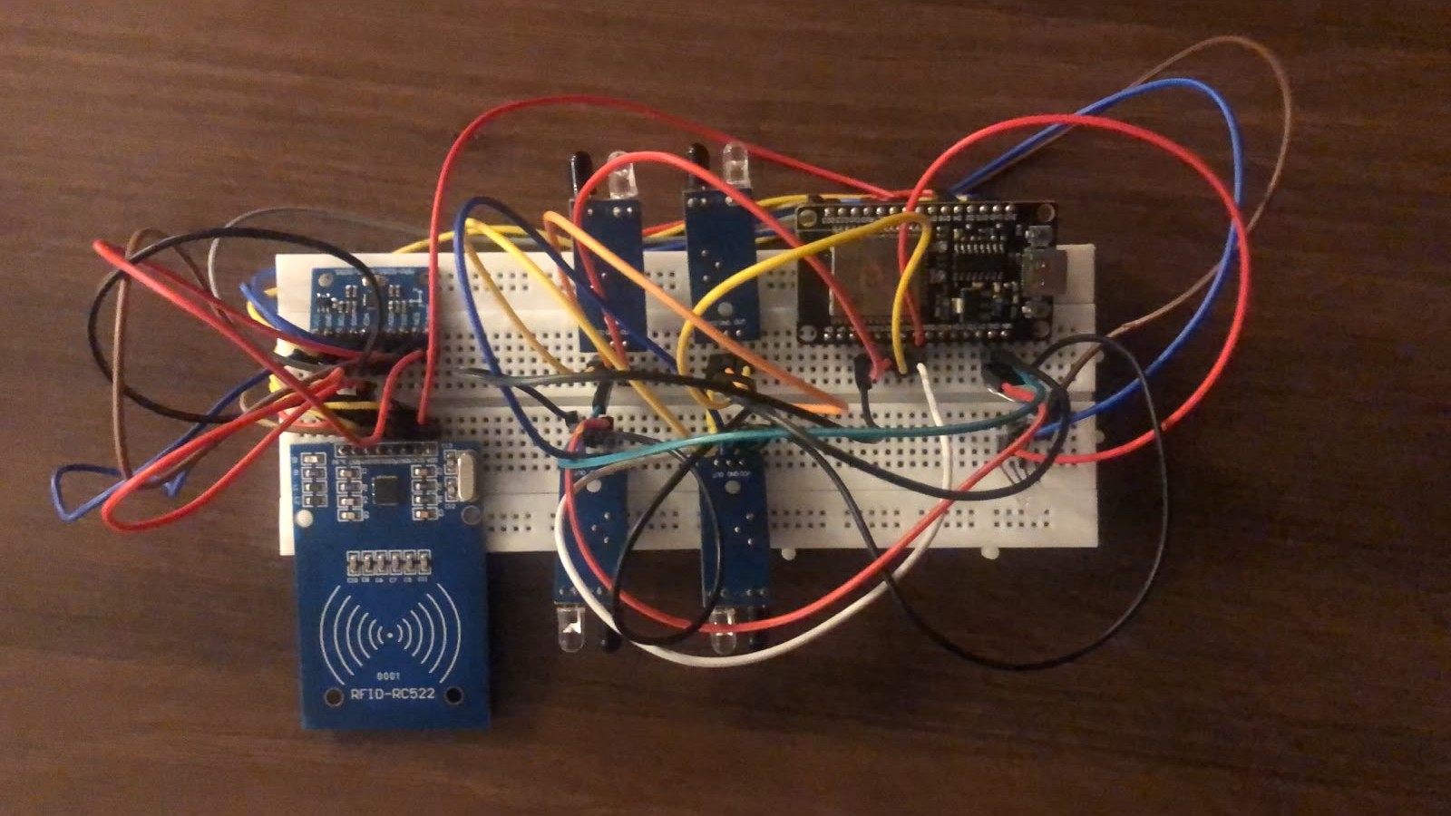
Hardware
Notes:
Identical wiring on every brick, all signal GPIOs 35 or below. Left side: RFID reset/select, RGB LED, motor gate, I2C to the IMU. Right side: RFID SPI, buzzer, four IR inputs.

Slide 11
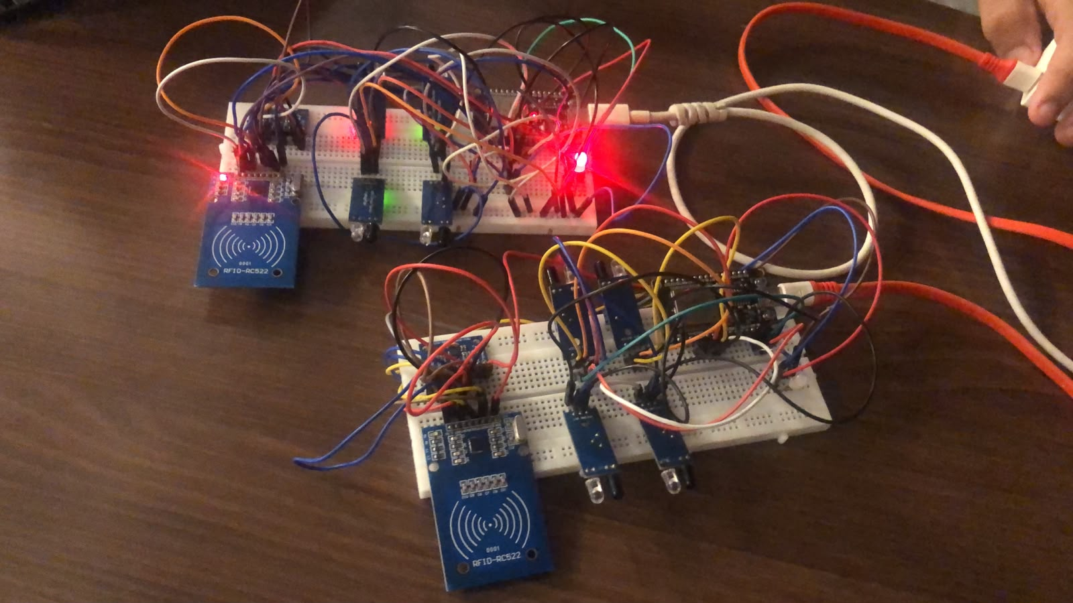
Hardware
Notes:
Identical wiring on every brick, all signal GPIOs 35 or below. Left side: RFID reset/select, RGB LED, motor gate, I2C to the IMU. Right side: RFID SPI, buzzer, four IR inputs.

Slide 12
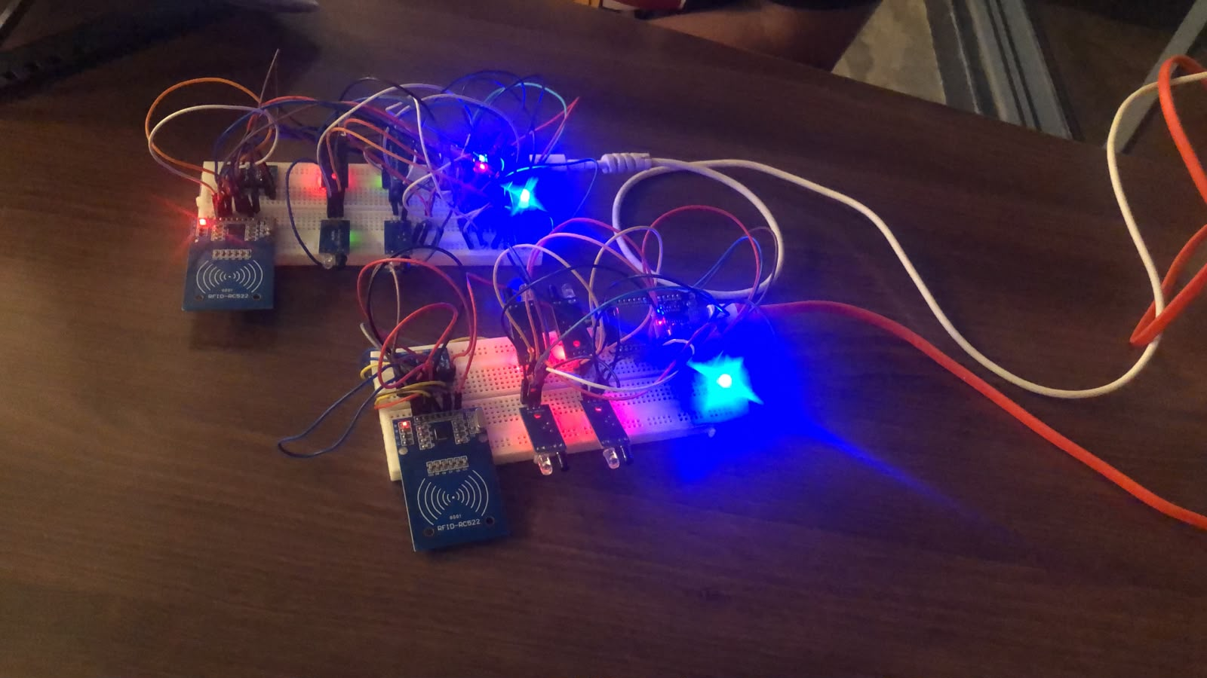
Hardware
Notes:
Identical wiring on every brick, all signal GPIOs 35 or below. Left side: RFID reset/select, RGB LED, motor gate, I2C to the IMU. Right side: RFID SPI, buzzer, four IR inputs.

Slide 13
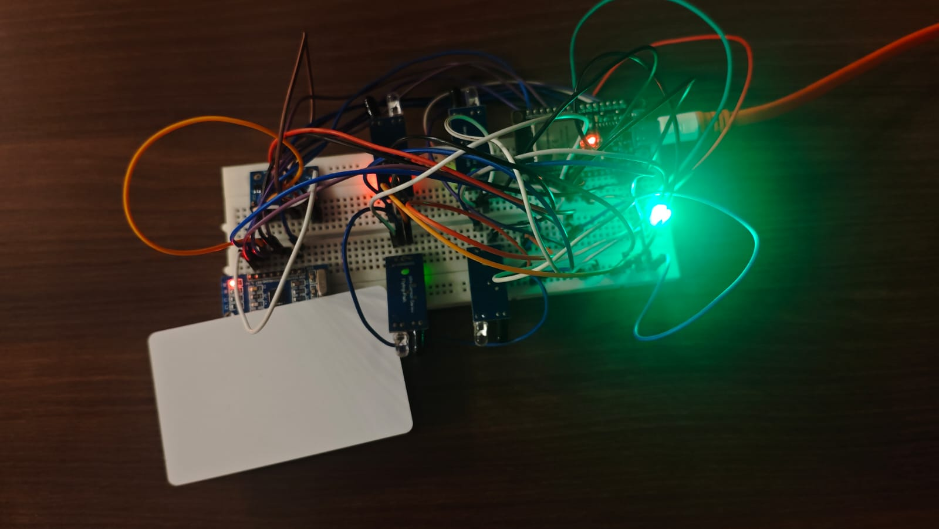
Hardware
Notes:
Identical wiring on every brick, all signal GPIOs 35 or below. Left side: RFID reset/select, RGB LED, motor gate, I2C to the IMU. Right side: RFID SPI, buzzer, four IR inputs.

Slide 14
What We Have Built
ESP-NOW P2P
Peer telemetry, RSSI proximity, peer aging
Dynamic Identity
One firmware; numbers from hardware UID
Gateway Election
Lowest UID hosts hotspot + dashboard
RFID + IR Sensing
Instrument scans, debounced face occupancy
Gyro Yaw Tracking
Aligned-start bias calibration, relative heading
2D Layout Solver
Verified on 2x2, 1x4 and rotated grids
Notes:
Walk through the six cards. Emphasise that the same firmware runs on every brick, the solver was verified against independent exhaustive checks in host tests, and hardware acceptance testing is in progress.

Slide 15
Demonstration
http://192.168.4.1/
Notes:
Step through the pipeline. Key point: we never guess. If tracking is lost we say so and ask for realignment, and when several layouts fit the readings we show all candidates and let the operator confirm.

Slide 16
Project Status
Current Status
Challenges and Mitigations
Unified firmware, identical on every brick
Peer-to-Peer gateway election and dashboard implemented
Layout and yaw logic verified in host test suites
Hardware acceptance testing in progress
Gyro drift
Realign + tracking-lost state
Ambiguous layouts
Candidate list + operator confirm
Power distribution
Standard USB C
Instrument presence
Last-scan only; continuous check open
Notes:
Left: where we are. Right: the main challenges and what we did about each. Be upfront that gyro drift is inherent and handled by realignment, and that continuous instrument-presence detection is still open.

Slide 17
Future Roadmap
1
Full hardware acceptance
Compile, calibrate and test every brick; measure gyro drift
2
Continuous instrument presence
Move beyond last-scan RFID to confirm tools are still seated
3
Modular 3D-printed enclosures
Snap-fit casing with instrument slots and diffusers
4
Haptic and audio confirmation
Tactile feedback for alignment and docking events
5
IoT Advancement
Potential Cloud based Integration for log keeping and recording
Notes:
Prioritise: finish hardware acceptance first, then continuous instrument presence, then scaling and enclosures. These are the items we expect to close before final evaluation.

