Slide 1
Two-phase Deep Learning-based EdoS Detection System

Slide 2
Overview

Slide 3
Overview of the experiment
This document is the guideline to setup, run the testbed for the two-phase Deep learning DoS attack defense system.
The experiment will firstly test how accuracy of the deep learning algorithms in the period detector and the flow detector when detecting the abnormal traffic.
Then, we will test how efficiency the two-phase Deep leanring-based DoS attack defense system when protecting the victim server by testing the response time of the normal traffic and the CPU usage of the victim server.

Slide 4
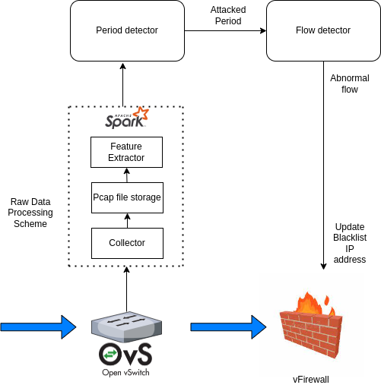
Overview of the system
During the data preprocessing stage, the collector runs a tool named Wireshark tool every 5 seconds to capture all packets going through the virtual switch (open vSwitch).
The network packets will be captured into a pcap file and saved to a disk.
Then this pcap file will be fitted into the feature extractor to extract the necessary features. These necessary features are fitted into the period detector.
If there is an abnoral period detected, the original pcap file will be splitted into m numbers of pcap files that are corresponding to m network flows in that time period.
Next, each pcap file in number of m pcap files will be sent to the feature extractor to extract a set of flow-based features.
The set of flow-based feature will be sent to the flow detector to detect if this flow is abnormal.
If that flow is abnormal, the IP address of this flow will be sent to the firewall to update the blacklist IP address.

Slide 5
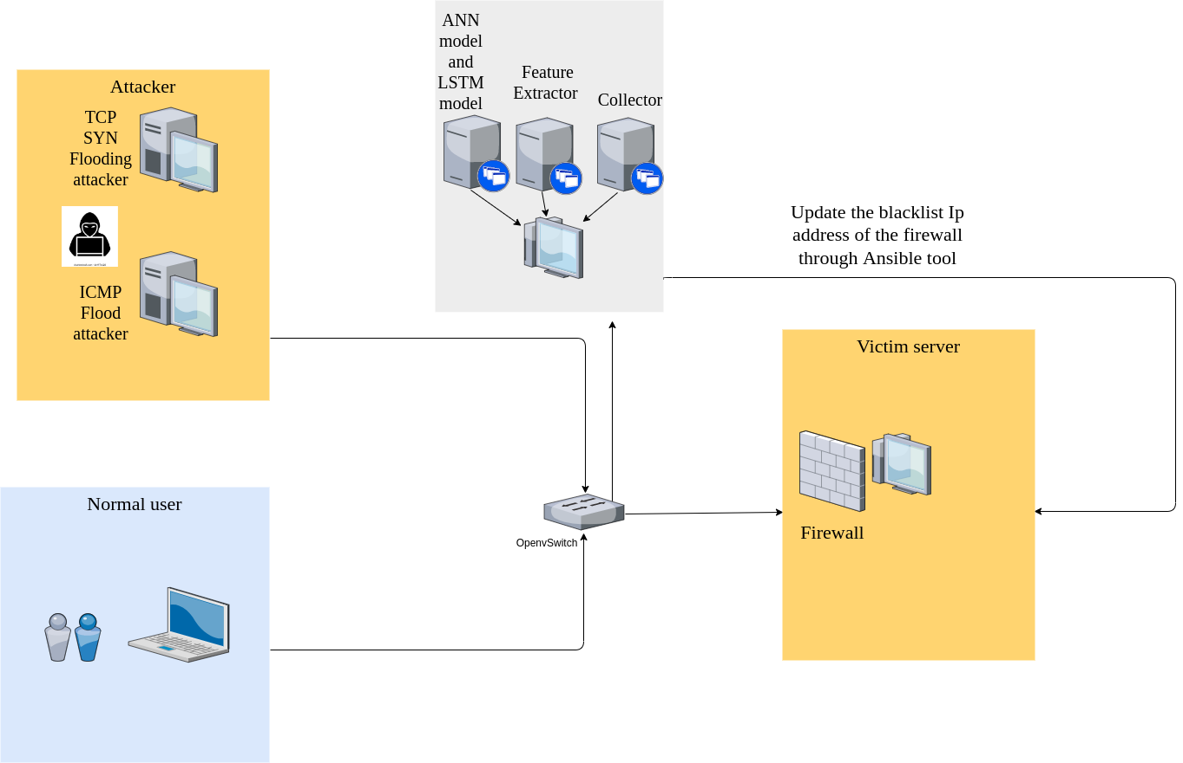
The attacker, normal user, victim server are running on 3 different ubuntu Vms. Those virtual machines are created in Oracle Virtualbox.
The two-phase detector, collector, feature extractor are running on a Ubuntu physical machine.
The Oracle Virtualbox is installed in the physical machine.
Collector is the Wireshark tool
Feature extractor and two-phase detector are python scripts.
Firewall (iptable firewall) is installed in the victim server by default

Slide 6
Setup and Installation

Slide 7
In the Ubuntu physical machine
Install Oracle Virtual box to host Vms:
sudo apt-get update
sudo apt-get install virtualbox-6.1
Install wireshark:
sudo apt-get install wireshark
Install openVswitch:
sudo apt install openvswitch-switch
Install requirement packages for deep learning model training:
pip install numpy
pip install keras
pip install tensorflow
pip install pandas
pip install sklearn
Install pyspark (big data processing framework)
sudo apt install default-jdk scala git -y
pip install pyspark
Install scapy (network packet processing python library)
git clone https://github.com/secdev/scapy.git
cd scapy
sudo python3 setup.py install
Install yaml package
pip install yaml

Slide 8
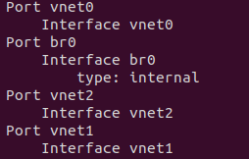
In the Ubuntu physical machine
Now we need to create a virtual switch named br0 to connect Vms and physical machine:
sudo ovs-vsctl add-br br0
We need to create interfaces on that switch. Each interface will connect to ports of attacker, normal user, collector, victim server. In this experiment, we need to create 4 virtual interfaces to connect 4 modules: an attacker (vnet0), a normal user (vnet2), collector (br0), a victim server (vnet1):
sudo ip tuntap add mode tap vnet0
sudo ip link set vnet0 up
sudo ovs-vsctl add-port br0 vnet0
sudo ip tuntap add mode tap vnet1
sudo ip link set vnet1 up
sudo ovs-vsctl add-port br0 vnet1
sudo ip tuntap add mode tap vnet2
sudo ip link set vnet2 up
sudo ovs-vsctl add-port br0 vnet2
Now check the installed switch:
sudo ovs-vsctl show
Now assign the ip address for the collector machine:
sudo ifconfig br0 172.16.1.1/24

Slide 9
In the Ubuntu physical machine
Install ansible tool: Ansible will control a machine to execute a task by a playbook which is a script that design a set of task you want the controlled machin do and written in yaml file. In our case, we want the victim machine update blacklist of ip table firewall after detecting the attecker’s ip address. And the physical machine will use ansible to control the victim server do that task:
sudo apt update
sudo apt install ansible
We need to install some ansible python package to run the detector program:
pip install ansible-inventory
pip install ansible-playbook-runner
Install SplitCap tool (Splitcap tool split pcap files into multiple pcap files of flows)
sudo apt install mono-runtime
Next, we create 3 ubuntu Vms by Oracle Virtualbox

Slide 10
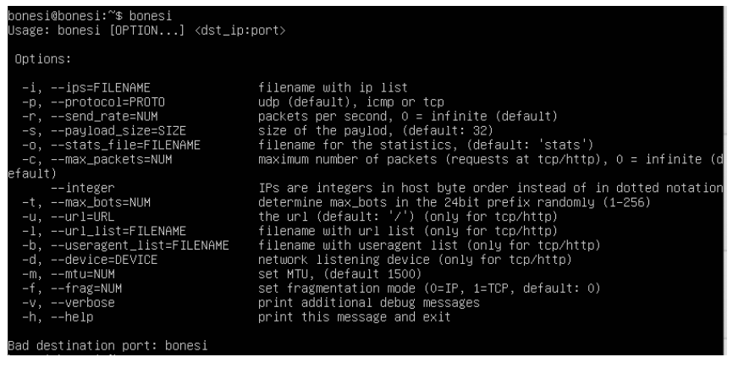
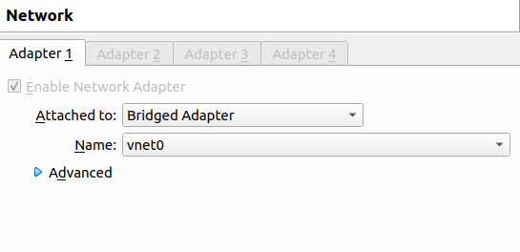
In the attacker VM
Install bonesi tool to launch attacks:
-Install required library
sudo apt install build-essential sudo apt install libpcap-dev sudo apt install libnet1-dev sudo apt install autoconf sudo apt install automake sudo apt install gcc sudo apt install git sudo apt install make
-Install bonesi:
git clone https://github.com/Markus-Go/bonesi.git
cd bonesi autoreconf -f -i ./configure make make install
-To check:
bonesi
Now, we turn off attack VM and setting
The network interface to Bridge Adapter
And choose vnet0
Assign IP address for attacker VM:
sudo ifconfig enp0s3 172.16.1.2/24

Slide 11
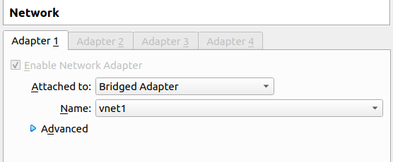
In the victim VM
Install Nginx server as victim server:
sudo apt install docker.io sudo docker pull nginx
Then, turn off the victim VM and setting the network interface to Bridge Adapter and choose vnet1
Assign IP address to the victim VM:
sudo ifconfig enp0s3 172.16.1.3/24

Slide 12
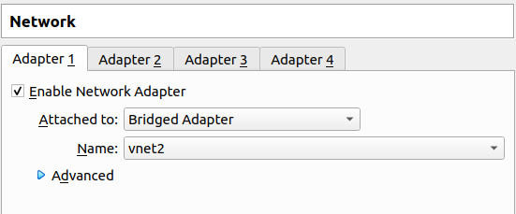
In the normal user VM
Setting the network interface to Bridge Adapter and choose vnet2
Assign IP address to the normal user VM:
sudo ifconfig enp0s3 172.16.1.4/24

Slide 13
Execution

Slide 14
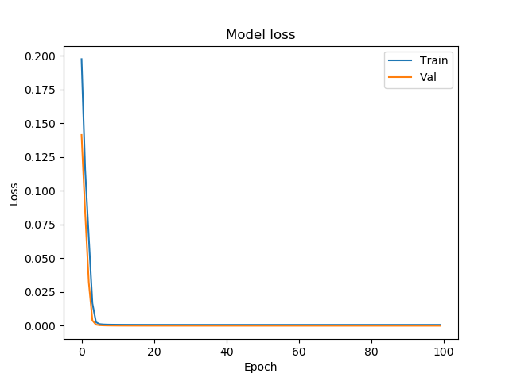
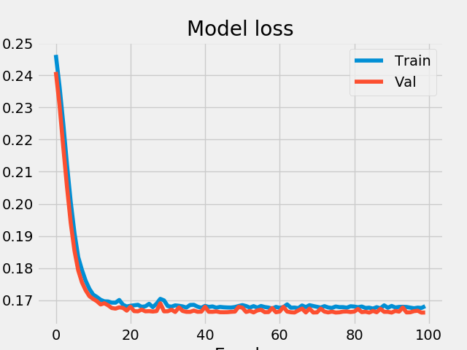
In the physical machine:
Training Period detector and Flow detector
In the folder code, open terminal and run:
python3 training_period_detector.py
python3 training_flow_detector.py
After finishing training, there will be two trained model file saved:
period_model.h5 and flow_model.h5

Slide 15
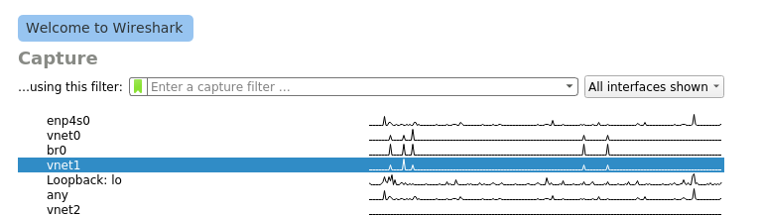
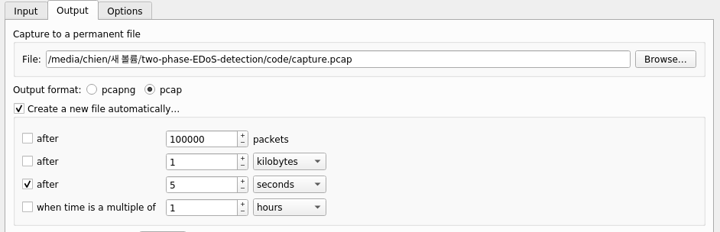
In the physical machine:
Setup wireshark to capture the packet to the victim server
On the folder code, open termial and run:
sudo wireshark
We will configure Wireshark tool to capture network packets going through the victim server every 5 seconds. Because we attached vnet1 to the victim server, Wireshark tool will capture in vnet1:
Go to “Capture” -> Options (or Ctrl+K)-> Click “Output”.
In “File” choose where to save .pcap files after capturing.
Choose “pcap” in “Output format”
To automatically save packet captured to a .pcap file after 5 seconds, click on “Create a new file after…” then choose “5” seconds

Slide 16
In the physical machine:
Executing the two-phase deep learning-based EdoS detector:
In the folder code, open terminal and run the script:
./two_phase_EdoS_detector.sh
This script will monitor every captured period pcap files and detect the attacker on that. Firstly, it calls the period_detector.py to detect the period pcap file.
If there is a normal period, it only indicates “This is normal period”
If there is a abnormal period, it splits the pcap file into multiple pcap files based on flows by SplitCap tool and then calls flow_detector.py to detect each pcap file of flow whether this is an abnormal or normal flow.

Slide 17
In the attacker machine:
Starting the attack:
In the folder bonesi, open terminal and run:
To fire a TCN SYN Flood attack:
sudo bonesi -p tcp -d enp0s3 i 50k-bots 172.16.1.3:80
To fire a UDP flood attack:
sudo bonesi -p udp -d enp0s3 172.16.1.3:80
To fire an ICMP flood request:
sudo bonesi -p icmp -d enp0s3 172.16.1.3:80

Slide 18
In the normal user machine:
To generate normal traffic:
ping 172.16.1.3 -i 0.025
Here we send a normal traffic of 400 req/second

Slide 19
Results

Slide 20
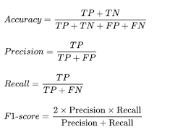


Accuracy of the detection algorithms:
We test the accuracy of the detection algorithms in the period detector, flow detector through the following metrics:
Here TP is the true positive: the number of real abnormal ones classified as the abnormal ones
TN is the true negative: the number of real normal ones classified as the normal ones
FP is the false positive: The number of real normal one classified as the abnormal ones
FN is the false negative: The number of real abnormal one classified as the normal ones
In this experiment, we test the detection algorithms with the test dataset and to simplify, we executed the test process right after the training process and integrated into the training scripts. Thus, just running:
training_period_detector.py to show the accuracy of the period detection algorithm:
python3 training_period_detector.py
python3 training_flow_detector.py

Slide 21

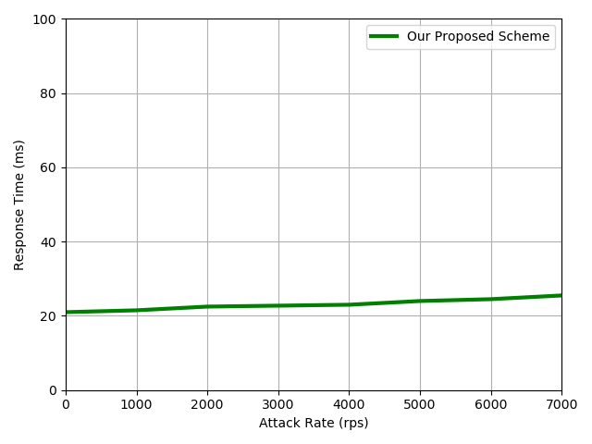
Respond time of the normal traffic
When the victim server is attacked, the victim server consumes a lot of resources to process abnormal traffic and the bandwidth is fullfilled by the major of the abnormal traffic. Thus, the normal traffic can not be processed timely. Consequently, the respond time of the normal traffic increases.
Here we test the respond time of the normal traffic when the victim server is being protected by the defense system.
To test the respond time of the normal traffic we only need using ping command from the normal user virtual machine:
ping 172.10.1.3 -i 0.0025
Here we send the normal traffic with the traffic rate is 400 req/second
The “time = 2.09 ms” is the respond time of the normal traffic
We can test the respond time of the normal traffic when the attack rate changes dynamically by running the DoS attack with different attack rate and run the ping command in the normal user to show the respond time.

Slide 22
2)CPU usage of the victim server
When the victim server is attacked, the victim server consumes a lot of resources to process abnormal traffic a. Consequently, the cpu usage of the victim server increases.
Here we test the CPU usage of the victim server when the victim server is being protected by the defense system to prove the efficiency of the system .
To test the CPU usage of the victim server we only need using top command from the normal user virtual machine:
top

