Slide 1
Node in Action

Slide 2
Node
Node is an open-source, minimalist server-side JavaScript TCP/IP framework that merges the speed of Google's V8 JavaScript engine (used by the Google Chrome web browser) with two projects, libev and libeio.
These projects that provide highly efficient TCP/IP networking capability and "asynchronous" programming support

Slide 3
WordSquared
Massive Tiles
Limited Viewport
How to push
Original ‘Pusher’ service
Now use Socket.io
Both of these update mechanisms leverage the WebSocket protocol

Slide 4
Node Advantage
Modern Web Technologies
Asynchronous Programming
Not Just for Web
for the creation of new TCP/IP protocols, client/server applications, command-line applications, and more

Slide 5
History of Node
Before Node
Web as Document
Form driven App
AJAX
Real-Time App
Node
Event Driven (Async)

Slide 6
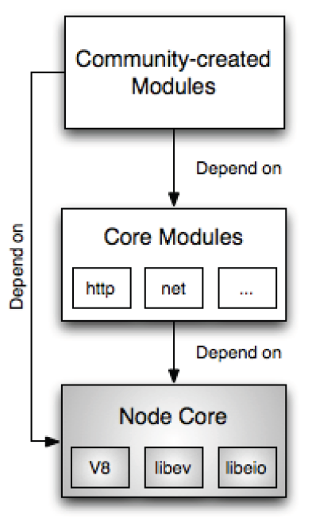
Node Conceptual Components
Node Core
V8 Engine
Compiles instead of interpret Javascript
libev/libio (C libraries)
provide event driven networking and IO

