Slide 1
Computer Networks

Slide 2
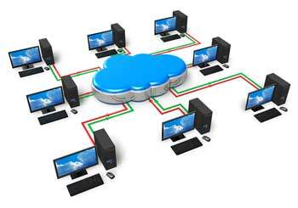
Network basics

Slide 3
ILO’s
Students should be able to explain what a computer network is, discuss risks and benefits of networks and the relative merits of wired and wireless networking.

Slide 4
Computer networks
Computer networks connect computers and/or devices together
This can enable them to share information
For example we can connect a printer to laptop using a network, enabling us to print documents

Slide 5
What are the advantages of computer networks?

Slide 6
file sharing - users can share files with other users
hardware sharing - users can share hardware, such as a printer
communication - users can communicate via email, chat, or by video
roaming access - users can sign in to any computer on the network and be able to access their files
On larger networks, such as those used by businesses and schools, there are additional benefits:
centralised maintenance and updates - network managers can apply software updates across a network, removing the need for a user to worry about having to do so
centralised security - anti-virus software and firewalls can be implemented across a network, helping to protect user files from risks
user monitoring - network managers can monitor what users do on a network
levels of access - different users can be given different access rights, and this gives network managers the ability to generally restrict user access to certain files, while granting permission to specific users

Slide 7
Computer Networking helps to develop more opportunities for the field of information security. → A device can be the most influential tool to safeguard personal information.
Being on the cheaper side, almost every person can bear the expense of a computer network. → A family can get a new device/node for less than Rs 17000/- and still enjoy the advantages of a network.
A network provides a better-personalized experience. → Modern Computers give a very diverse user experience. → One can have more computing power in their pocket as compared to that of astronauts flying in space.
It allows us to collaborate on projects. → Most companies use computer networking to connect with the teams to get all the updates and get the shared documents. → The same document can be shared among many people.
It can ease us to send/receive large-sized files in a few blinks of the eye. → Nowadays, we’ve facilities like iCloud, google cloud, dropbox, etc. With the help of these, we can send and receive files, regardless of the size of the file.
It is a great way to make money. → It provides many freelancing ways to all entrepreneurs.
It also helps to save money. → Sharing devices on a single network can help us to reduce many physical assets. → Productivity using computer networking also helps to save money.
A single internet connection can be shared in computer networking. → Our one single device can work on a single unit to get online information. → This will reduce the cost of cables and other accessories.
We can enlarge the capability of the computer network. → We can use IoT to link devices and get advantages in similar ways.
It is reliable. → If for any reason, the system crashes, the data will remain with us because we are storing them on a network, and we can access that data from another device.

Slide 8
What are the disadvantages of computer networks?

Slide 9
It can lead us to lose access to information very quickly. → If a file crashes over a computer network, we will not be able to access that information instantly. → Managing an extensive network is complex.
Work-life balance gets changed due to computer networking. → Computer network makes each of the tasks handy in our device and contributes to changing the work-life balance. → It can lead us to lose access to information very quickly.
The cost of computer networking is very high. → Executing the network as a whole, along with the cables, is pretty expensive. → The equipments used in computer networking are also expensive.
Computer Networking can direct us to various types of distractions. → If self-discipline is not present with personal interactions with the technology. → Switching between tasks can lose up to 40% productivity.
It requires a specific type of setup. → It requires a minimum range of electromagnetic impedance to get appropriate coverage for a network. → Exceptional care is required during the installation.
Computer networking can result in people stopping believing in their memory. → Dependence on digital platforms can lead us to this. → According to the studies, 6000 adults in Europe explore that they depend on computers over one-third of the time.
One device can create problems for the whole network. → A virus in one device can also disturb the entire network.

Slide 10
cost - additional equipment is needed to allow computers to communicate
management - networks require management by technical staff such as a network manager
spread of malware - viruses and other forms of malware can easily spread across an improperly secured network
hacking - once a device is connected to another device, it is possible that data may be accessed without the device owner's permission

Slide 11
How can we make connections?

Slide 12
How can we make connections?
WIRED VS WIRELESS

Slide 13
Pro’s and con’s of wired connections…go!

Slide 14
Advantages of Wired Networks
Stability and Reliability
When configured and utilised properly, wired networks can provide unparalleled reliability. As soon as the hubs, switches, and cables are installed, you can have a reliable network at your disposal.
Wired connections do not get influenced by other network connections in the vicinity or get bogged down by connectivity issues as much as their wireless counterparts. This is why you will find that wired networking based infrastructures are generally more stable.
Faster Speeds and High Connectivity
Wired networks deliver much faster speeds than wireless networks. The speeds have kept on improving since the use of Gigabit routers became a common practice. In addition to that, a wired network has a limited set of users connecting to it at any time, so it’s rarely bogged down by unexpected traffic – delivering nearly constant high speeds at all times.
Apart from this, since a separate ethernet cable is used to connect each of the devices directly to the network, users can’t run into common connectivity issues (like dead spots, for example), when connected to a wired network.
Better Security
Once the firewalls and other necessary security applications are configured on the network, a wired network is quite well-protected from unwanted and unauthorised access. Such a connection can provide your office with ample protection for daily business operations, as long as the network is being monitored for any highly suspicious activity.
Accessibility
Wired networks are not visible to devices on other networks. This means it’s nearly impossible for users outside the network to try and directly connect to the network. At the same time, any device that can access the wired network can freely communicate with other devices on the network, as long as it’s allowed to. And this means, network admins can exercise a high level of user access control with relative ease.

Slide 15
Disadvantages of Wired Networks
Inconvenience Due to Lack of Mobility
Needless to say, wired networks are very inflexible when it comes to mobility. To be able to access a wired network at a different location, there’s no other option but to run extra cables and install switches at that location – which may or may not always be inconvenient, depending on how much mobility your business or staff demands.
May Require More Time to Install
In order to connect each and every device directly to the network, installation of the switches, routers, and hubs can be a lengthy and complex process. Installation of a wired network may also take longer, because more components may be required, depending on the size of your infrastructure and other requirements.
Larger Infrastructures Require More Maintenance
If you are setting up a small wired network, it may or may not need a server. However, once you begin growing the network or start adding more devices to the network, it’s essential to install a server, in order to handle the required bandwidth and network load. In such a situation, the maintenance costs could increase. In addition to this, you may also need to hire staff to oversee the maintenance, in case you need to set up multiple servers.
Slight Inconvenience Due to Too Many Cables
Relying on a wired network would mean dealing with a bunch of cables that won’t just be unsightly, but also inconvenient. The ethernet cables can also get disconnected by the office staff or cleaning crews, by mistake. However, this disadvantage may not bother you if the security, stability, and reliability of your network connections are more of a priority for your business.

Slide 16
Pro’s and con’s of wireless connections…go!

Slide 17
Advantages of Wireless Networks
High Mobility
When you set up a wireless network, all your employees can access the network from almost anywhere in the office. This way, they can bring laptops and other devices into the meeting rooms and continue to access or download the important files and reference documents for discussions – without having to rely on a set of cables to stay online. It may not sound like a big deal, but it may improve your teams’ productivity, especially during meetings.
Lower Cost of Setup
Setting up a wireless network typically requires far fewer switches, routers, ethernet cables, and other hardware, as compared to installing wired networks. This is why the cost of implementing it is relatively cheap, in most cases – unless your network setup requires additional equipment, such as a commercial-grade router or wireless repeaters.
BYOD Policy is Easy to Implement
It’s becoming commonplace for workplaces to implement a BYOD (Bring Your Own Device) policy. It’s much easier to implement such a policy on a wireless network, as compared to a wired network.
Makes Your Office Look Neat and Organised
Needless to say, wireless networks make your workplace look neater, since there are far fewer cables to worry about. Again this isn’t a big deal, but worth considering, if you are serious about making your office space look more organised and clutter-free.
Easier to Install and Maintain
Overall, a wireless network can be installed much faster and with relative ease, because it requires far less equipment to set up. Plus, you don’t need to spend time installing countless cables and connecting each device to your network separately. If this wasn’t enough, maintenance is also easier, since most of the job is software-based, and not hardware-based.

Slide 18
Disadvantages of Wireless Networks
Connectivity May Suffer Occasionally
The possibility of interference or obstructions due to other wireless-enabled devices in the vicinity is higher. This can compromise both the performance as well as the quality of your connection. Users may also run into dead spots or areas that have a bad connection, an issue that is occasionally present in a wireless network area, due to objects or walls that might obstruct the connection. So, if your staff needs to work closely with other teams or change in location, for example, the strength of the signal may a lot and cause inconvenience.
Security Can Be a Concern
Generally, wireless networks are a bit less secure than wired networks. The main reason for this is the communication signals that get transmitted through the air and easier to intercept by bad actors. You would need proper encryption technology (WEP, WPA2), firewalls, and several other security measures in place to render it safe for business use.
Slightly Lower and Unreliable Data Transfer Speed
Wireless networks typically can’t match the speed of wired networks. However, since the data transmission speed is primarily dependent on your current configuration’s maximum speed capability, you can always improve it further by using a hybrid solution (using both wired and wireless connections together).

Slide 19
Exercises
Make flash cards summarising what we have learnt today
Test yourself until you get all of them correct

Slide 20
ILO’s
Students should be able to explain what a computer network is, discuss risks and benefits of networks and the relative merits of wired and wireless networking.

Slide 21

Types of networks

Slide 22
ILO’s
Students can describe LAN, WAN and PAN and understand star and bus topologies, including their relative merits.

Slide 23

https://www.youtube.com/watch?v=PBwAxmrE194
AN

Slide 24
LAN – local area networks

Slide 25
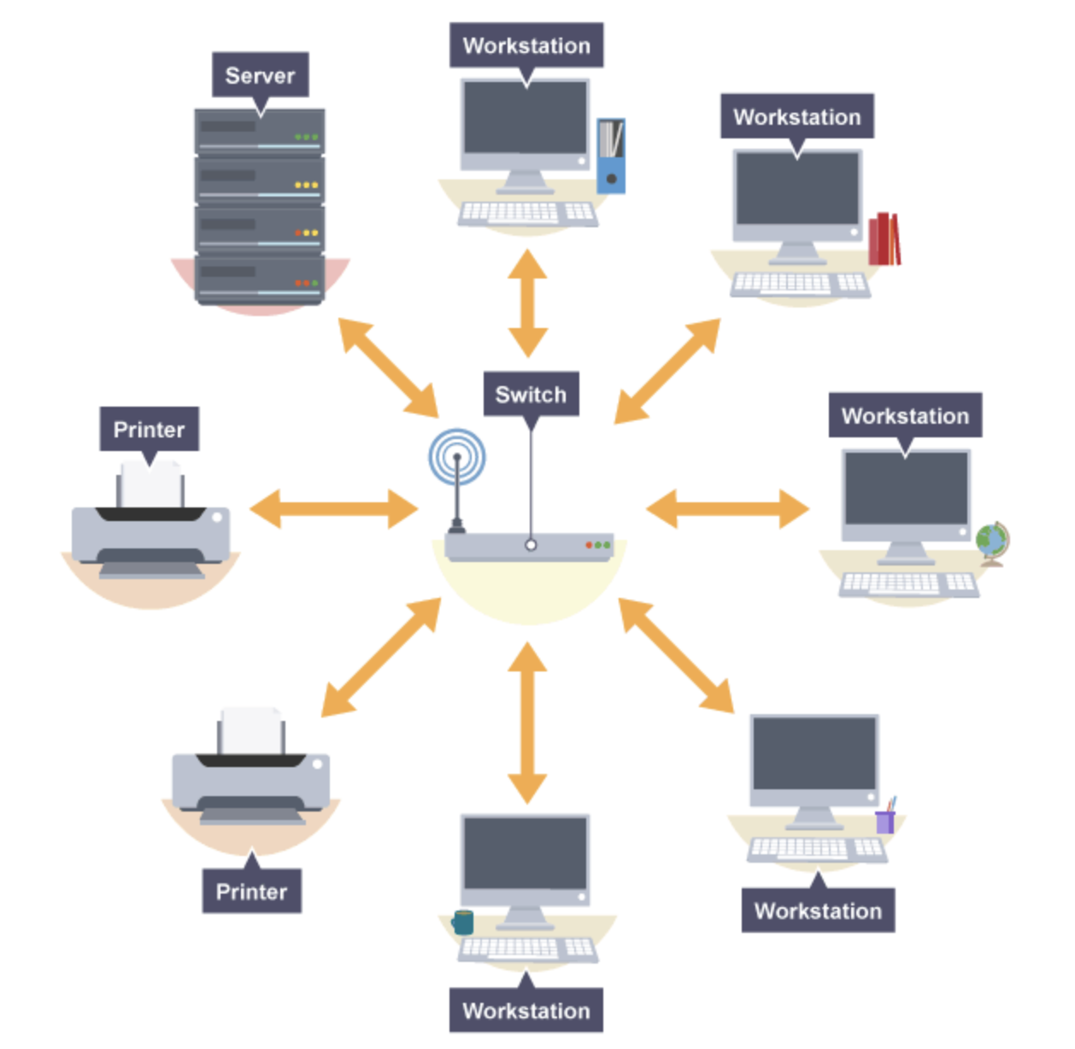
LAN – local area networks
A local area network (LAN) is a network that is geographically confined to one building or site.
LANs are owned and maintained by the organisation.

Slide 26
LAN – local area networks
A local area network (LAN) is a network that is geographically confined to one building or site.
LANs are owned and maintained by the organisation.
Examples?

Slide 27
LAN – local area networks
A local area network (LAN) is a network that is geographically confined to one building or site.
LANs are owned and maintained by the organisation.
Examples?
This school!

Slide 28
WAN – wide area networks

Slide 29
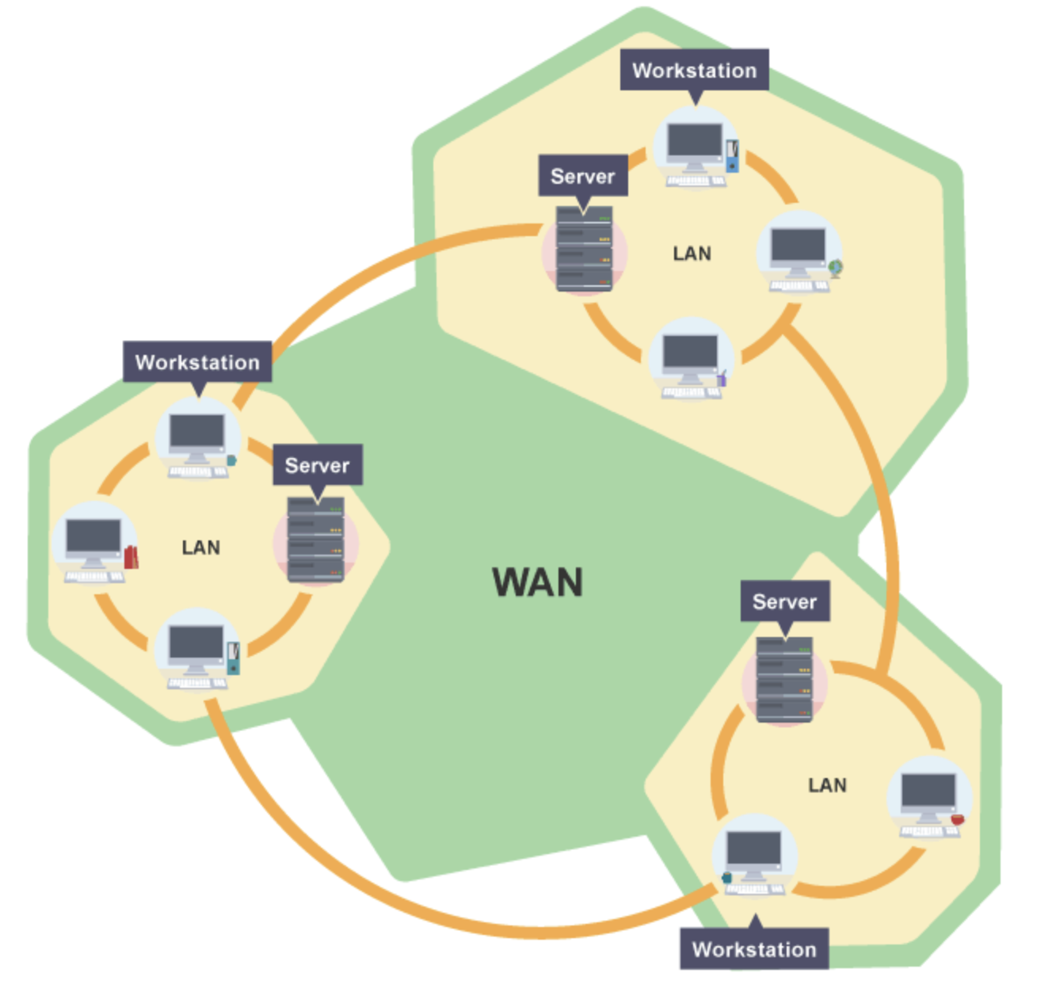
WAN – wide area networks

Slide 30
WAN – wide area networks
A wide area network (WAN) is a network that is spread over a wide geographical area. It can cover more than one site, or be spread across a country, or even the world!
Organisations that have more than one office or branch, such as banks, tend to use a WAN. The WAN allows the head office to communicate and share data with the sub-offices and branches.
Communication is through national telephone infrastructures or via wireless transmission. While each office or branch has its own LAN, they are connected together using the WAN.
The internet is essentially a huge, international WAN.

Slide 31
WAN – wide area networks
A wide area network (WAN) is a network that is spread over a wide geographical area. It can cover more than one site, or be spread across a country, or even the world!
Organisations that have more than one office or branch, such as banks, tend to use a WAN. The WAN allows the head office to communicate and share data with the sub-offices and branches.
Communication is through national telephone infrastructures or via wireless transmission. While each office or branch has its own LAN, they are connected together using the WAN.
The internet is essentially a huge, international WAN.
Examples?

Slide 32
WAN – wide area networks
A wide area network (WAN) is a network that is spread over a wide geographical area. It can cover more than one site, or be spread across a country, or even the world!
Organisations that have more than one office or branch, such as banks, tend to use a WAN. The WAN allows the head office to communicate and share data with the sub-offices and branches.
Communication is through national telephone infrastructures or via wireless transmission. While each office or branch has its own LAN, they are connected together using the WAN.
The internet is essentially a huge, international WAN.
Examples?
International businesses such as Twitter

Slide 33
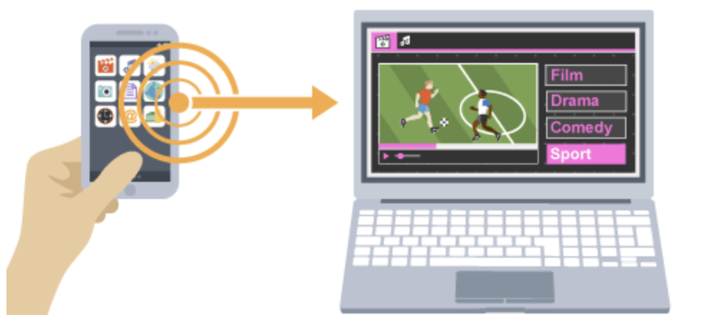
PAN – personal area networks
A personal area network (PAN) is a network that is spread over a very small area. It often covers no more than a few metres and is used to connect personal devices such as a smartphone and wireless headphones or a laptop.
Setting up a PAN using a smartphone is also known as creating a ‘hotspot’ and makes use of limited Wi-Fi or bluetooth to connect devices.

Slide 34
The star topology
Network topology: physical arrangements of nodes and connections in a network

Slide 35
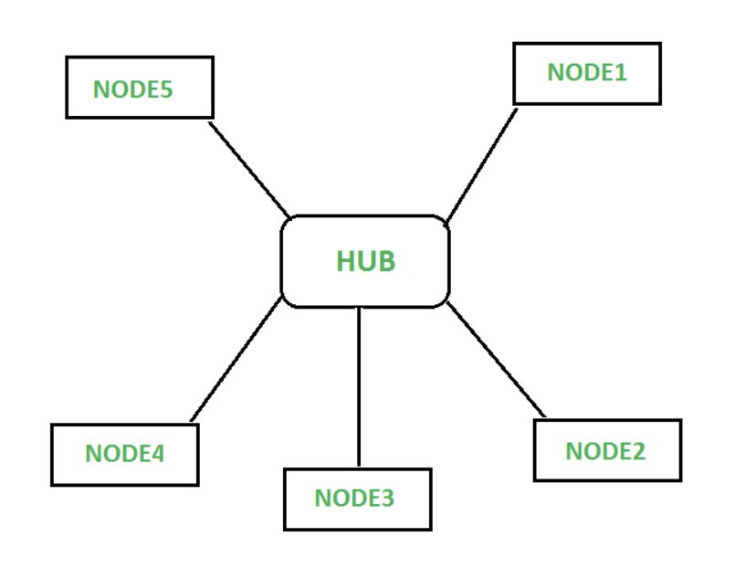
The star topology
Network topology: physical arrangements of nodes and connections in a network
Star topology:
All devices connected to a central hub
Central hub controls connection between all nodes
Wires needed for each node connection

Slide 36
The star topology
Network topology: physical arrangements of nodes and connections in a network
Star topology:
All devices connected to a central hub
Central hub controls connection between all nodes
Wires needed for each node connection

Slide 37
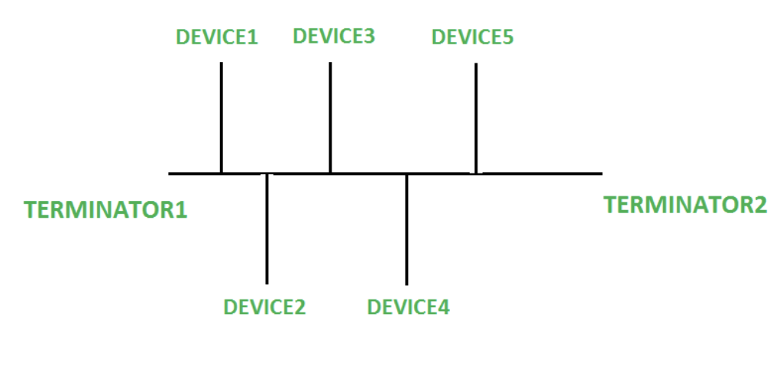
The bus topology
Bus topology:
All devices connected to a single cable
Easiest topology when devices are added linearly

Slide 38
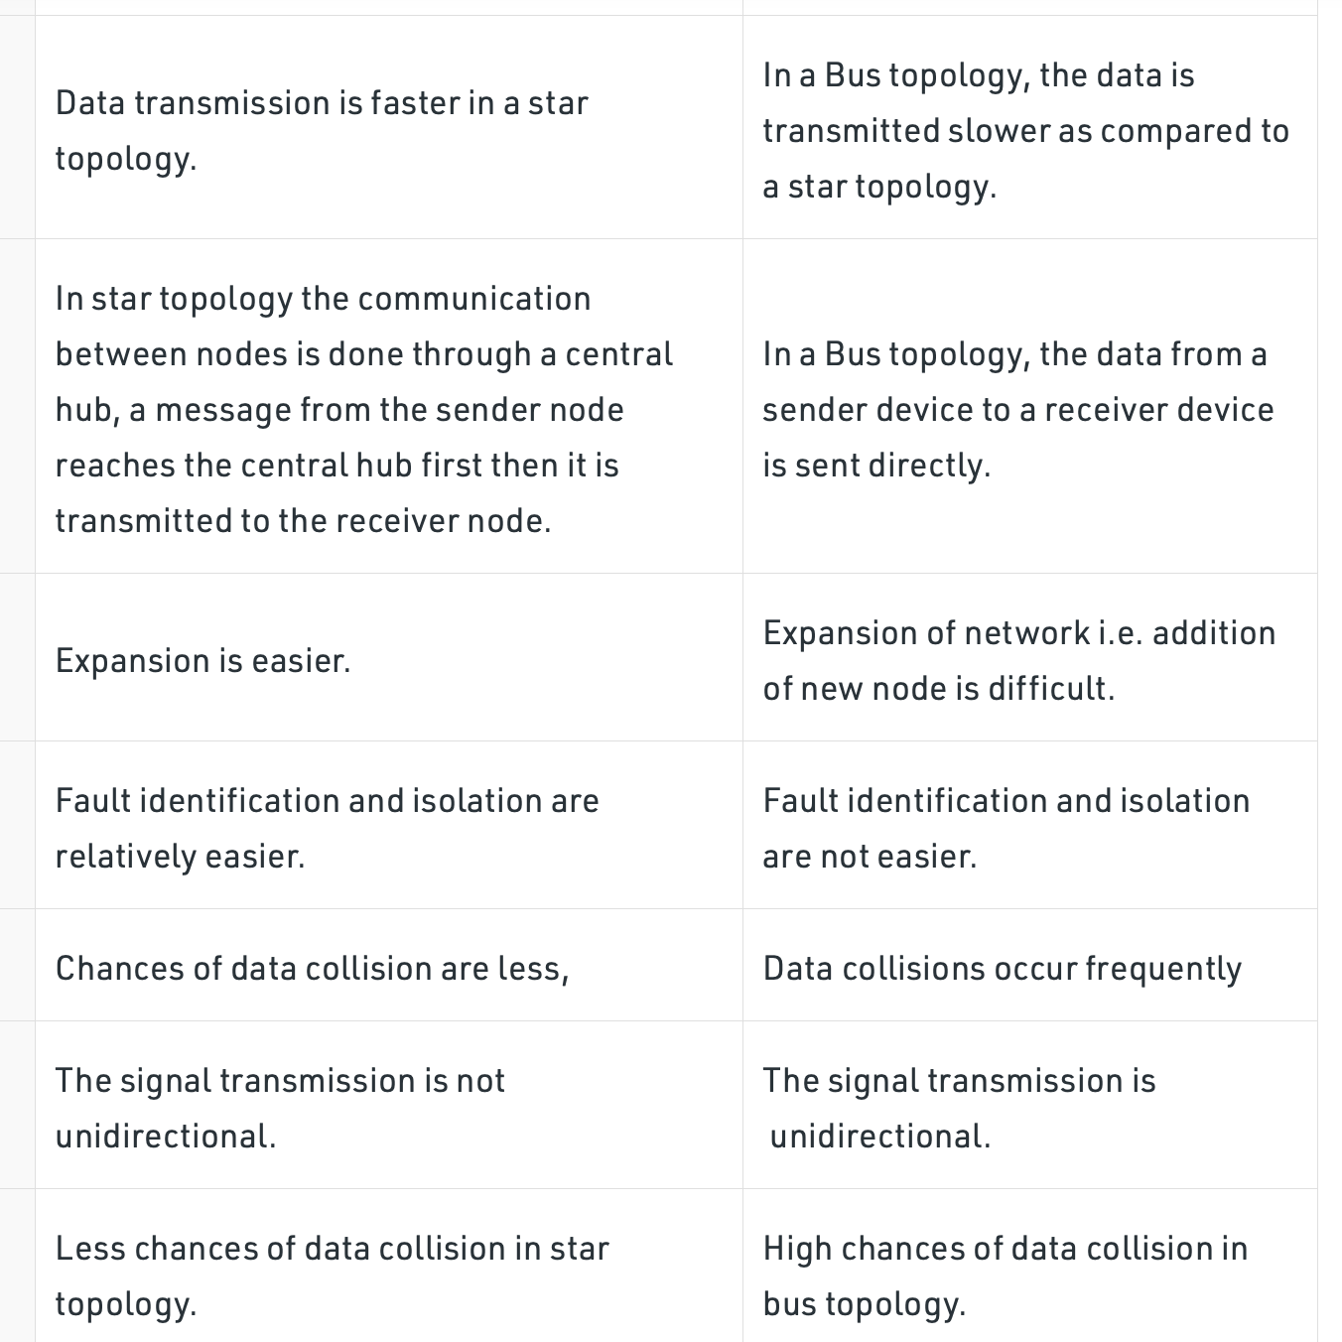
Star
vs
Bus

Slide 39
Exercises
Make flash cards summarising what we have learnt today
Test yourself until you get all of them correct

Slide 40
ILO’s
Students can describe LAN, WAN and PAN and understand star and bus topologies, including their relative merits.

Slide 41

Network protocols

Slide 42
ILO’s
Students understand and can describe what a protocol is.
Students can explain the purpose of the protocols and their use. They don’t need to know any technical details about implementation.

Slide 43
What is a network protocol?

Slide 44


What is a network protocol?
Any form of communication requires rules

Slide 45
What is a network protocol?
Any form of communication requires rules.
These determine how the communication is actually made and manage key factors like transmission speed, error checking and methods of addressing, for example, how to locate another node on the network

Slide 46
What is a network protocol?
Any form of communication requires rules.
These determine how the communication is actually made and manage key factors like transmission speed, error checking and methods of addressing, for example, how to locate another node on the network
Rules that govern communication are known as protocols

Slide 47
What protocols are there?

Slide 48
What protocols are there?
TCP/IP - Transmission Control Protocol/Internet Protocol
Enables communication over the internet

Slide 49
What protocols are there?
TCP/IP - Transmission Control Protocol/Internet Protocol
Enables communication over the internet
HTTP and HTTPS - Hypertext Transfer Protocol
Governs communication between a webserver and a client. HTTPS (secure) includes secure encryption to allow transactions to be made over the internet

Slide 50
What protocols are there?
TCP/IP - Transmission Control Protocol/Internet Protocol
Enables communication over the internet
HTTP and HTTPS - Hypertext Transfer Protocol
Governs communication between a webserver and a client. HTTPS (secure) includes secure encryption to allow transactions to be made over the internet
FTP - File Transfer Protocol
Governs the transmission of files across a network and the internet

Slide 51
Overview of protocols

Slide 52
Overview of protocols
Is this safe? Will it work?

Slide 53
Exercises
Make flash cards summarising what we have learnt today
Test yourself until you get all of them correct

Slide 54
ILO’s
Students understand and can describe what a protocol is.
Students can explain the purpose of the protocols and their use. They don’t need to know any technical details about implementation.

Slide 55

Network security

Slide 56
ILO’s
Students understand why security is important on networks (more so than standalone computers) and the listed security measures.

Slide 57
The need for security

Slide 58
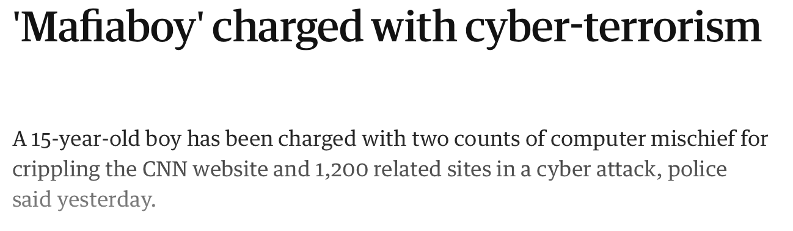
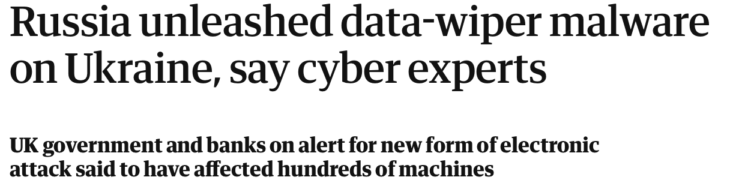
The need for security

Slide 59
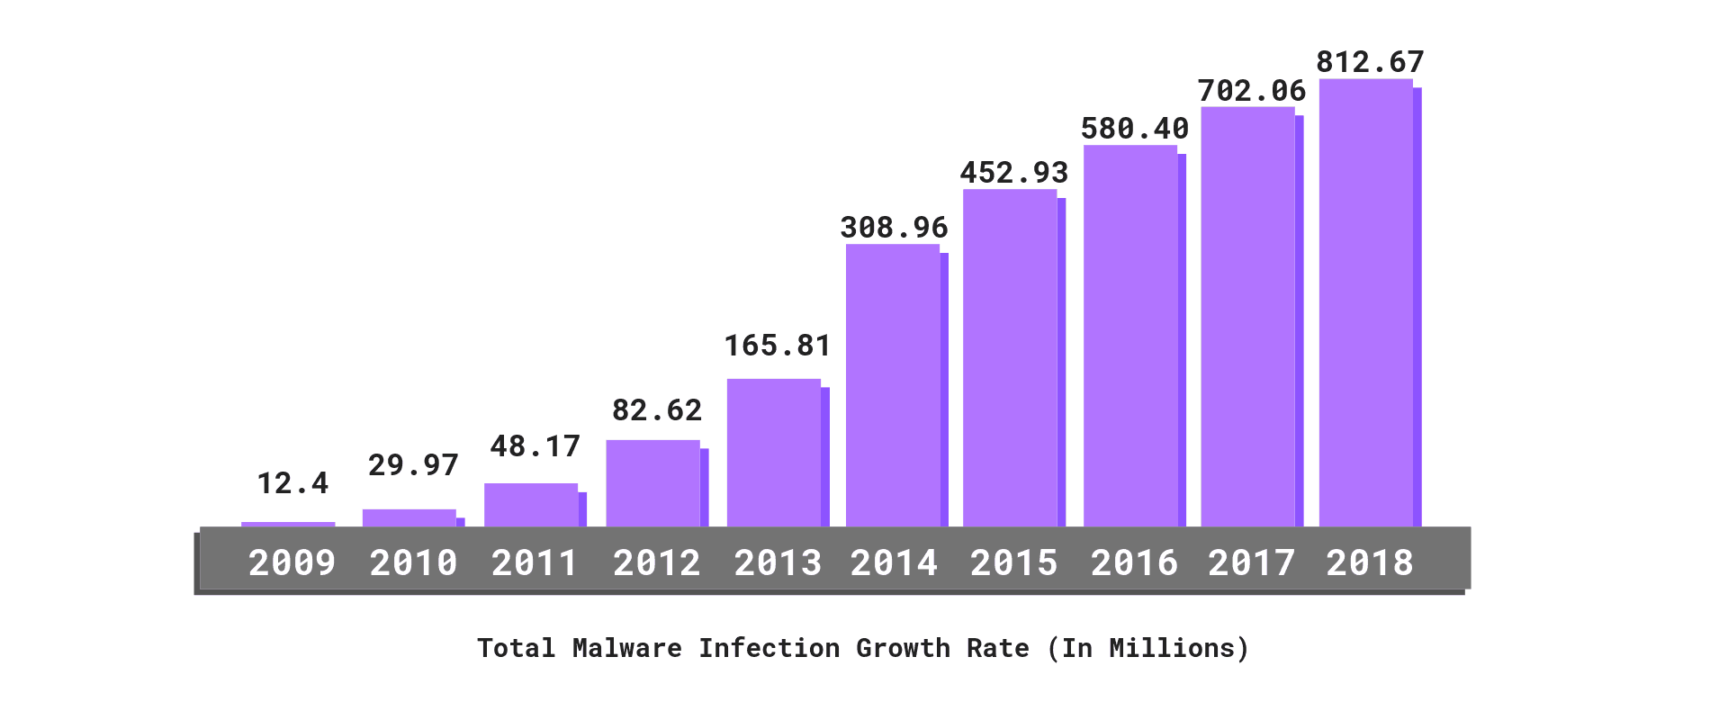
The need for security
Cyber attacks are becoming more common

Slide 60
The need for security
Cyber attacks are becoming more common
Take down online systems
Steal money
Access to private information

Slide 61
How can we protect networks?

Slide 62
How can we protect networks?
Authentication
Encryption
Firewall
MAC address filtering

Slide 63
How can we protect networks?
Authentication
Encryption
Firewall
MAC address filtering
Authentication
Protects sensitive data by requiring permission
Authentication is the process of a user confirming that they are who they say they are on a computer system

Slide 64
How can we protect networks?
Authentication
Encryption
Firewall
MAC address filtering
Authentication
Protects sensitive data by requiring permission
Authentication is the process of a user confirming that they are who they say they are on a computer system
What types do you know?
Usernames/passwords
Biometrics

Slide 65
How can we protect networks?
Authentication
Encryption
Firewall
MAC address filtering
Encryption
Disguises messages which need to be read with a key
Protects sensitive information
Unencrypted messages are classed as plaintext
Encrypted messages are classed as ciphertext

Slide 66
How can we protect networks?
Authentication
Encryption
Firewall
MAC address filtering
Encryption
Disguises messages which need to be read with a key
Protects sensitive information
Unencrypted messages are classed as plaintext
Encrypted messages are classed as ciphertext
What examples do you know?

Slide 67
How can we protect networks?
Authentication
Encryption
Firewall
MAC address filtering
Encryption
Disguises messages which need to be read with a key
Protects sensitive information
Unencrypted messages are classed as plaintext
Encrypted messages are classed as ciphertext
What examples do you know?
Morse code
Caesars cipher

Slide 68
How can we protect networks?
Authentication
Encryption
Firewall
MAC address filtering
Firewall
Software that blocks unexpected connections
Uses ports that only allow specific data in/out of a network

Slide 69
How can we protect networks?
Authentication
Encryption
Firewall
MAC address filtering
Firewall
Software that blocks unexpected connections
Uses ports that only allow specific data in/out of a network
Where have you experienced this?

Slide 70
How can we protect networks?
Authentication
Encryption
Firewall
MAC address filtering
Firewall
Software that blocks unexpected connections
Uses ports that only allow specific data in/out of a network
Where have you experienced this?
Schools usually have blockers

Slide 71
How can we protect networks?
Authentication
Encryption
Firewall
MAC address filtering
MAC address filtering
Media Access Control (MAC) address is unique to a device
Network manager can create a more secure network by using this address to limit the devices on the network

Slide 72
How can we protect networks?
Authentication
Encryption
Firewall
MAC address filtering
MAC address filtering
Media Access Control (MAC) address is unique to a device
Network manager can create a more secure network by using this address to limit the devices on the network
Have you experienced this?

Slide 73
How can we protect networks?
Authentication
Encryption
Firewall
MAC address filtering
MAC address filtering
Media Access Control (MAC) address is unique to a device
Network manager can create a more secure network by using this address to limit the devices on the network
Have you experienced this?
Bluetooth connections
Student vs teacher computers

Slide 74
ILO’s
Students understand why security is important on networks (more so than standalone computers) and the listed security measures.

Slide 75
Exercises
Make flash cards summarising what we have learnt today
Test yourself until you get all of them correct

Slide 76

Network layers

Slide 77
ILO’s
Students should know what the four layers are and some functions of each layer, together with which of the protocols listed operate at which layer.

Slide 78
Layering
Messages between devices get broken up and sent into specific components or activities
Each layer handles a different part of communication
This is referred to as: Transmission Control Protocol/Internet Protocol TCP/IP – model
A layer is represented in the Stack data type (holds ordered information – perk)

Slide 79
The 4 main layers

Slide 80

The 4 main layers
Application layer
Applications such as web browsers and email programs operate at this layer
Protocols such as HTTP, HTTPS, SMTP, IMAP and FTP operate at this layer

Slide 81
The 4 main layers

Slide 82
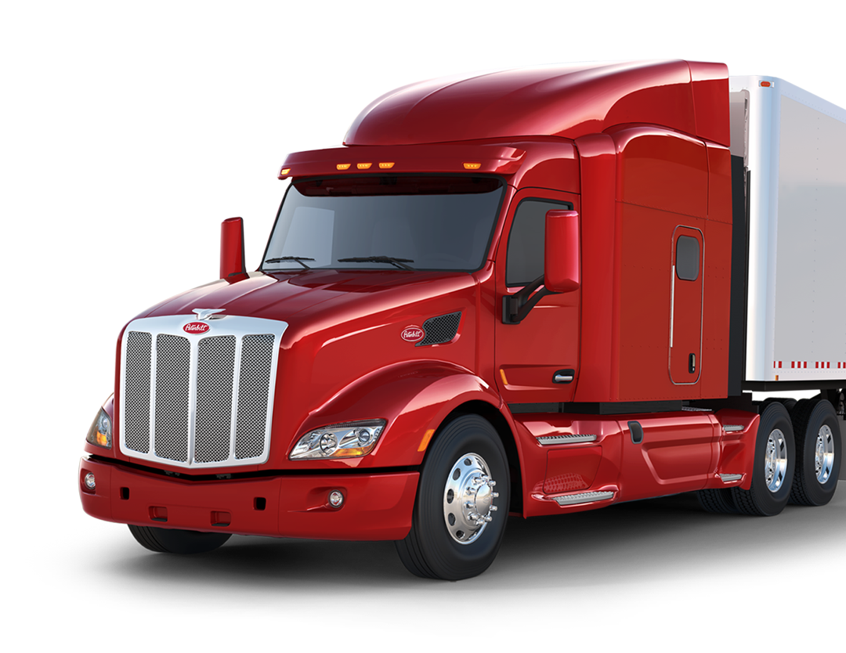
The 4 main layers
Transport layer
This breaks down the message into small chunks (packets)
Each packet is given a packet number and the total number of packets
This layer sets up the communication between hosts, using protocols such as TCP and UDP.

Slide 83
The 4 main layers

Slide 84

The 4 main layers
Network layer
This adds the sender’s and recipient’s IP addresses to the packet, and packages the data to make it ready for transmission
The network layer also routes the packets across the network.

Slide 85
The 4 main layers

Slide 86
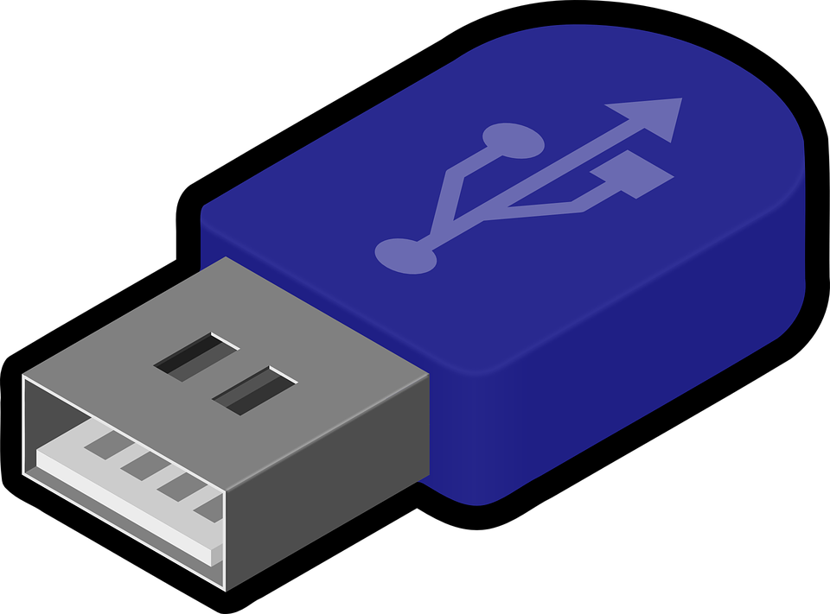
The 4 main layers
Data link layer
The network interface card/controller (NIC)and operating system drivers are at this layer

Slide 87
The 4 main layers
Data link layer
The network interface card/controller (NIC)and operating system drivers are at this layer

Slide 88
The 4 main layers
Data downloaded from Firefox via FTP
Data is broken down into packets and establishes connection between Firefox host and user host
IP addresses of send and recipient added to packages, ready for transmission
Data is then transferred to the physical storage components

Slide 89
ILO’s
Students should know what the four layers are and some functions of each layer, together with which of the protocols listed operate at which layer.

Slide 90
Exercises
Make flash cards summarising what we have learnt today
Test yourself until you get all of them correct

