Slide 1
Ethical, legal and environmental impacts including privacy

Slide 2
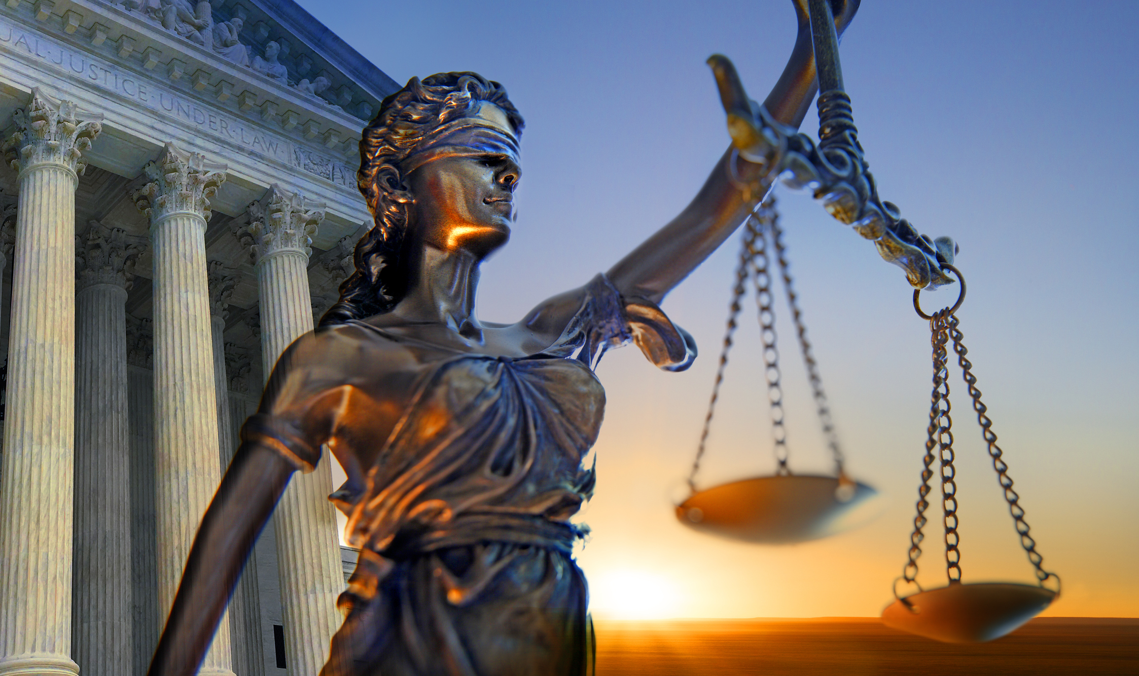
Current debates in computing

Slide 3
ILO’s
Students understand the key identified areas in general principles.
Students should be aware that citizens generally value their privacy.
Students should be aware that governments and security services argue for access to private data.

Slide 4
Exam debates
Questions will be focussed on the following:
Cyber security
Mobile technologies
Wireless networking
Cloud storage
Hacking (unauthorised access to a computer system)
Wearable technologies
Computer based implants
Autonomous vehicles

Slide 5
Task(s)
We are going to act as legal advisors for the council
Independently, research the ethical, legal and environmental impacts and risks on society for the debatable subjects on the previous slide
Create a table of pro’s and con’s for each of the subjects in the areas of:
Ethics
Legality
Environmental impact
Risk on society
Each area is split into four joint subjects to do each lesson

Slide 6
Exam debates
Questions will be focussed on the following:
Cyber security
Mobile technologies
Wireless networking
Cloud storage -
Hacking (unauthorised access to a computer system)
Wearable technologies - https://www.youtube.com/watch?v=u8tnYt30L-A
Computer based implants - https://www.youtube.com/watch?v=P674CG9mOTs
Autonomous vehicles

