Slide 1


Time-Constrained Indoor Keyword-aware Routing
Harry Kai-Ho Chan¹ , Tiantian Liu² , Huan Li² , Hua Lu¹
¹Department of People and Technology, Roskilde University, Denmark
²Department of Computer Science, Aalborg University, Denmark

Slide 2
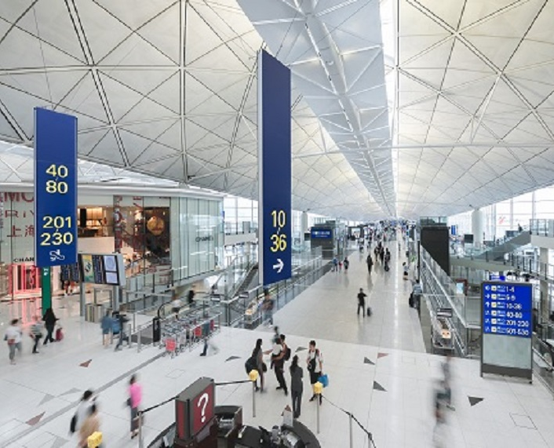
My Experience…
Flight from Hong Kong to Denmark
I want to buy a coffee, some souvenirs and a new charging cable.
60 minutes “free time” before boarding time

Slide 3

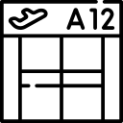
My Experience…
Query
Time limit: 60mins
Problem: to find k routes from source point to target point such that each route
passes through shops that are “desirable” to users
is within the time constraint
Coffee shop
Souvenir
Charging cable
Low in static cost and relevance to users
Current location:
Just passed the security check
Target location:
Boarding gate

Slide 4






My Experience…
Problem: to find k routes from source point to target point such that each route
passes through shops that are “desirable” to users
is within the time constraint
Coffee shops
Souvenirs shop
A possible route
Apple store
bank
Another possible route

Slide 5
Route in an Indoor Space
Existing indoor route planning queries focus on minimizing the length of the route
Indoor distance and route are defined based on indoor topology
Not a trivial task to find the shortest route from a point to another
To simplify things, we use dotted line arrow here

Slide 6
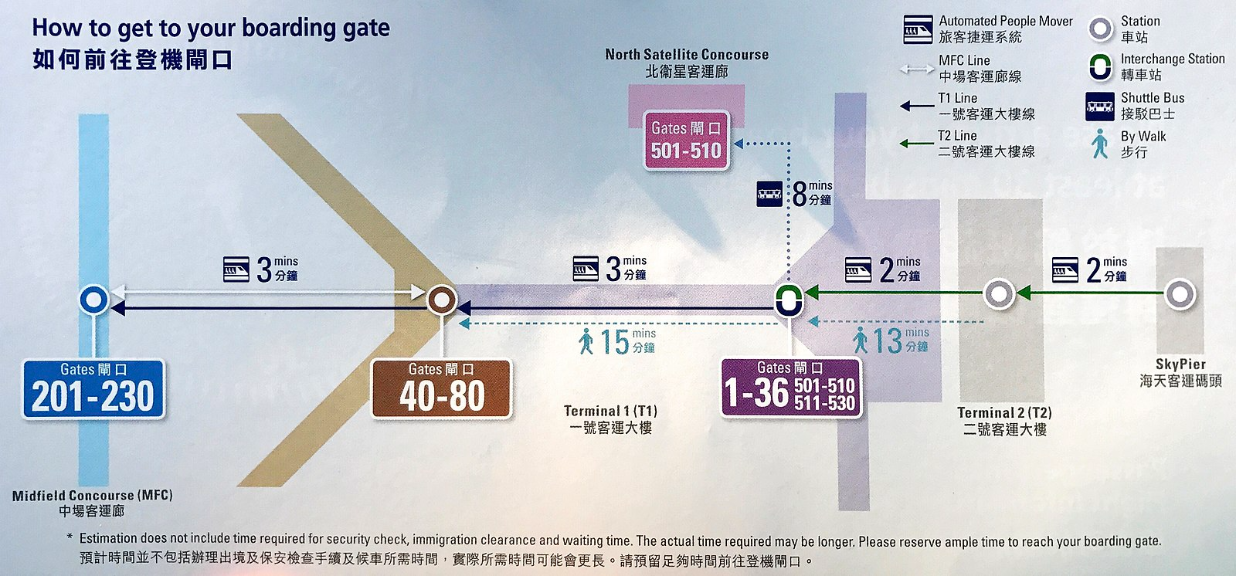
Route in an Indoor Space
2+3=5 mins by Automated People Mover (APM)
My boarding gate
My current location
13+15=28 mins by walking
Instead, we measure the time needed to complete the route
Existing studies adopt the distance metric that overlooks the means other than walking
Time Cost: We define the route’s time cost to be travelling time + waiting time

Slide 7
Route in an Indoor Space
Time Cost: We define the route’s time cost to be travelling time + waiting time
3 mins walking time
6 mins waiting time
3 mins walking time
8 mins waiting time
4 mins walking time
5 mins APM travelling time + 3 mins walking time
Route Time Cost = 3 + 8 + 3 + 6 + 4 + 10 + 5 + 3 = 48 min < 60min
10 mins waiting time
A feasible route

Slide 8
Route in an Indoor Space
Time Cost: We define the route’s time cost to be travelling time + waiting time
6 mins waiting time
7 mins waiting time
8 mins walking time
4 mins walking time
22 mins walking time
Route Time Cost = 8 + 7 + 8 + 10 + 4 + 6 + 22 = 65 min > 60min
8 mins walking time
10 mins waiting time
An infeasible route

Slide 9
Related Work
Indoor Keyword-aware Routing Query (IKRQ) [ICDE 2020]
Find k routes with the highest score
Considered keyword relevance and spatial distance
Our problem setting differs from IKRQ that we
Consider time constraint as a hard constraint
Take static cost of the shops into account
Adopt a concept of unique partition set to diversify result
Have a more comprehensive indoor keyword organization

Slide 10
Keywords in an Indoor Space
e.g., shop’s product
e.g., shop’s name
“partition” is a formal naming of “shop”
Thematic word: tag relevant to the shop
Identity word: specific name of a shop
Category word: type of the shop
Three types of keywords
Textual Relevance: We define the shops and route’s textual relevance based on the types of each query keyword

Slide 11
Algorithm: Set-Based Search
High Level Idea: searches for the resulting routes by focusing on the partition sets
Find candidate key partition set (Step 1)
Feasible route exist?
(Step 3)
Find a key partition set (Step 2)
Yes
Maintain top-k results
Query
No

Slide 12


Algorithm: Set-Based Search
Step 1. Find candidate key partition set
Coffee shop
Charging cable
Souvenirs
Too far away

Slide 13
Algorithm: Set-Based Search
Step 2. Find a key partition set

Slide 14
Algorithm: Set-Based Search
Find a route with time cost < 60min
Step 3. Find a feasible route
Stop searching on this set once such a route is found
Resume Step 2 with another key partition set

Slide 15
Algorithm: Set-Based Search
Partition Time Cost
Set Cost
Set Waiting Time
Route Time Cost
Pruning techqniues are applied in each step to filter out unpromising routes quickly
Route Pruning
Pruning 1
Lemmas 1 and 2
Pruning 2
Pruning 3
Lemma 3
Cross-iteration computation strategy
Find candidate key partition set (Step 1)
Feasible route exist?
(Step 3)
Find a key partition set (Step 2)
Yes
Maintain top-k results
Query
No
Store and reuse partial route for future iterations

Slide 16
Experiment
Dataset:
Indoor Space: A building based on a real floor plan
Number of partitions: 705
Number of doors: 1100
Partition Keyword:
1225 shop information from 5 shopping malls in Hong Kong
11 categories (e.g., clothing, cosmetics, restaurant)
Randomly assign a shop to a partition

Slide 17
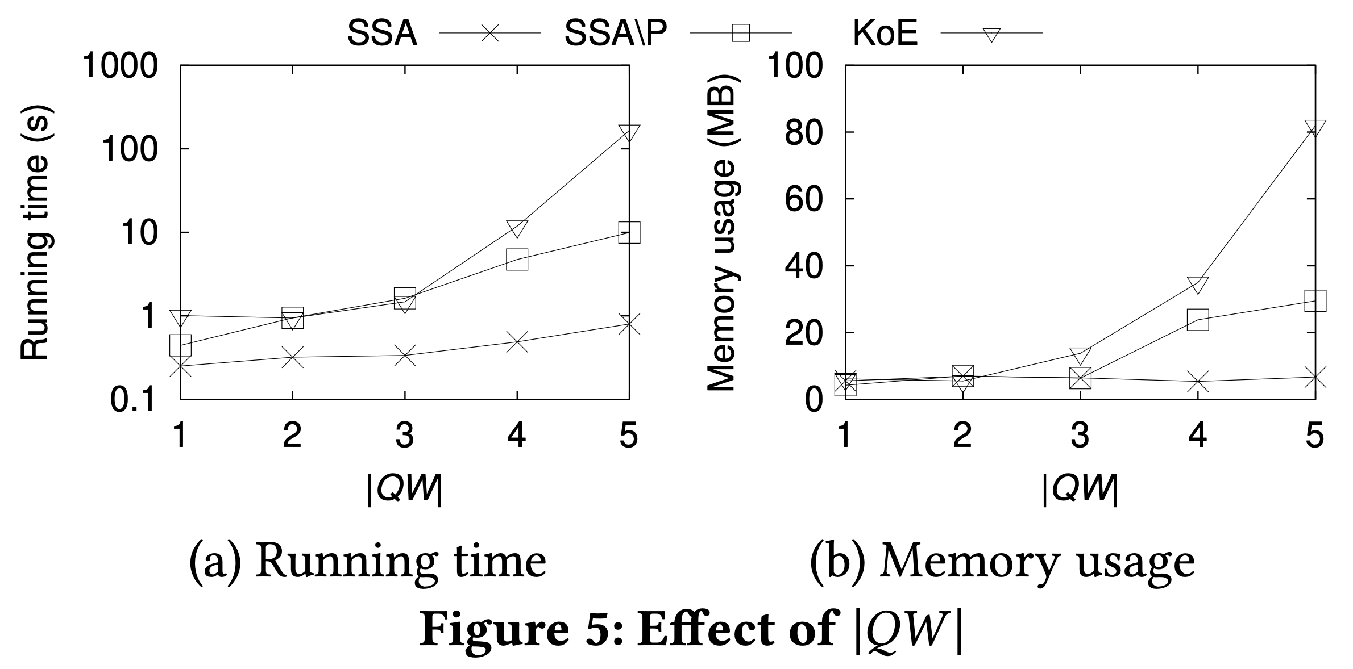
Experiment
Set-based Search
without pruning techniques
Adaption which originally designed for IKRQ
Our proposed Set-based Search
Running time increases with an increasing |QW|
SSA consumes fewer memories than the competitors
SSA runs consistently faster than competitors

Slide 18
Conclusion
Studied Time-constrained indoor keyword-aware routing
Find desirable routes with minimum route costs
Satisfying a time constraint
Developed a Set-based Search Algorithm
Future Direction
Take the opening hours of shops and doors into account
Allow user to specify a prefered visiting order

Slide 19
Q & A

