Slide 1


Continuous Social Distance Monitoring in Indoor Space
Harry Kai-Ho Chan¹ , Huan Li² , Xiao Li¹ , Hua Lu¹
¹Department of People and Technology, Roskilde University, Denmark
²Department of Computer Science, Aalborg University, Denmark

Slide 2

Introduction
Suppose I am visiting a museum...
However, I have to maintain social distance with others
keep at least 1-2 meters between people
COVID-19 precaution
Government policy

Slide 3
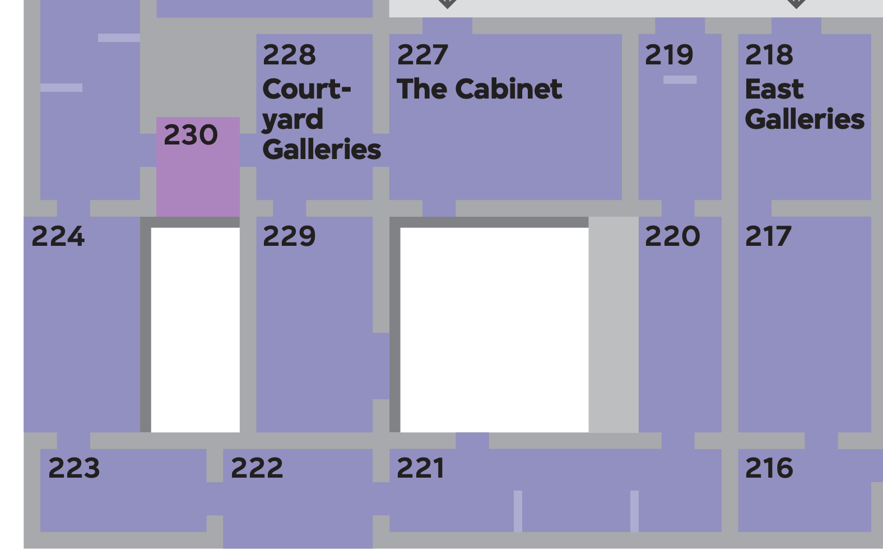

Introduction
help me (and other visitors) to maintain proper social distancing while visiting
social distance monitoring is integrated into the guide app of the museum

Slide 4
Problem Definition
e.g., visitors in the gallery / museum
Setting: Moving objects in an indoor space
e.g., staff in quarantine hotel
Social Distance Monitoring Problem: We want to continuously find all object pairs that are likely to contact in a near future
v₄
v₂
o₄
o₁
o₂
A pre-defined future prediction interval e.g., 10 seconds
Distance smaller than a pre-defined threshold e.g., 1 meter
o₃
x
d₅
d₄
d₁
d₂
Applications:
maintains social distancing among people to avoid the spread of disease
gives insights to policy-makers on the effectiveness on the restrictions
o₆
v₆
o₅
d₃
v₃
v₅
x
v₁
d₆
e.g., limiting the maximum number of people in certain areas at peak hours

Slide 5
Related Work
A closely related work
Distance-aware Join for Indoor Moving Objects [TKDE 2014]
Range Join and kNN Join
A snapshot query
Our SDM problem setting differs from it that we
Consider a continuous setting
Object uncertainty regions take future movement into account

Slide 6
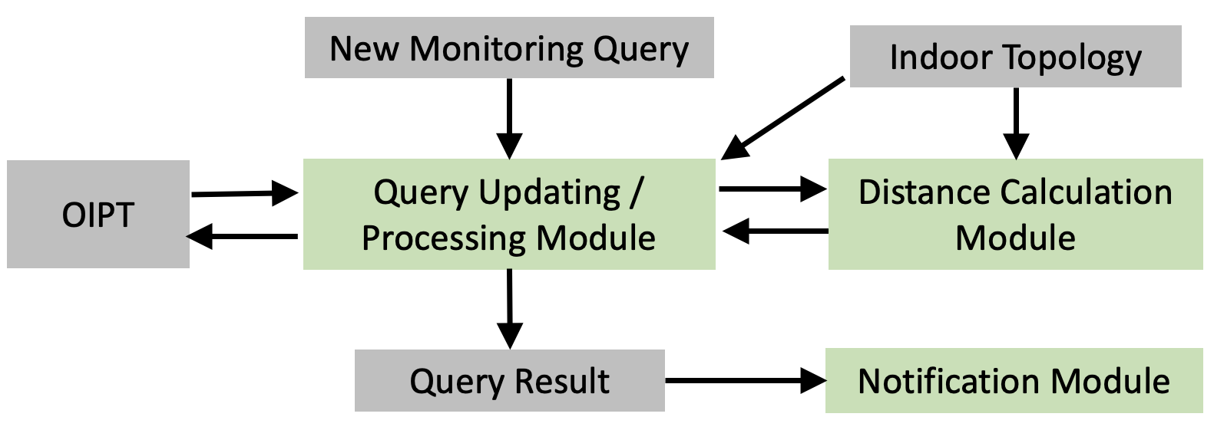
Framework for SDM
Accessibility Graph and Indexes
Calculates the expected indoor distance between objects
Online Indoor Positioning Table
Efficient algorithms to search for all possible contact pairs

Slide 7
Object Uncertainty Regions
Challenges:
Object locations are inaccurate
Location updates are discrete (e.g., 5-10 seconds / update)
Future movements are uncertain and unknown
v₄
v₂
v₄
v₂
o₄
o₄
o₁
o₁
o₂
o₂
o₃
o₃
x
x
d₄
d₅
d₄
d₁
d₅
d₁
d₂
d₂
v₆
o₆
v₆
o₅
o₆
o₅
v₅
d₃
v₅
d₃
v₃
v₃
x
x
d₆
v₁
d₆
v₁

Slide 8
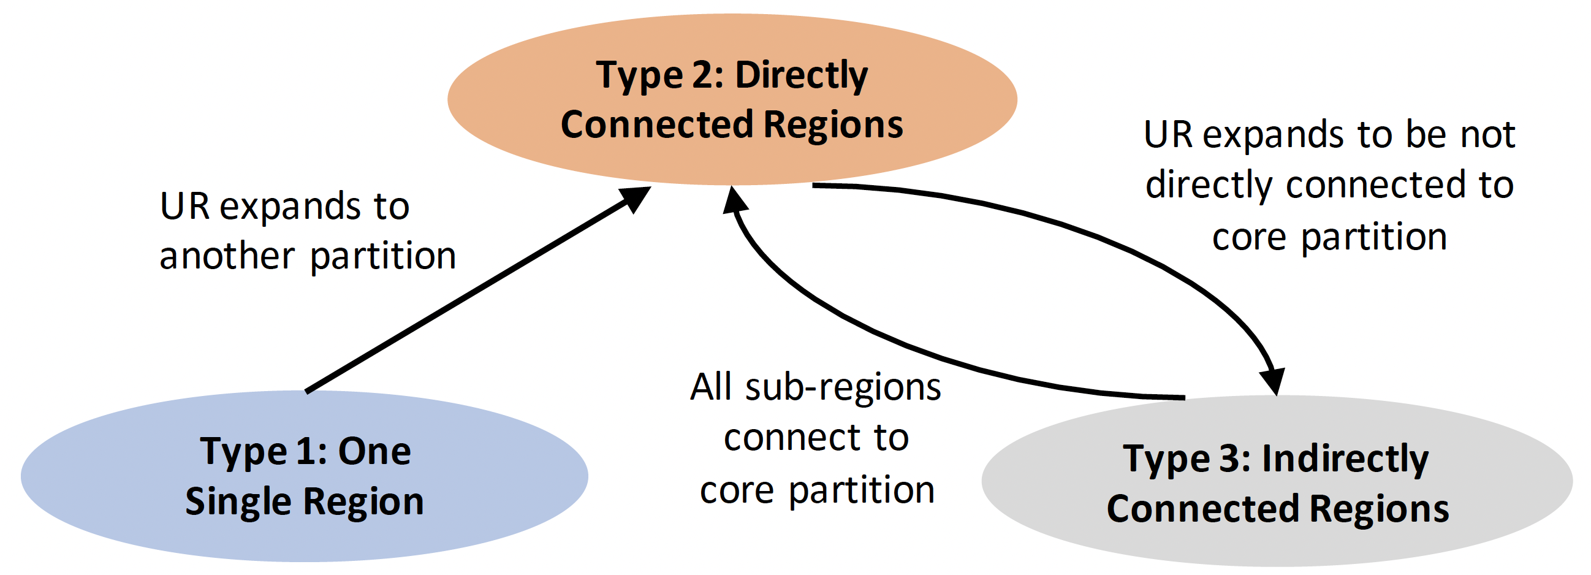
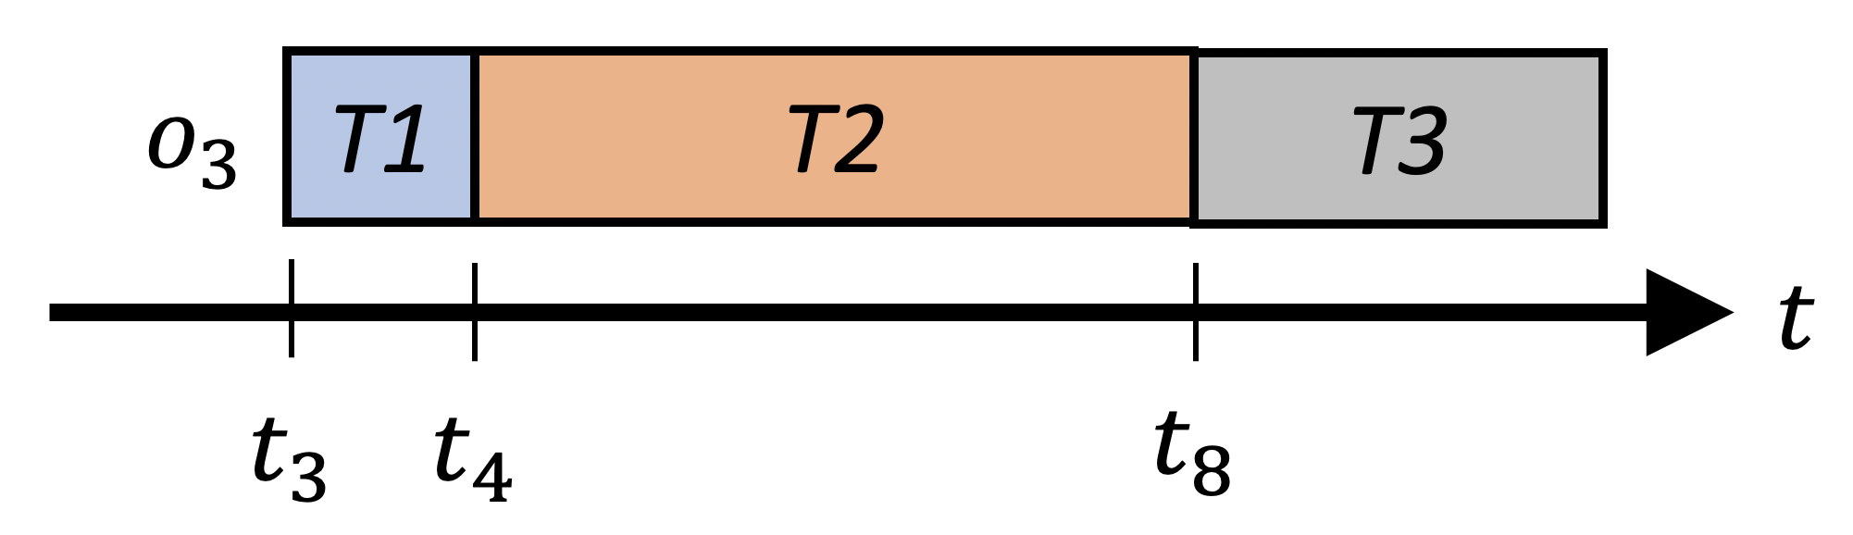
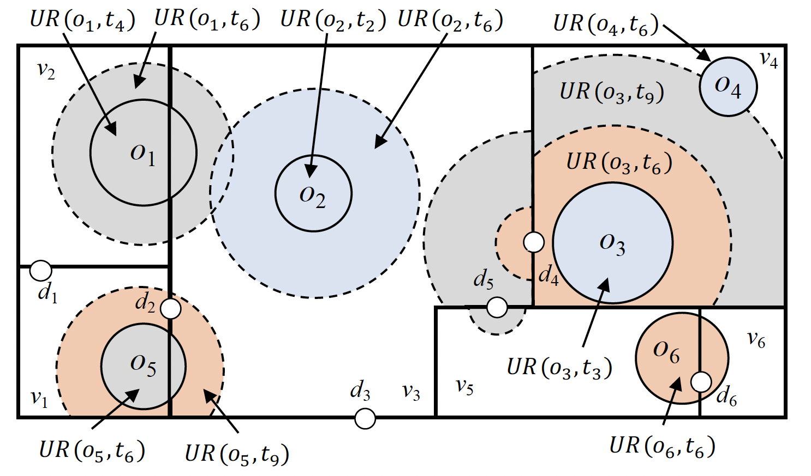
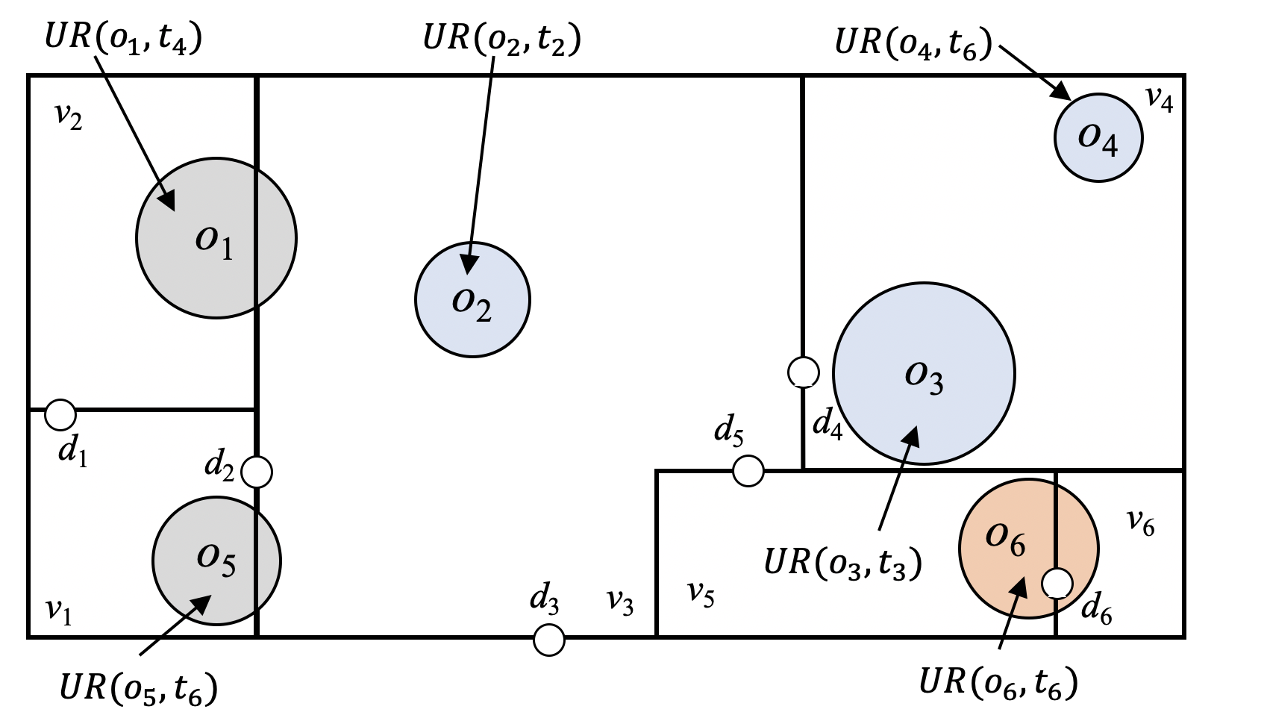
Object Uncertainty Regions
Define and calculate the expected indoor distance between object pairs of different types
Analyze and define the object uncertainty region carefully

Slide 9
Query Updating/Processing Module
Prune unpromising object pairs
Floor-based pruning
Topology-based pruning
Probability-based pruning
Query Update (QU)
Searches pair-by-pair
Batch Processing (BP)
Groups nearby objects into one large group
Updates distances between objects within and outside the group in one pass
Utilize the object types to provide tighter distance bounds

Slide 10
Experiment Setup
Algorithm
Synthetic Data
Indoor space: 20 floors each contains 141 partitions, 220 doors
Size of each floor: 600m x 600m
Maximum initial diameter of uncertainty region: 4m
Each object updates its location every 5 to 20 seconds
Future prediction interval: 10 seconds
 | Batch Processing | Query Update
with probability-based pruning | BP | QU
without probability-based pruning | BPM | QUM

Slide 11
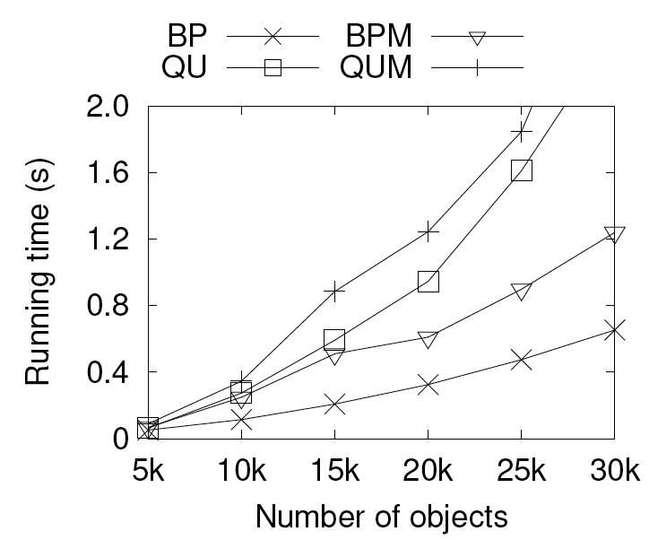
Experiment Result on Synthetic Data
Our batch processing algorithm is scalable and terminates <1s for 30k objects
Varying the number of objects

Slide 12
Experiment
Real Dataset
A shopping mall in Hangzhou, China
977 partitions, 1613 doors
7-floor, each around 108m x 80m
680,368 positioning records from 4,412 objects, spanning 24 hours
Each object updates it location every 15 seconds

Slide 13
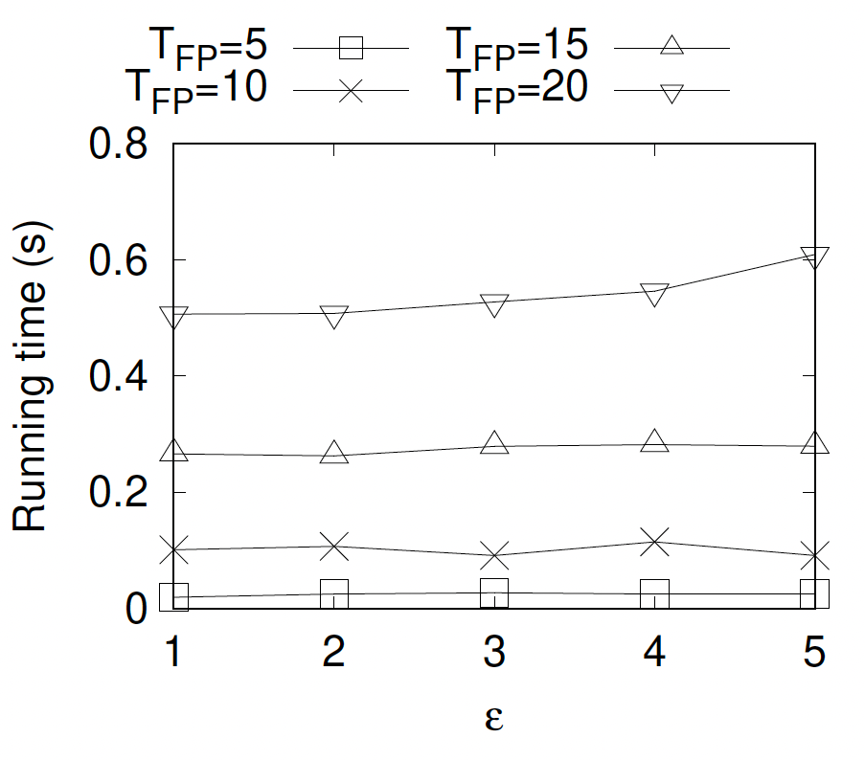
Experiment Result on Real Data
BP with different length of future prediction intervals
Longer future prediction intervals incur a higher running time
In general, running times of all settings are insensitive to the distance threshold
Varying the distance threshold (meter)

Slide 14
Conclusion
Continuous indoor social distance monitoring (SDM)
Monitors and predicts the distances between object pairs
Finds those pairs that will be in close contact soon
Developed framework and algorithms to update the results
In an online setting
Future Directions
Derive a tailor-made distance threshold for each room
Extend the framework to provide alternative route suggestions

Slide 15
Q & A

