Slide 1
Inherent-Cost Aware Collective Spatial Keyword Queries
Harry Kai-Ho Chan: The Hong Kong University of Science and Technology
Cheng Long: Queen’s University Belfast
Raymond Chi-Wing Wong: The Hong Kong University of Science and Technology

Slide 2
Outline
Introduction
Contribution
Problem Definition
Algorithms
Experimental Results
Conclusion

Slide 3
1. Introduction
Spatial-textual data
Spatial points of interest
Restaurants, hotels, tourist attractions,...
Geo-tagged web objects
Photos with both tags and geo-locations at Flickr, check-in information on places in FourSquare,...

Slide 4
1. Introduction
Cao et al. SIGMOD 2011 Long et al. SIGMOD 2013
Cao et al. TODS 2015
Collective Spatial Keywords Queries (CoSKQ)
Given a query with a location and a set of keywords
It finds a set S of objects that
Covers the keywords collectively
Has the smallest cost
Application
A tourist wants to find several POIs for sightseeing, shopping and dining, and the POIs are close to him
A manager wants to set up a project consortium of partners

Slide 5
1. Introduction
Collective Spatial Keywords Queries (CoSKQ)
k₃
k₁
k₁, k₃
k₂, k₃
q
k₃
k₂
k₃
k₁, k₂, k₃

Slide 6
1. Introduction
Collective Spatial Keywords Queries (CoSKQ)
k₃
k₁
k₁, k₃
k₂, k₃
q
k₃
k₂
k₃
k₁, k₂, k₃

Slide 7

1. Introduction
Collective Spatial Keywords Queries (CoSKQ)
Cost functions proposed by previous studies
$cost_{Sum},cost_{SumMax},$ $cost_{MaxMax},$ $cost_{Dia}, cost_{MinMax}$
Suitable in applications where the cost of a set of objects could be captured well by the spatial distances among the objects and the query only.
However, we observe that in some applications, each object has an inherent cost (e.g., workers have monetary costs), which are not captured by any of these existing cost functions.

Slide 8
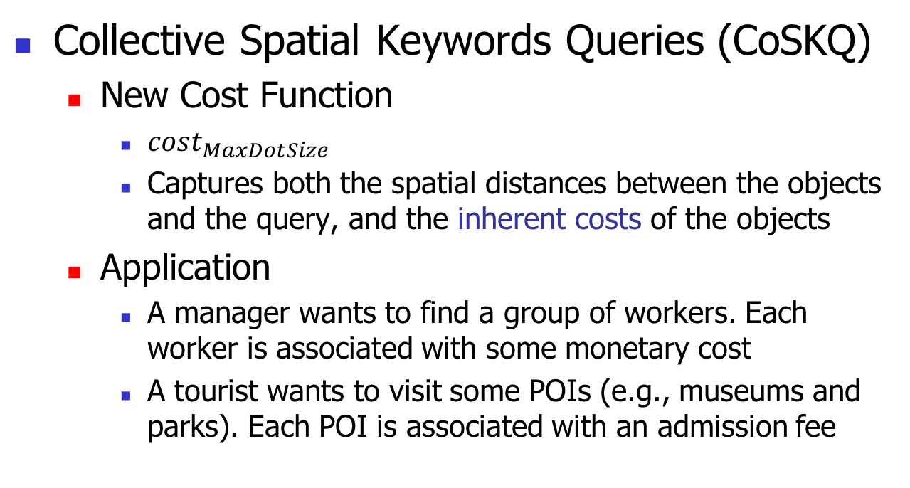
1. Introduction
Collective Spatial Keywords Queries (CoSKQ)
New Cost Function
$cost_{MaxDotSize}$
Captures both the spatial distances between the objects and the query, and the inherent costs of the objects
Application
A manager wants to find a group of workers. Each worker is associated with some monetary cost
A tourist wants to visit some POIs (e.g., museums and parks). Each POI is associated with an admission fee

Slide 9
1. Introduction
Collective Spatial Keywords Queries (CoSKQ)
3
k₃
4
3
k₁
4
k₁, k₃
k₂, k₃
q
5
k₃
6
8
k₂
k₃
k₁, k₂, k₃
2

Slide 10
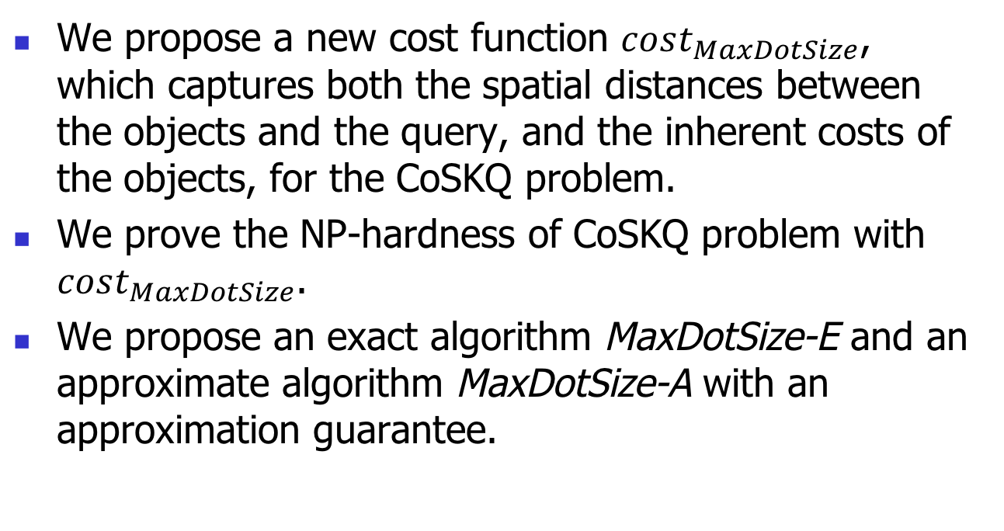
2. Contributions
We propose a new cost function $cost_{MaxDotSize}$, which captures both the spatial distances between the objects and the query, and the inherent costs of the objects, for the CoSKQ problem.
We prove the NP-hardness of CoSKQ problem with $cost_{MaxDotSize}$.
We propose an exact algorithm MaxDotSize-E and an approximate algorithm MaxDotSize-A with an approximation guarantee.

Slide 11
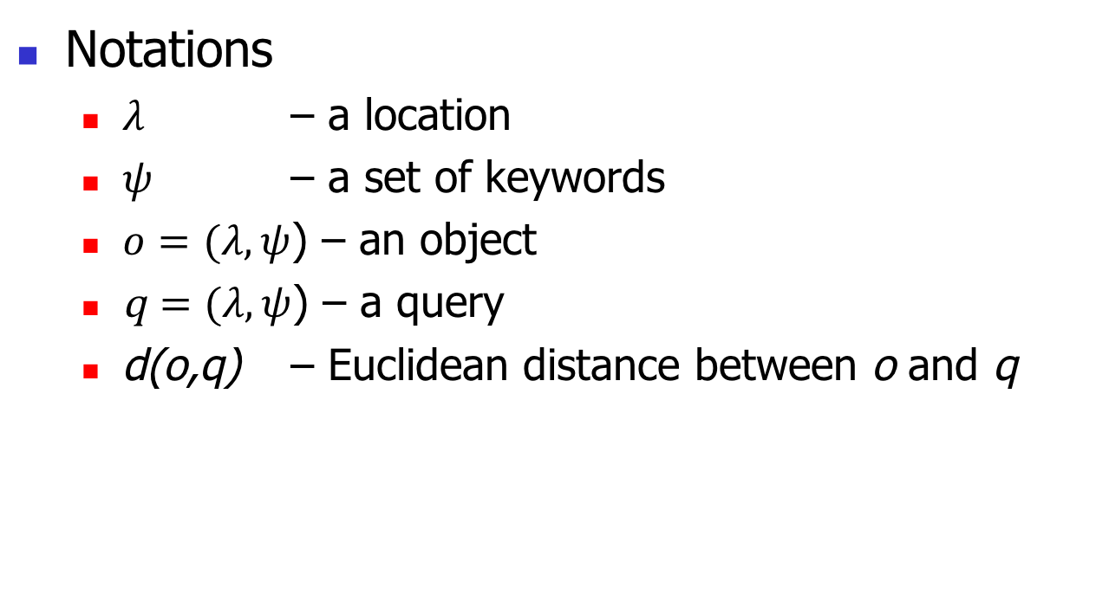
3. Problem Definition
Notations
$λ$ – a location
$ψ$ – a set of keywords
$o=(λ,ψ$) – an object
q $=(λ,ψ$) – a query
d(o,q) – Euclidean distance between o and q

Slide 12
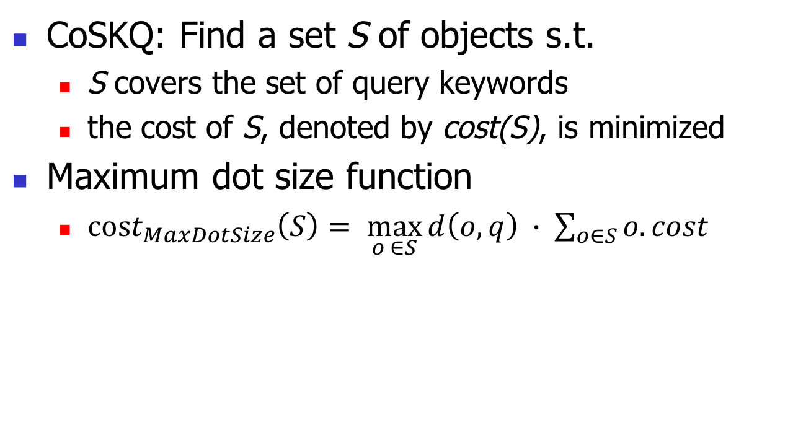
3. Problem Definition
CoSKQ: Find a set S of objects s.t.
S covers the set of query keywords
the cost of S, denoted by cost(S), is minimized
Maximum dot size function
$cost_{MaxDotSize}\left(S\right)= \max_{o ∈S}{d\left(o,q\right) }∙ \sum_{o∈S}{o.cost}$
Captures the spatial distances between the objects and the query
Captures the inherent costs of the objects

Slide 13
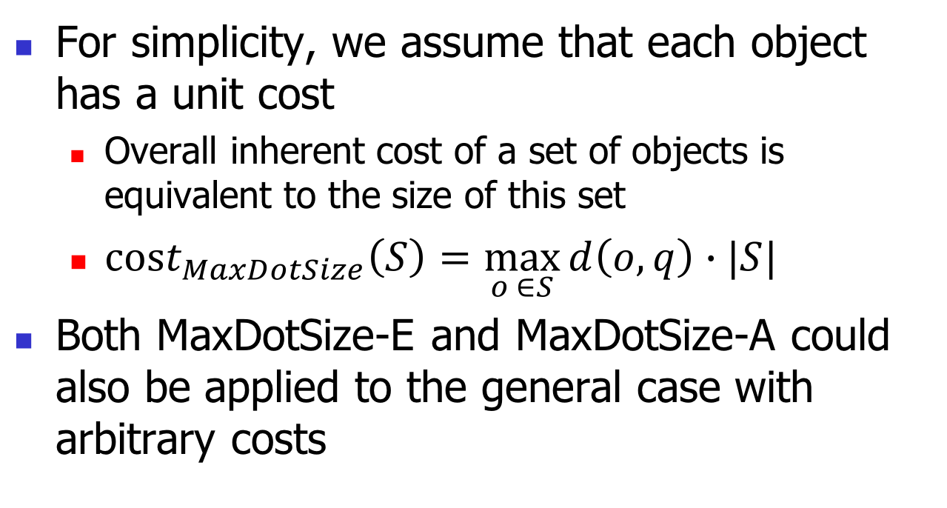
3. Problem Definition
For simplicity, we assume that each object has a unit cost
Overall inherent cost of a set of objects is equivalent to the size of this set
$cost_{MaxDotSize}\left(S\right)=\max_{o ∈S}{d\left(o,q\right)}∙|S|$
Both MaxDotSize-E and MaxDotSize-A could also be applied to the general case with arbitrary costs

Slide 14
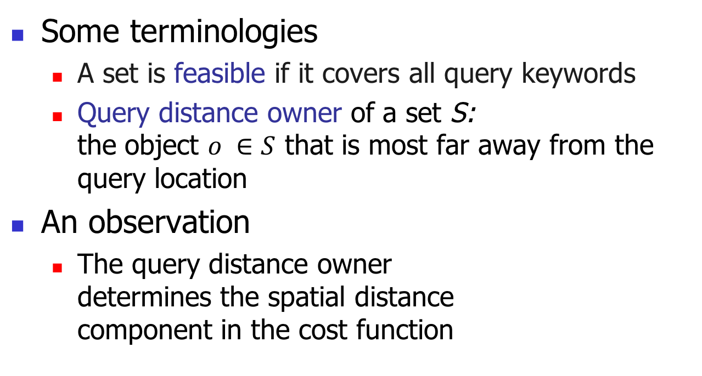
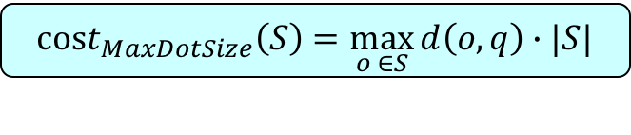
4. Algorithm MaxDotSize-E
Some terminologies
A set is feasible if it covers all query keywords
Query distance owner of a set S: the object $o ∈S$ that is most far away from the query location
An observation
The query distance owner determines the spatial distance component in the cost function
o
q
$$cost_{MaxDotSize}\left(S\right)=\max_{o ∈S}{d\left(o,q\right)}∙|S|$$

Slide 15
4. Algorithm MaxDotSize-E
Algorithm
Speedup strategies
Constraints for objects to be a query distance owner
Prune objects when enumerating best feasible set
Maintain a best-known feasible set S
For each query distance owner o
Find the best feasible set S’
Update S by S’ if cost(S’) < cost(S)
Return S

Slide 16
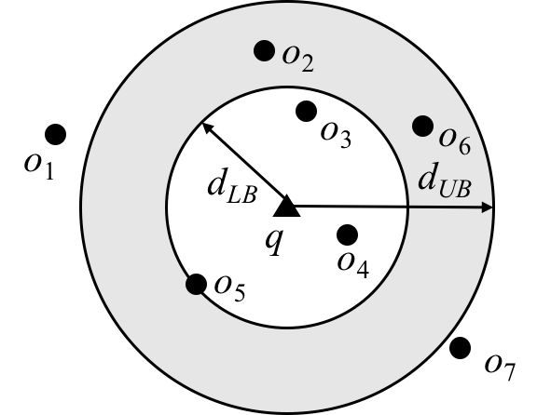
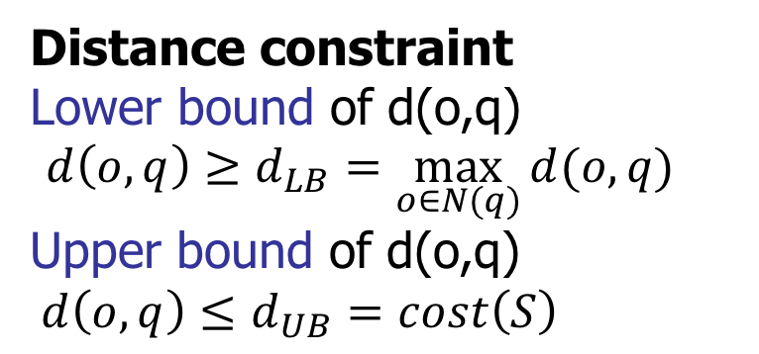
4. Algorithm MaxDotSize-E
Pruning: Not each object o is necessary to be considered as a query distance owner
Distance constraint
Lower bound of d(o,q) ${d\left(o,q\right)≥d}_{LB}=\max_{o∈N(q)}{d(o,q)}$
Upper bound of d(o,q) ${d\left(o,q\right)≤d}_{UB}=cost\left(S\right)$

Slide 17
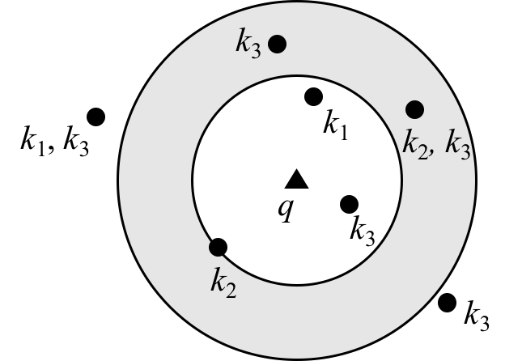
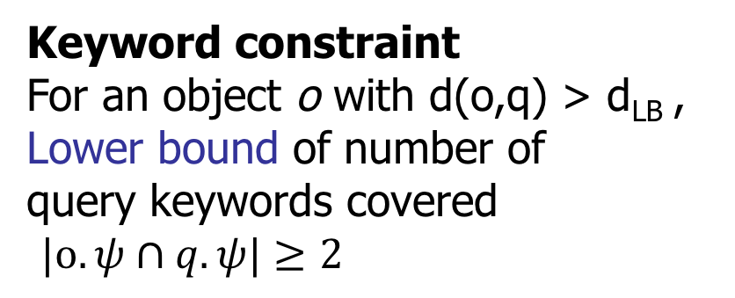
4. Algorithm MaxDotSize-E
Pruning: Not each object o is necessary to be considered as a query distance owner
Keyword constraint
For an object o with d(o,q) > d_{LB} ,
Lower bound of number of
query keywords covered
$|o.ψ∩q.ψ|≥2$

Slide 18
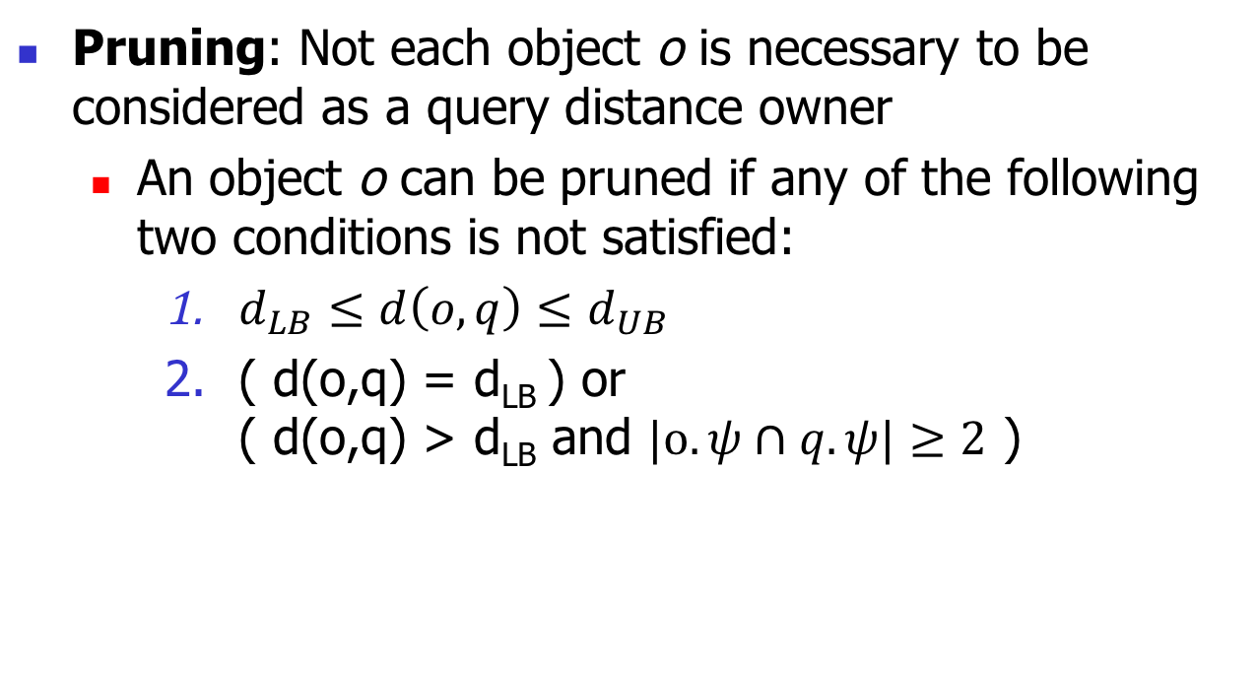
4. Algorithm MaxDotSize-E
Pruning: Not each object o is necessary to be considered as a query distance owner
An object o can be pruned if any of the following two conditions is not satisfied:
$d_{LB}≤{d\left(o,q\right)≤d}_{UB}$
( d(o,q) = d_{LB} ) or ( d(o,q) > d_{LB} and $|o.ψ∩q.ψ|≥2$ )

Slide 19
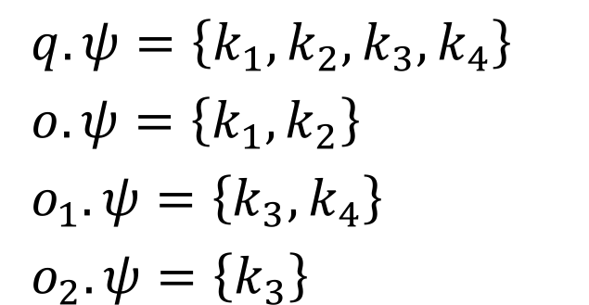
4. Algorithm MaxDotSize-E
Finding the best feasible set S’ with the query distance owner o
Exhaustive search for S’ in D(q,d(o,q))
Pruning: Not each object o’ is necessary to be enumerated
o
$q.ψ=\left\{k_{1}, k_{2},k_{3},k_{4}\right\}$
$o.ψ=\left\{k_{1},k_{2}\right\}$
$o_{1}.ψ=\left\{k_{3},k_{4}\right\}$
$o_{2}.ψ=\left\{k_{3}\right\}$
o₁
q
o₂
o₂ is dominated by o₁
D(q,d(o,q))

Slide 20
4. Algorithm MaxDotSize-A
Algorithm
Maintain a best-known feasible set S
For each query distance owner o
Find the best feasible set S’
Update S by S’ if cost(S’) < cost(S)
Return S
Find a feasible set S’ (which may not be the best but easier to find)

Slide 21
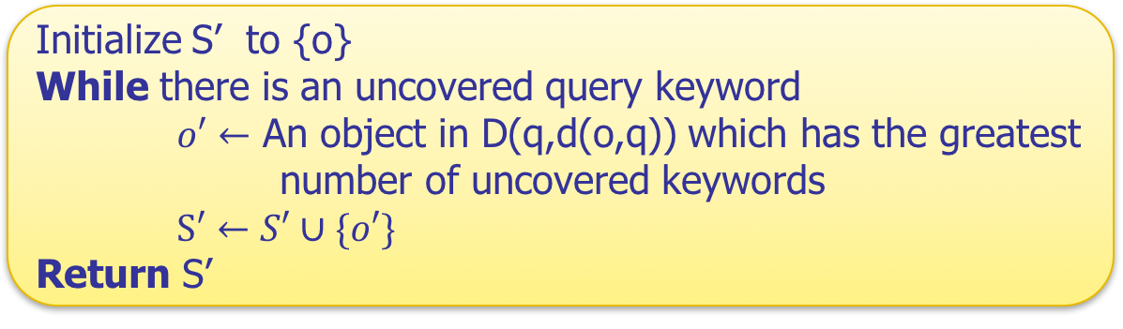
4. Algorithm MaxDotSize-A
Find a feasible set S’
Initialize S’ to {o}
While there is an uncovered query keyword
$o′←$ An object in D(q,d(o,q)) which has the greatest number of uncovered keywords
$S′←S′∪\{o′\}$
Return S’
o
q
D(q,d(o,q))

Slide 22
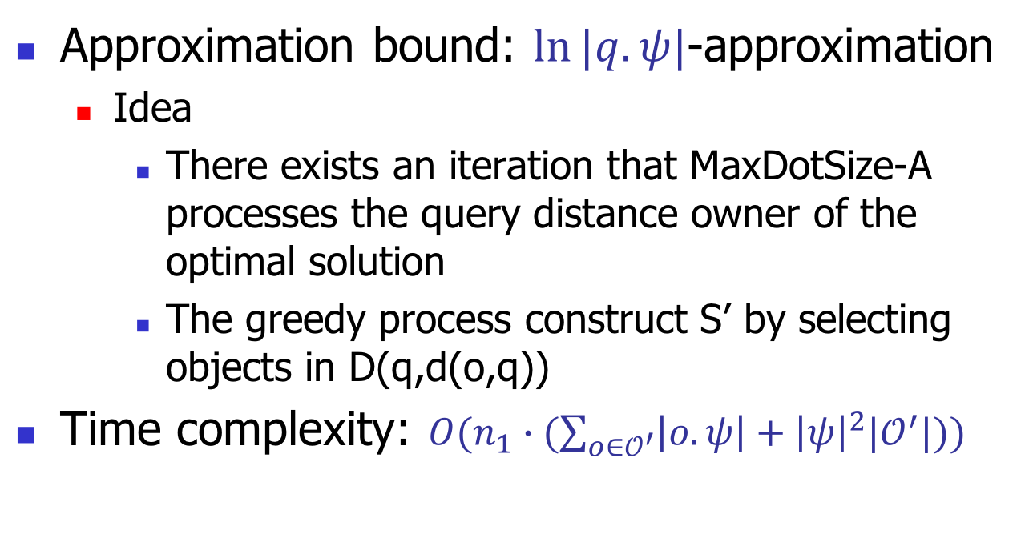
4. Algorithm MaxDotSize-A
Approximation bound: $\ln{|q.ψ|}$-approximation
Idea
There exists an iteration that MaxDotSize-A processes the query distance owner of the optimal solution
The greedy process construct S’ by selecting objects in D(q,d(o,q))
Time complexity: $O(n_{1}∙(\sum_{o∈𝒪^{′}}{\left|o.ψ\right|+{\left|ψ\right|}^{2}|𝒪^{′}|)})$

Slide 23
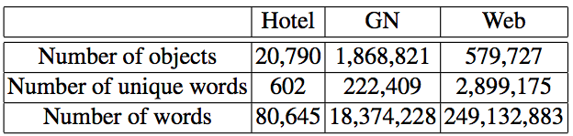
5. Experiment
Datasets: Hotel, GN and Web (same as the existing studies)
Algorithms
Cao-E, MaxDotSize-E
Cao-A1, Cao-A2, Cao-A3, Long-A, MaxDotSize-A
Factors
No. of query keywords, Average No. of keywords contained by an object, No. of objects in the dataset
Measurements
Running time and approximation ratio

Slide 24
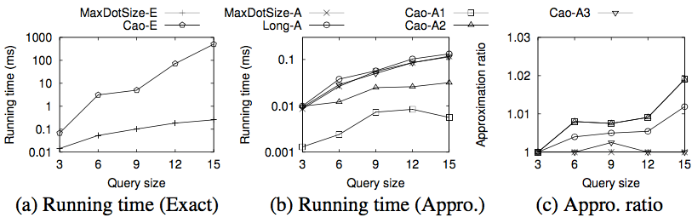
5. Experiment
Dataset: Hotel
Factor: Number of query keywords

Slide 25
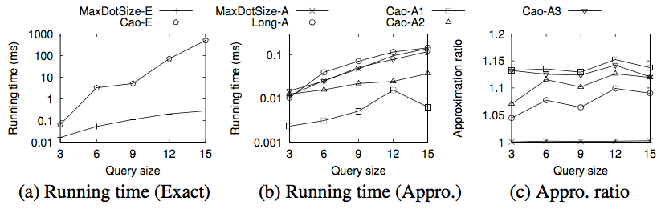
5. Experiment
Object Inherent Cost
We assign each object an integer inherent cost in the range [1,5] randomly

Slide 26
6. Conclusion
Studied Collective Spatial Keyword Query problem
Proposed a new cost function
Captures both spatial distances and object inherent cost
Developed exact and approximate algorithms
Extensive experiments

Slide 27
Q & A

