Slide 1
ACT vs. SAT
Harrison Connelly

Slide 2
Information Collected
State
Participation Rate
Income
SAT Scores
Math
English
Total
ACT Scores
Math
English
Reading
Science
Composite

Slide 3
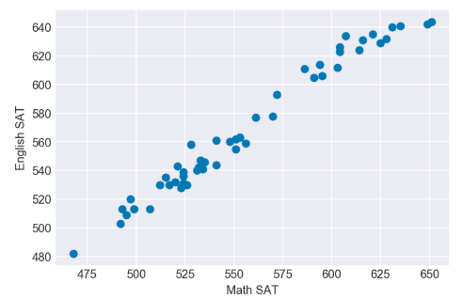
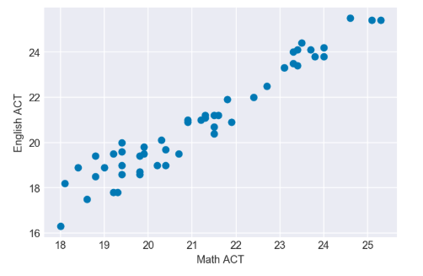
English vs Math
SAT
ACT

Slide 4
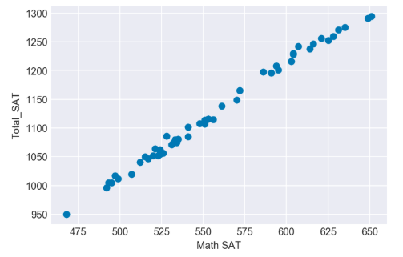
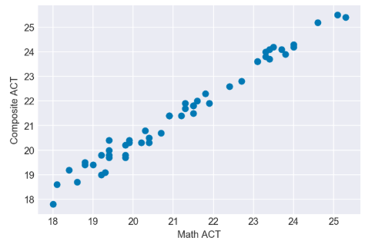
Math vs Total
SAT
ACT

Slide 5
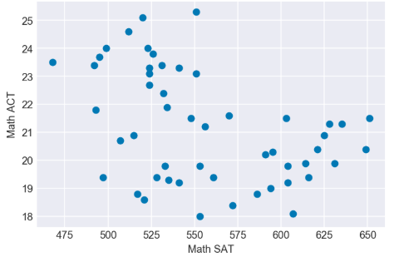
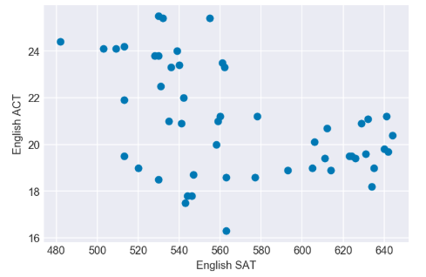
ACT vs SAT
Math
English

Slide 6
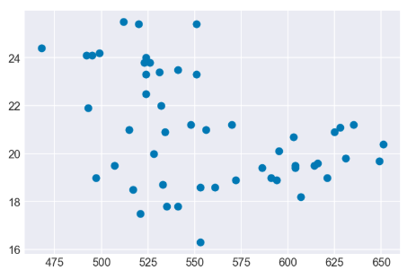
ACT vs SAT
Math
English
Notes:
-.49 and -.42

Slide 7
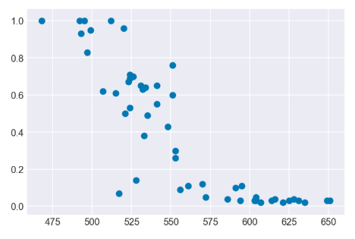
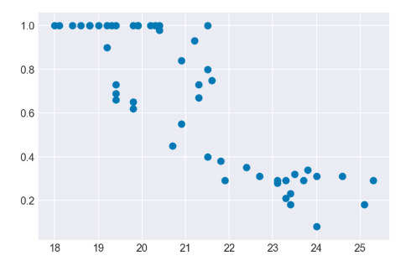
Math VS Participation
SAT
ACT

Slide 8
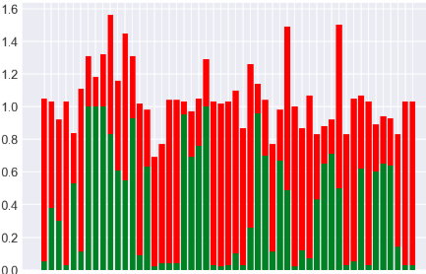
State by State ACT vs SAT Usage
Green = ACT Red = SAT
Notes:
States that do the most of both. Florida, Carolinas. Hawaii,DC. Least is California, Iowa, Kansas, West VA.
Texas at risk. .45 and 63?
ACT has way more 1.00 states than SAT. mandatory.

Slide 9
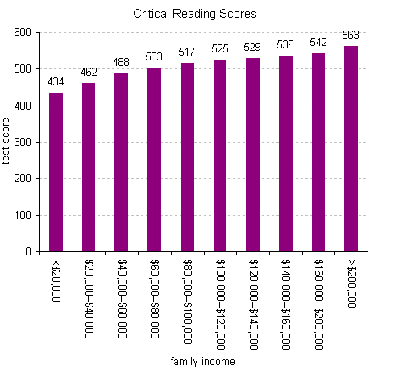
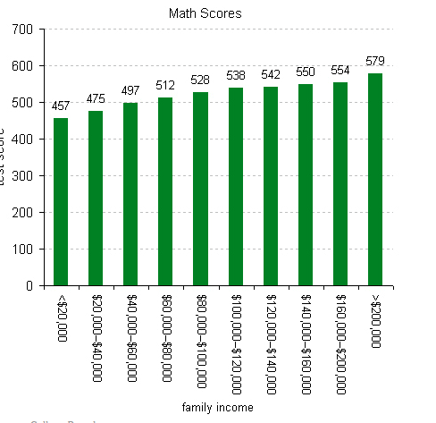
SAT Scores Relative To Income
Property of Time Magazine 2009

Slide 10
Conclusions
Student Profile:
Motivation
Easy and Effective Training/ Studying
Mobile App
Study in other states/ Travel
Get in schools early
Income
Targeted Advertising and Education
Population Size
Worth Investment
Test Preference
Need Improvement
Ideal Profile Legislation: North Carolina, South Carolina.
Ideal Profile Grassroots: California, Texas, Florida wealthy highly motivated student.
Legislation Profile:
Location
Other popular schools
Value of Education
Population Size
Worth Investment
Government Influence
Government Openness
Private schools target
Test Preference
Notes:
Florida, Texas, California.
North Carolina, South Carolina. 50% of students do it anyways. UNC,USC, Duke, Costal Carolina. 15 million people.

Slide 11
Further Research
Subjects of interest in the future:
Students by student basis.
Control for income and motivation.
School system grading system.
Profiles for students most likely to travel
Create Profiles of students that perform better on SAT than ACT

