Slide 1

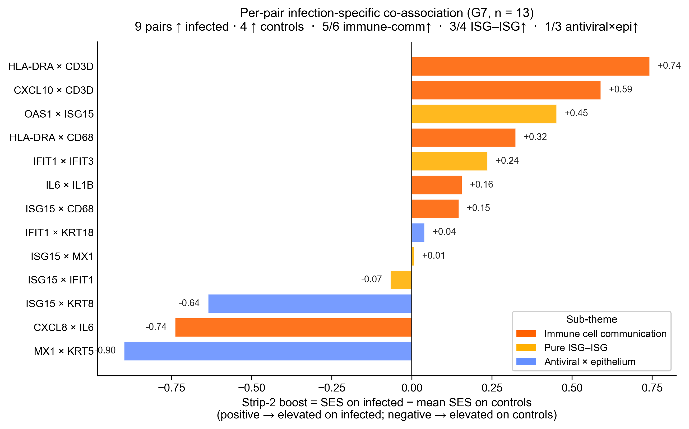
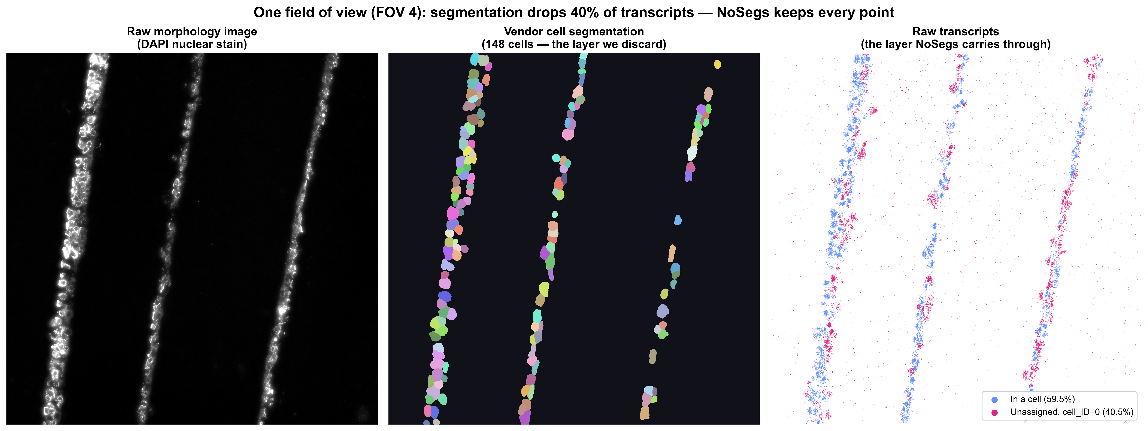
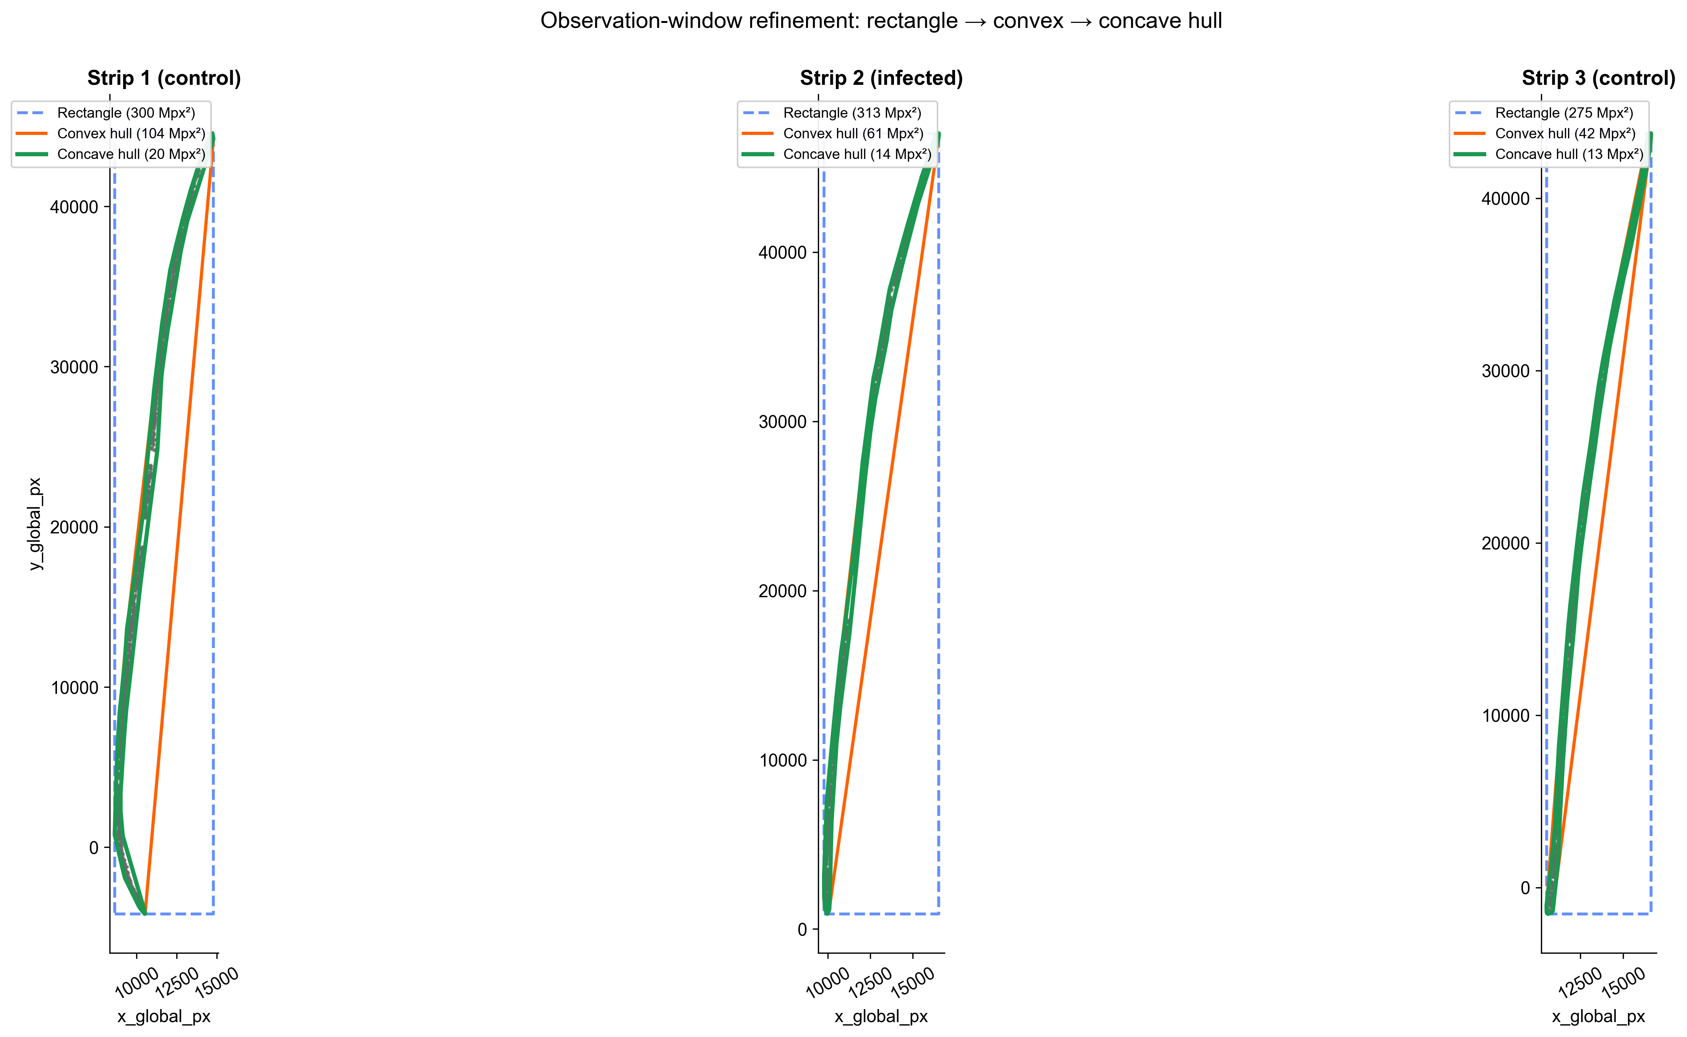
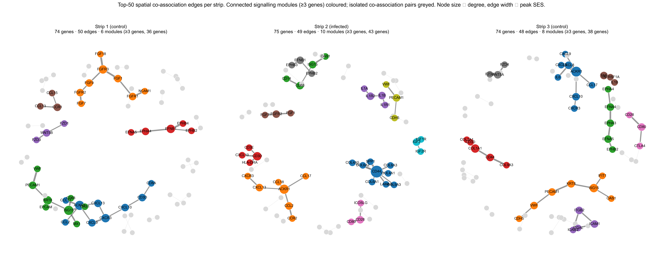
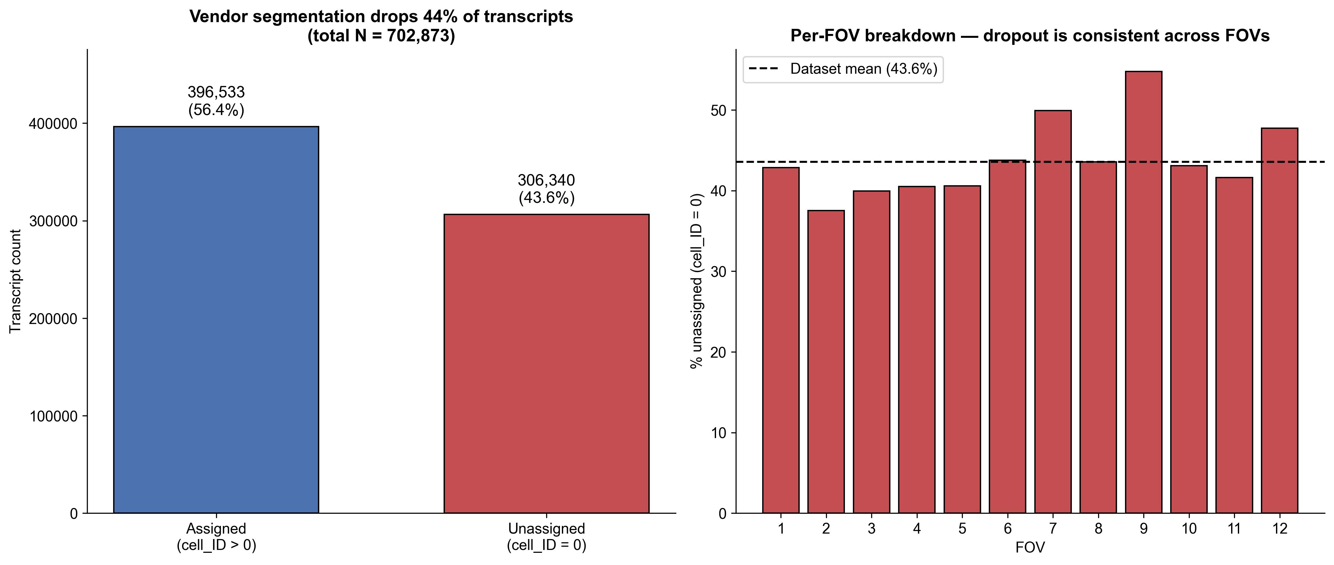
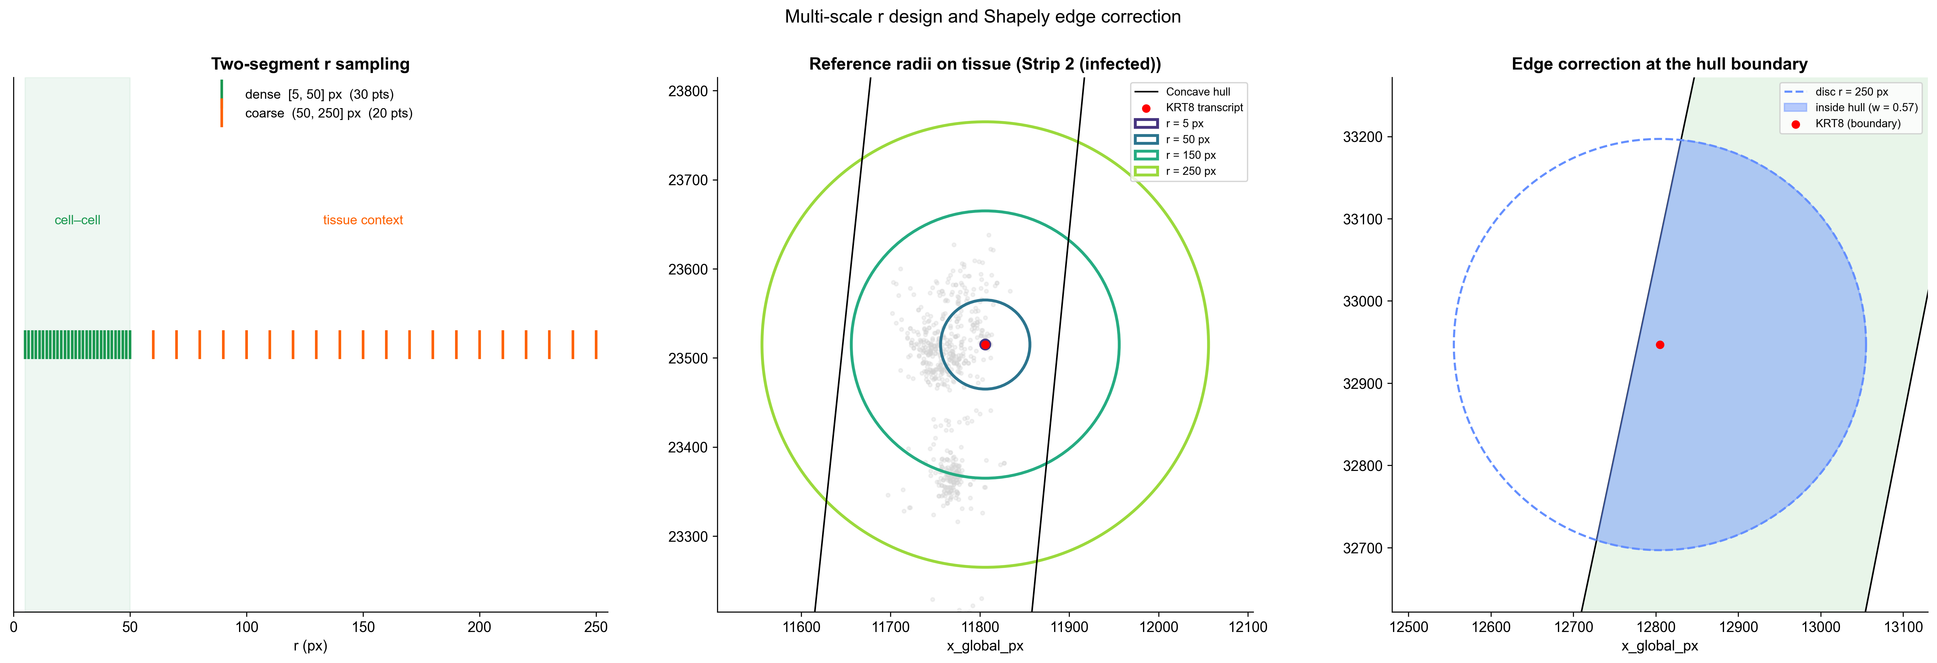
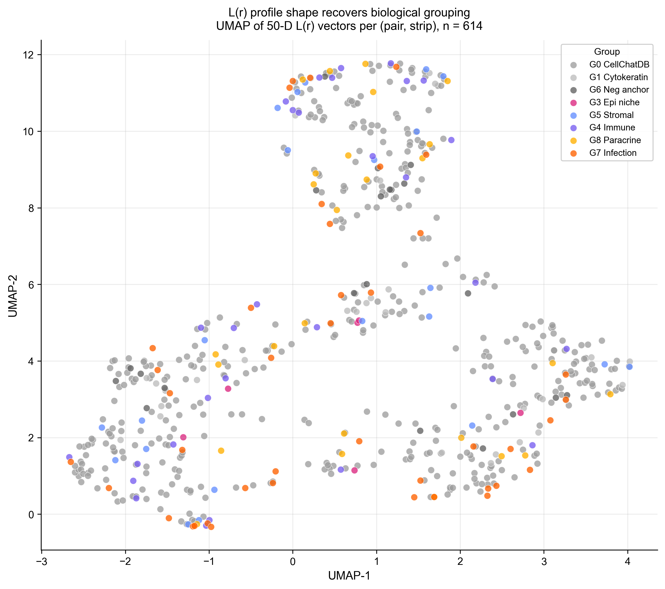
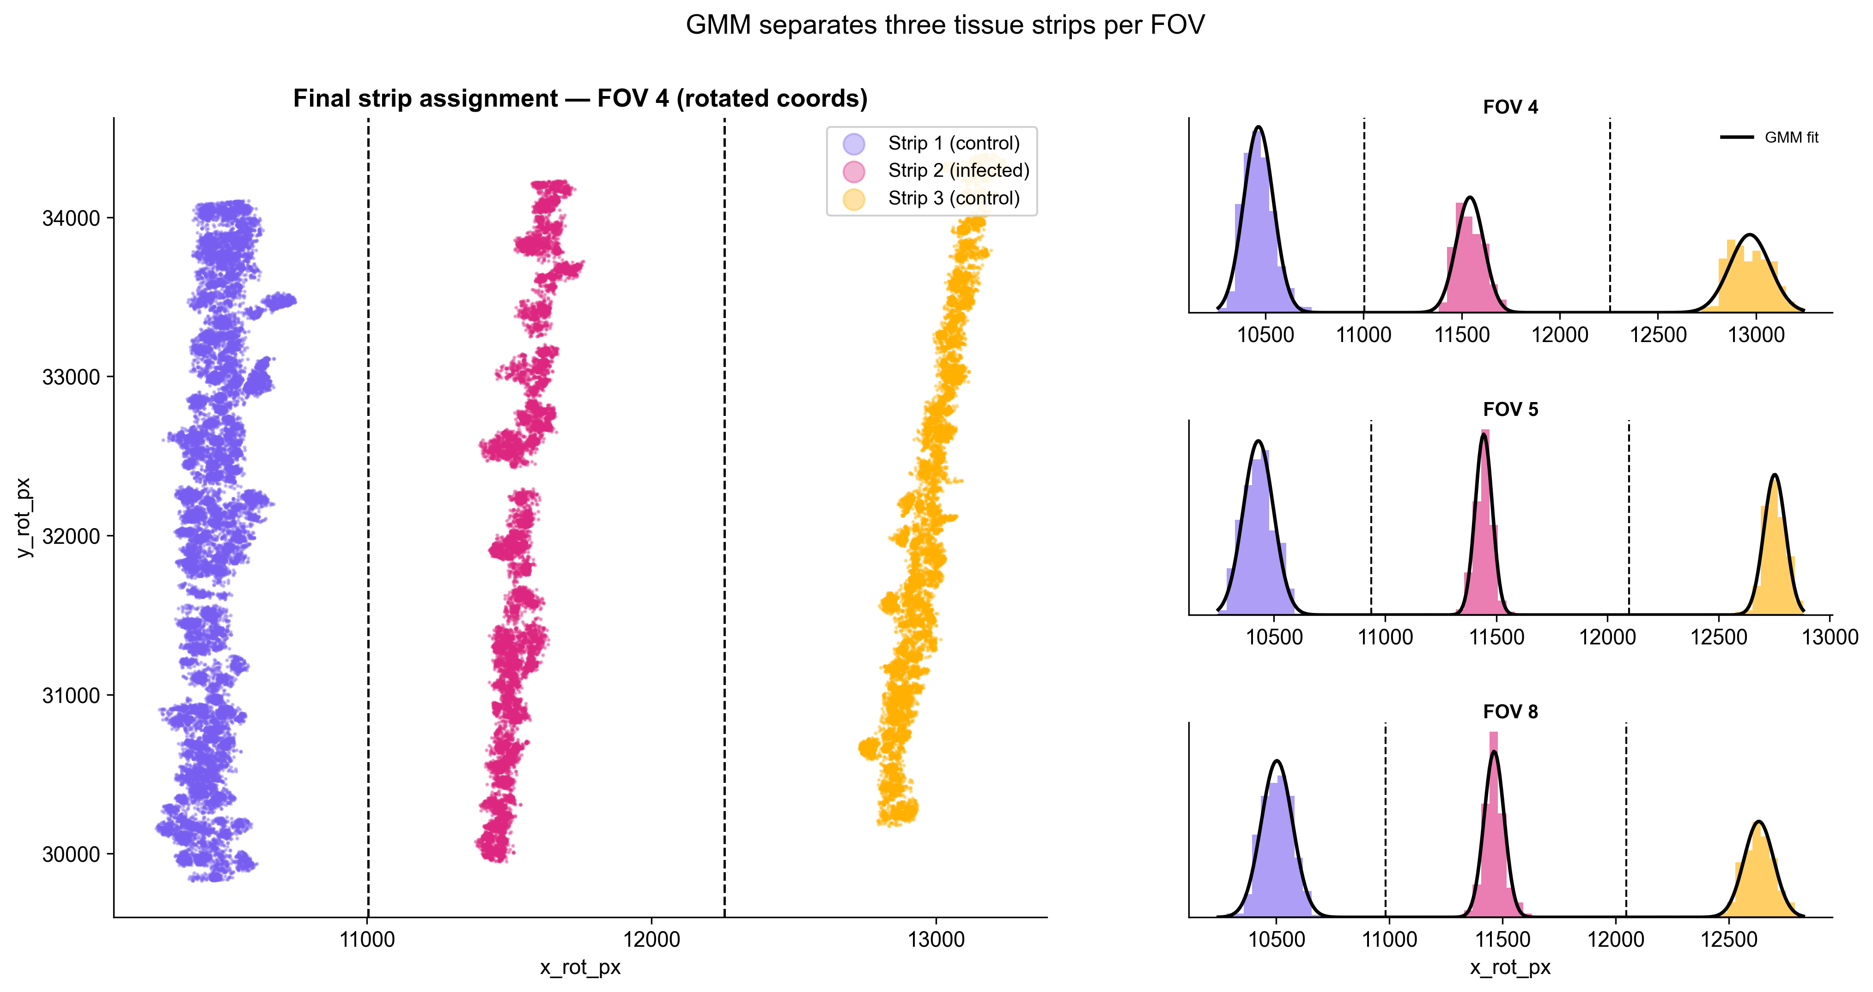
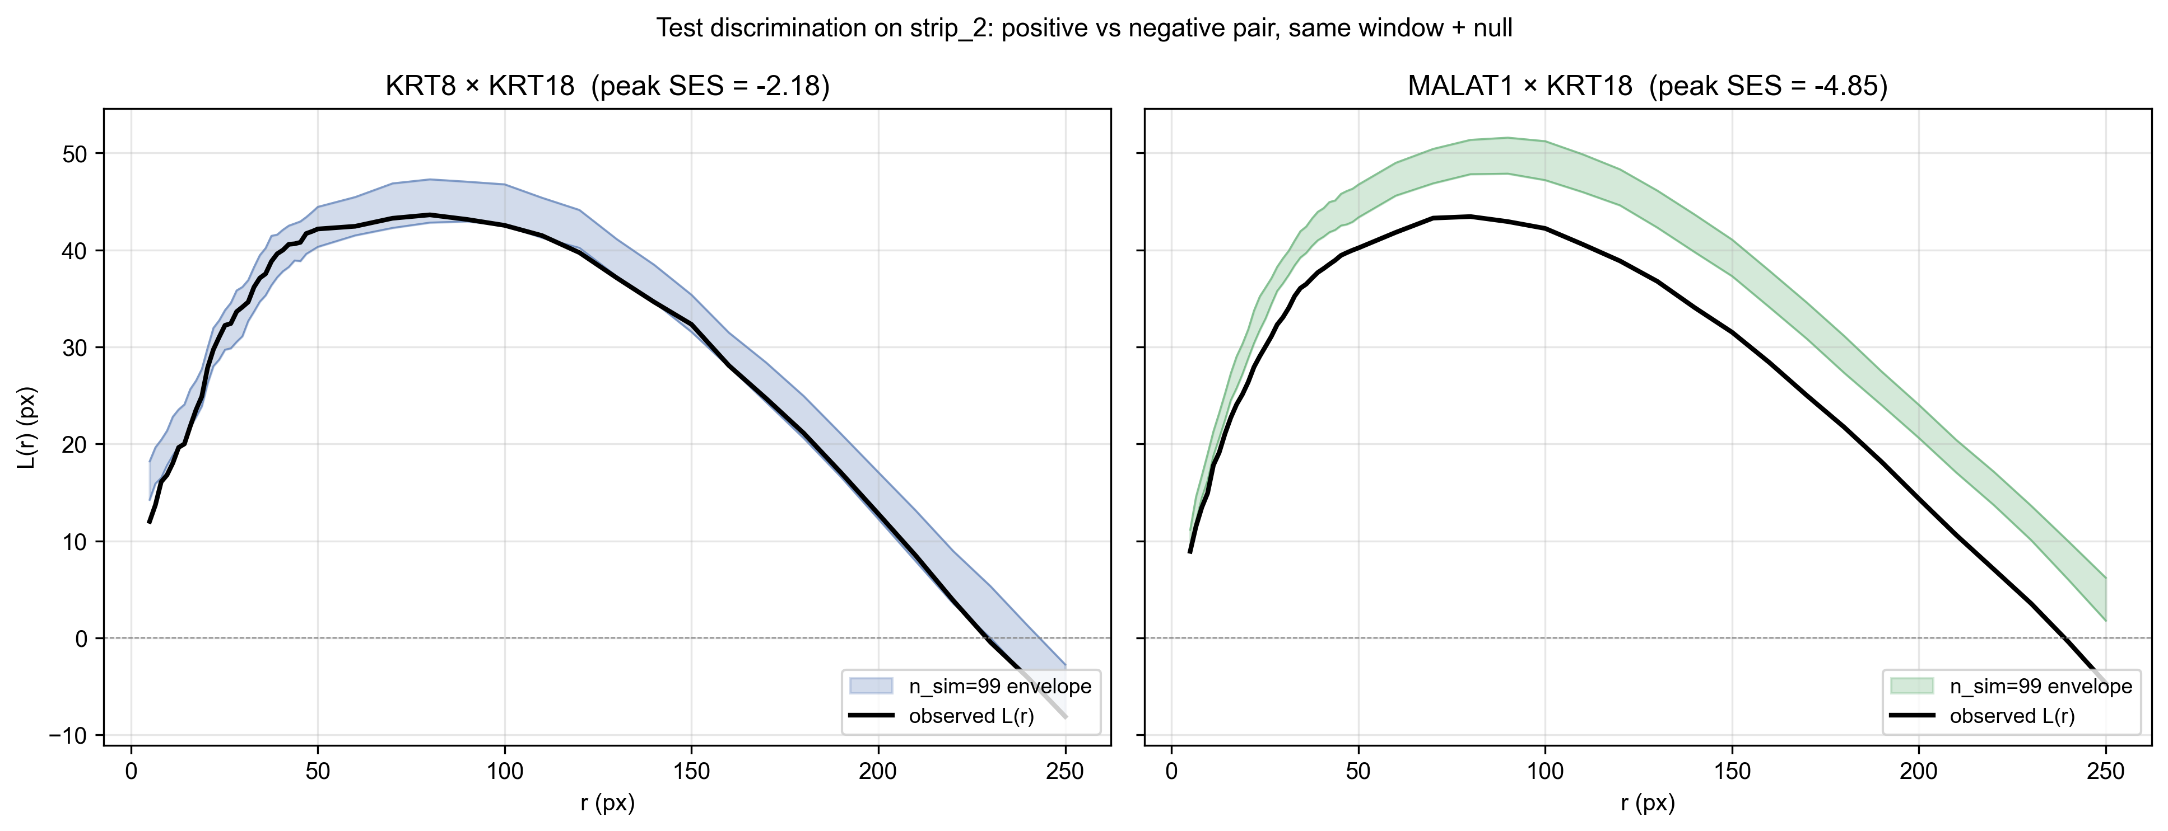
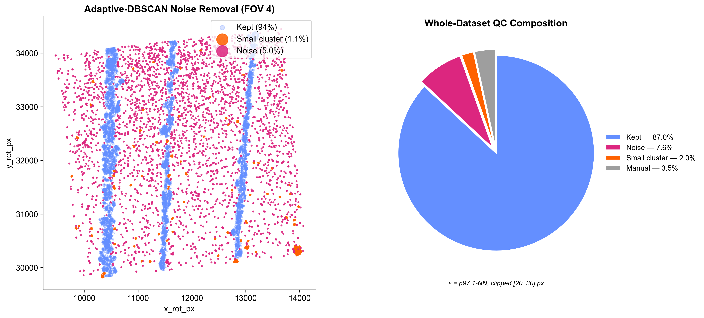
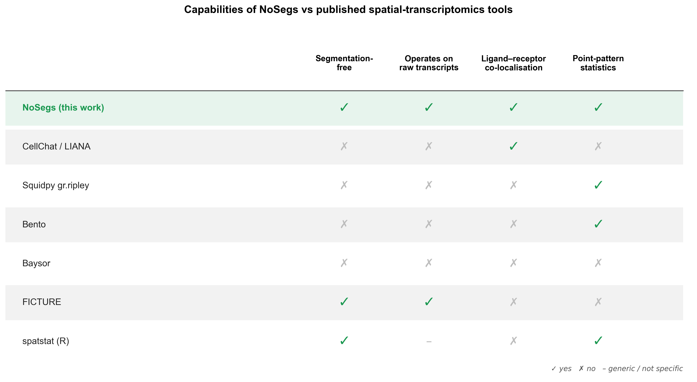
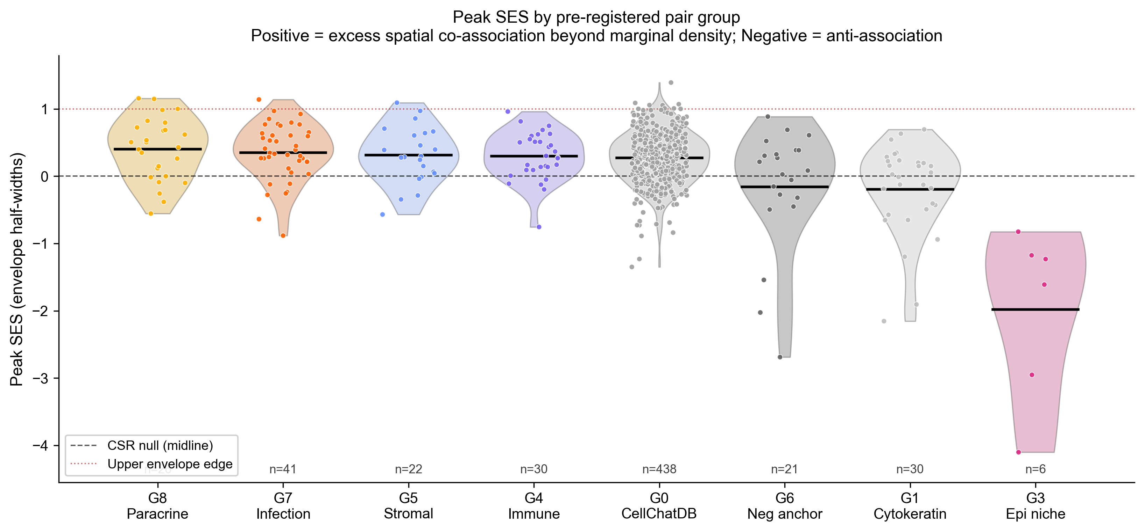

NoSegs: Segmentation-Free Ligand-Receptor Co-Localisation in Spatial Transcriptomics
Bivariate point-pattern statistics on raw transcripts | No cells, no clusters, no segmentation.
Harry Woodward | Supervisor: Dr Dan Nicolau, Nicolau Lab | MSc Bioinformatics, King's College London | 2026
Platform: NanoString CosMx SMI | Tissue: severe asthmatic, RSV-infected human lung | ~2.66 M transcripts | 1,000-gene panel
Introduction
The NoSegs Pipeline, End to End
Results | Infection Biology
Spatial transcriptomics maps gene expression at single-molecule resolution in intact tissue (He 2022). Almost every downstream analysis - cell-type calling, ligand-receptor inference, niche detection - requires a fragile first step: assigning each transcript to a cell membrane.
On the CosMx sample analysed here, vendor segmentation leaves 43.6% of transcripts unassigned and most subcellular labels missing - segmentation quality is a known, platform-wide weakness (Petukhov 2022; Marco Salas 2025). Even third-party tools (Cellpose, MOSAIK) often struggle to recover the signal from wet-lab challenges, such as poor DAPI staining, so segmentation-dependent tools (CellChat, LIANA, Bento) become unusable (Jin 2021).
NoSegs takes a different route: treat each gene as a 2-D point pattern in tissue space and use bivariate Ripley's K-functions with label-permutation envelopes to detect ligand-receptor co-localisation directly. No cells. No clusters. Just transcripts.
The tissue is severe asthmatic lung during RSV infection. This is a clinically important setting where the spatial organisation of antiviral and immune signaling matters most, yet exactly where segmentation is least reliable.
Eight stages take raw transcripts to signaling networks with no cell calling. Each gene becomes a 2-D point pattern; bivariate Ripley's K with a label-swap null then tests every ligand-receptor pair for spatial co-localisation. Teal marks the statistical core; amber chips mark the tunable choice at each step.
5/6
immune pairs positive on the infected strip
Immune cell-communication pairs preferentially co-localise on infected tissue - recovered with no segmentation step.
Controls separate by +2.67 envelope half-widths.
INPUT — raw transcripts (x, y, gene, FOV)
Antigen presentation, T-cell recruitment and antiviral monocyte signalling all preferentially co-localise on the infected strip - the textbook adaptive immune response to RSV (Openshaw 2017; Russell 2017), recovered here with no segmentation step.
1 PCA align + per-FOV GMM strips
3-component GMM
Infection signalling boost
2 DBSCAN noise removal
adaptive ε = p97 1-NN, [20, 30] px
3 Observation window
rectangle / convex / concave hull
4 Bivariate Ripley K → L(r)
multi-scale r-grid (cell + tissue)
Segmentation Loses Half the Signal
5 Label-swap permutation envelope
n_sim = 99 / 199 + edge correction
Vendor segmentation is unreliable on this sample. In a single field of view the cell mask captures only a fraction of the transcripts (Fig 1), and the loss is systematic across the dataset: 43.6% of all transcripts are never assigned to any cell (Fig 2). Every cell-level tool silently discards them.
6 Effect-size (SES) ranking
binary test or continuous SES
OUTPUTS: networks | UMAP | heatmaps
Fig 5. The end-to-end workflow. Eight native, editable stages from raw transcripts to signalling networks.
Fig 10. Per-pair Strip-2 boost for the surviving infection-response pairs. Immune cell-communication pairs are positive (5/6): antigen presentation onto T cells (HLA-DRA×CD3D, +0.74; Roche & Furuta 2015), chemokine-driven T-cell recruitment (CXCL10×CD3D, +0.59; Groom & Luster 2011) and macrophage antigen presentation (HLA-DRA×CD68, +0.32) - the expected adaptive response to RSV (Openshaw 2017). A paradoxical second finding only a segmentation-free method can surface: antiviral interferon-stimulated genes paired with epithelium (ISG15×KRT8, MX1×KRT5; Schoggins 2011) move off infected tissue, consistent with epithelial loss redistributing antiviral activity into immune cells.
Observation window
Co-localisation networks
Fig 1. One field of view, three layers. Left: raw DAPI morphology. Middle: the vendor cell-segmentation mask (148 cells) – this is the layer NoSegs discards. Right: the raw transcripts, with ~40% never assigned to any cell (magenta). NoSegs carries every point through.
Fig 6. The observation window is the dominant lever for inferential power. A concave hull tracks the true tissue extent, shrinking the area ~20× vs the bounding box and tightening the permutation null.
Multi-scale r-grid & edge correction
Fig 11. Top-50 spatial co-association edges per strip with Louvain community detection. Communities are spatial signalling modules - interferon response, chemokine signalling, stromal ECM recovered without any cell segmentation. Strip 2 (infected) carries more and larger modules than the controls.
Fig 2. Across all FOVs, vendor segmentation never assigns 43.6% of transcripts to a cell, so every cell-level tool silently discards them — consistently across the whole dataset.
Spatial signatures (UMAP)
Preparing the Point Field
Fig 7. A deliberate multi-scale r-grid resolves both cell-scale and tissue-scale co-association; Shapely edge correction down-weights discs that spill outside the tissue window, following standard second-order point-pattern theory (Ripley 1976; Diggle 2003; Baddeley 2015).
NoSegs keeps every transcript and works on the raw point cloud. Two light-touch steps prepare it: a per-FOV Gaussian mixture separates the infected and control tissue strips (Fig 3), and an adaptively-tuned DBSCAN pass removes diffuse background while retaining 87% of points (Fig 4).
Validation & Controls
The method must first pass known-answer controls. A focal positive pair scores high and a diffuse housekeeping pair does not; both sit inside or below the permutation envelope under the production window, but their effect sizes separate cleanly (Figs 8–9). We therefore rank pairs by continuous standardised effect size (SES) - the continuous form of the global rank envelope test (Myllymäki 2017) - not binary significance.
Fig 12. Each (pair, strip) treated as a 50-dim L(r) curve-shape vector, embedded with UMAP. The method recovers biological grouping as soft visual structure from raw transcripts alone.
Where NoSegs Sits
Fig 3. After PCA aligns the tissue axis, a per-FOV 3-component Gaussian mixture separates the three tissue strips; boundaries are set per FOV, with manual overrides where the mixture is ambiguous.
Fig 8. The positive control (KRT8×KRT18) and the housekeeping×specific negative (MALAT1×KRT18) fall inside or below the label-swap envelope on the infected strip, yet their effect sizes separate by 2.67 envelope half-widths. We therefore rank by continuous peak SES, not binary pass/fail.
No existing tool tests ligand–receptor co-localisation on raw transcripts. Cell-level methods require segmentation or cell-typing first; the one segmentation-free neighbour, FICTURE, infers tissue domains rather than pairwise interactions. NoSegs is the only method that satisfies all four capabilities at once (Fig 13).
Adaptive noise removal
Control | Pair | Expected | Observed
Positive | KRT8 × KRT18 | Above null | SES = −2.18
Negative | MALAT1 × KRT18 | Far below | SES = −4.85
Fig 13. No published tool screens LR co-localisation on raw transcripts without segmentation. CellChat/LIANA (Jin 2021), Squidpy (Palla 2022), Bento (Mah 2024) and Baysor (Petukhov 2022) require segmentation or cell-typing; FICTURE (Si 2024) is segmentation-free but answers a different question (tissue domains); spatstat is a generic point-pattern library. NoSegs satisfies all four capabilities.
Fig 4. DBSCAN with an adaptively-set ε (97th-percentile 1-NN, clipped 20–30 px) flags diffuse background and stray clusters; 87% of transcripts survive QC.
Fig 9. Method is correctly null for diffuse markers (cytokeratins, housekeeping anchors) and elevated for focal pairs (paracrine, infection, stromal, immune). Bivariate K under this null detects excess spatial co-association beyond marginal density.
Conclusions & Next Steps
Key References
Acknowledgements
Bivariate Ripley's K on raw transcript point clouds detects LR co-localisation with no cell segmentation step.
Discriminates positive from negative controls by effect size (separation = +2.67 envelope half-widths under the production window).
Fills a vacant niche: Bento, Squidpy, CellChat, LIANA all require segmentation - NoSegs does not.
Next: Extended cytokeratin/housekeeping anchor panel; marker-gene pseudo-segmentation for cell-type stratification; benchmark vs Squidpy gr.ripley on cell-level reductions.
1. Ripley BD (1976) J. Appl. Prob. 13:255–266 | The K-function.
2. Diggle PJ (2003) Statistical Analysis of Spatial Point Patterns, 2nd ed. Arnold.
3. Baddeley A, Rubak E, Turner R (2015) Spatial Point Patterns. CRC Press.
4. Myllymäki M et al. (2017) J. R. Stat. Soc. B 79:381–404 | Rank envelope test.
5. He S et al. (2022) Nat. Biotechnol. 40:1794–1806 | CosMx SMI platform.
6. Petukhov V et al. (2022) Nat. Biotechnol. 40:345–354 | Baysor segmentation.
7. Si Y et al. (2024) Nat. Methods 21:1843–1854 | FICTURE (segmentation-free).
8. Marco Salas S et al. (2025) Nat. Methods 22:813–823 Z Xenium QA/segmentation.
9. Palla G et al. (2022) Nat. Methods 19:171–178 | Squidpy.
10. Mah CK et al. (2024) Genome Biol. 25:82 | Bento.
11. Jin S et al. (2021) Nat. Commun. 12:1088 | CellChat / CellChatDB.
12. Openshaw PJM et al. (2017) Annu. Rev. Immunol. 35:501–532 | RSV immunity.
13. Russell CD et al. (2017) Clin. Microbiol. Rev. 30:481–502 | Human RSV response.
14. Schoggins JW et al. (2011) Nature 472:481–485 | ISG antiviral effectors.
15. Roche PA, Furuta K (2015) Nat. Rev. Immunol. 15:203–216 | MHC class II.
16. Groom JR, Luster AD (2011) Immunol. Cell Biol. 89:207–215 | CXCR3 ligands.
HPC compute courtesy of King's College London (CREATE HPC). Dataset courtesy of Nicolau Lab and clinical collaborators. CellChatDB via Jin et al. 2021. Thank you to Dr Dan Nicolau for project supervision and for his ideas and wisdom.
github.com/harrydaw/cosmx-pointpattern | harry.1.woodward@kcl.ac.uk | MSc Applied Bioinformatics

