Slide 1

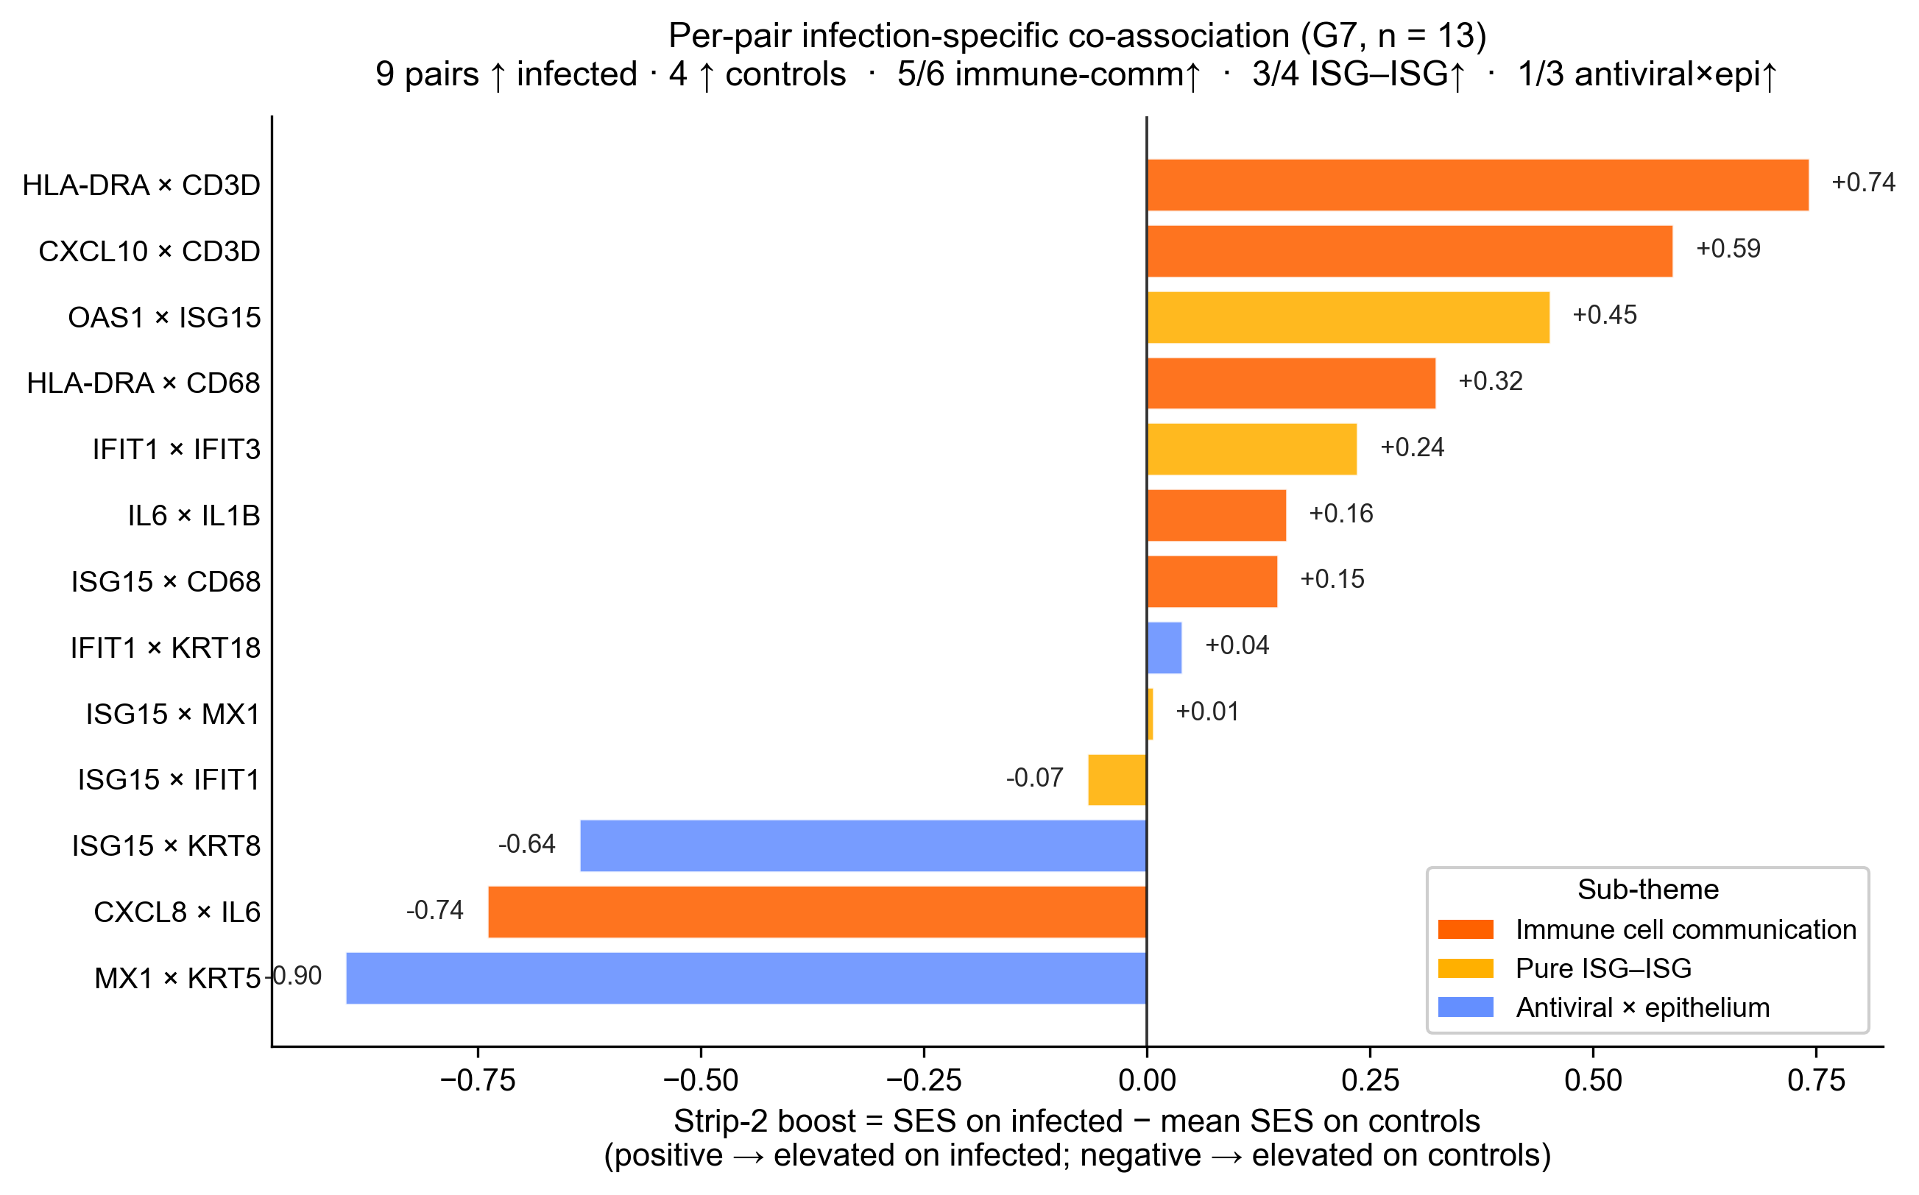
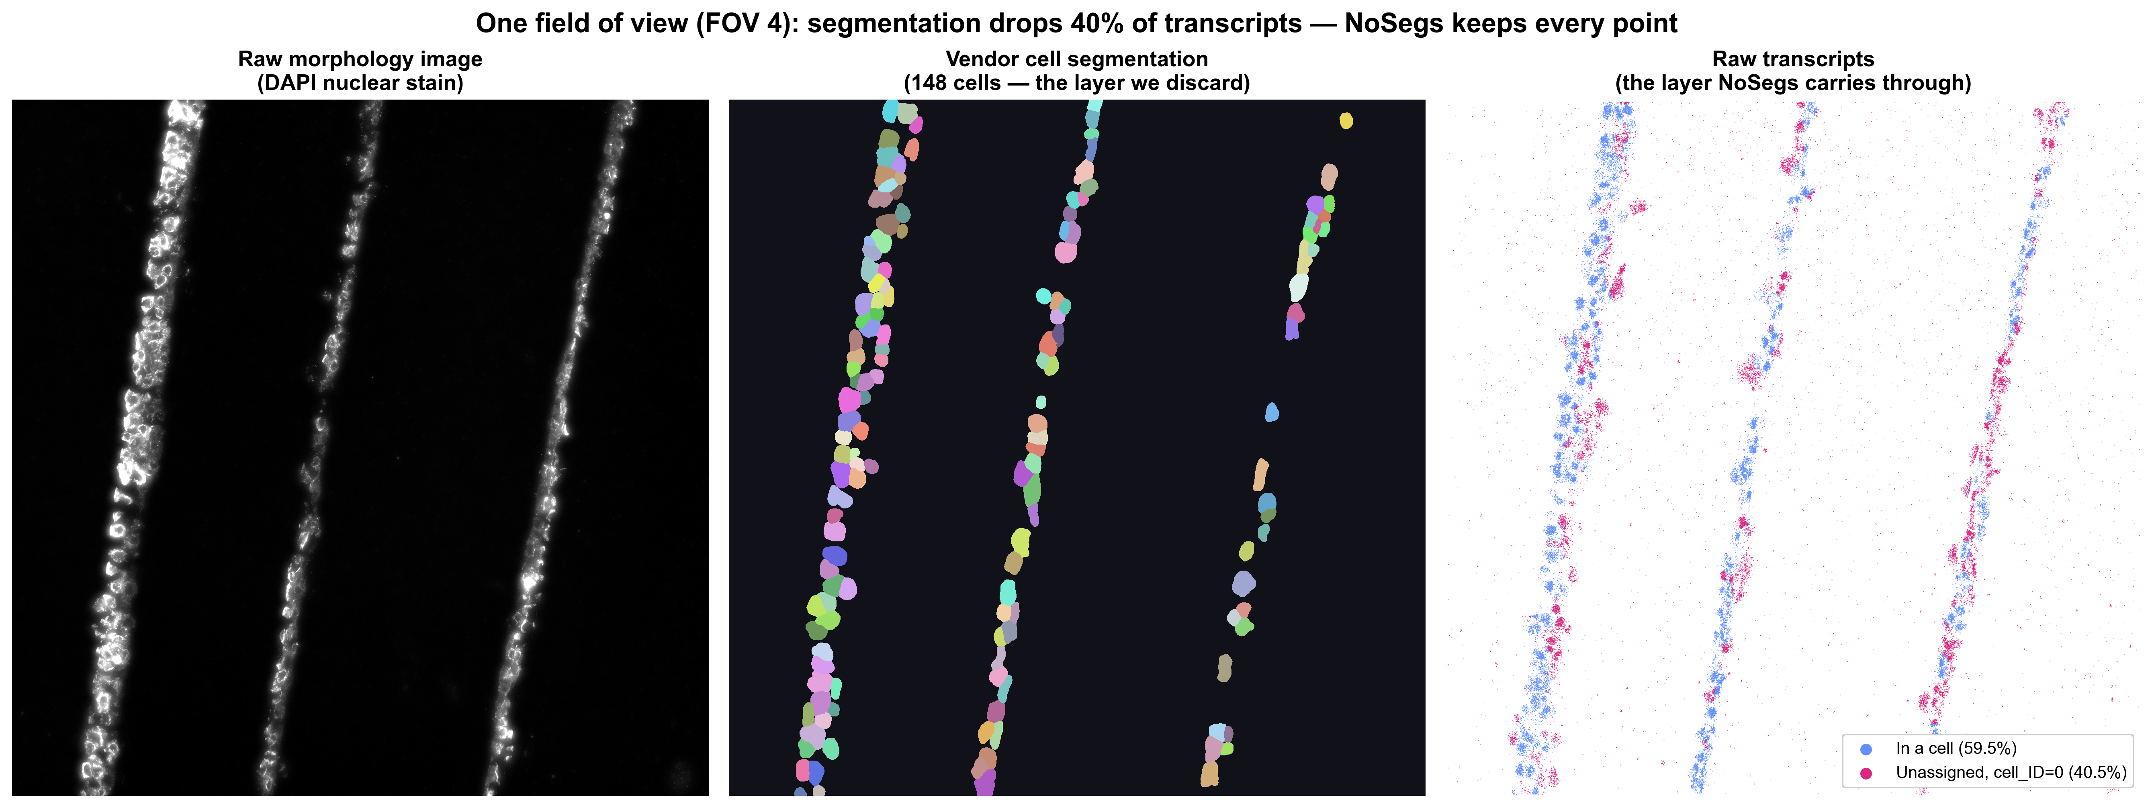
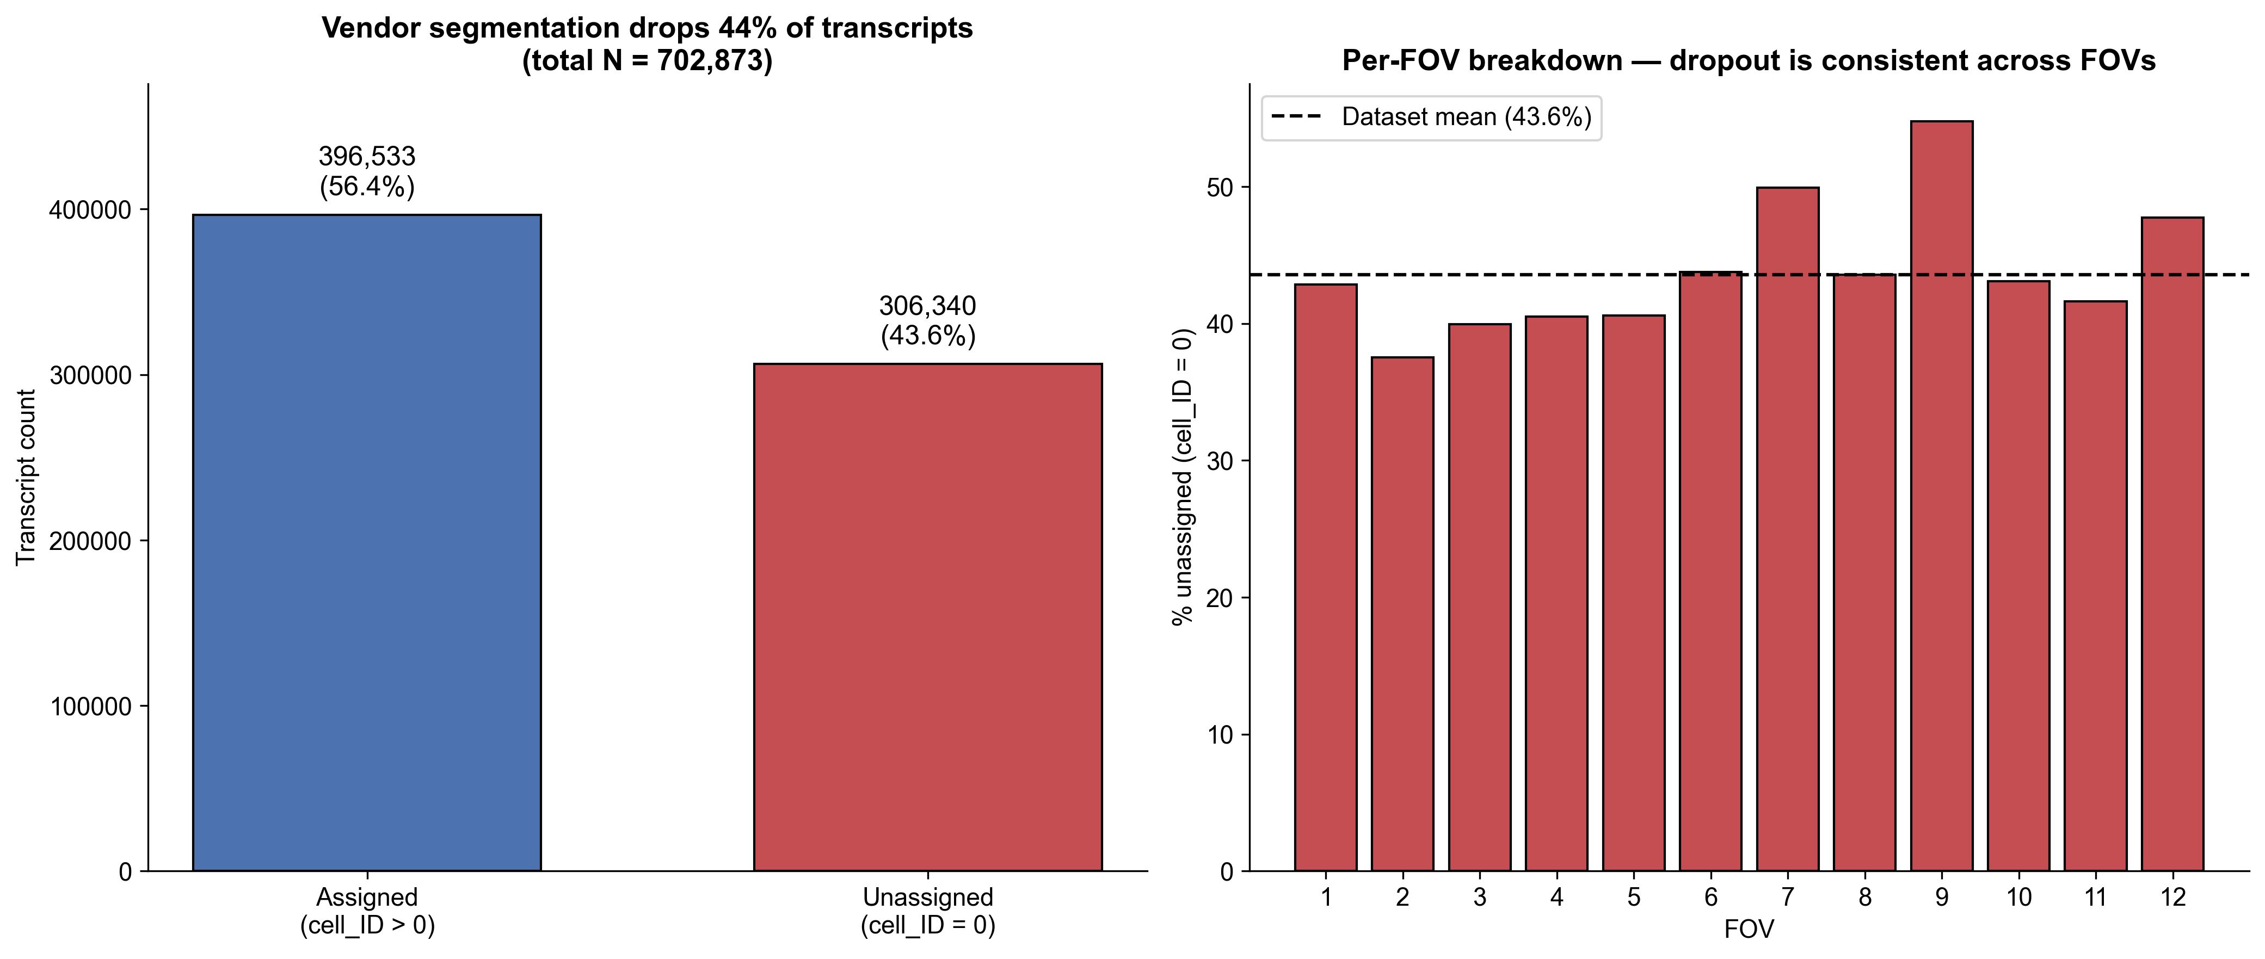
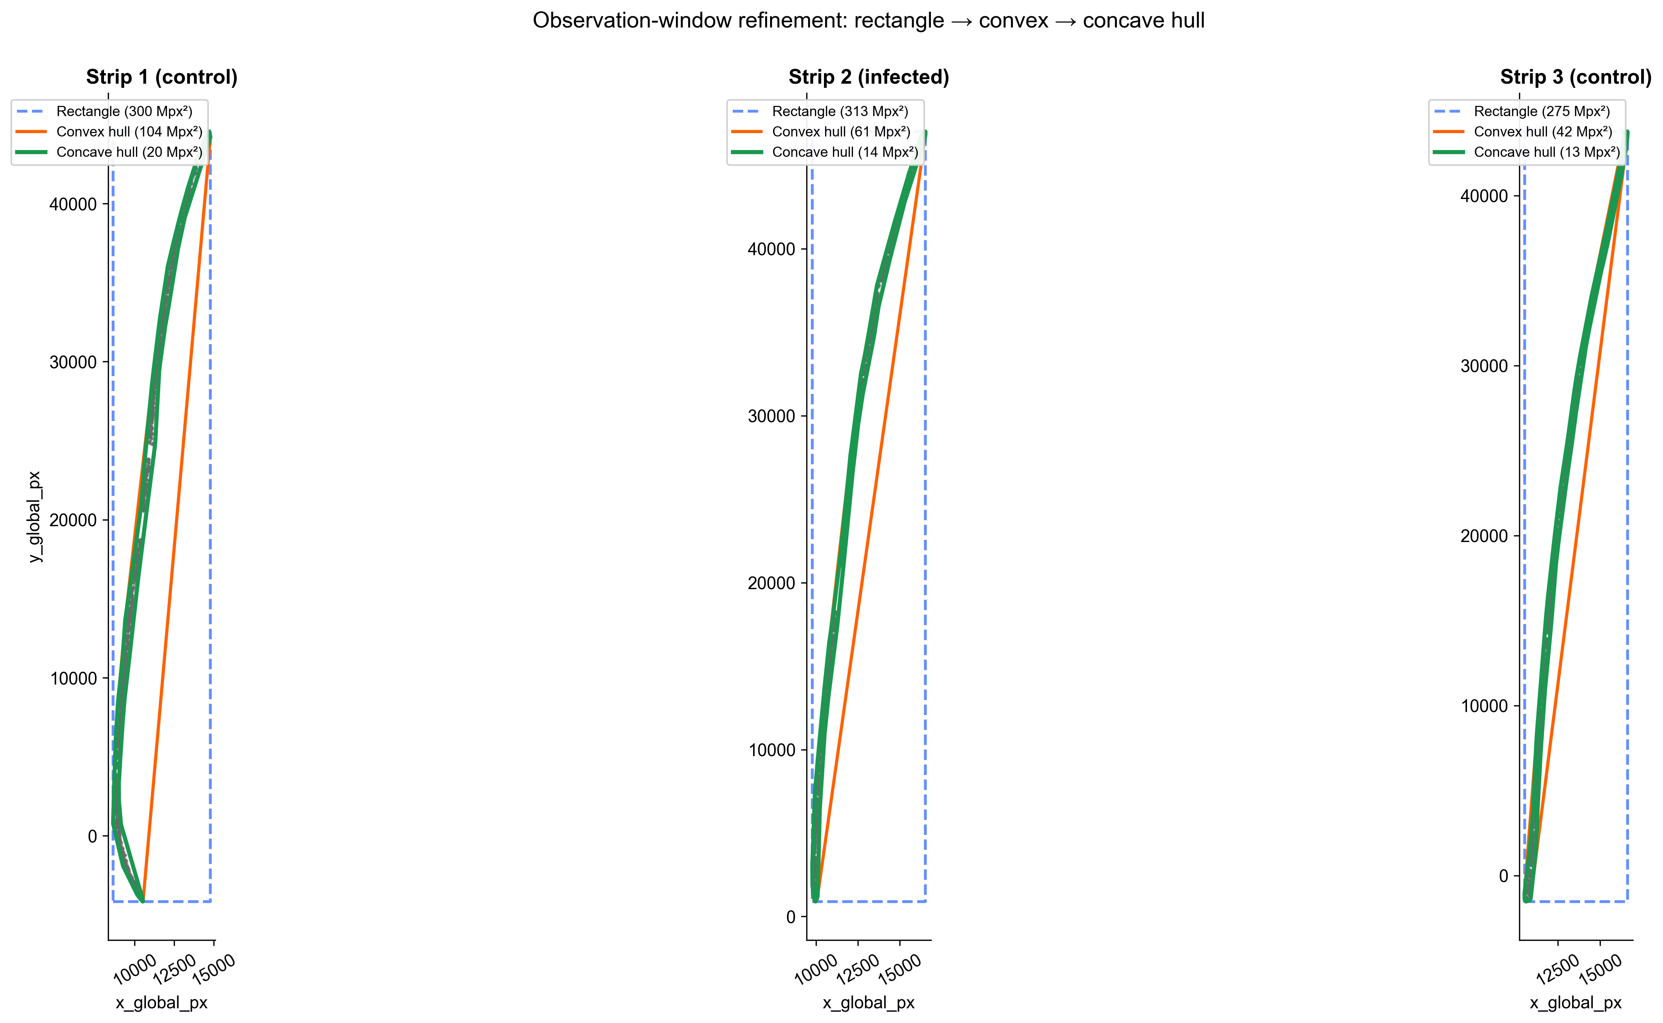
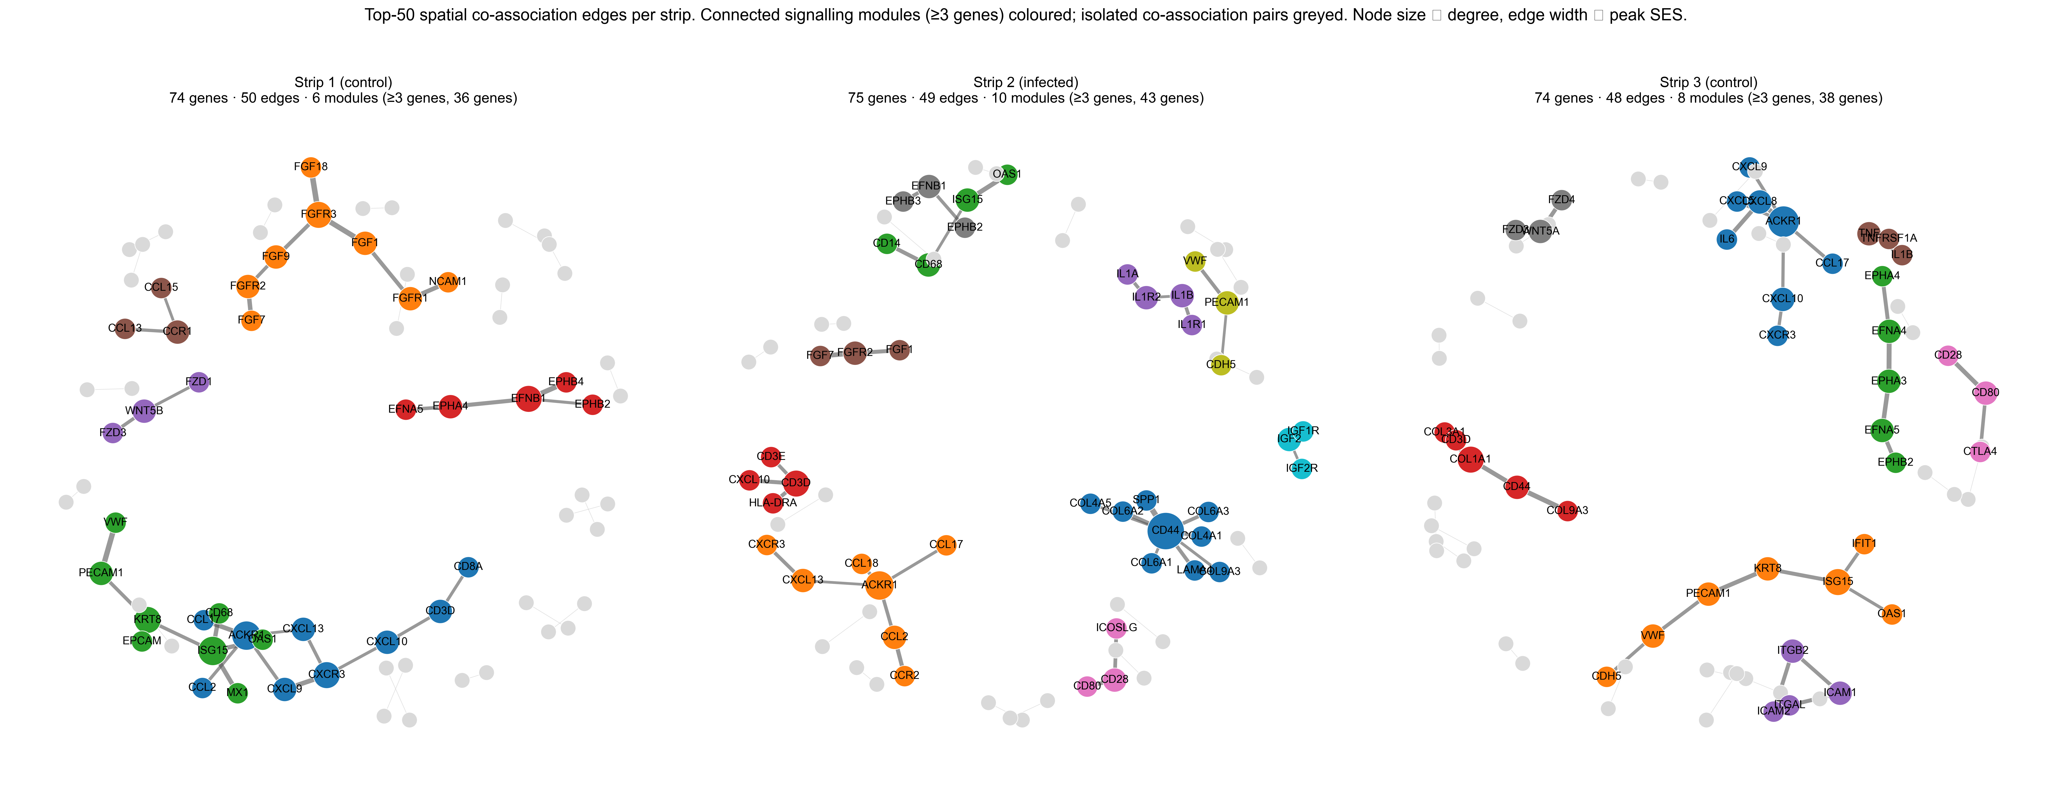
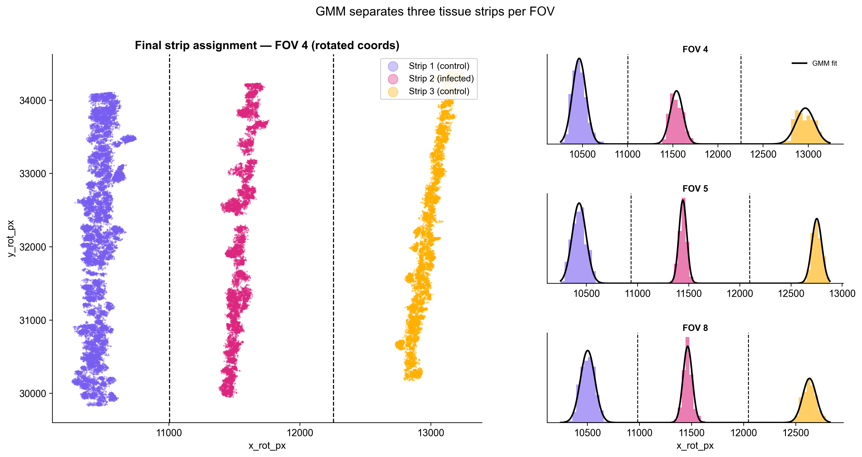
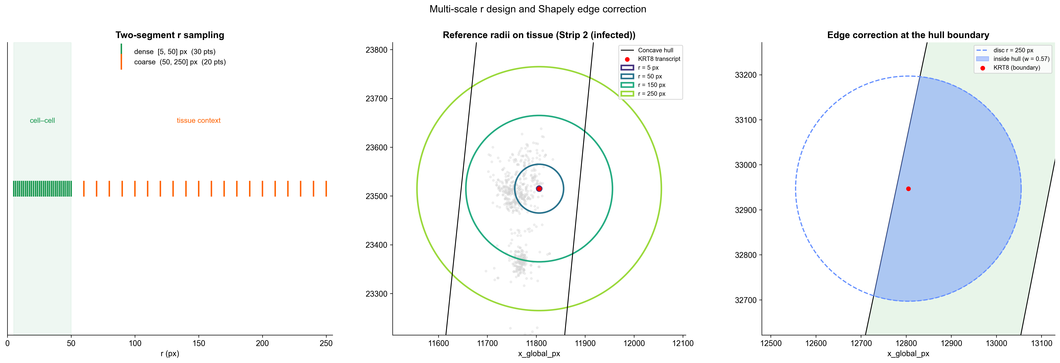
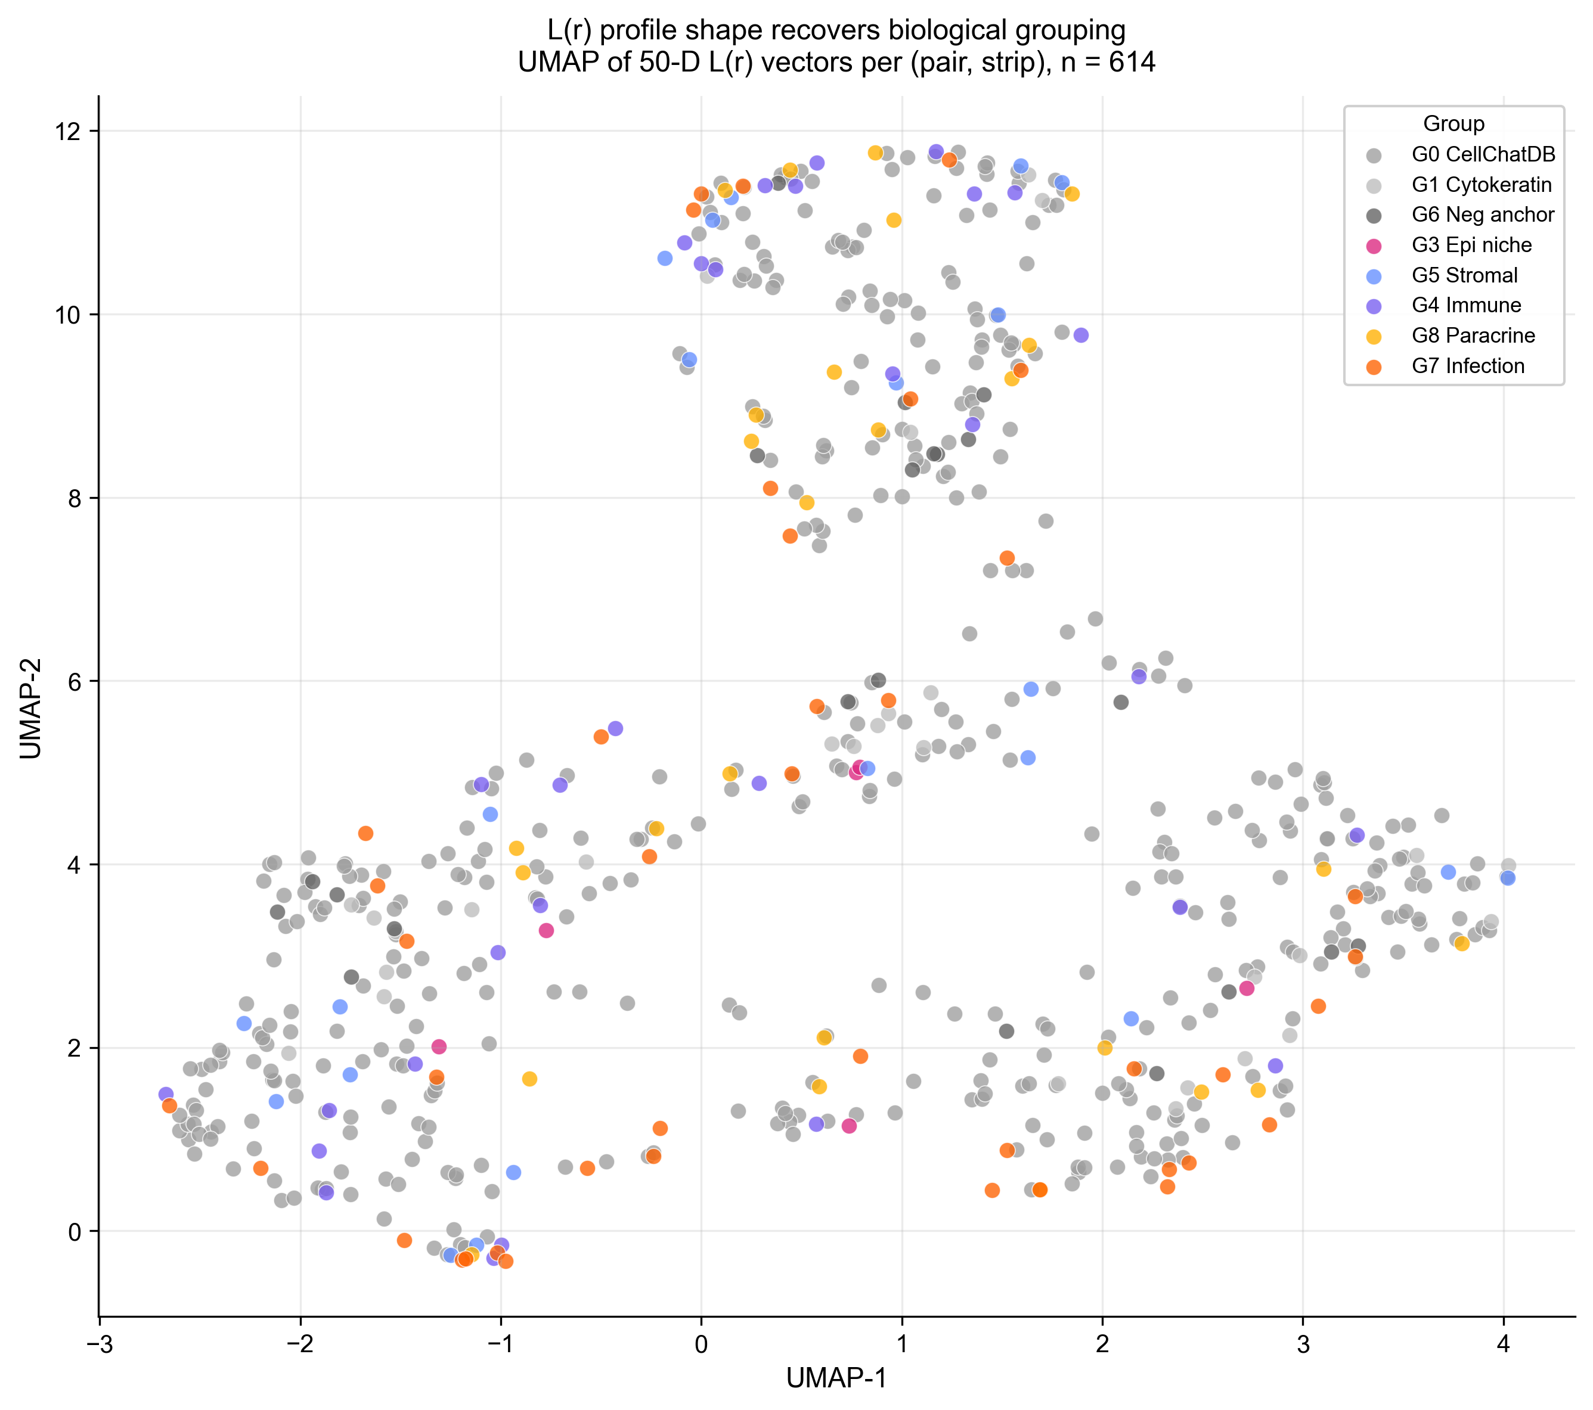
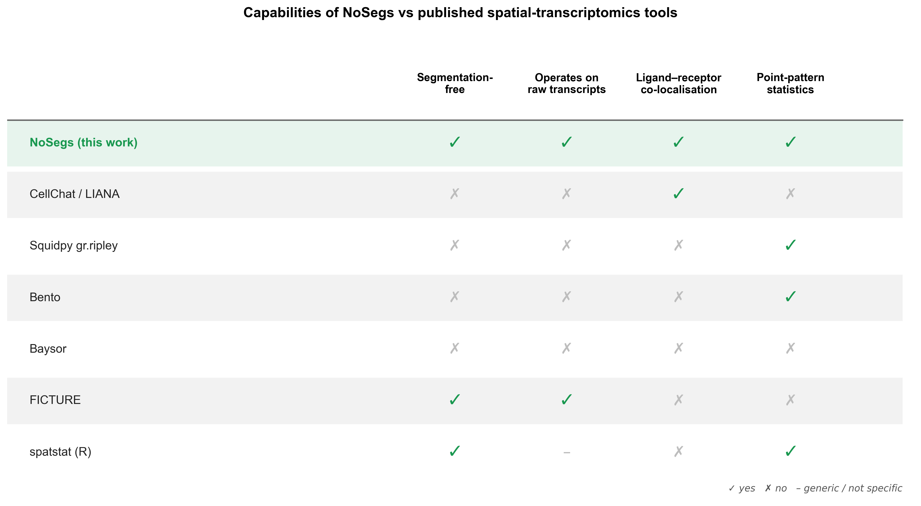
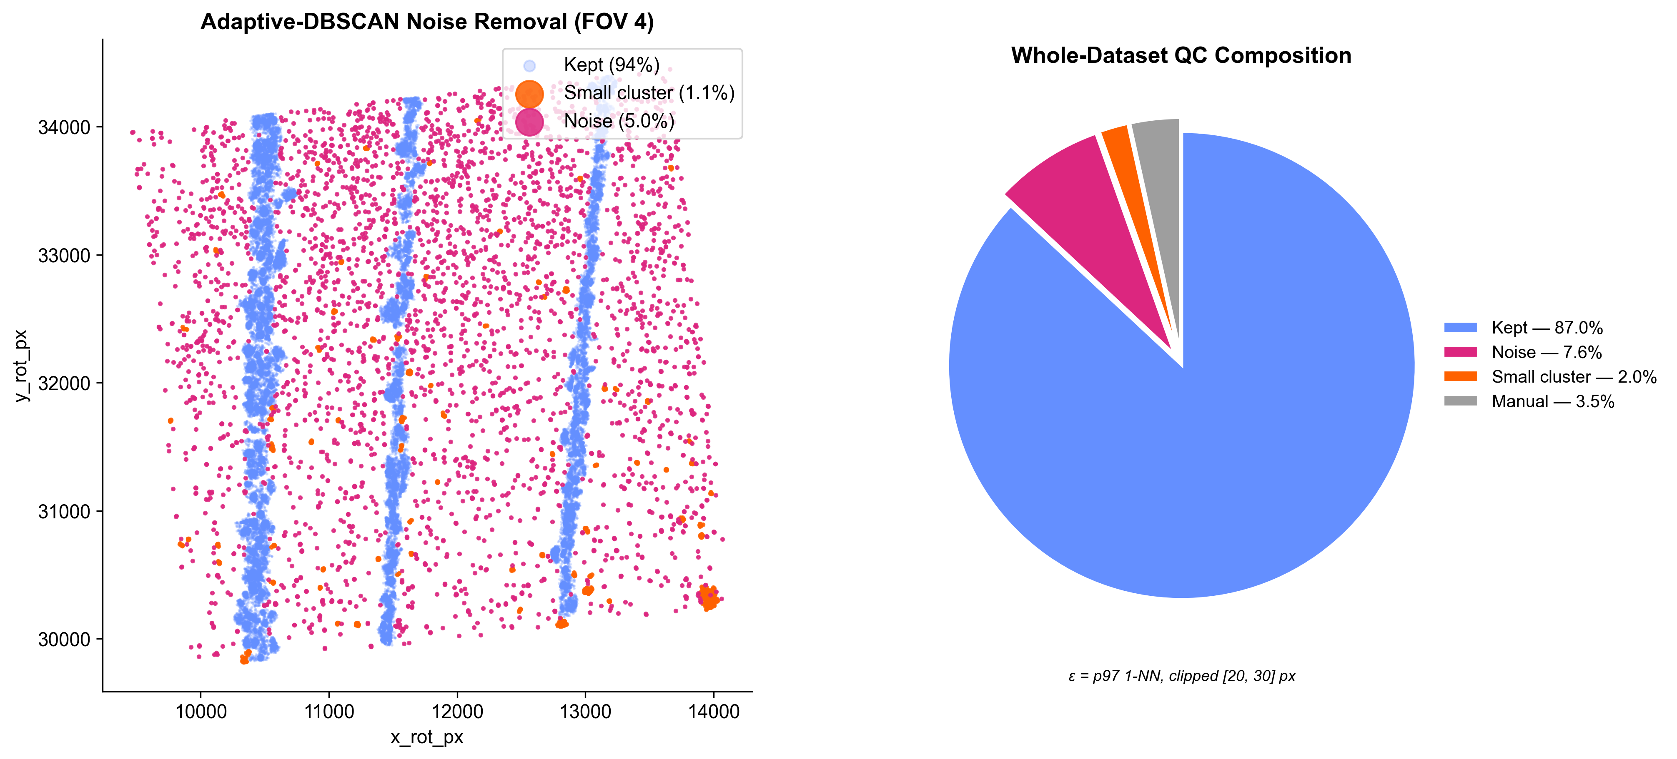
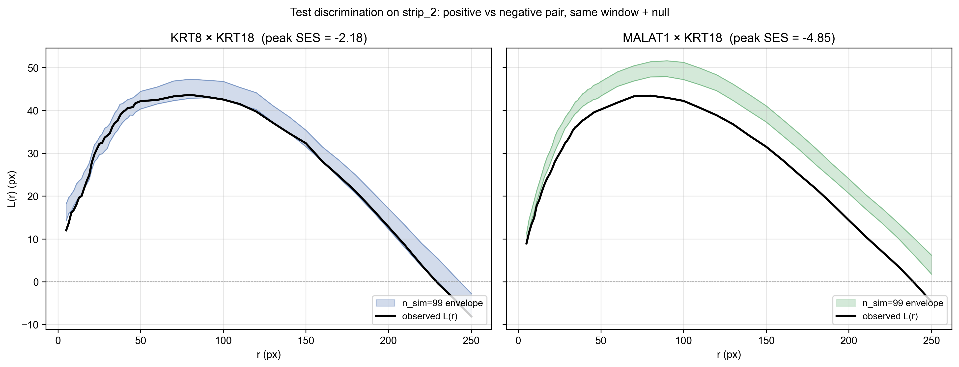
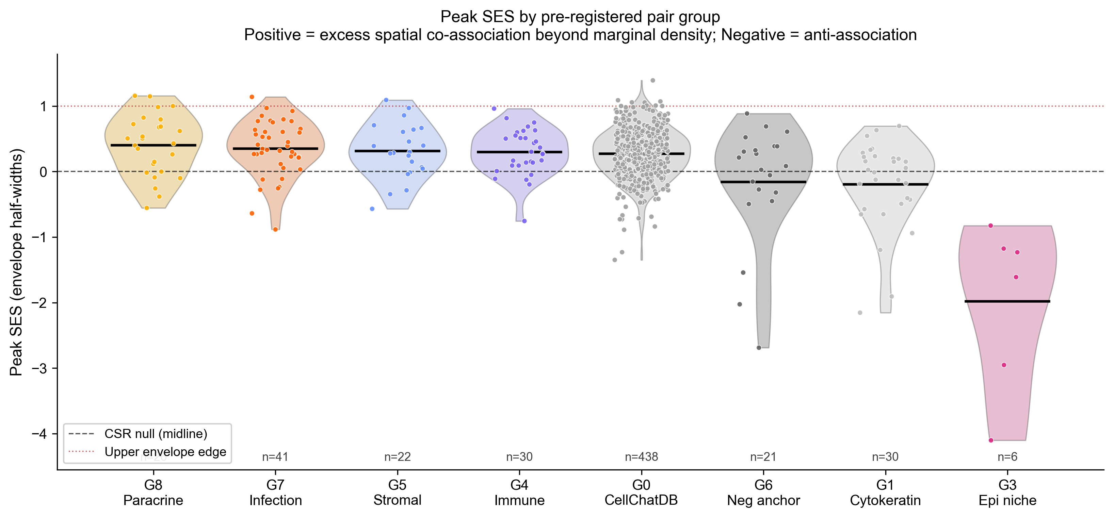

NoSegs: Segmentation-Free Ligand–Receptor Co-Localisation in Spatial Transcriptomics
Bivariate point-pattern statistics on raw transcripts — no cells, no clusters, no segmentation.
Harry Woodward · Supervisor: Dr Dan Nicolau, Nicolau Lab · MSc Bioinformatics, King's College London · 2026
Platform: NanoString CosMx SMI · Tissue: severe asthmatic, RSV-infected human lung · ~2.66 M transcripts · 1,000-gene panel
Introduction
Methods — The NoSegs Pipeline
Results — Infection Biology
Spatial transcriptomics maps gene expression at single-molecule resolution in intact tissue (He 2022). Almost every downstream analysis — cell-type calling, ligand–receptor inference, niche detection — requires a fragile first step: assigning each transcript to a cell.
On the CosMx sample analysed here, vendor segmentation leaves 43.6% of transcripts unassigned and most subcellular labels missing — segmentation quality is a known, platform-wide weakness (Petukhov 2022; Marco Salas 2025). Third-party tools (Cellpose, MOSAIK) cannot recover the signal from poor DAPI staining, so segmentation-dependent tools (CellChat, LIANA, Bento) become unusable (Jin 2021).
NoSegs takes a different route: treat each gene as a 2D point pattern in tissue space, and use bivariate Ripley's K-functions with label-permutation envelopes to detect ligand–receptor co-localisation directly. No cells. No clusters. Just transcripts.
The tissue is severe asthmatic lung during RSV infection — a clinically important setting where the spatial organisation of antiviral and immune signalling matters most, yet exactly where segmentation is least reliable.
INPUT — raw transcripts (x, y, gene, FOV)
5/6
immune pairs positive on the infected strip
Immune cell-communication pairs preferentially co-localise on infected tissue — recovered with no segmentation step.
Controls separate by +2.67 envelope half-widths.
1 PCA align + per-FOV GMM strips
3-component GMM
Antigen presentation, T-cell recruitment and antiviral monocyte signalling all preferentially co-localise on the infected strip — the textbook adaptive immune response to RSV (Openshaw 2017; Russell 2017), recovered here with no segmentation step.
2 DBSCAN noise removal
adaptive ε = p97 1-NN, [20, 30] px
3 Observation window
rectangle / convex / concave hull
Infection signalling boost
4 Bivariate Ripley K → L(r)
multi-scale r-grid (cell + tissue)
5 Label-swap permutation envelope
n_sim = 99 / 199 + edge correction
The Problem — Segmentation Fails
6 Effect-size (SES) ranking
binary test or continuous SES
OUTPUTS — networks · UMAP · heatmaps
Quick start — use NoSegs when…
✓
segmentation fails or is unavailable on your sample
✓
you want ligand–receptor co-localisation straight from transcripts
✓
imaging platforms (CosMx, MERFISH, Xenium); ≥ ~50 transcripts / gene / ROI
Fig M6. The end-to-end workflow and a quick-start guide. Eight native, editable stages from raw transcripts to signalling networks; teal marks the statistical core, and amber chips mark the tunable option at each step.
Fig M0. One field of view, three layers. Left: raw DAPI morphology. Middle: the vendor cell-segmentation mask (148 cells) — the layer NoSegs discards. Right: the raw transcripts, with ~40% never assigned to any cell (magenta). NoSegs carries every point through.
Significance → effect size. Under the production concave-hull window even the positive control sits within the permutation envelope — the window is the dominant lever for inferential power. We rank pairs by continuous standardised effect size (SES), the continuous form of the global rank envelope test (Myllymäki 2017), not binary significance.
Fig F. Per-pair Strip-2 boost for the surviving infection-response (G7) pairs. Immune cell-communication pairs are positive (5/6): antigen presentation onto T cells (HLA-DRA×CD3D, +0.74; Roche & Furuta 2015), chemokine-driven T-cell recruitment (CXCL10×CD3D, +0.59; Groom & Luster 2011), and macrophage antigen presentation (HLA-DRA×CD68, +0.32) — the expected adaptive response to RSV (Openshaw 2017). A paradoxical second finding only a segmentation-free method can surface: antiviral interferon-stimulated genes paired with epithelium (ISG15×KRT8, MX1×KRT5; Schoggins 2011) move off infected tissue, consistent with epithelial loss redistributing antiviral activity into immune cells.
Observation window
Co-localisation networks
Fig M1. Across all FOVs, vendor segmentation never assigns 43.6% of transcripts to a cell, so every cell-level tool silently discards them — consistently across the whole dataset.
Fig M4. The observation window is the dominant lever for inferential power. A concave hull tracks the true tissue extent, shrinking the area ~20× vs the bounding box and tightening the permutation null.
From Transcripts to Point Patterns
Multi-scale r-grid & edge correction
Fig G. Top-50 spatial co-association edges per strip with Louvain community detection. Communities are spatial signalling modules — interferon response, chemokine signalling, stromal ECM — recovered without any cell segmentation. Strip 2 (infected) carries more and larger modules than the controls.
Spatial signatures (UMAP)
Fig M5. A deliberate multi-scale r-grid resolves both cell-scale and tissue-scale co-association; Shapely edge correction down-weights discs that spill outside the tissue window, following standard second-order point-pattern theory (Ripley 1976; Diggle 2003; Baddeley 2015).
Fig M2. After PCA aligns the tissue axis, a per-FOV 3-component Gaussian mixture separates the three tissue strips; boundaries are set per FOV, with manual overrides where the mixture is ambiguous.
Where NoSegs Sits
Adaptive noise removal
Fig H. Each (pair, strip) treated as a 50-dim L(r) curve-shape vector, embedded with UMAP. Stromal, immune and infection-response pairs occupy distinct regions — the method recovers biological grouping as soft visual structure from raw transcripts alone.
Fig T. No published tool screens L–R co-localisation on raw transcripts without segmentation. CellChat/LIANA (Jin 2021), Squidpy (Palla 2022), Bento (Mah 2024) and Baysor (Petukhov 2022) require segmentation or cell-typing; FICTURE (Si 2024) is segmentation-free but answers a different question (tissue domains); spatstat is a generic point-pattern library. NoSegs satisfies all four capabilities.
Fig M3. DBSCAN with an adaptively-set ε (97th-percentile 1-NN, clipped 20–30 px) flags diffuse background and stray clusters; 87% of transcripts survive QC.
Validation & Controls
Fig B. Both the positive control (KRT8×KRT18) and the housekeeping×specific negative (MALAT1×KRT18) fall inside the label-swap envelope on the infected strip, yet their effect sizes separate by 2.67 envelope half-widths. We therefore rank by continuous peak SES, not binary pass/fail.
Conclusions & Next Steps
Control | Pair | Expected | Observed
Positive | KRT8 × KRT18 | Above null | SES = −2.18 (top)
Negative | MALAT1 × KRT18 | Far below | SES = −4.85
Bivariate Ripley's K on raw transcript point clouds detects L–R co-localisation with no cell segmentation step.
Discriminates positive from negative controls by effect size (separation = +2.67 envelope half-widths under the production window).
Fills a vacant niche: Bento, Squidpy, CellChat, LIANA all require segmentation — NoSegs does not.
Next: extended cytokeratin/housekeeping anchor panel; marker-gene pseudo-segmentation for cell-type stratification; benchmark vs Squidpy gr.ripley on cell-level reductions.
Key References
Acknowledgements
1. Ripley BD (1976) J. Appl. Prob. 13:255–266 — the K-function.
2. Diggle PJ (2003) Statistical Analysis of Spatial Point Patterns, 2nd ed. Arnold.
3. Baddeley A, Rubak E, Turner R (2015) Spatial Point Patterns. CRC Press.
4. Myllymäki M et al. (2017) J. R. Stat. Soc. B 79:381–404 — rank envelope test.
5. He S et al. (2022) Nat. Biotechnol. 40:1794–1806 — CosMx SMI platform.
6. Petukhov V et al. (2022) Nat. Biotechnol. 40:345–354 — Baysor segmentation.
7. Si Y et al. (2024) Nat. Methods 21:1843–1854 — FICTURE (segmentation-free).
8. Marco Salas S et al. (2025) Nat. Methods 22:813–823 — Xenium QA/segmentation.
9. Palla G et al. (2022) Nat. Methods 19:171–178 — Squidpy.
10. Mah CK et al. (2024) Genome Biol. 25:82 — Bento.
11. Jin S et al. (2021) Nat. Commun. 12:1088 — CellChat / CellChatDB.
12. Openshaw PJM et al. (2017) Annu. Rev. Immunol. 35:501–532 — RSV immunity.
13. Russell CD et al. (2017) Clin. Microbiol. Rev. 30:481–502 — human RSV response.
14. Schoggins JW et al. (2011) Nature 472:481–485 — ISG antiviral effectors.
15. Roche PA, Furuta K (2015) Nat. Rev. Immunol. 15:203–216 — MHC class II.
16. Groom JR, Luster AD (2011) Immunol. Cell Biol. 89:207–215 — CXCR3 ligands.
Dataset and HPC compute courtesy of King's College London (CREATE HPC, msc_appbio partition). We thank the Nicolau Lab and clinical collaborators for access to the RSV-infected lung tissue. CellChatDB via Jin et al. 2021. Project supervised by Dr Dan Nicolau, Nicolau Lab.
Fig C. Method is correctly null for diffuse markers (cytokeratins, housekeeping anchors) and elevated for focal pairs (paracrine, infection, stromal, immune). Bivariate K under this null detects excess spatial co-association beyond marginal density.
github.com/harrydaw/cosmx-pointpattern · harrywoodward99@gmail.com · MSc Bioinformatics — King's College London — 2026

