Slide 1

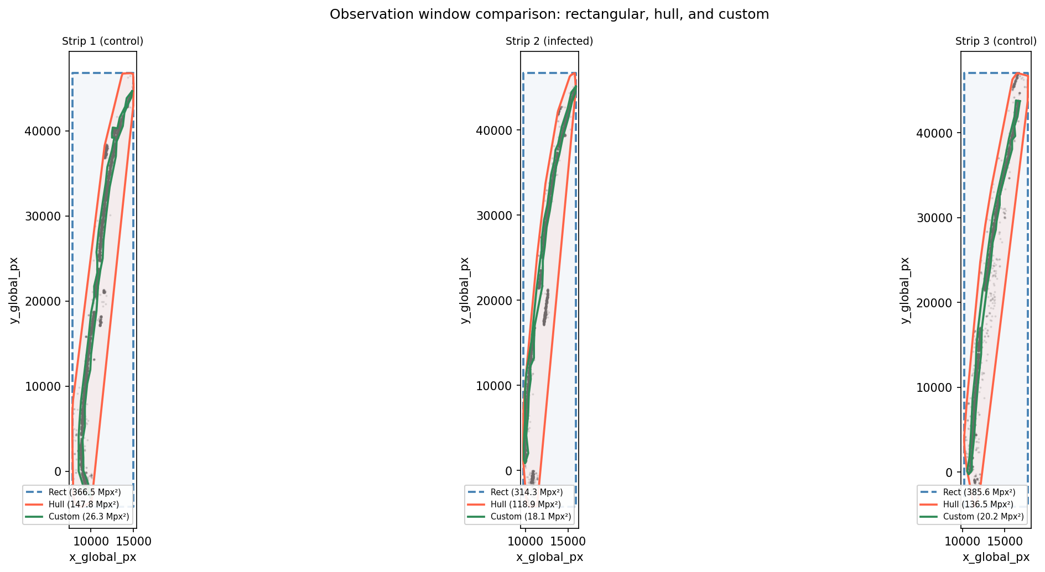
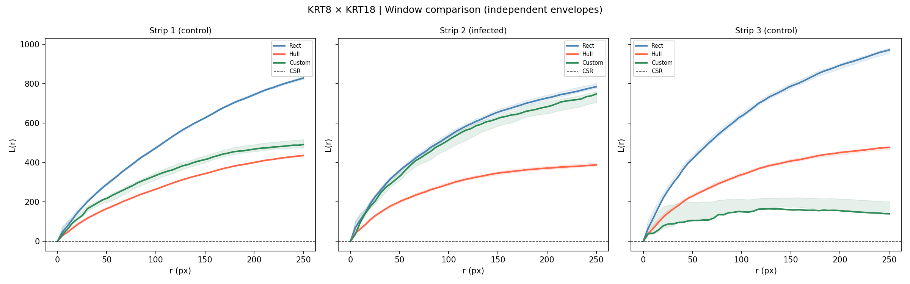
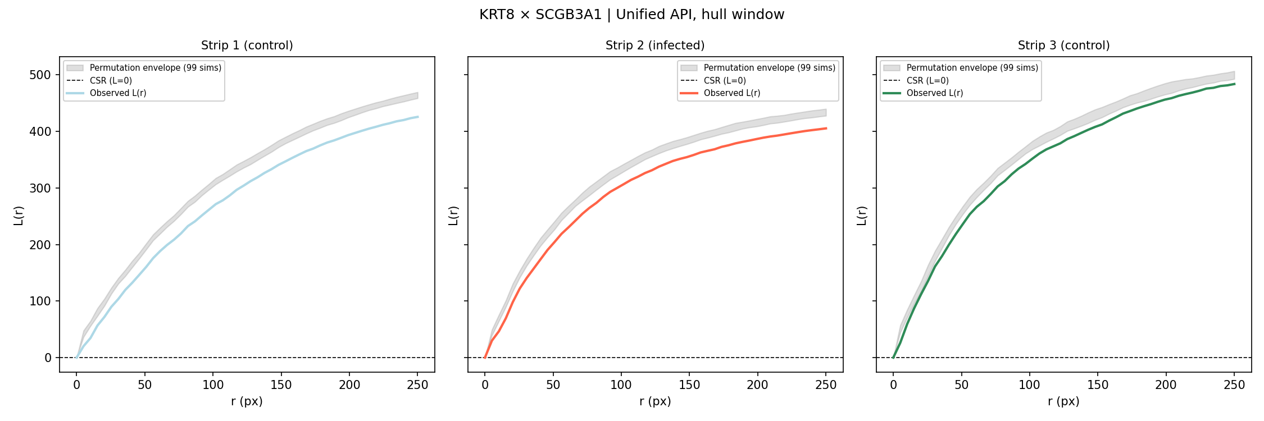

NoSegs: Segmentation-Free Spatial Co-Expression Analysis of Spatial Transcriptomic Data
Harry Woodward | Supervisor: Dr Dan Nicolau | Nicolau Lab | MSc Bioinformatics, King's College London | 2026
Platform: NanoString CosMx SMI | Tissue: Severe asthmatic RSV-infected human lung | ~2.66M transcripts | 1,000-gene panel
Introduction
Methods — Analysis Pipeline
Results
• Spatial transcriptomics maps gene expression in tissue, but standard workflows require cell segmentation - a major bottleneck prone to failure on poor-quality imaging data. • NanoString CosMx SMI data from RSV-infected human lung: ~42% of transcripts unassigned to cells after native segmentation. Tools (Cellpose, MOSAIK) insufficient due to poor DAPI staining. • NoSegs treats transcripts directly as a spatial point process and asks: do genes A and B co-localise in space, beyond what tissue structure alone would predict? • Uses bivariate Ripley's K / L functions with permutation envelopes - the framework of spatial ecology and epidemiology, applied to transcriptomics at panel scale.
1. Load & QC Raw Data
A
CosMx zarr → extract transcripts → characterise FOVs
2. Strip Assignment
[ Figure: Window Overlay ] 09c_window_overlay.png Rect · Hull · Custom polygon overlaid on transcript scatter
Per-FOV 3-component GMM on x-coordinate → strip_1 (ctrl) | strip_2 (infected) | strip_3 (ctrl)
3. DBSCAN Noise Filtering
Fig A. Three observation window types over S1 transcript scatter. Convex hull (purple) captures tissue geometry; concave hull (orange) improves but is still dominated but white space, bounding box (grey) wastes >60% of area on empty slide.
Adaptive eps (1-NN p97, clipped 20–30 px) 6.8% of transcripts removed as optical noise
B
4. Observation Window
Convex hull of transcript cloud (default) 40% of rect area | matches tissue boundary
[ Figure: Positive Control ] 09c_KRT8_KRT18_window_comparison.png L(r) vs permutation envelope KRT8 × KRT18 across 3 strips
5. Bivariate Ripley's K / L Function
K_{AB}(r): expected co-occurrences within radius r L(r) = √(K/π) − r | ~ zero under CSR
Dataset
6. Permutation Envelope
Fig B. KRT8 × KRT18 positive control. L(r) exceeds the permutation envelope at r < 50 px (cell scale, ~9 µm) across all three tissue strips, confirming robust co-localisation detection.
Property
Value
199 label-swap simulations | pointwise min/max bands Tests gene-specificity vs tissue-structure confound
C
Platform
CosMx SMI (NanoString)
Tissue
RSV-infected human lung
Transcripts
~710,751 (Slide S1)
[ Figure: Negative Control ] 09a_KRT8_SCGB3A1_hull.png L(r) within permutation envelope KRT8 × SCGB3A1 across 3 strips
Gene panel
1,000 targets + controls
7. Panel-Wide L-R Screening
L-R pairs
146 via CellChatDB
Validation Controls
146 CellChatDB pairs × 3 strips via HPC SLURM Significant: L(r) > envelope for ≥3 consecutive r
Positive: KRT8 × KRT18 (co-expressed epithelial keratins) L(r) above envelope at r < 50 px across all 3 strips Negative: KRT8 × SCGB3A1 (different epithelial lineages) L(r) within permutation envelope
8. Network Construction
Fig C. KRT8 × SCGB3A1 architectural negative. L(r) remains within the envelope across all strips, confirming specificity — different epithelial lineages are not detected as co-localising.
NetworkX graph per strip | edges = significant pairs weight = peak L(r) | modularity community detection
D
Edge correction: fraction_inside_hull - Shapely intersection of search disc with convex hull polygon. Systematic negative bias in absolute K(r) cancels in the permutation test; only position relative to the envelope is interpreted.
[ IN PROGRESS ] L-R Co-localisation Network Strip 2 (infected) vs Strips 1 & 3 (control) Modularity community detection
Fig D. Co-localisation network per tissue strip. Nodes = genes; edges = significant L-R pairs weighted by peak L(r). Community structure identifies infection-specific signalling programmes.
Conclusions & Next Steps [WIP]
Key References
Acknowledgements
• NoSeggs successfully detects transcript-level co-localisation without cell segmentation - validated across positive and negative controls in all three tissue strips. • Convex hull observation windows with Shapely-based edge correction reduce artefactual intensity inflation from empty slide space. • HPC screening of 146 CellChatDB L-R pairs is complete - network construction and figure generation in progress. • Next: network community structure, infected vs control differential edges, external dataset validation, and packaging as a reusable Python tool (src/nosegs/).
XXXXXXXXXXXXXXXXXXX
XXXXXXXXXXXXXXXXXXX
Dataset: King's College London. L-R annotations: CellChatDB (Jin et al. 2021), accessed via LIANA (Dimitrov et al. 2022). HPC: KCL CREATE cluster.
github.com/harrydaw/cosmx-pointpattern | harrywoodward99@gmail.com | MSc Bioinformatics, King's College London, 2026

