Slide 1

NoSegs
Segmentation-Free Point Pattern Statistics
for CosMx Spatial Transcriptomics Data
Harry | MSc Bioinformatics | King's College London

Slide 2
Overview
Ripley’s K Function
K(r) = λ_{B}⁻¹ Σ I (d_{AB} < r)
Where:
I = Indicator function (True [1] / False [0]) r = Search radius
λ_{B} = Overall density of B points
d = Euclidian Distance from point A to B

Slide 3
Overview
Under CSR:
K(r) = πr²
L Function (stabilised K)
L(r) = √(K(r)/π) – r
L(r) = 0

Slide 4

Notebook Overview
01
Data Loading & Inspection
05
Negative Control (MALAT1 x KRT18)
02
Closer Inspection
06
Ligand-Receptor Pairs
03
Core Stats Functions
07
Multi-FOV Pipeline
04
First positive control (KRT8 x KRT18)
08
Network & Module Discovery

Slide 5

01
Data Loading & Inspection

Slide 6

01 — Data Loading & Inspection
Method
1. Load the Varsha_1234.zarr spatial object
2. Inspect the general structure, number of transcripts and FOVs etc.
3. Broadly understand the data I am working with
- Global vs. local coordinates
- Gene abundancies
4. FOV of interest selection

Slide 7
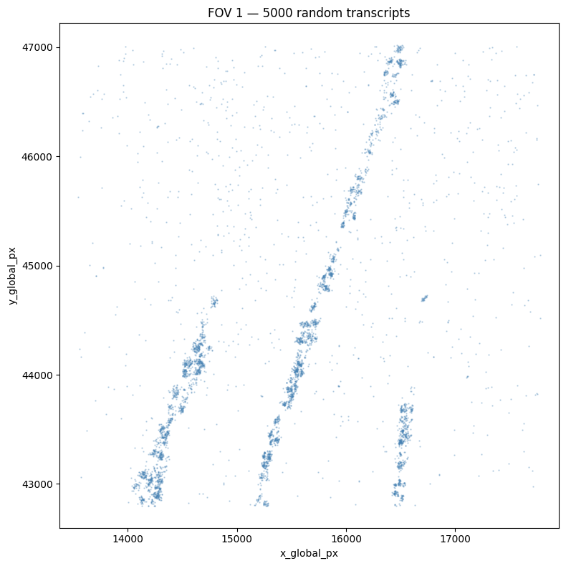
01 — Data Loading & Inspection
Findings
2.7 million transcripts total
63 (of 67 initial) FOVs
4 slides:
S1 is the densest and clusters
Very poor native cell type mapping

Slide 8
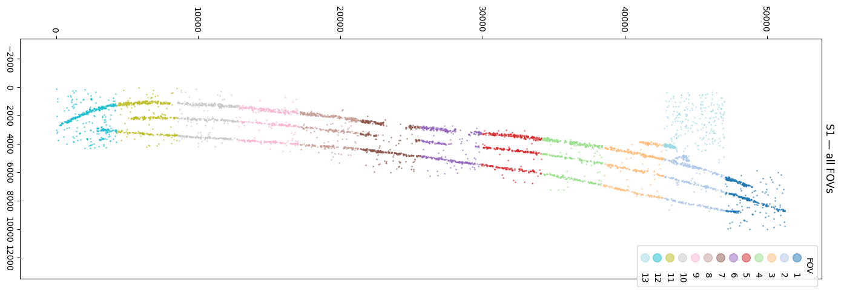
01 — Data Loading & Inspection

Slide 9
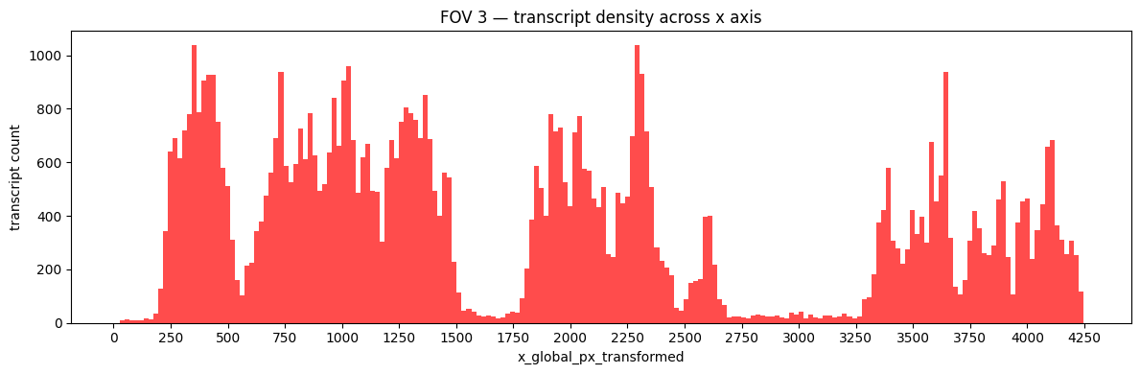
01 — Data Loading & Inspection

Slide 10
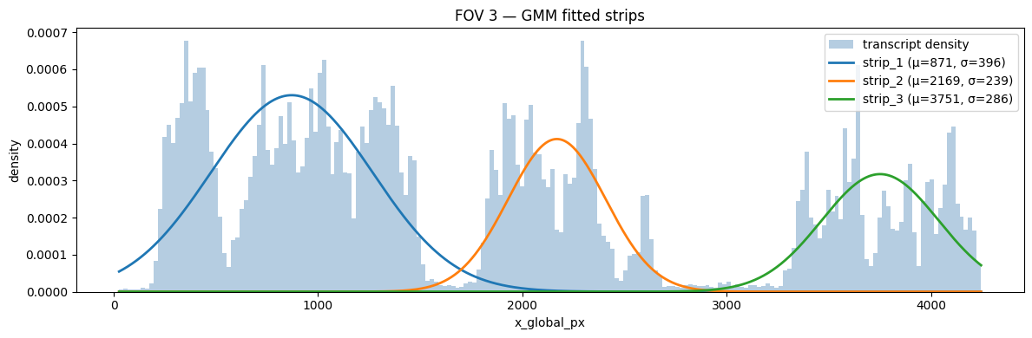
01 — Data Loading & Inspection

Slide 11
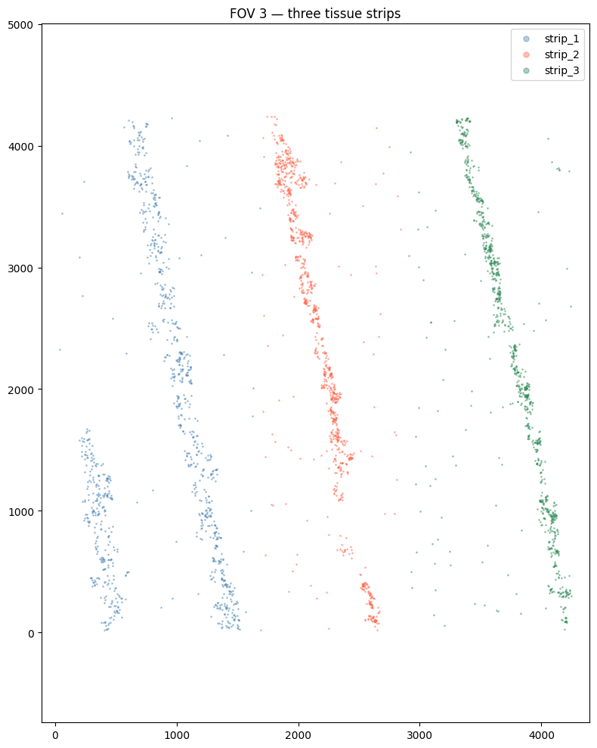
01 — Data Loading & Inspection
Strip-assigned column-oriented data saved for subsequent analysis
Moving forward with FO3 / S1
Most transcripts, good strip assignment
working_fov.to_parquet(
"../data/processed/fov3_strips.parquet“
)

Slide 12

02
Closer Inspection

Slide 13

02 — Closer Insepction
Method
1. Load the fov3_strip.parquet
2. Per strip gene sparsity check
(Need N > 50 for reliable ripley K function)
3. Pick a positive control and scatter plot

Slide 14
02 — Closer Insepction
~72,000 Transcripts
15 columns
(13 + 2 transformed coords)
1206 genes
(1000 gene panel + “SystemControl00”s)

Slide 15
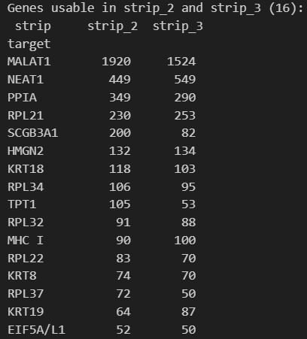
02 — Closer Insepction
Strip 2 vs. strip 3 comparison
(Infected vs. control)
Primarily housekeeping genes
Positive control candidates are KRT18, KRT8 and KRT19
(Epithelial keratins)

Slide 16
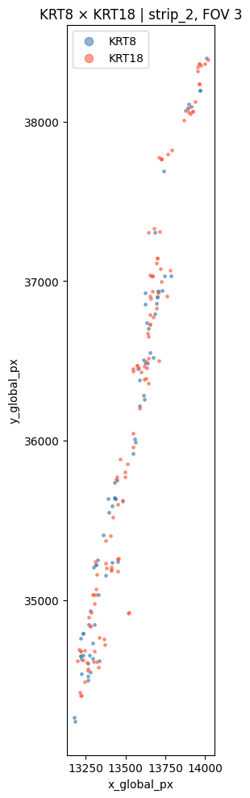
02 — Closer Insepction
Clear co-localisation
Elongated nature of the viewing window potentially confounding

Slide 17

03
Core stats functions

Slide 18
03 — Core stats functions
Method
1. Implement get_coords() and get_window()
2. Implement K and L functions including parameters for:
Point patterns A and B
Window area (|W|)
W_{ij} (an edge correction weight)
3. Implement compute_envelope() and plot diagnostics()

Slide 19
03 — Core stats functions
get_coords()
Takes an input dataframe, search gene, x_column and y_column
Defaults to using (“x_global_px” and “y_global_px”)
Returns the coordinates of that gene as a 2D array

Slide 20
03 — Core stats functions
get_window()
Takes an input dataframe, X coordinates and Y coordinates
Returns a minimum (rectangular) bounding box for all transcripts in a tissue

Slide 21
03 — Core stats functions
bivariate_k()
Takes A and B point coordiantes, r_vals, and window()
Runs bivariate (cross-type) Ripley’s K-function K_{AB}(r)
Includes edge correction weighting
Multiply by reciprocal fraction of circle inside of the window

Slide 22
03 — Core stats functions
k_to_l()
Takes bivariate_k() output and r_vals array
Returns the variance stabilised L-function:
(K(r) / π) - r

Slide 23
03 — Core stats functions
compute_envelope()
Takes A and B coords, r values, window, number of simulations (defaults to 99) and a random seed
Performs Monte Carlo permutation to produce an envelope for the bivariate L-function
Result is similar to an L value for likelihood of random occurrence of the observed co-localisation
Specifically tests whether gene label contributes to the co-localisation

Slide 24
03 — Core stats functions
plot_diagnostics()
Takes all of the previous inputs and plot the bounding box and gene transcripts
Allows the user to visually check the window allocation
Also shows the spread of gene transcripts for confirmation and hypothesis development
Will be more useful when the bounding window function is expanded
Designed to be an optional call within the final function

Slide 25
03 — Core stats functions
Bonus: synthetic_csr_test()
Generates two independent, random, uniform patterns and runs my functions on them
L(r) values should be ~0 if these are working correctly
It runs on both a square and rectangular bounding window
Will need more testing when get_window() is expanded

Slide 26
03 — Core stats functions
Double bonus: run_pair_analysis()
Just a function that allows me to call all the stats functions in sequence, providing just the dataframe, genes A and B, and r values
This is the function that also allows me to call the diagnostics plots if they are needed

Slide 27

04
First positive control
(KRT8 x KRT18)

Slide 28

04 — First Positive Control
Method
1. The key point here is that KRT8 and KRT18 are both epithelial keratins that are obligate heterodimers, and so should strongly co-express and interact
2. Also proof of concept for all of my functions, diagnostics, and data

Slide 29
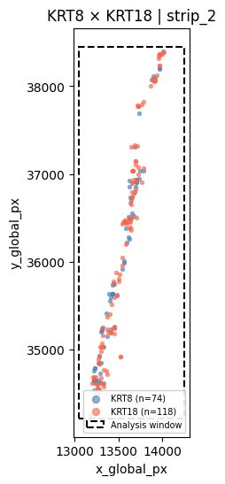
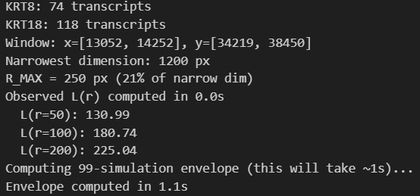
04 — First Positive Control

Slide 30
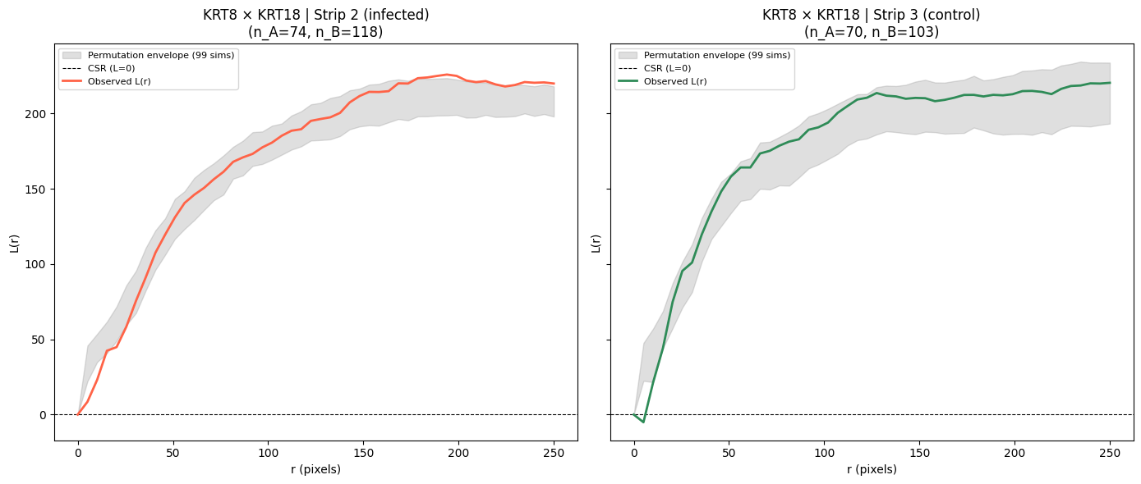
04 — First Positive Control

Slide 31
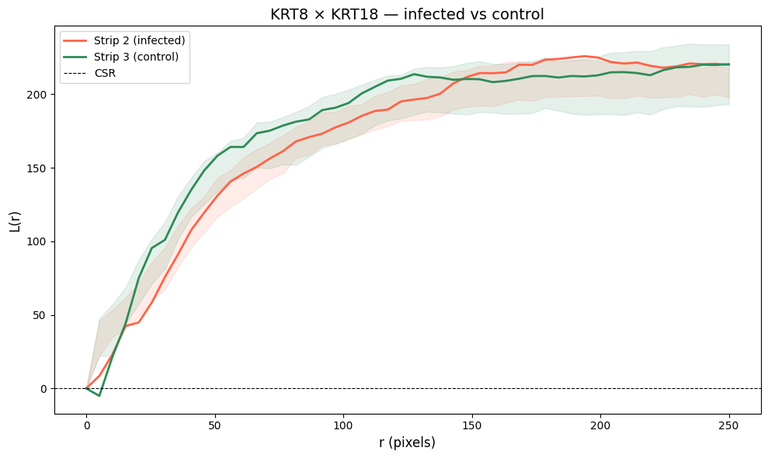
04 — First Positive Control

Slide 32
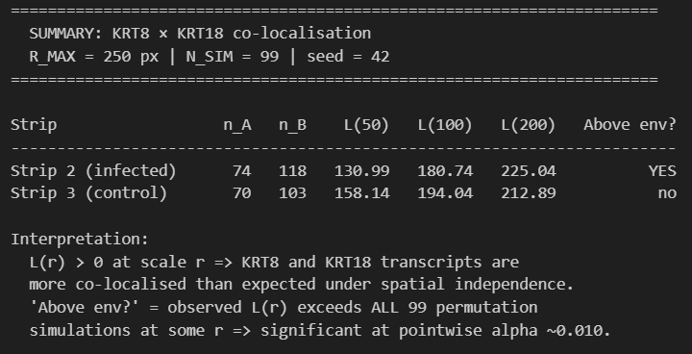
04 — First Positive Control

Slide 33

05
Negative Control
(MALAT1 x KRT18)

Slide 34

05 — Negative Control
Method
1. MALAT1 is a ubiquitous, house-keeping gene so label-specific co-localization should not be present
2. In practice, this will present as the L(r) values being high, but well within the test envelope

Slide 35
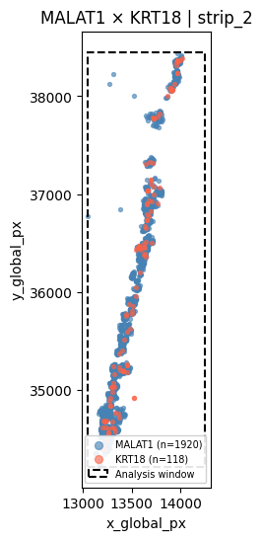
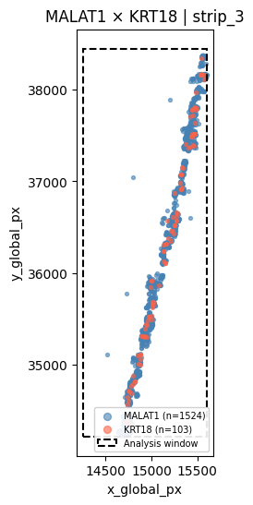
05 — Negative Control
Vastly more MALAT transcripts
Obvious co-localisation because of the tissue stricture

Slide 36
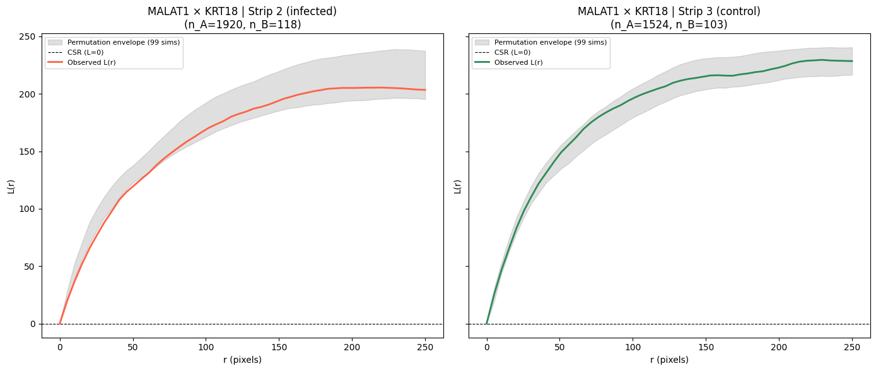
05 — Negative Control

Slide 37
05 — Negative Control
1. L(r) values are well within the permutation envelope, meaning we cannot reject the null
2. Gene-label specific interactions are not significant in the co-occurance of these two genes
3. The co-occurance is due to shared tissue stricture and spatial distribution, not gene-specific co-localisation

Slide 38
05 — Negative Control
Fairly limited with the usable (n>50) genes across these two strips, for this FOV, for this slide
MALAT1 is ubiquitous so co-localises with everything
Something like SCGB3A1 (a secretory cell marker) is expressed only in club cells and goblet cells in the airways
SCGB3A1 x KRT8 could be more informative as a negative control

Slide 39
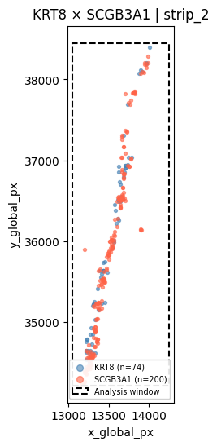
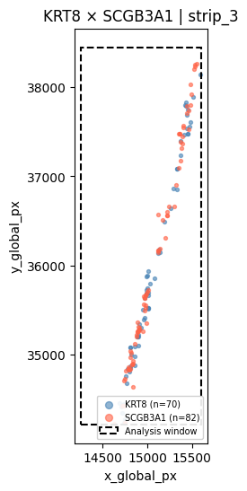
05 — Negative Control
Far fewer transcripts overall compared with the MALAT1 control
The tissue shape and structure means everything always co-localises to some extent

Slide 40
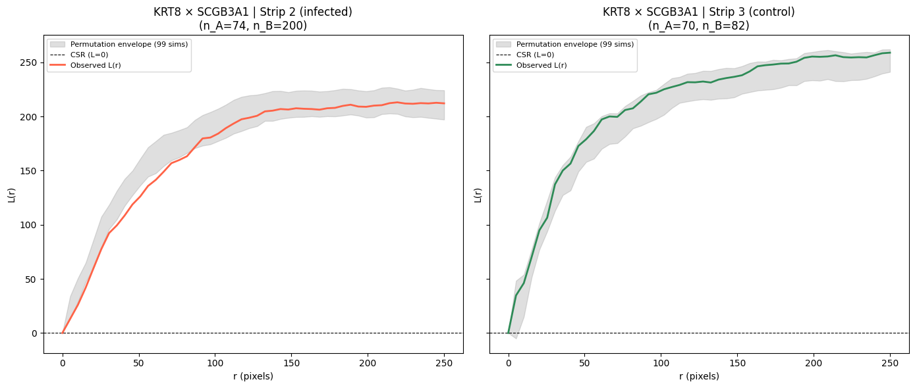
05 — Negative Control

Slide 41
05 — Negative Control
1. The key insight from these tests is that the narrow tissue strips mean that raw L(r) magnitude is always high, being dominated be the global geometry
2. These values will be high (well above CSR) in all cases
3. The permutation envelope is therefore very important, and the main informer for rejection of, or failure to reject, the null

Slide 42

06
Ligand-Receptor Pairs

Slide 43
06 — Ligand-Receptor Pairs
Method
1. LIANA+ is a python package that allows for the use of any of the key Ligand-Receptor tools or resources
2. Uses select_resource from LIANA+ to access the CellChatDB curated L-R database
3. Compare this list against my gene panel

Slide 44
06 — Ligand-Receptor Pairs
CellChatDB:
1912 Ligand-receptor pairs
529 Unique Ligands
490 Unique Receptors

Slide 45
06 — Ligand-Receptor Pairs
CellChatDB:
1912 Ligand-receptor pairs
529 Unique Ligands
490 Unique Receptors
My Gene Panel
1123 Genes
203 L-R pairs with both genes in panel

Slide 46
06 — Ligand-Receptor Pairs
1. Next step is to check transcript counts for these 203 candidate pairs
strip_2: ACKR1: 20 transcripts LOW ACKR3: 12 transcripts LOW ACKR4: 8 transcripts LOW ADGRE5: 23 transcripts LOW ANGPT1: 7 transcripts LOW ANGPT2: 7 transcripts LOW ANXA1: 34 transcripts LOW APP: 10 transcripts LOW AREG: 7 transcripts LOW AXL: 18 transcripts LOW CCL11: 6 transcripts LOW
...
Every single pair had n<50 for both strips in this FOV

Slide 47
06 — Ligand-Receptor Pairs
Method
1. Need to expand the search and analysis to a larger set of data
2. Create a QC loop that presents each FOV in the slide for manual selection/exclusion

Slide 48
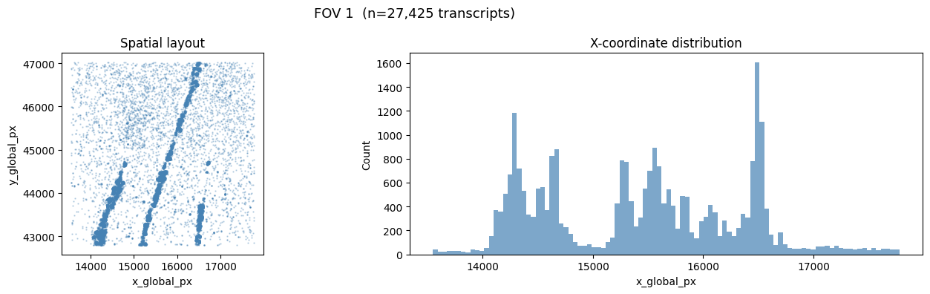
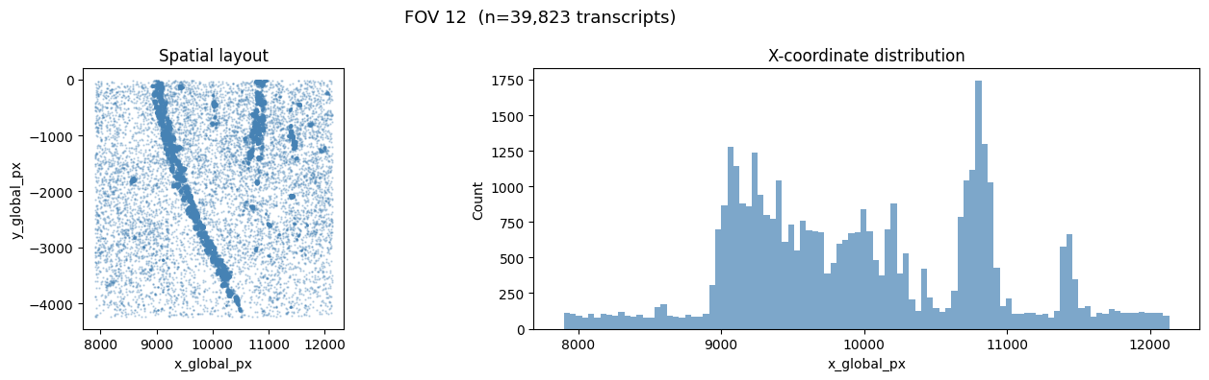
06 — Ligand-Receptor Pairs
…

Slide 49
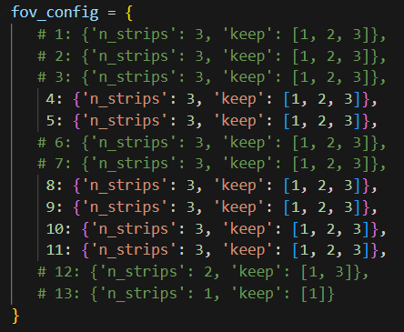
06 — Ligand-Receptor Pairs

Slide 50
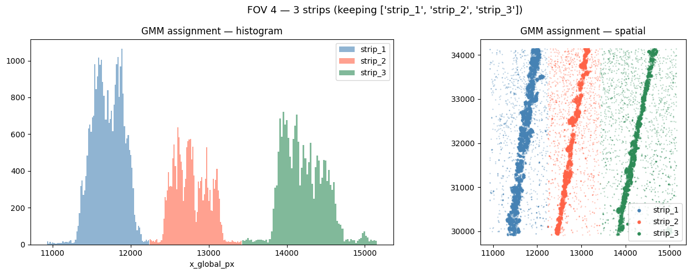
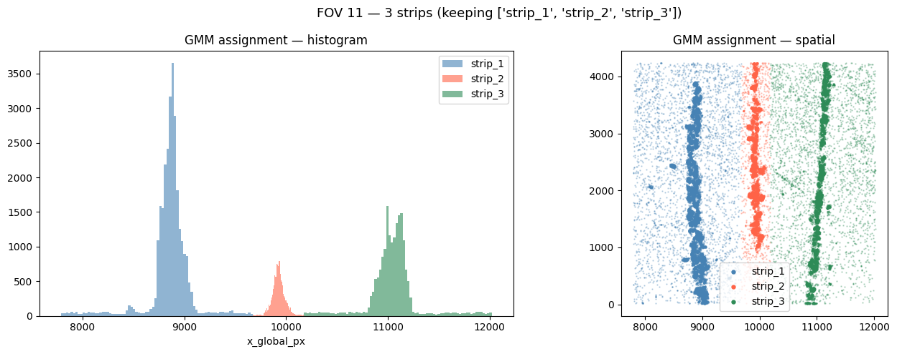
06 — Ligand-Receptor Pairs
…
strip
strip_1 28872
strip_2 14829
strip_3 18559
Processed 6 FOVs
400,238 total transcripts

Slide 51
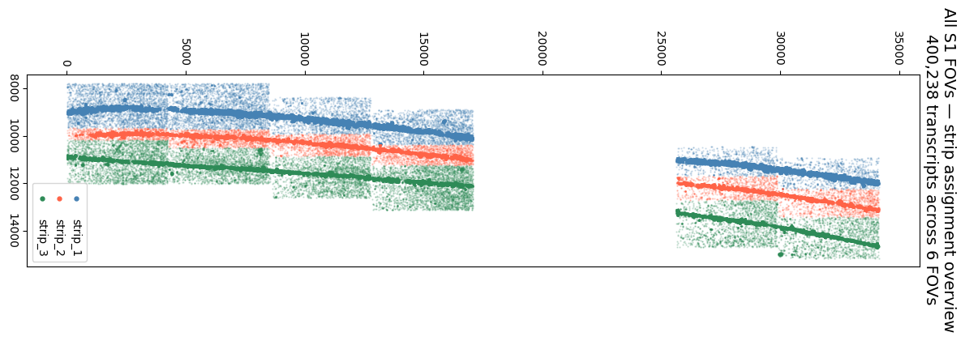
06 — Ligand-Receptor Pairs

Slide 52
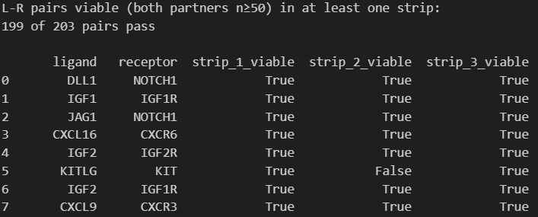
06 — Ligand-Receptor Pairs
…

Slide 53
06 — Ligand-Receptor Pairs
1. We don’t want to test all 146 pairs
2. Main focus for analysis should be on:
- Infection-relevant pairs
- Immune checkpoint pairs
- Vascular/growth factor pairs
146 pairs are viable in ALL strips (ideal for cross-strip K analysis)

Slide 54

07
Multi-FOV Pipeline

Slide 55
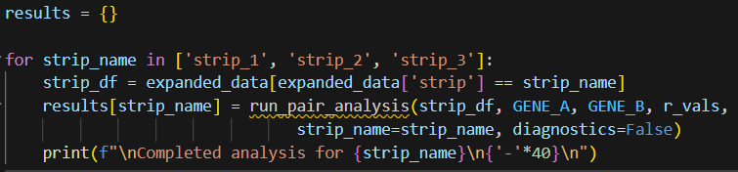
07 — Multi-FOV Pipeline
Method
1. Expanded Bivariate Ripley’s analysis on all verified FOVs
2. Starting with positive control, KRT8 x KRT18

Slide 56
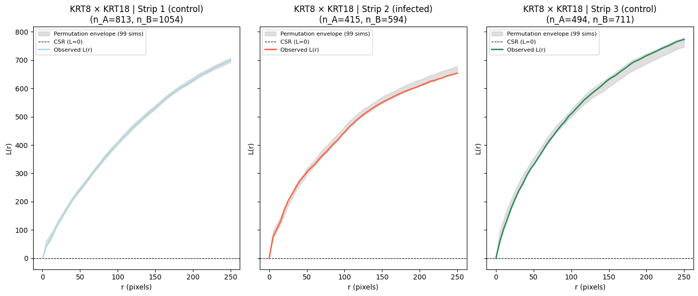
07 — Multi-FOV Pipeline

Slide 57
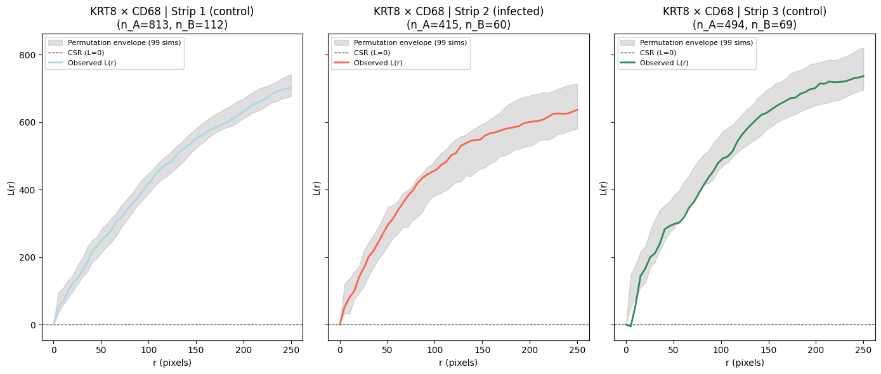
07 — Multi-FOV Pipeline
Now KRT8 x CD68 (transmembrane protein found in lysosomes and macrophages)

Slide 58
07 — Multi-FOV Pipeline
Now a synthetic CSR dataset to be able to confirm predictions about the plot results and subsequent analysis
Three stages:
1. Co-clustered data, positive test (plateu at expected value)
2. Clustered A, random B, negative test (inside envelope throughout)
3. CSR baseline (0 throughout)

Slide 59
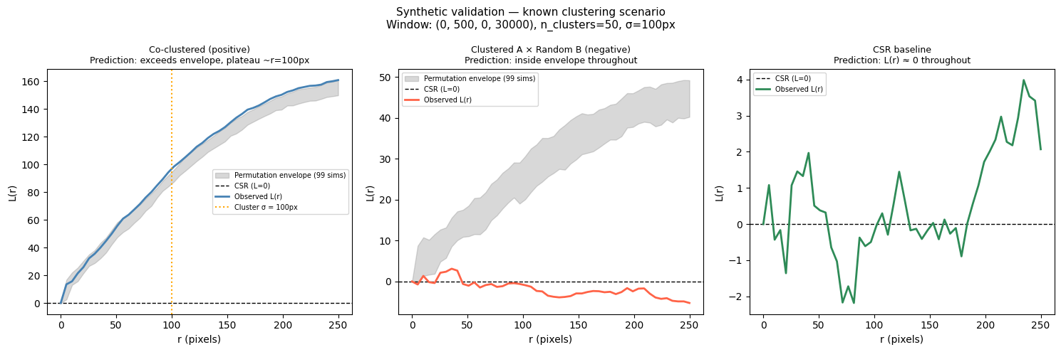
07 — Multi-FOV Pipeline
“Exceeds envelope, plateau at ~100”
“~0 Throughout”
“Inside envelope throughout”

Slide 60
07 — Multi-FOV Pipeline
1. Clearly not enough understanding about my tests, data, or results
2. Thus far, focus has been purely statistical and technical
3. Need to return to the biology for greater understanding
4. Scaffolding is now there though

Slide 61
07 — Multi-FOV Pipeline
Ripley’s K function assumptions:
1. Stationarity (mean density is constant across the study area)
2. Isotropy (pattern properties are independent of direction)
Currently my window functions are purely rectangular, and so are almost entirely white space with my tissue data. The tissue itself is also long and thing, meaning edge effects are strong, and vary between X and Y. Both assumptions violated.

Slide 62
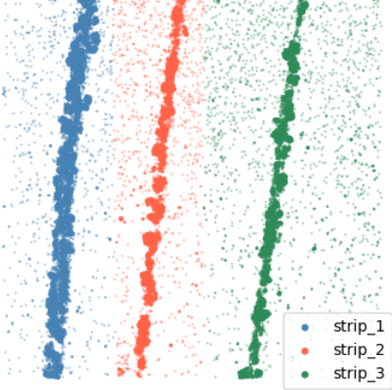
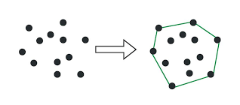
07 — Multi-FOV Pipeline
Solutions:
1. More coherent QC to clear up random unassigned points in the viewing window
2. More choice for the window functions
I’ll keep the rectangular/histogram
functionality for simplicity but also add
polygonal and convex hull options

Slide 63

08
Network & Module Discovery
Introduction

Slide 64

08 — Network & Module Discovery
Method
Add your method content here

Slide 65
08 — Network & Module Discovery
Conclusion
Key Findings
Implications

