Slide 1
Sexual Assault Reporting: What makes a difference?
Harry Elworthy

Slide 2
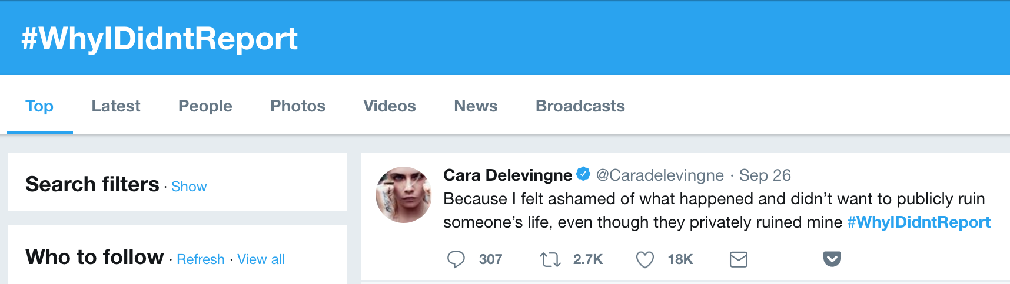
Motivation
Sexual assault is a perennial issue
Much more so now with the me too movement, Kavanaugh, and everything else that has gone along with that
“I have no doubt that, if the attack on Dr. Ford was as bad as she says, charges would have been immediately filed”

Slide 3
Gaps in Literature
Very little evidence on how well sexual assault-oriented interventions work
Many results at the individual level that reducing the costs of reporting will increase the chance of a report
Results recently that investigate individual effects e.g. of party culture on assault reports (2018 paper discussed later)
But still very little on effectiveness of policies implemented to combat sexual assault
“Duke isn’t doing enough” – what should Duke do?

Slide 5
How did we get this massive increase in reports?

Slide 6
Background continued
The 2011 Title IX Changes:
If a school knew or “reasonably should know” of sexual harassment or assault, it was to conduct a “prompt, thorough, and impartial” investigation (Ali, 2011).
These investigations would use a “preponderance of evidence standard,” which requires less proof than the standards of normal courts (Lindo et al., 2018b)
If the investigation found that sexual harassment or assault had occurred, the school was to “take immediate action to eliminate the hostile environment, prevent its reoccurrence, and address its effects” (Ali, 2011).
Changes made in effort to make reporting easier for victims

Slide 7
Reasons for Increase
From Associate Dean of Students:
An uptick in reporting is probably due to a lot of factors. While I can’t speak to the standard that other institutions use, or the changes in their policies or reported number of assaults, I can say that increase in numbers at Duke are probably connected to: increases of mandatory reporting by university officials, increased awareness of the university’s disciplinary process and this as an available option for students who report they have been assaulted; increased awareness of this issue nationally through enforcement efforts of the Obama administration (most famously for the Dear Colleague letter in 2011); and actual changes in the ease of reporting.

Slide 8
Reasons for Increase - Cont.
From Title IX coordinator:
Before I came to Duke, I worked at the Office for Civil Rights at the U.S. Department of Education, including when the 2011 guidance was issued. The general consensus at the agency was that the increase in reporting of sexual misconduct allegations – both through universities and to OCR – was due to the issuance of the guidance, the visibility of several OCR complaints (including one at UNC Chapel Hill) (often assisted by groups such as Know Your IX), and to journalistic reporting by the Center for Public Integrity (which spurred OCR to issue the guidance). I don’t know if there is research to support this.

Slide 9
Changes after 2011
Every school was required to use preponderance of evidence standard after 2011 – previously some had used it, some had used stronger standards of evidence, such as “clear and convincing”
Discourse around campus sexual assault in national media increased
A number of schools had high profile Title IX cases with OCR, likely increasing discourse further at those specific schools
More stringent enforcement of campus mandatory reporters – those employees of universities that are legally required to report crimes they learn about
Note – better word than discourse/buzz??

Slide 10
Can we estimate any of those effects?

Slide 11
Changes after 2011
Every school was required to use preponderance of evidence standard after 2011 – previously some had used it, some had used stronger standards of evidence, such as “clear and convincing”
Discourse around campus sexual assault in national media increased
A number of schools had high profile Title IX cases with OCR, likely increasing discourse further at those specific schools
More stringent enforcement of campus mandatory reporters – those employees of universities that are legally required to report crimes they learn about

Slide 12
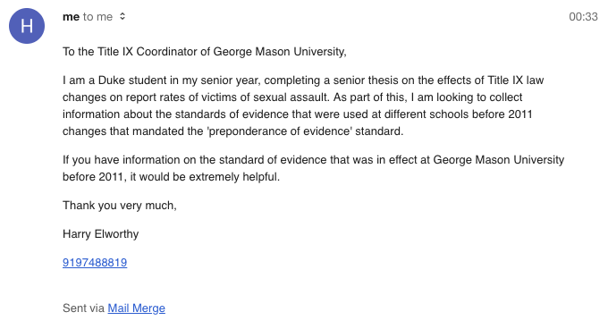
Tried: Emails

Slide 13
Data
CSS data: School-by-year reports of crime. 2005 on.
No granularity – one category “Sexual Assault/Harassment”
Lots of auxiliary data can be pulled in by School ID
Where initial graph came from
NIBRS data: Individual reports of crime to police stations. 1995 on.
40% ish of population covered (some police stations don’t report)
Timestamped, both report and incident datetime, lots of extra information
Hard to work with!
Google Trends data:
Weekly trends on “rape + sexual assault”
Whole US, working on getting by state

Slide 14
Data continued
Title IX Cases
Opened when a student believes they were mistreated
Only started after 2011
Data for each start/end date by school
Used in Lindo et al. to test effects on enrollment/applications/etc.
Find increase factors, not decrease
Find that case opening has sizable impact on google trends for “[school name] rape” – so somewhat salient
I use their model for some of my regressions

Slide 15
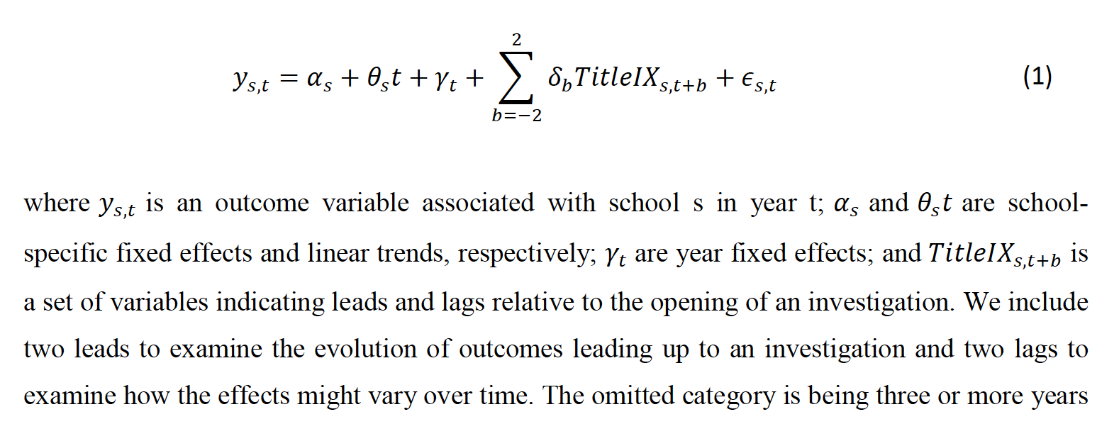
Only additions for my regressions are an occasional “after_2011” dummy to look at the increases after 2011 changes, and a ‘week of year’ fixed effect for weekly regressions to account for seasonality

Slide 16
Initial Results

Slide 17
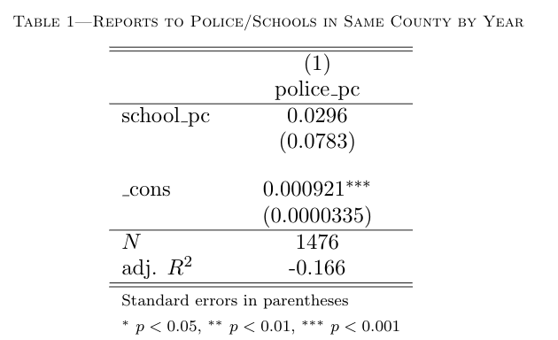

Slide 18
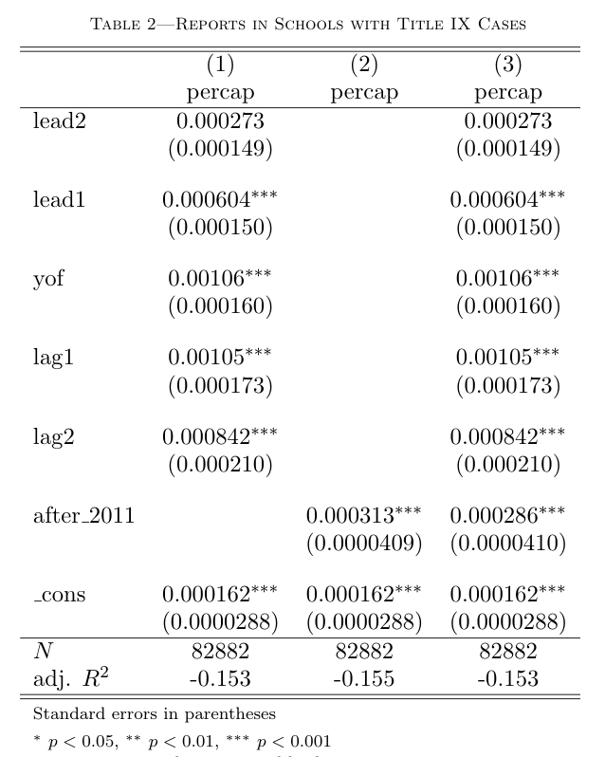

Slide 19
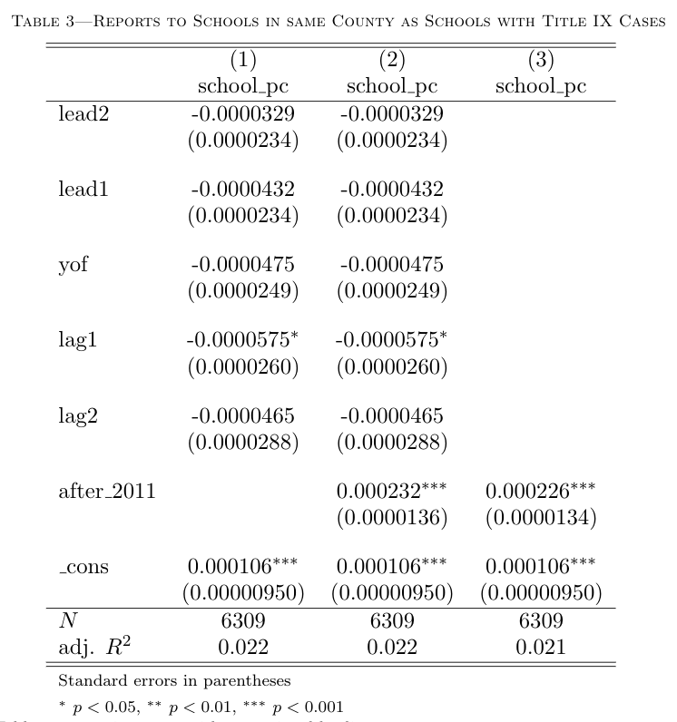

Slide 20
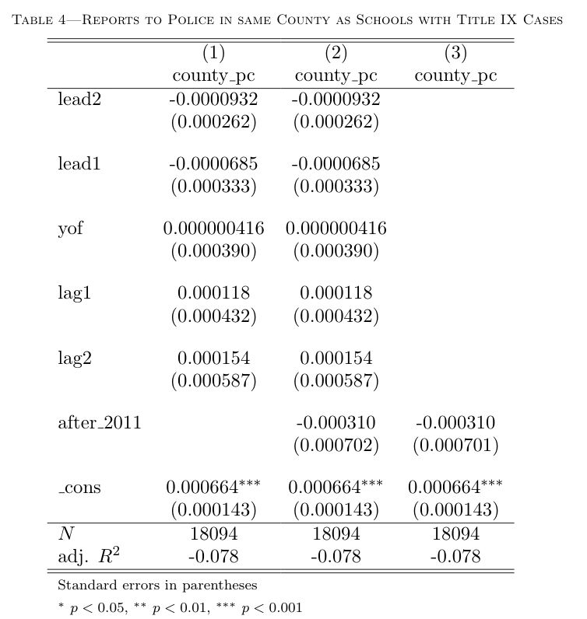

Slide 21
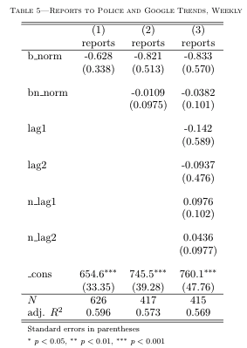

Slide 22
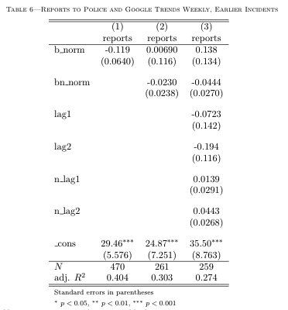

Slide 23
Initial Results Summarized
Within-county Police and School reports show no clear correlation
Schools with Title IX investigations experience huge increases in reports in the year of and years after the investigation
Start halfway through lead1, probably showing near instant increases
Schools in the area, however, see very little if any changes (negative??)
Police stations in the area also see no changes
Trends seem to have no effect on weekly reports to Police
Possible effect on reports of earlier events, but in wrong direction??
Not shown: T9 investigations not salient on trends (need to reassess)

Slide 24
To Dos
Get state by week trends data, and news data as well as search data
Need to API this – been lazy – shouldn’t be difficult
See if T9 Investigations are salient within states
See if state trends have any correlation with reports
Extend lags further than 2 years
Include all investigations to schools, not just first
Try to get school numbers changing e.g. gender makeup/applications by gender as a result of investigations
Qualitative look at school responses to Title IX investigations – talk to schools with largest changes
Subgroup police data by age – see if young reporters are affected

Slide 25
Questions/Comments

