Slide 1
Does Coverage of Sexual Assault Cases Ease the Reporting Decision?
Harry Elworthy

Slide 2
Motivation
An estimated 18.3% of women and 1.4% of men in the United States are sexually assaulted at some point in their lives, with more than a third of these assaults occurring before the victim turns 18 (Black et al., 2011)
According to Fisher et al. (2000), ”fewer than 5% of attempted or completed sexual assault against college age women are reported to law enforcement. 66% of victims tell friends but not family or school officials.”

Slide 3
Many Reasons to want to Increase Reporting
Justice for the victim
Victims of rape that report the crime to the police are also 9 times more likely to receive medical care than those that do not (Resnick et al., 2000) as well as more likely to receive psychological care
Benefits to wider society
Unreported sexual assault decreases the perceived likelihood of punishment for sexual assault
Important as there are a number of studies that find that propensity of men to commit sexual assault signif. decreased by threat of sanctions (Bachman, Paternoster, & Ward, 1992; Antunes & Hunt, 1974)
Additionally, assaulters who aren’t convicted have high recidivism rates (Abel et al., 1987)

Slide 4
Factors that Affect the Reporting Decision
Lots of previous research, some economics, mostly law. Lots of different individual findings:
More likely to report given social support and ancillary evidence associated with the crime (Allen, 2007)
More likely to report if the offender used physical force. No effect on reporting: whether the perpetrator was a stranger, whether the event occurred away from the victim’s home (Bachman, 1993; Du Mont et al., 2003)
More likely to report if offender used a weapon (Bachman, 1998)
Most common barriers to reporting for college students: (1) shame, guilt, embarrassment, not wanting friends and family to know; (2) concerns about confidentiality; and (3) fear of not being believed (Sable et al. 2010)

Slide 5
Limitations with these studies
All use either fairly small survey groups or a national sample survey (the National Crime Victimization Survey) and find their results primarily with logistic regressions
Useful for looking at correlations, but causal inference is tough, as a number of endogeneity issues – e.g. even papers that I looked at disagree on whether reporting to the police makes you more likely to seek medical attention or whether medical attention increases chances of reporting to the police
Selection biases – always present in surveys. Likely still non-reporters even in these relaxed survey environments, and we don’t know their characteristics

Slide 6
Leads to: Research Question
Does national coverage of sexual assault cases and allegations increase reporting of sexual assaults?
As far as I know, this question has not been investigated previously
Because of the nature of national coverage, this question lends itself to time series and instrumental variable analysis instead of survey analysis, thus avoiding many of the problems found in previous research.
Obviously many new problems abound! But a different research approach should still be complimentary to the existing literature

Slide 7
Importance of Research Question
Most importantly: if the effect is negatively – i.e. if coverage of sexual assault allegations suppresses the reporting of sexual assaults – then there are many important policy questions to ask.
Would be a little bit similar to the copycat effect found with coverage of suicide stories. Has in many countries resulted in policy to reduce such coverage, as not desirable
If the effect is positive, interesting, but no clear? Policy prescriptions

Slide 8
Data
National Incident-Based Reporting System
Individual reports of crime to police stations. 1991 to 2016.
About 40% of population covered (some police stations don’t report)and this number has increased since 1991 as more stations have begun reporting.
Timestamped, both report and incident datetime, lots of auxiliary information i.e. about the victim in question
Because is by incident, can be collapsed to any specification: Nationally Daily, statewide etc
Google Trends data
Daily and weekly trends for sexual assault 2008 to 2018
National and statewide trends.
Relative trends out of 100, scaled to 2008 numbers, so some numbers later on are higher.
Merge daily with police data for most of my investigation. Thus have reports of sexual assault grouped by either report or incident date together with Google Trends, daily, from 2008 to 2016.

Slide 9
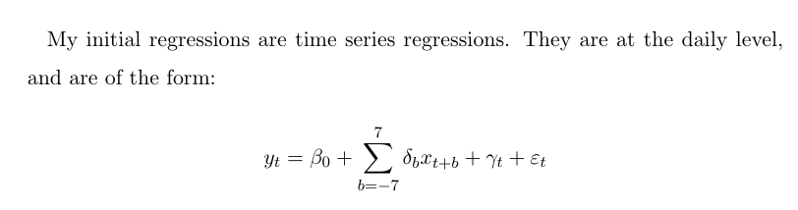
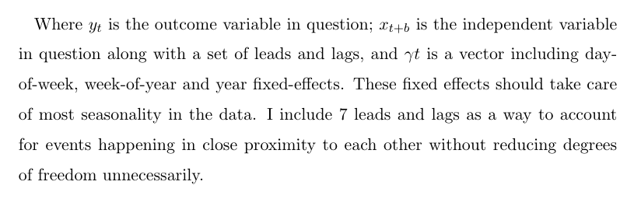

Slide 10
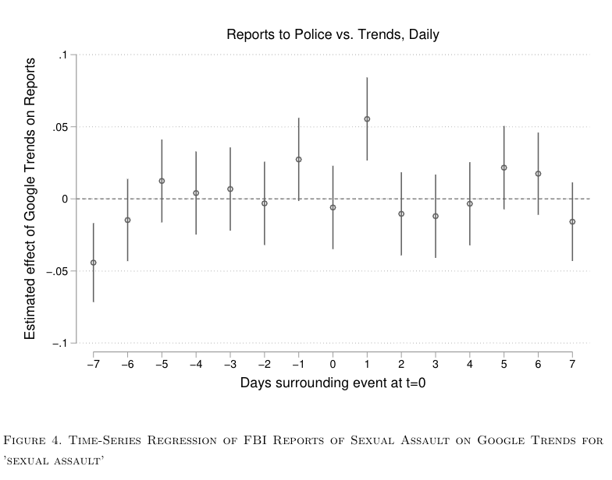

Slide 11
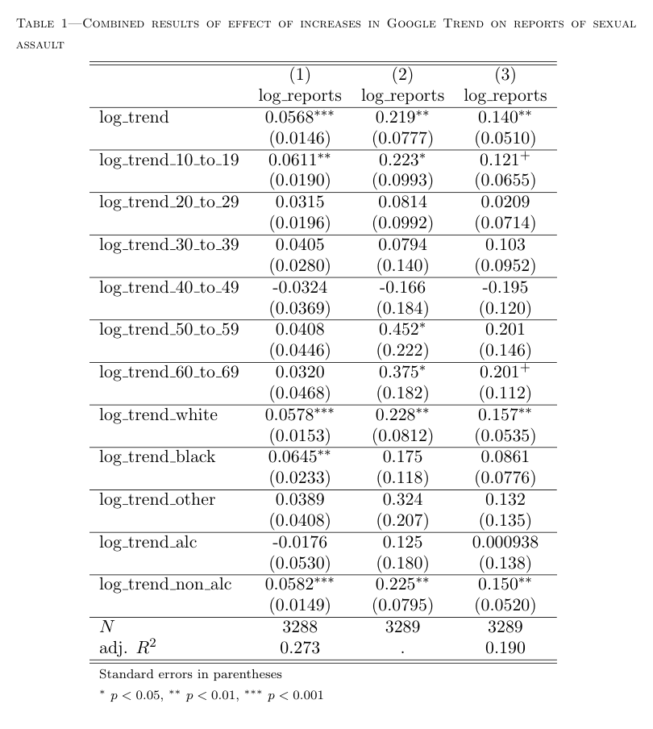

Slide 12
Instrumental Variable Analysis
To accompany these time series results, I find events that are plausibly exogenous shocks to the volume of coverage of sexual assault-related topics
These events are collected using Google’s ”Related Queries” function, that collects searches that are made in conjunction with the term in question over a specified time period.
I look at times at which the Google Trend for ’sexual assault’ is above 60% of its 6-month maximum for the 9 years in question, which gives 563 days. For each day, I look for distinct related queries.
For example, on November 19, 2014, ’Bill Cosby’ is the top related query, as he is for the next several days. I count only the first occurrence of these terms as a distinct ’high profile event’
To use these events as instruments for the Google Trend, they must be correlated with the Google Trend and uncorrelated with the error term
Notes:
Discuss mroe about why above 60%, need high profile events

Slide 13
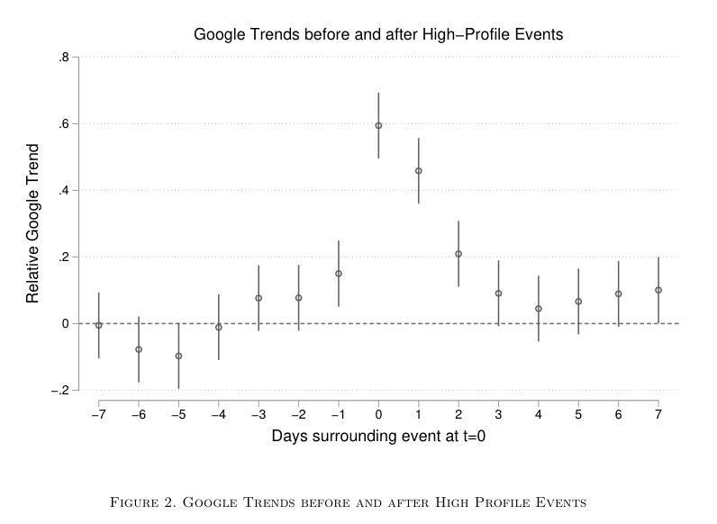
Test that correlated with trend

Slide 14
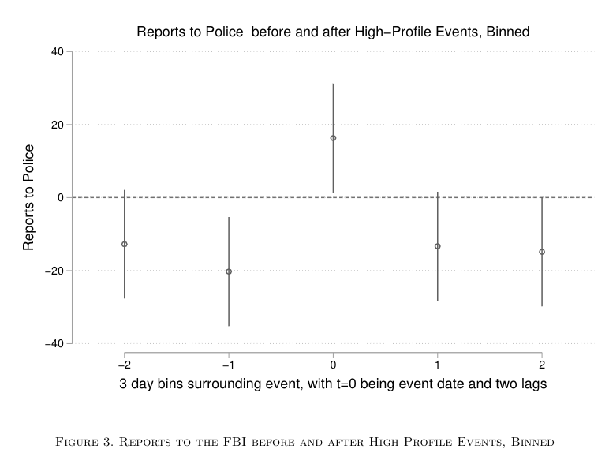

Slide 15
Two IV specifications
One with a dummy for ‘event date bin’ as the instrument, the other using each event as its own factor variable
I.e. the first looks at event days vs. non-event days, the second looks at the variation across event days

Slide 16
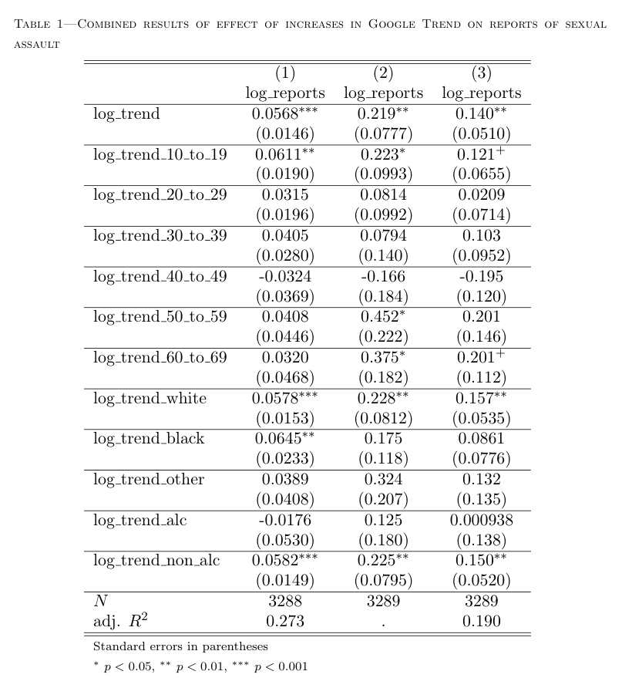
Notes:
How breakdowns have been affefcted over time overall numbers
Chi^2/F test/etc?? try F test for each model? Goodness of fit test statistic

Slide 17
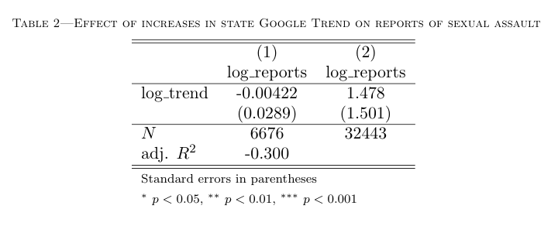
State by State variation?

Slide 18
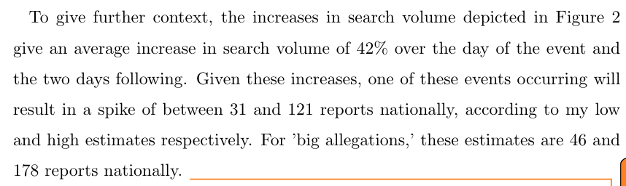

Slide 19
Driven by white young non-alcoholic incidents?
Maybe
These are all the most reported types of events, however, so may just be that other types don’t have n to reach significance.
Need to work out a better way to interpret this and to discuss it.
Notes:
Offer rationales

Slide 20
Fin
Robust evidence that coverage of sexual assault cases increases reporting of sexual assault, by a fairly significant amount
Need better discussion of costs of reporting, how coverage might increase or decrease costs, how I make sure not to include increased events (dropping events from that date), etc
More on limitations of my style vs. survey style papers
More on why results are important (??!!)
More on other econ work using google trends/search volume

Slide 21
Questions?

