Slide 1

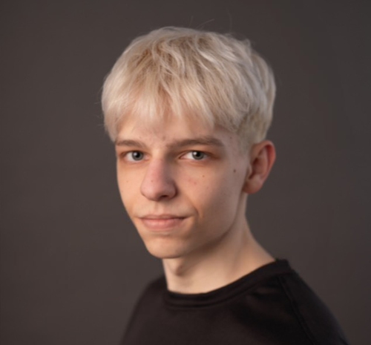
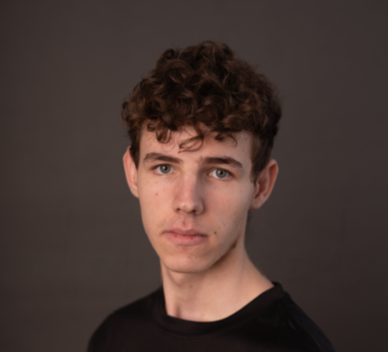
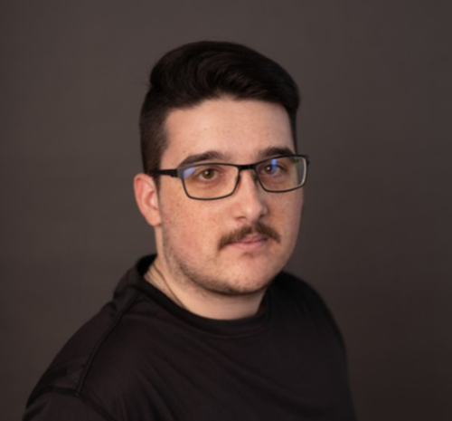
Dömötör Dániel
Schiller Zoltán Erik
Szabó Bence

Slide 2
Teamwork
Schiller Zoltán Erik(PM): - Console Port config - SSH config - VPN config - Save the config to servers - Szekszárd Subnet 2 config - Testing - HTML - Firewall
Szabó Bence: - Daily Message - OSPF - Dynamic Routing - Szekszárd Subnet 1 Config - Cloud Services - Testing - Presentation - Video
Dömötör Dániel: - Documentation - Presentation - Network Prototype - WIFI network/encryption - Static Routing - DHCP server - Acces Point Installation - Szekszárd Multilayer Switch configuration - ACL config

Slide 3
Introduction
A design for a next-generation network infrastructure to enhance the world’s network system.
By implementing modern networking solutions and optimizing existing resources, our new system provides a more efficient and future-proof foundation for DanErBe’s operations.
Reliability
Simplified management
Better scalability
Improved security
Problems to be solved
Reduced costs

Slide 4
DanErBe company
Danerbe is a growing telecommunications company specializing in internet and digital services.
Outdated network infrastructure
Scalable, secure and modern
Difficult management
Easy management
Problems
Solutions
Costly to maintain
High-speed and low cost
Vulnerable to security threats
Reliable and secure

Slide 5
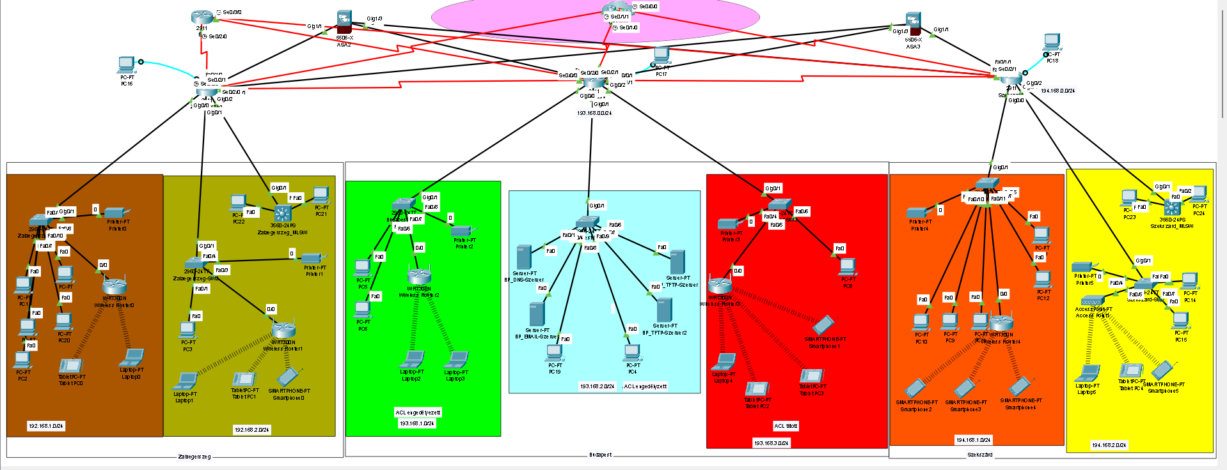
What technology we used
DHCP
ACL
VPN
HTTP
HTML
DNS
Static Routing
OSPF
RIP
CLOUD
Firewall
Console Port
SSH
Telnet
WIFI
IPv6/IPv4
Static and Dynamic NAT

Slide 6
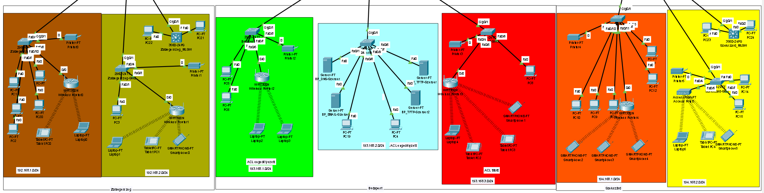
Subnets Topology
We have seven Subnets - 2 for the Zalaegerszeg Section - 3 for the Budepest Section - 2 for the Szekszárd Section

Slide 7
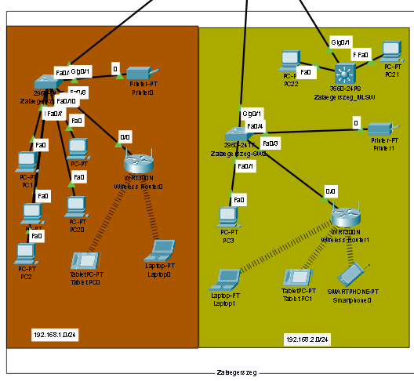
Zalaegerszeg Subnets
One of the subnet, which the colleagues are using for monitoring the other subnet and save data on the server, which is placed on the other subnet.
They are monitoring if everything is working perfectly and sending and saving data to the server.
We used: - DHCP - IPv4 and IPv6 - WIFI - Telnet - SSH - IPv6

Slide 8
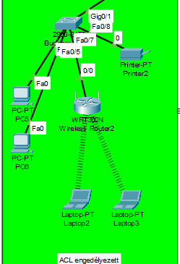
Budapest Subnet 1
This Subnet is monitoring the servers, monitoring the whole Network and collecting the data from the Zalaegerszeg server, saving and forwarding to the Budapest TFTP server.
We used: - DHCP - IPv4 - WIFI - Telnet - SSH - VPN - ACL(enabled)

Slide 9
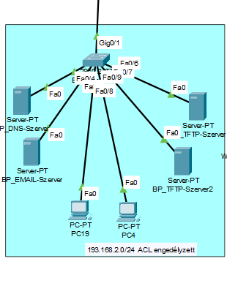
Budapest Subnet 2
This is the server subnet which the most secured place in this network and this subnet has all of the datas what is flowing through the whole network.
This subnet also has Firewall, DNS, TFTP and HTML server.
We used: - Firewall - DNS - TFTP - HTML - ACL(enabled) - DHCP

Slide 10
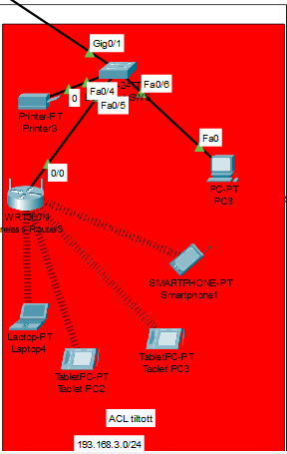
Budapest Subnet 3
This subnet is used for support services, this section has only PC-s, Laptop-s and Mobile Phone-s, which are monitoring the customers networks give them help if they have a question or problem with their network.
We used: - ACL(disabled) - DHCP - WIFI

Slide 11
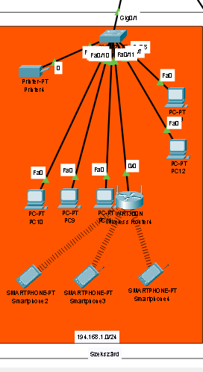
Szekszárd Subnet 1
This Subnet is used for collecting and saving the data's and sent to Budapest servers.
We used: - DHCP - DNS - IPv4 - WIFI connection - SSH - Telnet - VLAN

Slide 12
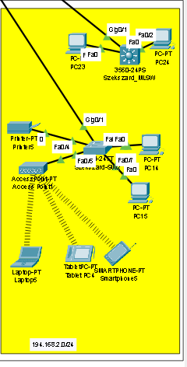
Szekszárd Subnet 2
This subnet is used for support services, this section has only PC-s, Laptop-s and Mobile Phone-s, which are monitoring the customers networks give them help if they have a question or problem with their network.
We used: - SSH - Telnet - DHCP - VLAN - IPv4 and IPv6

Slide 13
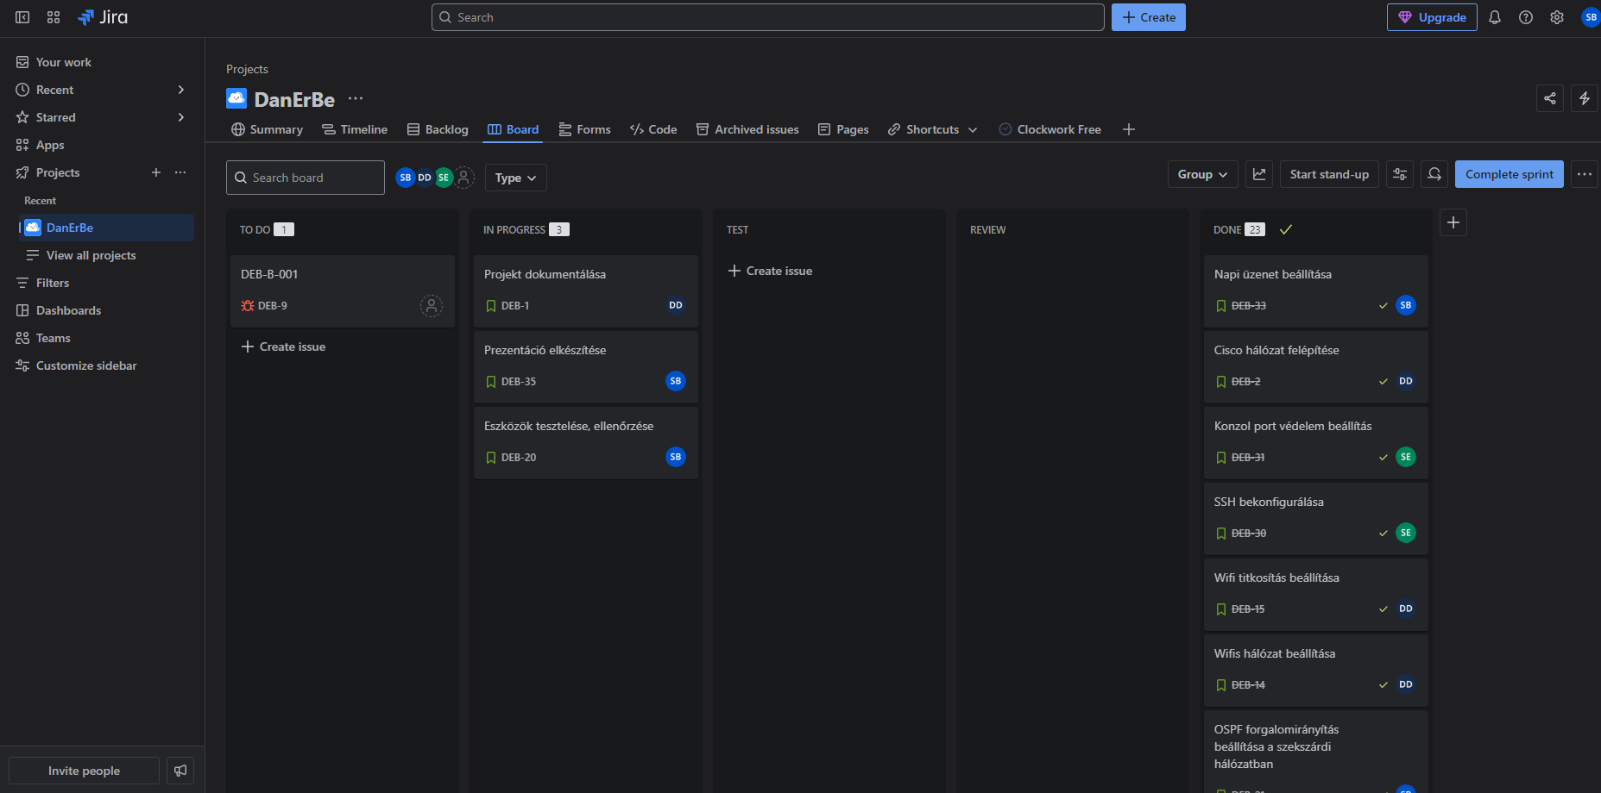
Jira
Jira is a project management and issue-tracking tool developed by Atlassian.
It's widely used for software development, allowing teams to plan, track, and manage tasks, bugs, and features.
It supports Scrum and Kanban.

Slide 14
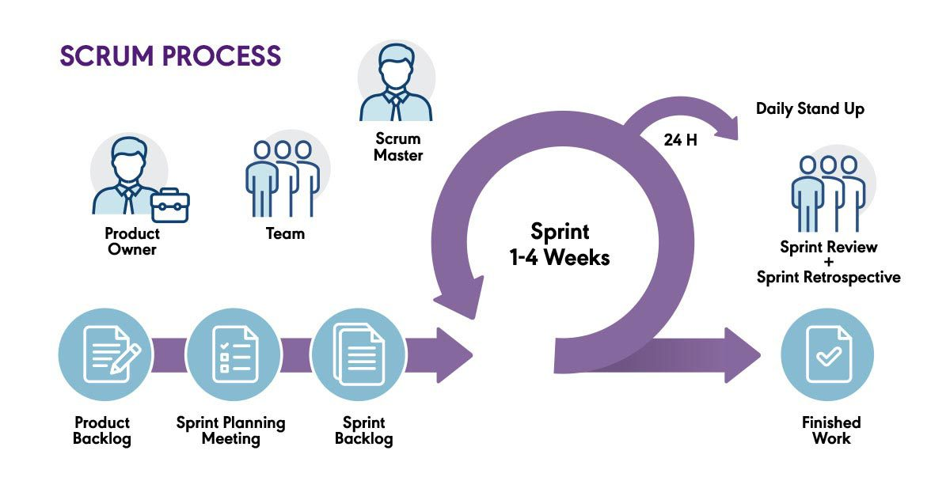
Scrum
Scrum is an agile framework used for developing, delivering, and sustaining complex products—primarily in software development but also in other fields. It emphasizes collaboration, adaptability, and iterative progress.

Slide 15
Clockwork
Szabó Bence
Schiller Erik
Dömötör Dániel

Slide 16
Thanks For Attention

