Slide 1
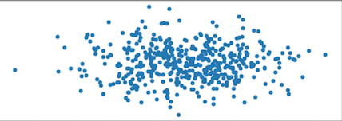




sigmoid
$$x\sim p_{data}(x)$$
Discriminator Network
Real: 0.79
Fake: 0.21
Real Fraud Data
D$\left(\text{x}\right)$
$$z\sim p_{z}(z)$$
Generator Network
Fake Fraud Data
Random Noise
$$G(z)$$

Slide 2


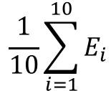

Dataset
s
s’
Original Dataset
Train folds
Test fold
1st iteration
$$E_{1}$$
2nd iteration
$$E_{2}$$
$$\frac{1}{10}\sum_{i=1}^{10}{E_{i}}$$
…
10th iteration
$$E_{10}$$

Slide 3
Cross validation loop
Oversampled Dataset
Test Fold
3
3
Original Dataset
3
3
2
2
2
2
Minority Class
2
1
1
1
1
1
Train Fold
3
Majority Class
n iterations

Slide 4
Cross validation loop
Oversampled Training only
Train-Test Split Data
3
Test Fold
Original Dataset
3
2
2
Minority Class
2
2
1
1
1
1
Train Fold
3
Majority Class
n iterations

Slide 5
Cross validation loop
Oversampled Training only
Train-Test Split Data
2
Test Fold
Original Dataset
2
3
3
Minority Class
2
3
1
1
1
1
Train Fold
3
Majority Class
n iterations

Slide 6
Baseline Models
KNearestNeighbors
LinearSVC
DecisionTreeClassifier
RandomForestClassifier
MLPClassifier
GaussianNB
CNN Models
Model 1 – Single Vector Input Approach
Model 2 – Time Series, Sliding Window Approach
GAN Models
Model 1 – Dense Generator Network
Model 2 – Previous CNN as Generator Network
General experimentation with using GANs

Slide 7
Input
Convolution
Flatten
Fully Connected
Softmax Output
Input 30x1
Kernel size 30x1
Genuine: 0.89
Fraud: 0.11
256 1x1 outputs
300 nodes

Slide 8
30
100
96
X 32 (32 different red kernels)

Slide 9
Fully Connected
Softmax Output
96 x 32
Genuine: 0.89
Fraud: 0.11
64 nodes
1 x 3072

Slide 10

sigmoid
Real: 0.79
Discriminator Network
Fake: 0.21
softmax
D$\left(\text{x}\right)$
Real 0: 0.70
Real 1: 0.09

