Slide 1
Deep Learning Techniques for Credit Card Fraud Detection
Harry Graham

Slide 2
Overview
$22.80 Billion Losses – 2016, 4.4% increase over 2015
‘Solved problem’ ? – Tree based classifiers, neural networks, time series (LSTM)
Taking successful architectures (CNNs, GANs) in other domains (Image classification) and being creative
Notes:
$22.80 Billion Losses– 2016, 4.4% increase over 2015 : Credit card fraud is a massive problem, it is very important the weight we put on fraud detection systems
‘Solved problem’ ? : “But hasn’t CCFD been done already?”
Machine learning has contributed a lot to this problem already. But because of the nature of the problem, it is always useful and interesting if we can experiment and perhaps find improvements.
This project aims to experiment with architecture's that have been very successful in the image classification space, namely CNNs and GANs. The point here is, can we be creative with these and to shed light on their use in the CCFD space, by treating the time series data as a metaphor for images.

Slide 3
Approach
Data exploration & Baseline models
CNNs
GAN
CNN sliding window
- Temporal ordering, batching together 100 vectors and treating as an image, with a striding window of size 5.
Notes:
Baseline Models : These comprise of a handful of classic, out-of-the-box supervised learning classifiers. These are to see what we can achieve off the bat, with the most common classifiers available to us. The best performer is tuned a bit further to give indication of what can be achieved with further work.
Unbalanced data. Fraud data is highly unbalanced as you can see. Therefore it is important to use the right metrics (see next slide). Also it is of interest to employ resampling methods. I chose to experiment with Under sampling, Oversampling and SMOTE (creating synthetic data points, extrapolations of existing data points). I chose these because these are three standard techniques.
CNNs - Here I try two variations. A 1D convolutional network, 1x29 vectors kernel size 29 and a second using temporal ordering and a sliding window approach, batching together vectors and striding down the list.
GAN – Generative Adversarial network, training a generator and a discriminator network. A few options, one of which is to use the generator as a classifier and compare this against previous work.
KFOLD CV: Standard technique to ensure to use all your data and to get full idea of generalizability of your model. In my case I needed to make sure to employ oversampling in the right place. If we oversample before cross validation, with each fold of KFOLD, the validation test set will contain some of the duplicate/fake data points, whereas we want to preserve a portion of the original dataset, with every fold. SOLUTION: oversample inside the KFOLD loop.

Slide 4
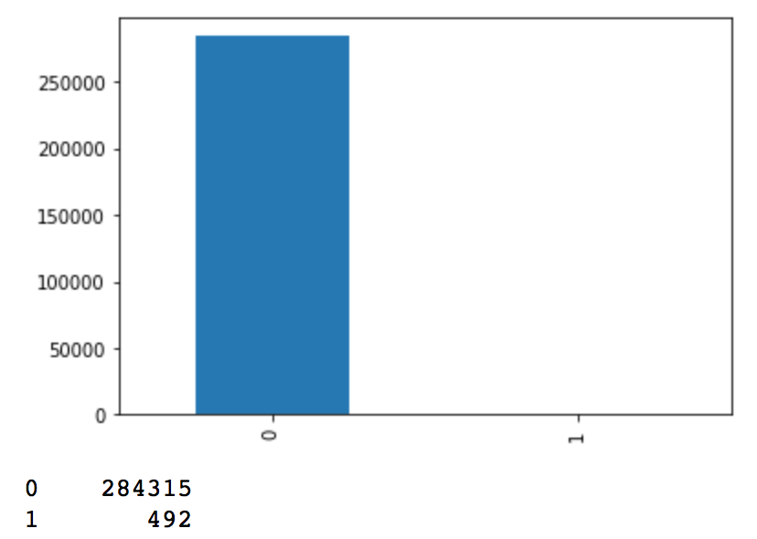
Data and techniques
Data: popular dataset from ULB (ML / Data mining group at University of Brussels).
Unbalanced data – resampling methods (Under, Over & SMOTE)
Oversampling in the right place – inside KFOLD cross validation and different in time series case!
Non Fraud / Fraud balance

Slide 5
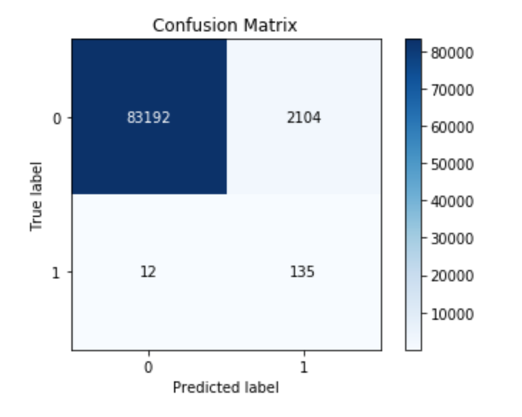
Evaluation (How the project is evaluated)
Accuracy NOT a good metric… model still 99.9% accurate if ALL frauds not caught.
Metrics – F1, precision, recall
ROC-AUC
Comparison across models using these metrics
Intuitive, written analysis of how the models compared and some of the insights gained from doing this
We care about specific portions of the confusion matrix
Notes:
Metrics – problem with accuracy is in unbalanced data, you have have almost 99% accuracy whilst catching no frauds at all. Therefore we care about parts of the confusion matrix, precision and recall specifically and their harmonic average, F1. In the context of the bank…
We care about Recall: catching frauds, but also precision (not mistakenly freezing the account of someone who is not subject to fraud) as this costs the bank time and money (and potentially customers!)
Evaluation of models will be a comparison of their performance with respect to these metrics. In addition to this, I will have a written analysis of how they compared and any insights from using these methods.

Slide 6
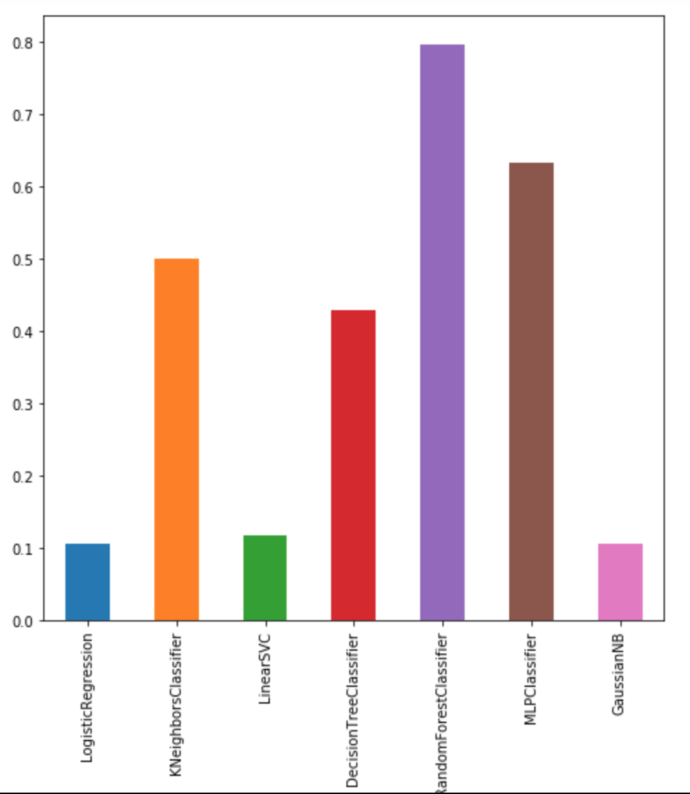
What I’ve done so far
F1 SCORES:
Random Forest (Tuned): 0. 827025
CNN: 0.745591
CNN 2: 0.79167 ( w/o CV)
CNN work:
Increase in precision, by about 10%.. Recall not quite there yet with respect to Random Forest
Further tuning may balance results
F1 score of baseline models. Tree based / NN are best, RF in particular.
Notes:
Baseline work - Results for baseline classifiers collated for each sampling method. Further tuned parameters of Random Forest (best performer).
These results give some insights into the model performances but of course not a certainty as to do so we would require confidence intervals etc, but interestingly we better in precision over most of the baseline classifiers, except random forest. It is expected that with further tuning of the CNN models, other than default parameters in a lot of cases, we could achieve very similar to that of the best baseline classifier.
Baseline work – Results collated, tuned best performer
CNN model 1
Prepared CNN model 2 for training
models learn better to not misclassify non-fraud, after using SMOTE.

Slide 7
What’s left to do…
Further tuning of CNN models to give insight to what could be achieved (i.e the window size, batch size, optimizer function etc).
Experiment with the GAN work
Finalize results and draw evaluations, using methods discussed previously

