Slide 1
Deep Learning Techniques for Credit Card Fraud Detection
Harry Graham

Slide 2
Overview
$22.80 Billion Losses – 2016, 4.4% increase over 2015
‘Solved problem’ ? – Tree based classifiers, neural networks, time series (LSTM)
Taking successful architectures (CNNs, GANs) in other domains (Image classification) and being creative
Notes:
$22.80 Billion Losses– 2016, 4.4% increase over 2015 : Credit card fraud is a massive problem, it is very important the weight we put on fraud detection systems
‘Solved problem’ ? : “But hasn’t CCFD been done already?” Well, yes there is of course a lot of work already gone into CCFD (tree based classifiers are popular and effective and of course deep learning in the sense of the amount of data being used, neural networks and time series architectures (LSTMs) are also employed.
But because of the nature of the problem, it is ongoing and increasing and therefore it is always useful and interesting if we can experiment and perhaps find new techniques for catching fraud.
90% of problems today can be solved effectively by standard supervised learning classifiers, this is to see if we can extend from this and make any improvements.
Taking successful architectures in other domains and being creative : This project takes architecture's that have been very successful in the image classification space, namely CNNs and GANs. The point here is, can we be creative with these and to shed light on their use in the CCFD space, by treating the time series data as images.

Slide 3
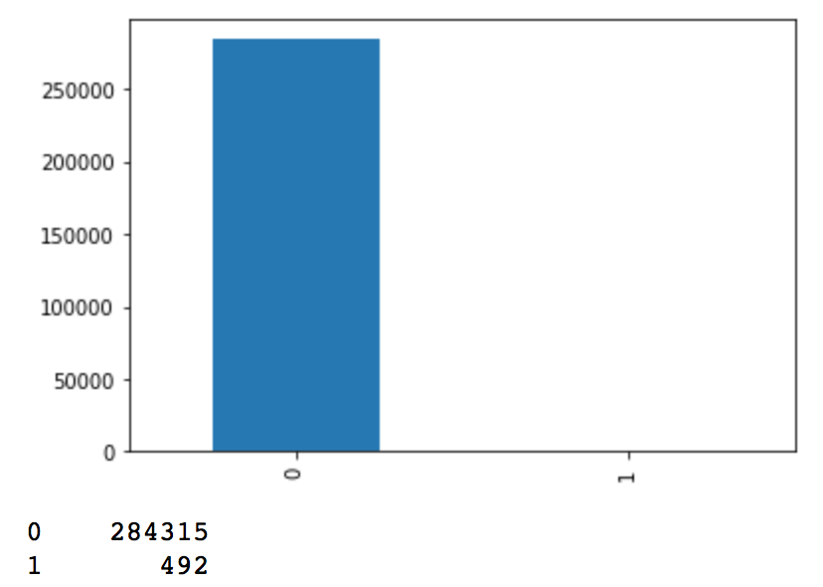
Main components
Data: popular dataset from ULB (ML / Data mining group at University of Brussels).
Unbalanced data – resampling methods (Under, Over & SMOTE)
Data exploration & Baseline models
CNNs
GAN
Oversampling in the right place – inside KFOLD cross validation
Non Fraud / Fraud balance
Notes:
Baseline Models : These comprise of a handful of classic, out-of-the-box supervised learning classifiers. These are to see what we can achieve off the bat, with the most common classifiers available to us. The best performer is tuned a bit further to give indication of what can be achieved with further work.
Unbalanced data. Fraud data is highly unbalanced as you can see. Therefore it is important to use the right metrics (see next slide). Also it is of interest to employ resampling methods. I chose to experiment with Under sampling, Oversampling and SMOTE (creating synthetic data points, extrapolations of existing data points). I chose these because these are three standard techniques.
CNNs – CNNs are widely known in the image detection space. Here I try two variations. A 1D convolutional network, 1x29 vectors kernel size 29 and a second using temporal ordering and a sliding window approach, batching together vectors and striding down the list.
GAN – Generative Adversarial network, two Networks fight each other a generator and a discriminator and learn from each other until the network is very good at generating fraud. The second portion of this can be used a classifier but we may also then use this to generate new data points.
KFOLD CV: Standard technique to ensure to use all your data and to get full idea of generalizability of your model. In my case I needed to make sure to employ oversampling in the right place. If we oversample before cross validation, with each fold of KFOLD, the validation test set will contain some of the duplicate/fake data points, whereas we want to preserve a portion of the original dataset, with every fold. SOLUTION: oversample inside the KFOLD loop.

Slide 4
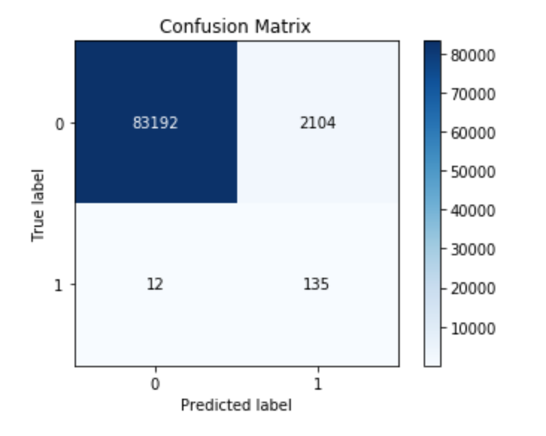
Evaluation (How the project is evaluated)
Metrics – F1, precision, recall
Accuracy NOT a good metric… model still 99.9% accurate if ALL frauds not caught.
Comparison across models using these metrics
Intuitive, written analysis of how the models compared and some of the insights gained from doing this
We care about specific portions of the confusion matrix
Notes:
Metrics – problem with accuracy is in unbalanced data, you have have almost 99% accuracy whilst catching no frauds at all. Therefore we care about parts of the confusion matrix, precision and recall specifically and their harmonic average, F1. In the context of the bank…
We care about Recall: catching frauds, but also precision (not mistakenly freezing the account of someone who is not subject to fraud) as this costs the bank time and money (and potentially customers!)
Evaluation of models will be a comparison of their performance with respect to these metrics. In addition to this, I will have a written analysis of how they compared and any insights from using these methods.

Slide 5
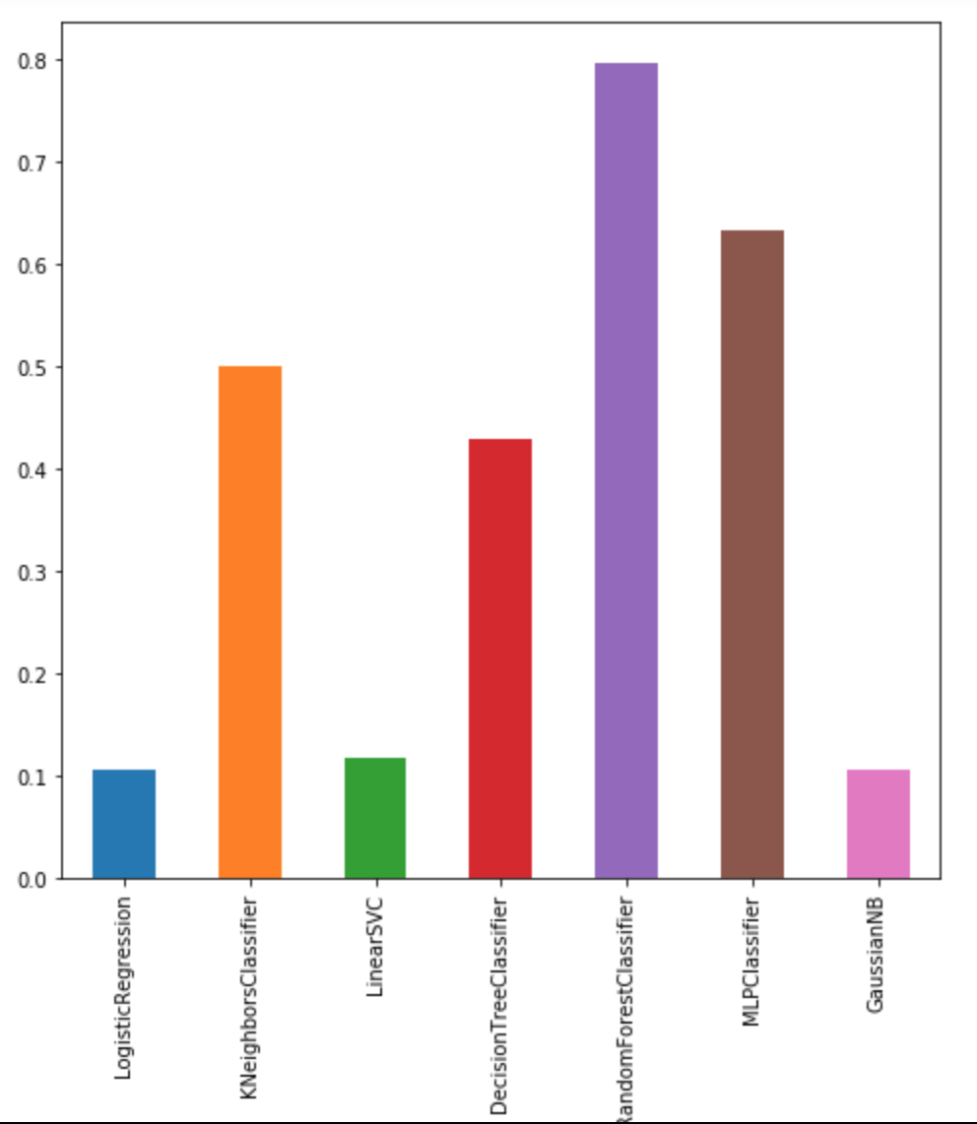
What I’ve done so far
F1 SCORES:
Random Forest (Tuned): 0. 827025
CNN: 0.745591
CNN 2: 0.79167 ( w/o CV)
CNN work:
Increase in precision, by about 10%.. Recall not quite there yet with respect to Random Forest
Further tuning may balance results
F1 score of baseline models. Tree based / NN are best, RF in particular. This aligns with industry standard (FeatureSpace - RF)
Notes:
Baseline work - Results for baseline classifiers collated for each sampling method. Further tuned parameters of Random Forest (best performer).
We haven't gained any improvement over the best baseline model yet, but interestingly we better in precision over most of the baseline classifiers, except random forest. It is expected that with further tuning of the CNN models, other than default parameters in a lot of cases, we could achieve very similar to that of the best baseline classifier.
Baseline work – Results collated, tuned best performer
CNN model 1
Prepared CNN model 2 for training
models learn better to not misclassify non-fraud, after using SMOTE.

Slide 6
What’s left to do…
Run time series cross-val and collate results for second CNN model:
- Temporal ordering, batching together 100 vectors and treating as an image, with a striding window of size 5.
Further tuning of CNN models to give insight to what could be achieved (i.e the window size, batch size, optimizer function etc).
Implement the GAN
Finalize results and draw evaluations, using methods discussed previously

