Slide 1


Property-Guided Shape Analysis
S.Itzhaky, T.Reps, M.Sagiv, A.Thakur and T.Weiss
Slides by Tomer Weiss
Submitted to TACAS 2014

Slide 2
Program Verification
Goals:
Precondition is true.
Postcondition holds.
One thing is missing...
void reverse( List h )
{
//Precondition: n*(h,null)
...
//Postcondition: n*(q,null)
}
SoCal Fall 2013

Slide 3
Verification tools
For every loop:
Annotate invariant.
Manual process.
void reverse( List h )
{
//Precondition: n*(h,null)
...
while( p != null {B}) //{I = ??}
{
...
}
...
//Postcondition: n*(q,null)
}
SoCal Fall 2013

Slide 4

Invariants are complex
Satisfy 3 properties:
{execution of code before loop} --> I
B and {execution of loop body} --> I
~B and I and {execution of code after loop} --> Postcondition
SoCal Fall 2013
Notes:
Taken from:
http://www.cs.miami.edu/~burt/learning/Csc517.041/workbook-notes/LoopInvar.html

Slide 5
Contribution
Automatically find invariants.
For programs that manipulate linked lists.
Implemented on While-Loop language.
SoCal Fall 2013

Slide 6
Linked lists
6 predicates to reason about linked lists.
n* relations:
n*(a,b) – path from a to b, of length 0 or more.
null
a
b
null
a
b
SoCal Fall 2013
Notes:
To express linked lists we use n* relations:
n*(a,b) means that there is a path from a to b, of length 0 or more.

Slide 7
Example
Program the reverses a linked list
void reverse( List h )
{
//Precondition: n*(h,null) -- h acyclic list
p = h;
q = null;
while( p != null ) //{I}
{
t = p->n;
p->n = q;
q = p;
p = t;
}
//Postcondition: n*(q,null) –- q acyclic list
}
If h is acyclic, q is acyclic
SoCal Fall 2013
Notes:
Suppose we want the invariant to look something like:
ForAll a:
a != null → ~( n*(p,a) and n*(q,a) )
This means that the list that starts with p and the list that starts with q are disjoint lists.

Slide 8

Consider
I= q != null → ~ n*(h,p) and
q != null → ~ n*(h,null) and
h == null → p == h and
( h != null and p != j ) → n*(q,h) and
( p != null and q != null ) → ~n*(p,h)
SoCal Fall 2013

Slide 9
So how to automatically find the invariant?
Hard problem:
Huge space of possible candidate invariants to consider
Infeasible to investigate them all.
SoCal Fall 2013

Slide 10
Algorithm
Start with a trivial invariant true.
Each iteration, refine the invariant.
The invariant needs to satisfy 3 conditions. Refine invariant by counterexample, till we find inductive invariant.
Based on notion of Property-Directed Reachability, where choices are driven by properties to prove.
SoCal Fall 2013

Slide 11


Implementation
Use Z3:
- an invariant is inductive
- strengthening an invariant when it is non-inductive.
- producing concrete counterexamples when the goal is violated.
Tool terminates, sound but not complete.
SoCal Fall 2013
Notes:
Rely on recently developed logic for expressing linked lists (AFR), for which SAT solvers are complete.
Use Z3 for proving that:
- an invariant is inductive
- strengthening an invariant when it is non-inductive.
- producing concrete counterexamples when the goal is violated.

Slide 12
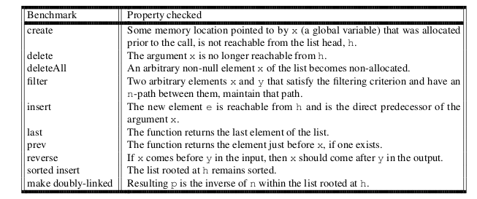
Benchmarks
Shape analysis: Reason about shape of data structure
SoCal Fall 2013

Slide 13
Conclusions
To the best of our knowledge, first tool for automatically inferring invariants for programs that manipulate linked list data structures.
Property-directed – choices are driven by the properties to be proven.
Implemented on top of standard SAT solver.
SoCal Fall 2013
Notes:
We use PDR because it works extremely well on other domains such as hardware verification, linear rational arithmetic and linear real arithmetic.
Our work presents first application of PDR to programs that manipulate dynamically allocated storage.

Slide 14

Questions?
tweiss@cs.ucla.edu
Tomer Weiss
SoCal Fall 2013

Slide 15

PDR related work
Based on Property-Directed Reachability (PDR), formerly known as IC3.
Thesis work by Aaron R. Bradley, theory.stanford.edu/~arbrad/
"The" IC3 paper: Aaron R. Bradley, SAT-Based Model Checking without Unrolling, VMCAI 2011
SoCal Fall 2013

Slide 16
Other related work
S. Itzhaky, A. Banerjee, N. Immerman, A. Nanevski, and M.Sagiv, Effectively-propositional reasoning about reachability in linked data structures. In CAV, 2013.
K. Hoder and N. Bjørner. Generalized property directed reachability. In SAT, 2012.
A. Podelski and T. Wies. Counterexample-guided focus. In POPL, 2010
SoCal Fall 2013

