Slide 1

ROCK PAPER SCISSORS
PRESENTED BY :
HARENDRA SINGH BHANDARI
UID – 21MCA3122
(MASTER OF COMPUTER APPLICATION)
UNIVERSITY INSTITUTE OF COMPUTING
DISCOVER . LEARN . EMPOWER

Slide 2
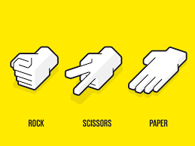
Contents
Introduction
Home page
Backend data
Output
Scope

Slide 3
Introduction
Rock Paper Scissors (also known by other orderings of the three items, with "rock" sometimes being called "stone", or as Rochambeau, roshambo, or ro-sham-bo)[1][2][3] is a hand game originating from China, usually played between two people, in which each player simultaneously forms one of three shapes with an outstretched hand. These shapes are "rock" (a closed fist), "paper" (a flat hand), and "scissors" (a fist with the index finger and middle finger extended, forming a V). "Scissors" is identical to the two-fingered V sign (also indicating "victory" or "peace") except that it is pointed horizontally instead of being held upright in the air.

Slide 4
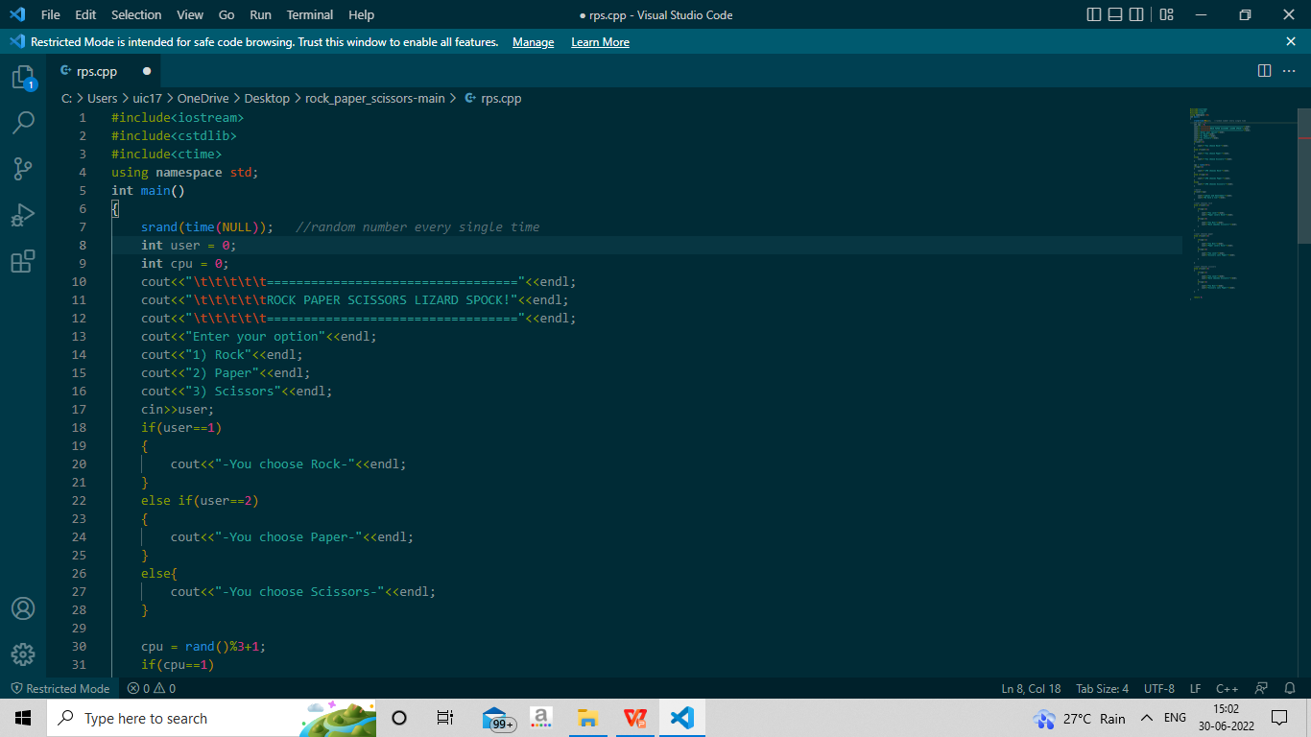
BACKEND USER INPUT DATA

Slide 5
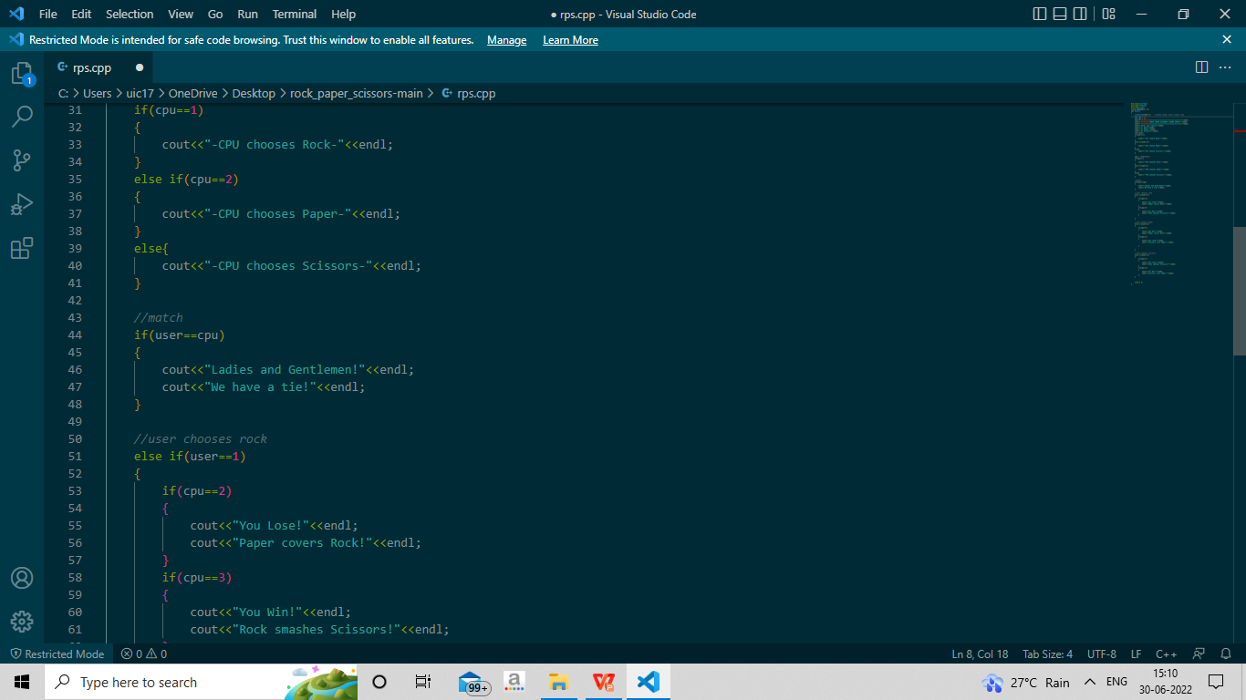
CPU RANDOM MOVES

Slide 6
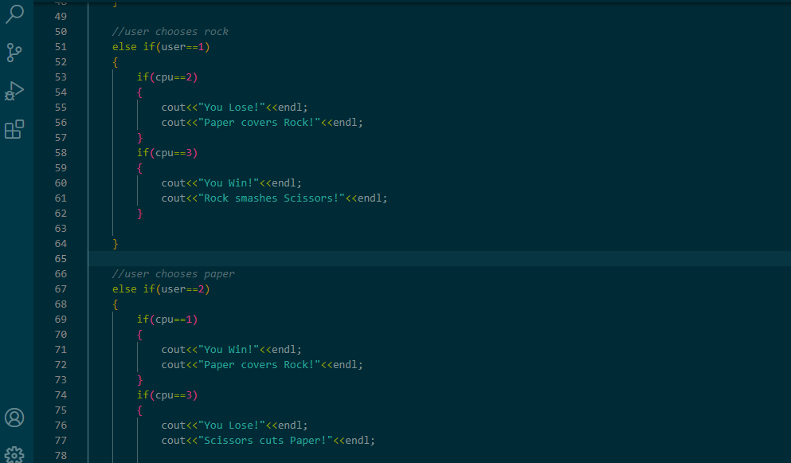
Notes:
Help Page

Slide 7
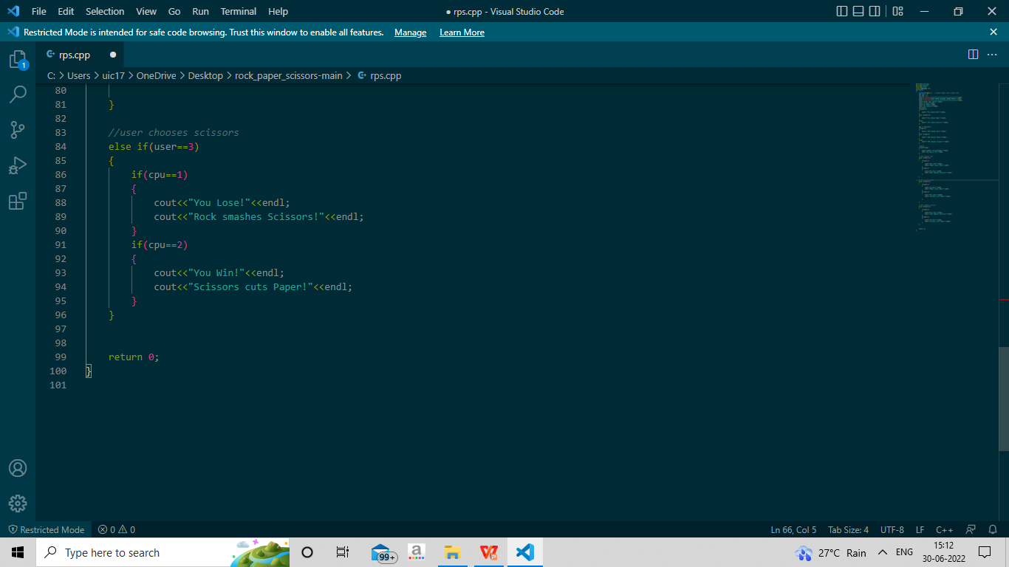
WHEN USER CHOOSES SCISSORS

Slide 8
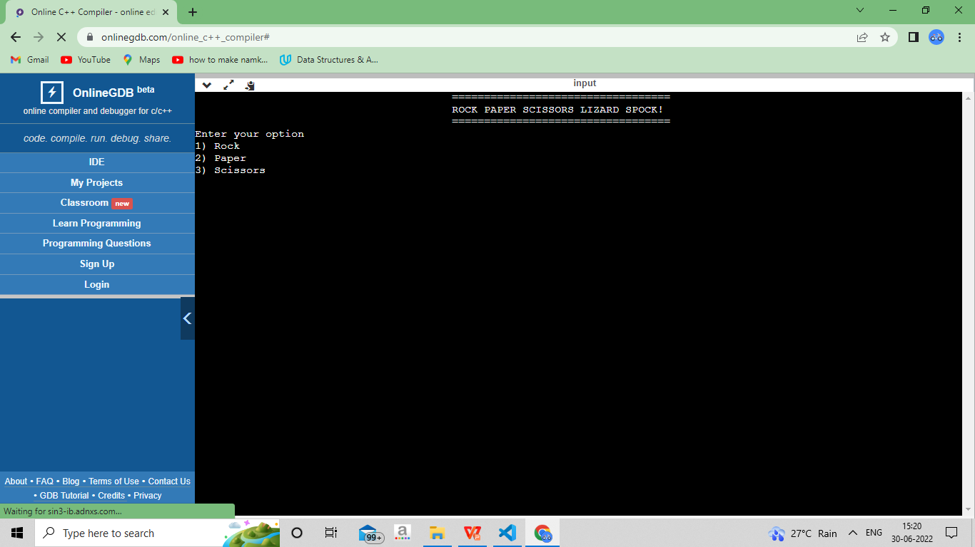
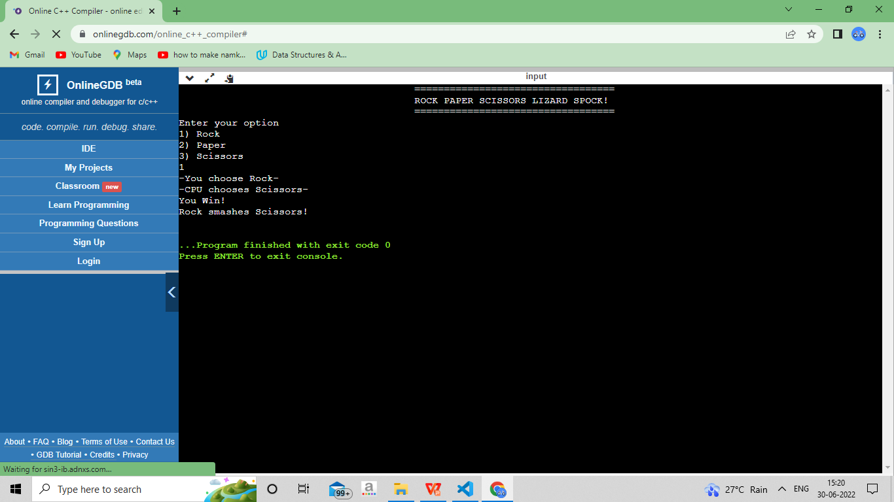
FINAL OUTPUT

Slide 9

ADVANTAGES
This game is fast as number of codes lines are less the time complexity of the program is less.
We can play these games in schools as it will help in building children curosity level and intelligence level too.

Slide 10
Reference
Book :-
internet
1. code with harry youtube channel.
2. w3school https://www.w3schools.com/
GITHUB LINK- https://github.com/harryhald/Stone-Paper-Scissors

Slide 11
Thank You
Notes:
Thank You for being with us for our Project Presentation.

