Slide 1
Lists and collections

Slide 2
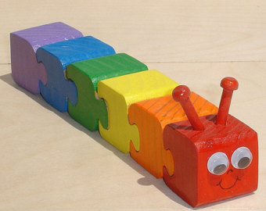
Lists
Can only add/remove at head
Immutable
Written with square brackets:
let myList = [1;2;3]

Slide 3

Sequence
Lazy – only get what you need as you need it
Same as IEnumerable
Written with curly braces:
let mySeq = seq { yield 1; yield 2}

Slide 4
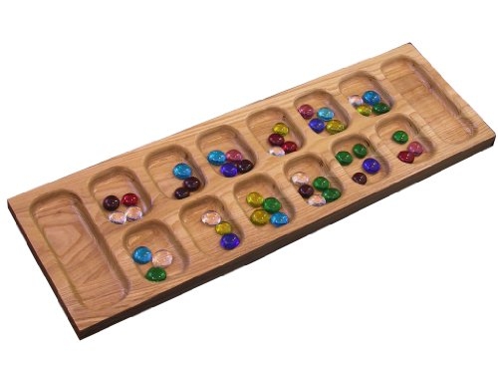
Array
Direct access to slots
Mutable (read/write)
Square brackets plus bar:
let myArr = [| 1;2;3 |]

Slide 5
Other available collection types
ResizeArray (same as List<T>)
map
set
Plus all .NET collections such as Dictionary

Slide 6
Lists
1
2
3
[]
[]
3::[]
1::2::3::[]
2::3::[]

Slide 7
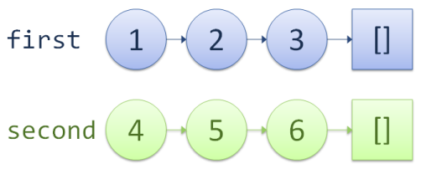
Lists

Slide 8
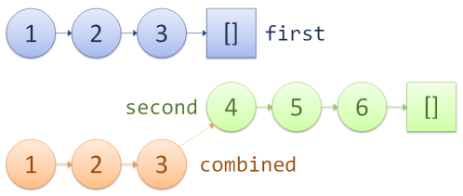
Lists

Slide 9
Pattern matching on lists
match list with
| [] -> ...
| first::rest -> ...
| [one;two;three] -> ...
Can match arrays in same way, but not seqs

Slide 10
Exercises
Practice creating lists
Practice matching lists

Slide 11
Coding Part 1b - Review
Lists, sequences
Filter, map, sortBy, reduce
Google for “msdn list module”

Slide 12
Transforming lists
Using functions as parameters

Slide 13
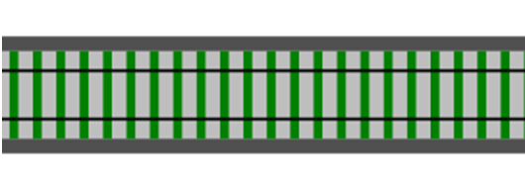
It is obvious how transformation works for simple values such as ints and strings.
But say that we want to transform a more complex structure. Perhaps we want to transform a list into a different list? How does that work?
Map list -> list
A list
A list
Function item-> item
No loops allowed!
Transformations only!
Pass in a function that transforms individual items
If you are used to LINQ or SQL, then you are already familiar with the `map` concept, but under the name `Select`.

Slide 14
So let's create some list transformation functions using "map" and a function parameter
let add1ToEveryElement = List.map add1
let doubleEveryElement = List.map double
let squareEveryElement = List.map square
Now we can use these functions just like the transformations we did on simple integers
[1..10] |> add1ToEveryElement
[1..10]
|> add1ToEveryElement
|> doubleEveryElement
|> squareEveryElement

Slide 15
Often, we won't bother to create special list transformation functions, but will instead use the `map` function "inline" as it were, like this:
[1..10]
|> List.map add1
|> List.map double
|> List.map square
If we are really lazy we will use lambdas to define the function parameter inline as well:
[1..10]
|> List.map (fun x -> x + 1)
|> List.map (fun x -> x * 2)
|> List.map (fun x -> x * x)

Slide 16
The same transformation approach can be used for filtering. We want to transform one list into another, but instead of transforming each item,
we want to include only items that meet certain criteria.
let isEven x = (x%2 = 0)
let isPositive x = (x > 0)
let onlyEvenElements = List.filter isEven
let onlyPositiveElements = List.filter isPositive
[-5..5]
|> onlyEvenElements |> onlyPositiveElements // = [2; 4]
[-5..5]
|> List.filter isEven
|> List.filter isPositive // = [2; 4]
Or don't bother with intermediate function

Slide 17
Extracting boilerplate
Reduce and fold

Slide 18
Loops in C#...
public static int Sum(IEnumerable<int> list)
{
int sum = 1;
foreach (var i in list)
{
sum += i;
}
return sum;
}

Slide 19
...become transformations in F#
Sum [1;2;3;4;5]
1+2+3+4+5
List.Reduce (+) [1..5]
List.Reduce (*) [1..5]
List.Reduce (+) ["Hello"; "World"]
Exercise – play with these...
Try reduce on empty list!

Slide 20
Loops in C#
public static int Product(int n)
{
int product = 1;
for (int i = 1; i <= n; i++)
{
product *= i;
}
return product;
}

Slide 21
Loops in C#
public static int SumOfOdds(int n)
{
int sum = 0;
for (int i = 1; i <= n; i++)
{
if (i % 2 != 0) { sum += i; }
}
return sum;
}

Slide 22
Running totals
Sum (1..5) example again
Calculation Running total
0 0
0 +1 1
(0+1) +2 3
((0+1)+2) + 3 6
(((0+1)+2)+3) + 4 10
((((0+1)+2)+3)+4) + 5 15

Slide 23
Extracting the logic
Function | Initial value | Inner loop logic
Sum | sum = 0 | Add the i'th value to the running total
Product | product=1 | Multiply the i'th value with the running total
SumOfOdds | sum=0 | Add the i'th value to the running total if not even

Slide 24
Introducing “fold”
let product n =
let initialValue = 1
let action productSoFar x =
productSoFar * x
[1..n] |> List.fold action initialValue
product 10 //test

Slide 25
Introducing “fold”
let product n =
let initialValue = 1
let action productSoFar x =
productSoFar * x
[1..n] |> List.fold action initialValue
product 10 //test
let sumOfOdds n =
let initialValue = 0
let action sumSoFar x =
if x%2=0 then sumSoFar else sumSoFar+x
[1..n] |> List.fold action initialValue
sumOfOdds 10 //test

Slide 26
Introducing “fold”
// exercise
let sum n = ?
sum 10 //test

Slide 27
Introducing “fold”
// exercise
let sum n =
let initialValue = ?
let action sumSoFar x = ?
[1..n] |> List.fold action initialValue
sum 10 //test

