Slide 1
Clustering type of business in different U.s. cities

Slide 2
Clustering type of business in different U.s. cities
- The entrepreneur would like to set up his/her own business in a city
- They need to consider the number of competitors in it and what type of business is the majority of the city
- They can make a better plan for choosing the city to set up their business

Slide 3
Data acquisition and cleaning
Wikipedia
Foursquare

Slide 4
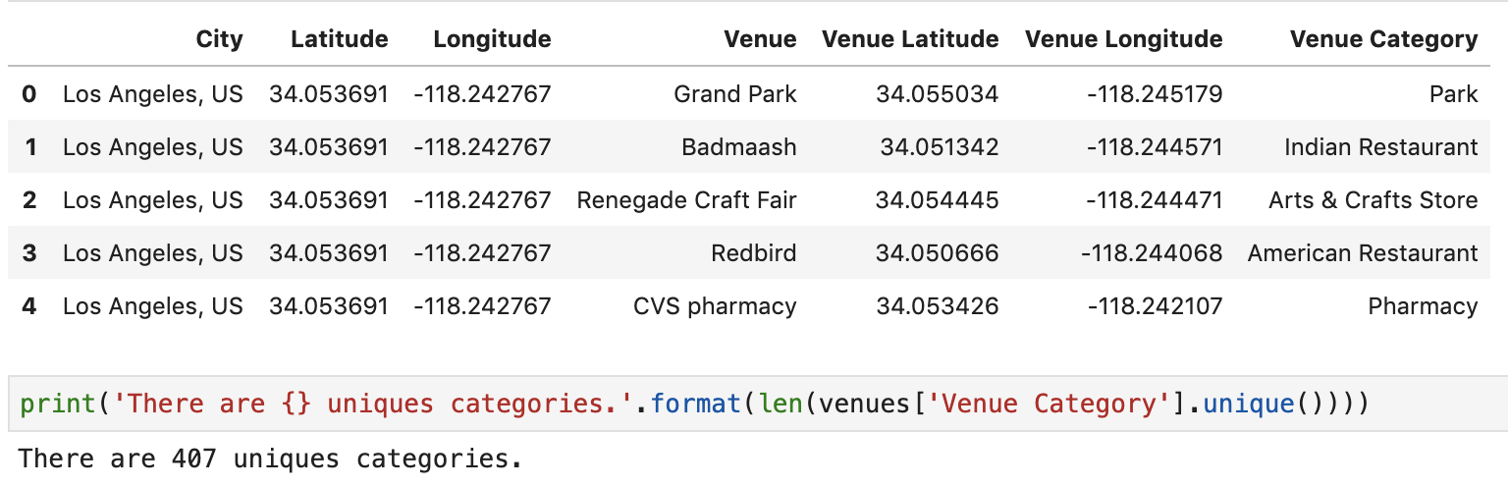
Venue data sample

Slide 5
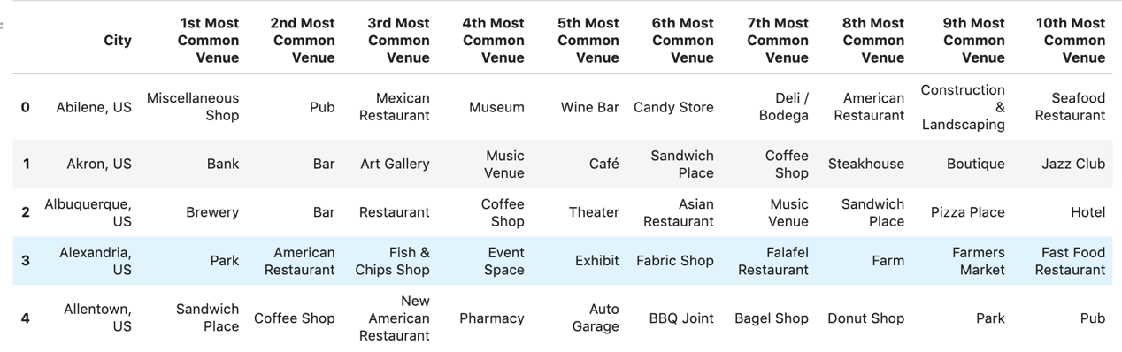
The most common venue in different cities

Slide 6
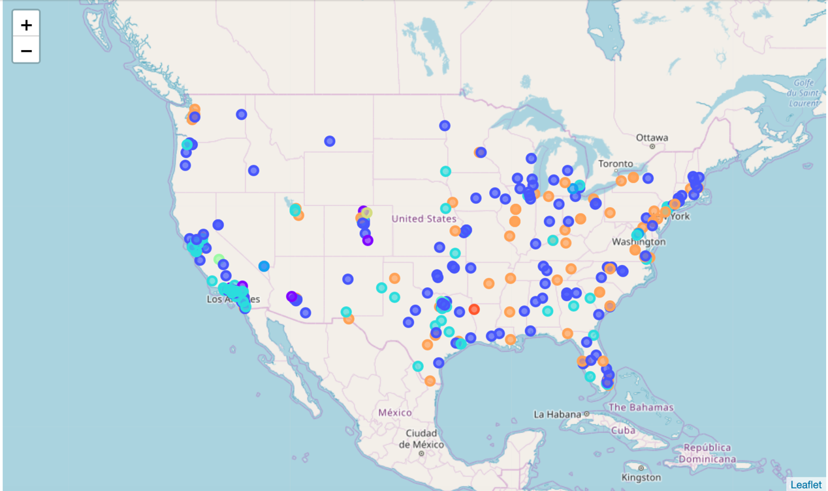
Different common venue in Different cities

Slide 7
Conclusion
Entrepreneur can use the above map as a reference to choose the cities to set up their own business.

