Slide 1
Clinic Schedule
Made By:
Harpreet Singh
Shifa Chaudhary

Slide 2
Problem
Shift Staffing:
Coordination problem/RSVP Issue
Map right volunteers
Panacea
An application using APPIAN
Actors
Administrator
Clinic Director
Shift Scheduler
Volunteers

Slide 3
Problem
Shift Staffing:
Coordination problem/RSVP Issue
Map right volunteers
Panacea
An application using APPIAN
Actors
Administrator
Clinic Director
Shift Scheduler
Volunteers

Slide 4
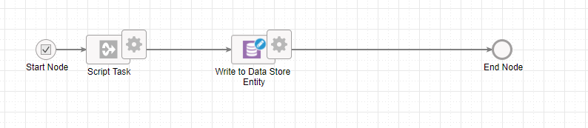
Summary of process flow
Adding volunteers

Slide 5
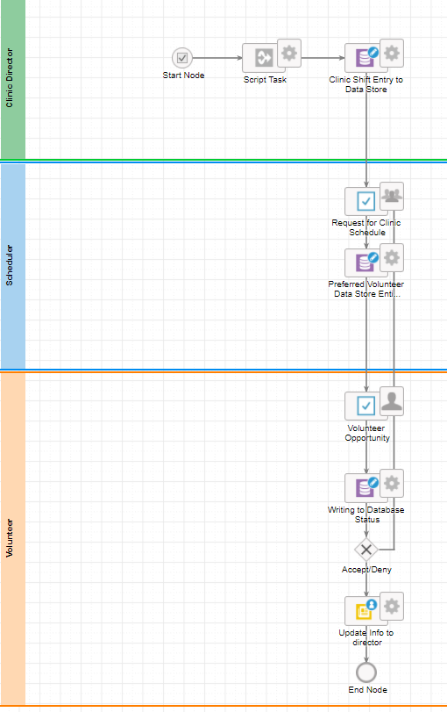
2. Shift Scheduling

