Slide 1
Use 70% - 110% LV
Total counts increase from 955 to 1,263 (32% more).
Impacted collateral:
  Commercial/Farm Properties: -3.1%
  Unsecured: -3.7%

Slide 2
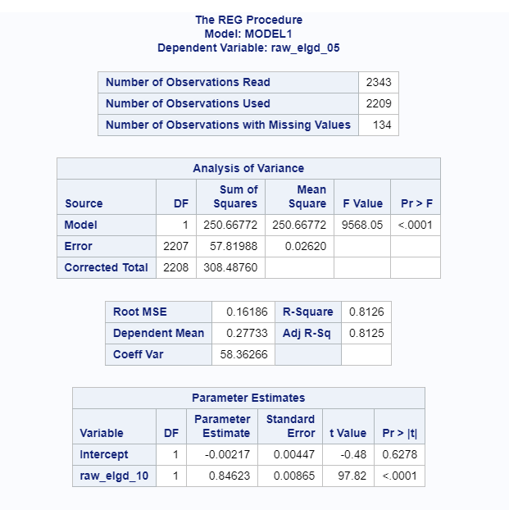
Relative Adjustment Factors – Regression approach
Regression is ran on raw_elgd_05 with raw_elgd_10.
raw_elgd_05 = -0.2%+0.85 * raw_elgd_10
This is equivalent to 15% discount.

Slide 3
Relative Adjustment Factors – Simple average
Facilities are grouped by collateral type and raw_elgd_05 for each collateral type is calculated using simple average.
collateral type with more than 15 counts are highlighted.
Ranking orders are not intuitive for some collateral types, i.e. A/R margined vs. Not margined. Unsecured vs. RE ADS.
Judgement needs to be applied for those don’t have sufficient count.
primary_collateral_bl | N Obs | Mean
A/R - Margined | 112 | 31.6%
A/R - Not Margined | 35 | 21.1%
Agriculture Livestock - Margined | 1 | 20.4%
Agriculture Livestock - Not Margined | 2 | 23.9%
Blanket Lien | 183 | 18.0%
Cash Equivalent | 8 | 14.3%
Commercial/Farm Properties | 1115 | 25.1%
Crop Production | 4 | 3.9%
Crops - Not Margined | 2 | 0.1%
Fixed Assets/PP&E | 87 | 22.0%
Government Guaranteed Loans | 12 | 39.9%
Inventories - Margined | 28 | 16.6%
Inventories - Not Margined | 14 | 1.8%
Marketable Securities - Not Margined | 5 | 37.4%
Performance LC - Developer (Standalone) | 2 | 60.8%
Performance LC - Developer (with Shared Construction Collateral) | 8 | 48.8%
Preferred Shares | 1 | 0.0%
R/E Constr. Projects/ADS | 391 | 37.3%
Residential Real Estate- 1st Charge | 220 | 28.2%
Residential Real Estate- Other | 10 | 26.0%
Secured No Lending Value | 4 | 1.1%
Unsecured | 99 | 35.6%
Total | 2343

Slide 4
F2019 Recalibration – With Pre-Conversion M&I
Calibrations scope:
  Q4F19 Performance Monitoring Dataset + F2017 M&I post-conversion facilities
 | Add/Exclusion | Total
Total facilities |  | 4,331
BSM | -1,548 | 2,783
TF | -55 | 2,728
Dealer Finance | -31 | 2,697
M&I Pre-conversion | 1,738 | 4,435

Slide 5
M&I Pre-Conversion

Slide 6
Calibration Result – Unadjusted LR LGD
Relative adjustment factor
The factor is used to scale the LR factor to reach the unadjusted LR factor.
This is determined by the relative difference of average ELGD with 10% discount rate vs. 5% discount rate.
  As of F2018, the factor is 10%.
  As of F2019, the factor is 20%.
Recommendation:
Align the factor with F2018 10%
Remove the adjustment factor given the lower LR LGD factor

Slide 7
Update Since Last Touchpoint – Documentation
Documentation
  Section 3 Data : data section is done pending on M&I pre-conversion.
    Section 3.7 - Data Representativeness and Quality: the reassessment will be performed in model revalidation (June 2020)
  Section 4 Model Development and Testing: this is almost done
    Section 4.4.1 Discussion of Candidate Variables : same variables are used as last development since there is no change on methodology. The reassessment will be performed in model revalidation (June 2020)
  TF calibration will be incorporated into CA commercial LGD Recalibration

Slide 8
Appendix: F2019 vs. F2018 Adjustment
Primary Collateral Group | F2019 Unres | F2018 Unres | F2019 DT | F2018 DT | F2019 Data | F2018 Data
A/R - Margined | 0.0% | 0.0% | 11.9% | 5.5% | 6.6% | 5.0%
Blanket Lien (Assets >= 10MM) | 7.7% | 1.6% | 8.2% | 4.1% | 2.7% | 3.9%
Commercial/Farm Properties | 0.6% | 0.3% | 7.5% | 4.6% | 1.8% | 1.5%
Fixed Assets/PP&E | 3.8% | 0.1% | 3.1% | 6.4% | 4.3% | 4.1%
R/E Constr. Projects/ADS | 0.0% | 0.0% | 2.3% | 2.7% | 3.5% | 2.8%
Residential Real Estate- 1st Charge | 0.1% | 0.3% | 8.2% | 6.6% | 4.2% | 3.0%
Unsecured | 2.7% | 0.4% | 10.9% | 2.7% | 5.7% | 5.1%

