Slide 1
Analysis of California population spread across counties based on Census 2015 data

Slide 2
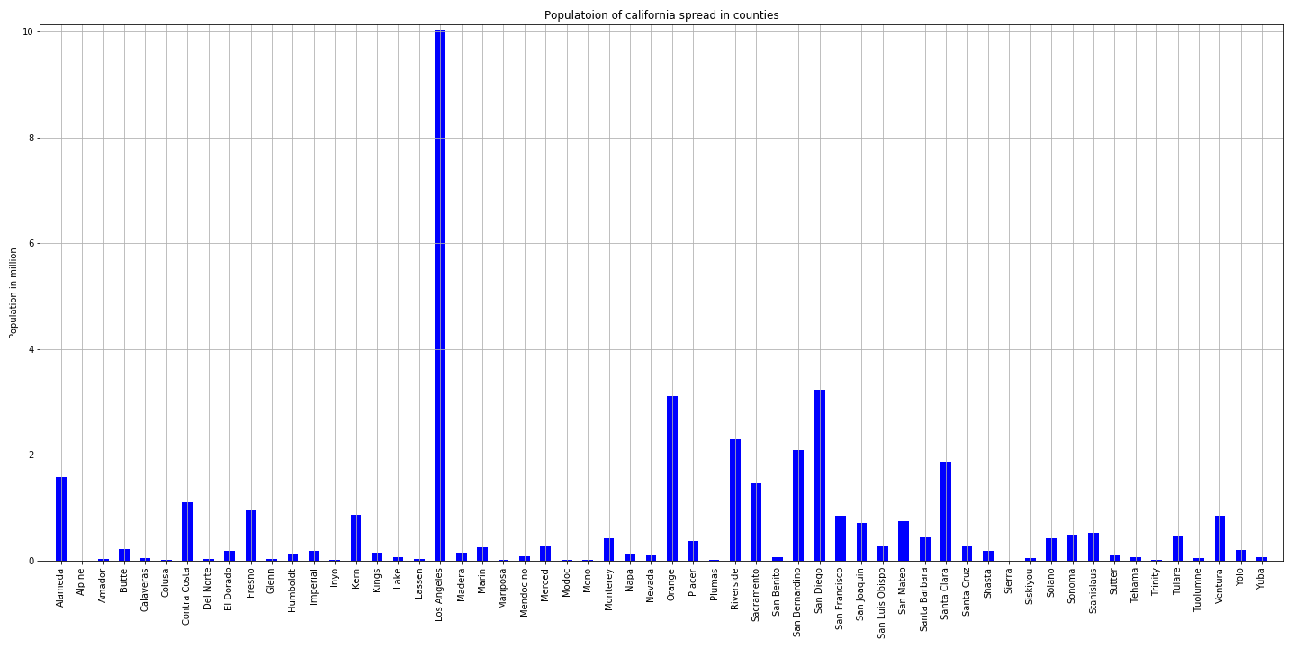
Population of California across counties

Slide 3
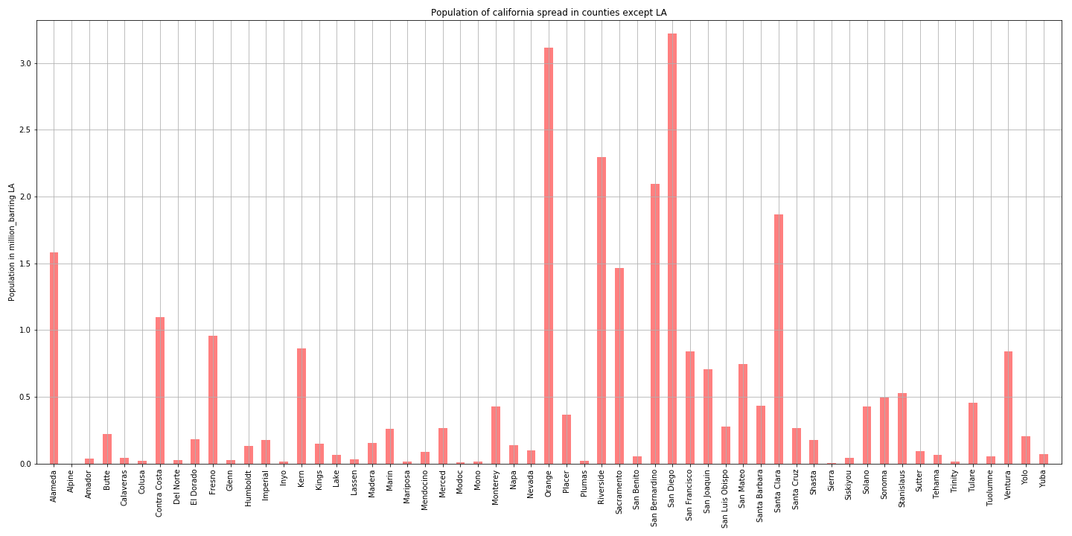
Population across counties removing LA as outlier for a closer observation of other counties

Slide 4
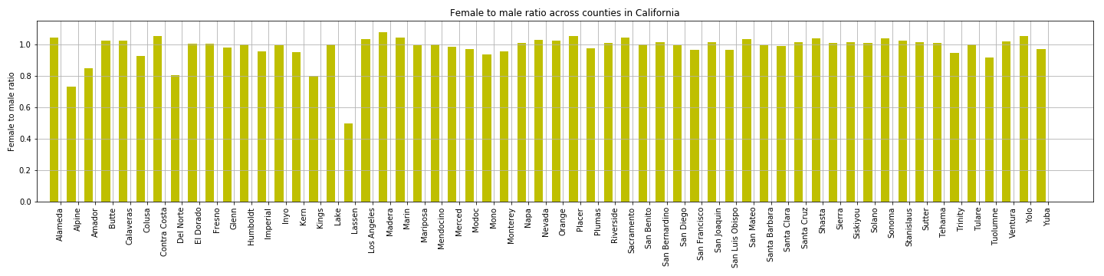
How does female to male ratio look like --

Slide 5
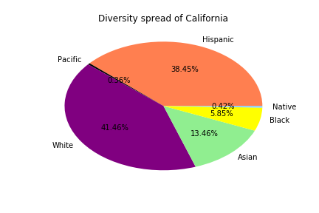
What about diversity?

Slide 6
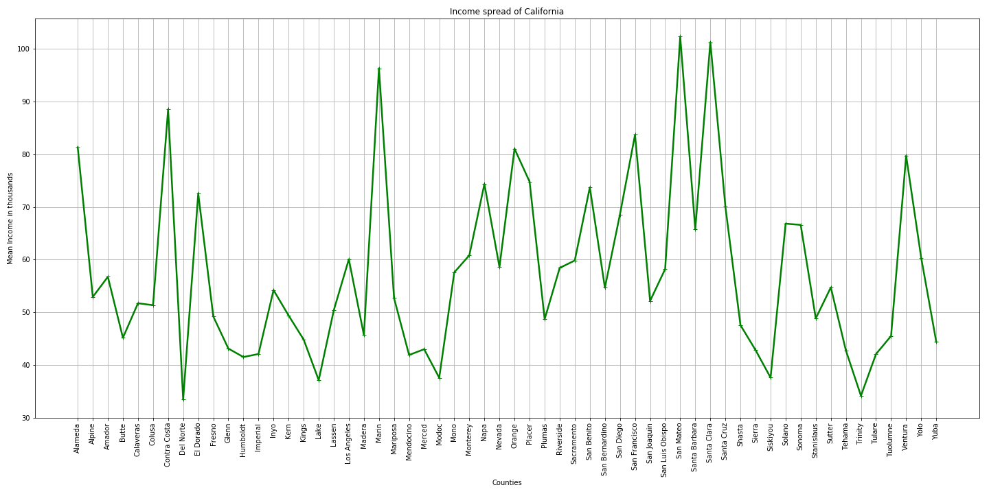
What is income levels here?

Slide 7
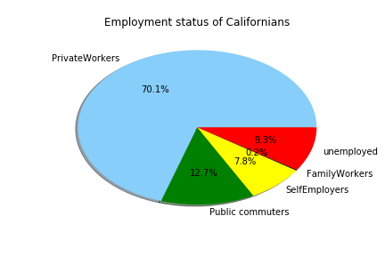
What is employment status?

Slide 8
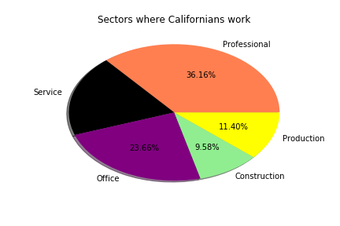
What are working sectors here?

Slide 9
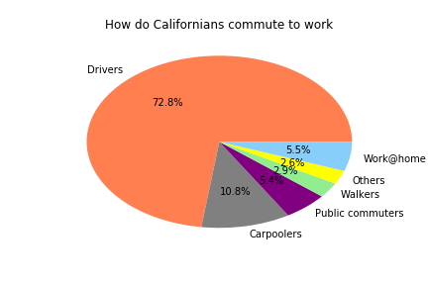
How do Californians commute to work?

Slide 10
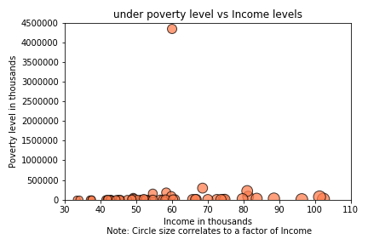
Is there a relation between income levels and poverty?

Slide 11
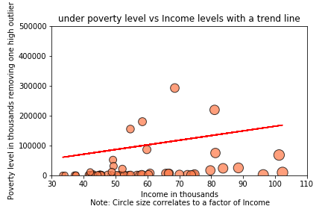
Income vs poverty - is there is trend?

