Slide 1
Analysis of California population spread across counties based on Census 2015 data

Slide 2
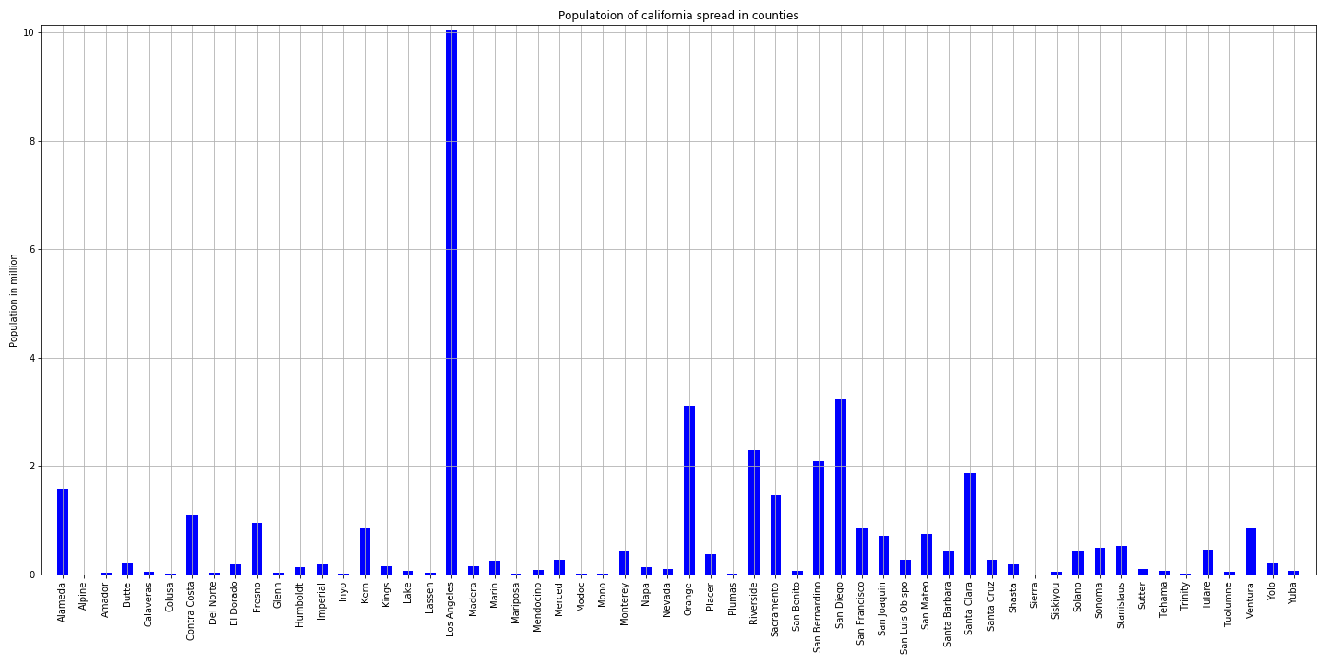
Population of California across counties

Slide 3
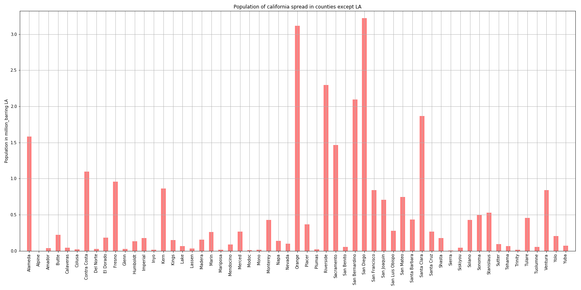
Population across counties removing LA as outlier for a closer observation of other counties

Slide 4
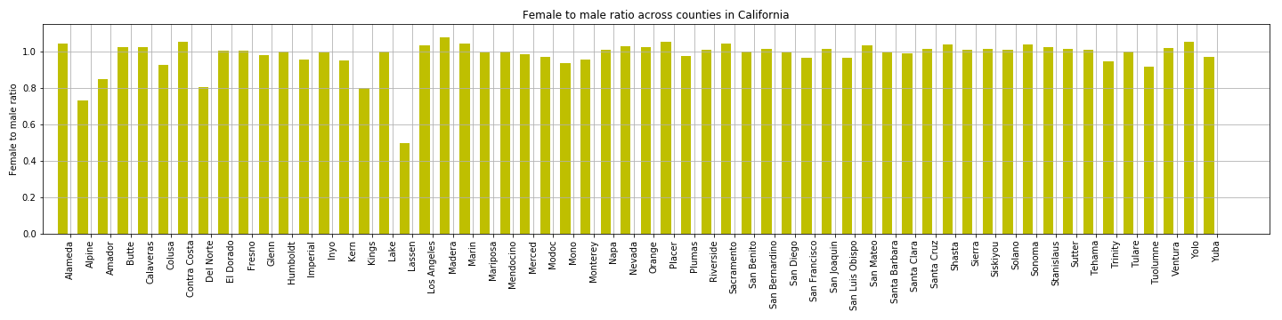
How does female to male ratio look like --

Slide 5
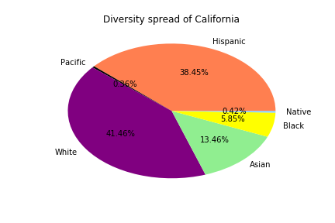
What about diversity?

Slide 6
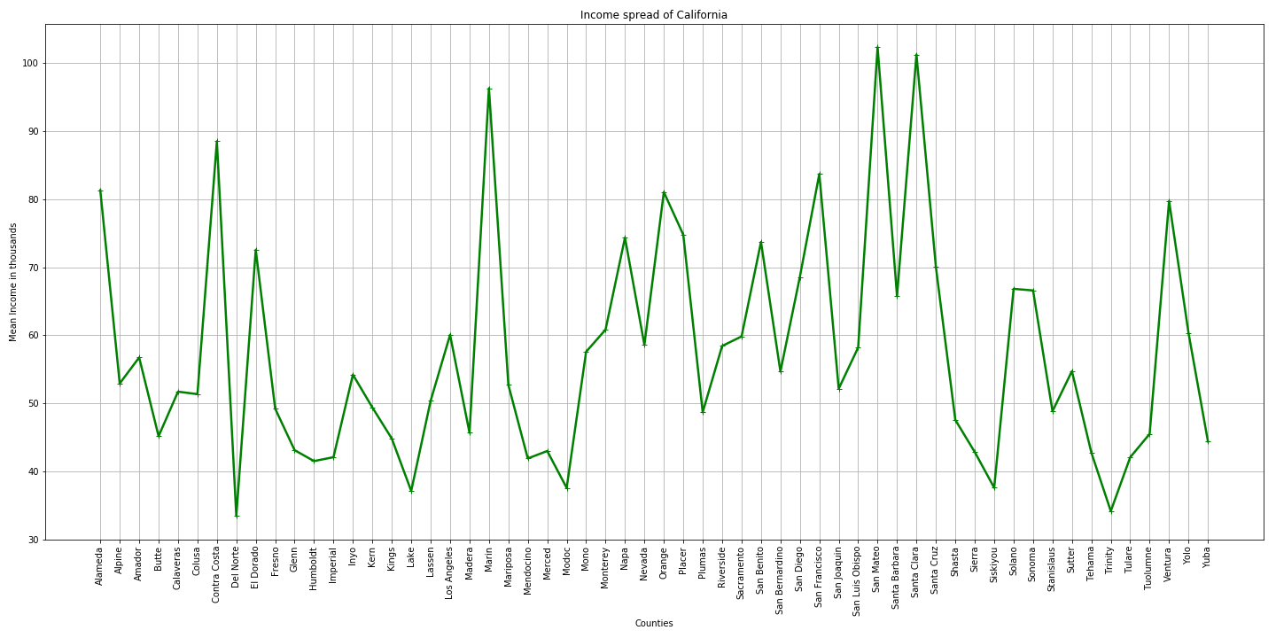
What Are income levels here?

Slide 7
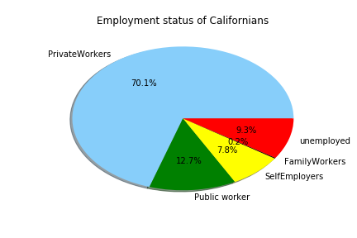
What is employment status?
#PrivateWork = % employed in private industry
#PublicWork = % employed in public jobs
#SelfEmployed = % self-employed
#FamilyWork = % in unpaid family work
#Unemployment = Unemployment rate (%)
Notes:
#PrivateWork = % employed in private industry
#PublicWork = % employed in public jobs
#SelfEmployed = % self-employed
#FamilyWork = % in unpaid family work
#Unemployment = Unemployment rate (%)

Slide 8
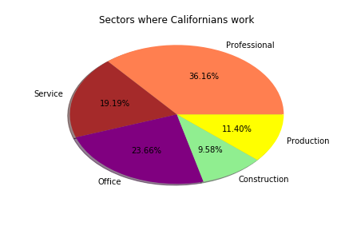
What are working sectors here?
#Professional = % employed in management, business, science, and arts
#Service = % employed in service jobs
#Office = % employed in sales and office jobs
#Construction = % employed in natural resources, construction, and maintenance
#Production = % employed in production, transportation, and material movement
Notes:
#Professional = % employed in management, business, science, and arts
#Service = % employed in service jobs
#Office = % employed in sales and office jobs
#Construction = % employed in natural resources, construction, and maintenance
#Production = % employed in production, transportation, and material movement

Slide 9
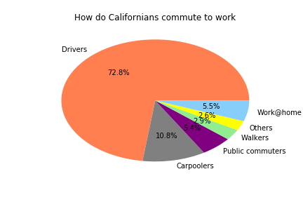
How do Californians commute to work?

Slide 10
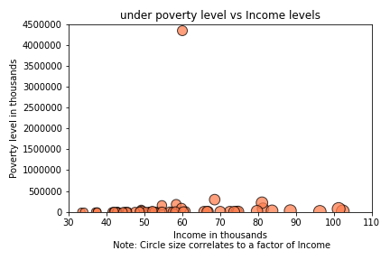
Is there a relation between income levels and poverty?

Slide 11
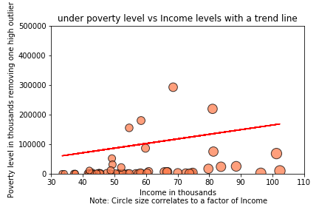
Income vs poverty - is there is trend?

