Slide 1
New & Improved Vernier Time- Measurement Block
Mika Nyström mika.nystroem@intel.com
Jin Yan jin2.yan@intel.com

Slide 2
Problem statement
First priority: to support 1588 timestamping in Rockvale
  Tight error budget (~1ns per timestamp, NAC had 3ns port-to-port)
  Clock-domain crossings must necessarily exist (networking: external data is on own clock)
Second priority: timestamping in general
  Aim at a simple, easy to understand interface
  Easy integration
  Good accuracy, good performance with noisy clocks
Already have something similar in Rimmon

Slide 3
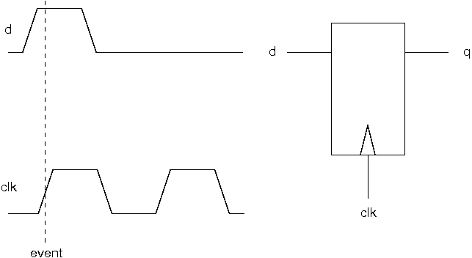
An event
The time of the event is defined as the time of the rising, receiving clock edge

Slide 4
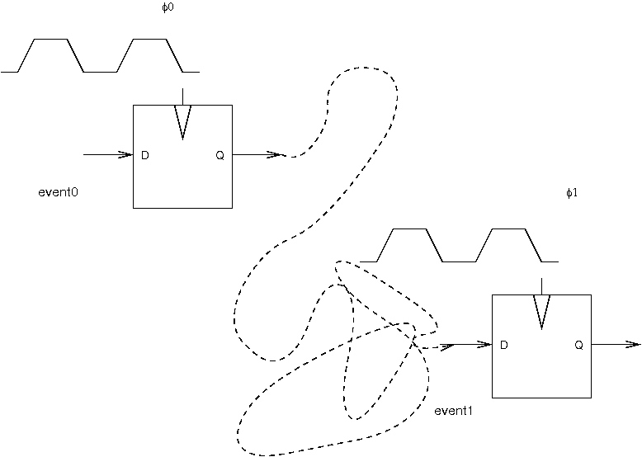
Problem in terms of events
How long between event0 and event1?

Slide 5
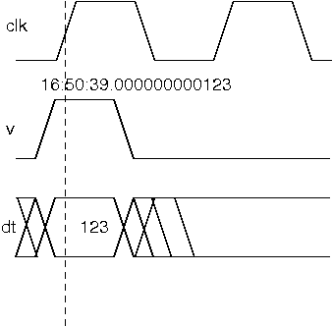
Representing a past event
Represent a past event as:
A current event
A time offset (the age of the past event)
(If it’s a current event, the offset is 0)
In example:
1-GHz clock
dt is in picoseconds (ps)
Represent that an event took place at 16:50:39.000000000000
Using this representation, we can easily solve our problem by bringing the two events
into physical proximity and subtracting their dt’s.

Slide 6
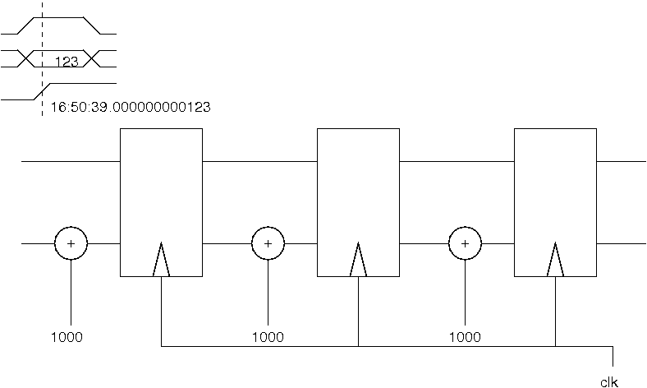
Forwarding an event in time

Slide 7
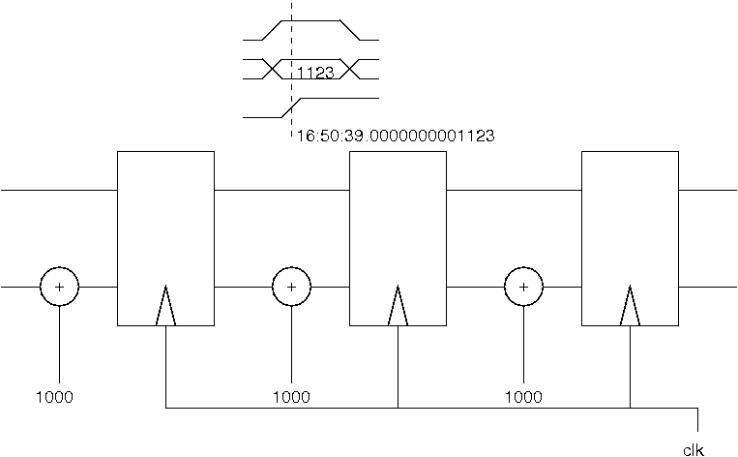
Forwarding an event in time

Slide 8
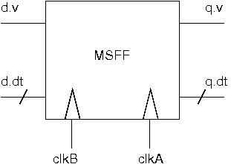
Two clock domains?
Auxiliary inputs:
Clock periods (binary numbers)
Reset handshakes: resets in clkA, clkB domains
Clear handshake (clkA domain)
Parameterized by size of constants
Otherwise, intended to be automatic

Slide 9



Theory of operation (briefly)
clkB (period pB) events to be received in clkA (period pA)
Compute phase of clkB w.r.t. A
Ask: “how long before clkA rose did clkB rise”

Slide 10
Theory of operation (briefly)
How long before clkA did clkB tick?
But the question must have an answer between 0 and pB
Choose C so that Delta behaves accordingly

Slide 11
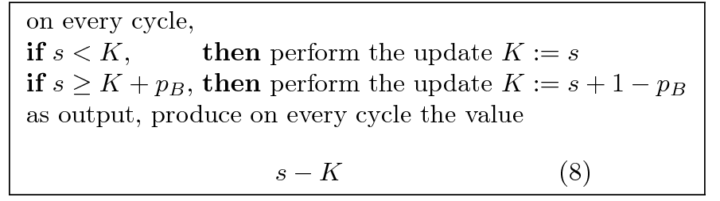
Theory of operation (briefly)
(Let s=nA pA – nB pB)

Slide 12
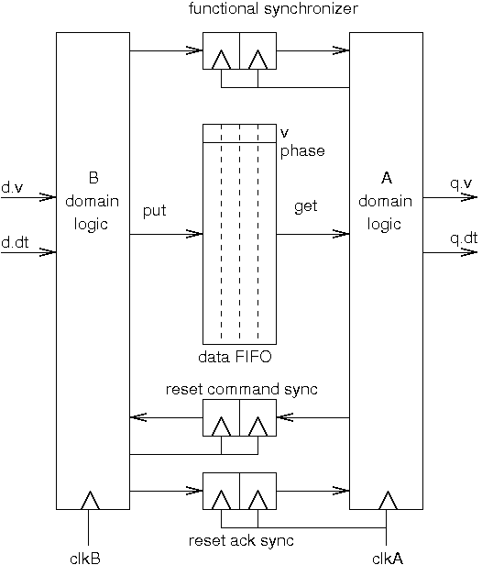
Implementation
WIP:
Reset and initialization
Arithmetic integration

Slide 13
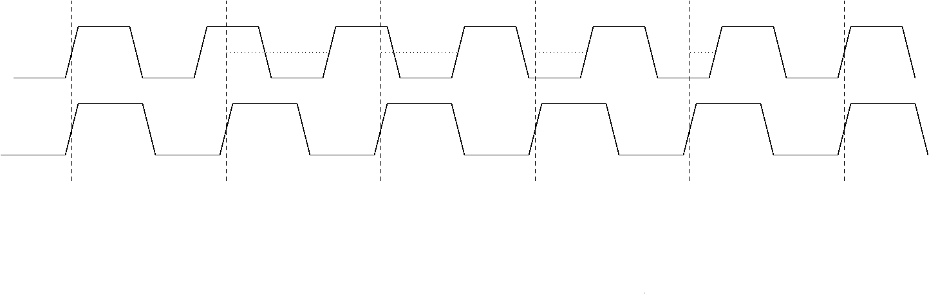
Waveforms
5:4 clock illustration

Slide 14
Theoretical performance
Theoretical performance
Precision GCD(pA,pB)
Convergence time LCM(pA,pB)

Slide 15
Example
clkB 390 5/8 MHz = 100/256 GHz, clkA 850 MHz = 17/20 GHz
pB 256/100 ns, pA 20/17 ns
Let TU = 1/(100x17) ns ≈ 588.235 fs
pB = 17 x 256 TU, pA = 20 x 100 TU
(lowest terms) pB = 272, pA = 125 / GCD = 1
Precision = 20/17/125 ns = 4/425 ns ≈ 9.412ps
Convergence = 272 clkA cycles = 125 clkB cycles = 320ns (exactly)

Slide 16
Experimental results
Theoretical precision = 20/17/125 ns = 4/425 ns ≈ 9.412ps
Measured in VCS: 9.432ps
With 100ppm clock drift: see 36.1ps in a quick sim (expect about 9.4 + 100ppm x 320ns = 41.4ps)

Slide 17
Further reading
“Precise Time-Interval Measurement Using Vernier Clocks”

