Slide 1
End-to-End Data Engineering Pipeline with AWS & Terraform
Final Project – Naya DE Course
By: Harry & Avital
Notes:
Introduce the project: End-to-end data engineering pipeline with AWS & Terraform. Simulates retailer data processing.

Slide 2
The Problem
Retailers generate lots of transactional data (customers, orders, products, order details).
Raw data is messy and spread across different systems.
We needed a pipeline to ingest, clean, transform, and load data into a warehouse
for analysis.
Notes:
Problem: Retailers face messy, distributed data. Goal: automated pipeline to ingest, clean, transform, and load into warehouse.

Slide 3
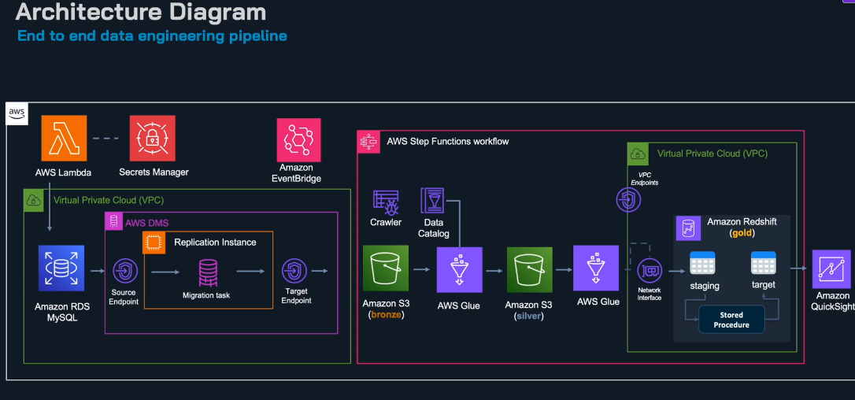
Architecture Overview
Data flows from raw sources into S3, processed by Glue, lands in Redshift.
Terraform ensures reproducible infra.
Notes:
Architecture: Data → S3 → DMS → Glue → Redshift. Terraform ensures reproducible infra.

Slide 4
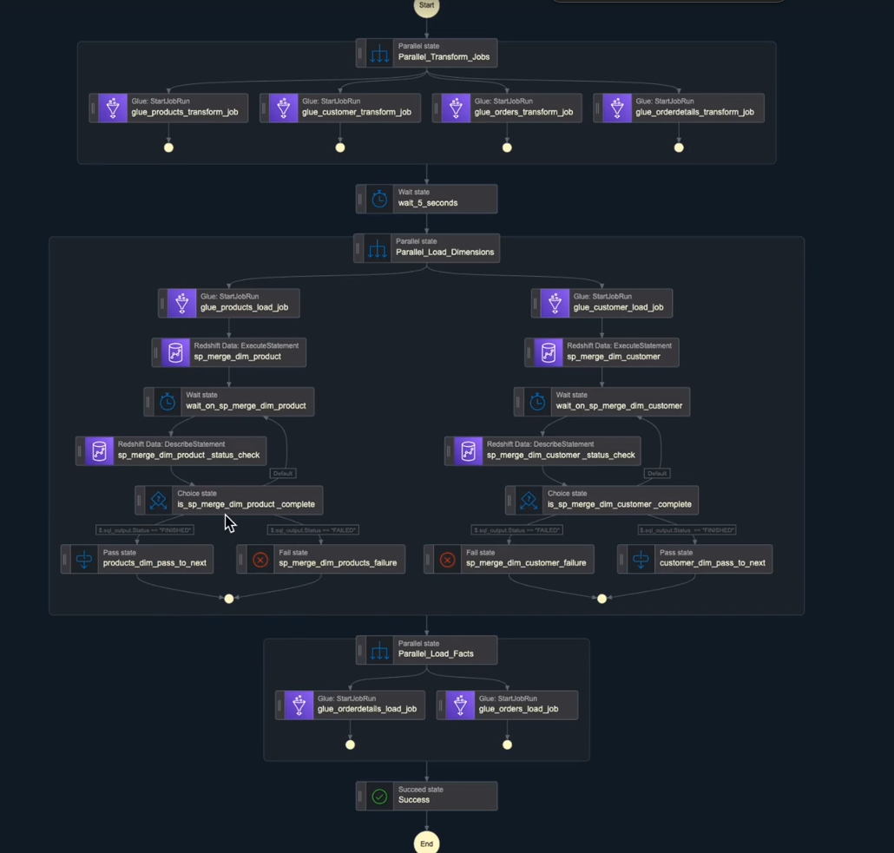
Orchestration with Step Functions
Dependencies: customers before orders, products before order details.
Step Functions ensures correct execution.
Notes:
Orchestration: Customers before orders, products before order details. Step Functions enforce correct sequence.

Slide 5
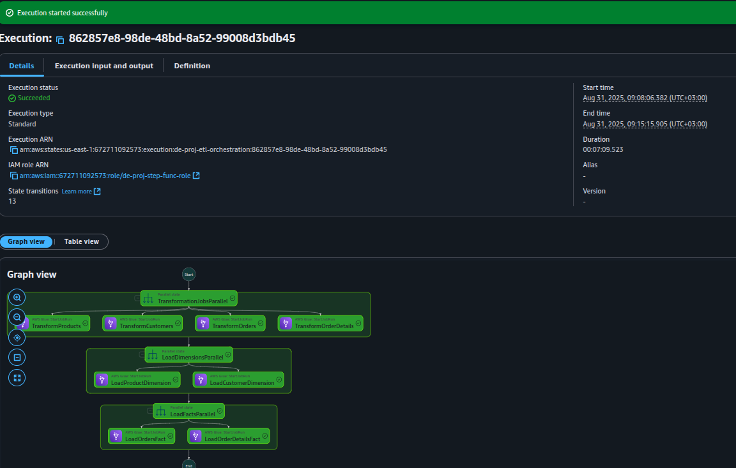
Data Processing with Glue & SQL
Glue ETL jobs transform raw → curated data.
Stored procedures refine Redshift schema.
Notes:
Data Processing: Glue jobs transform raw → curated tables. Stored procedures refine schema. Screenshot shows Glue run.

Slide 6
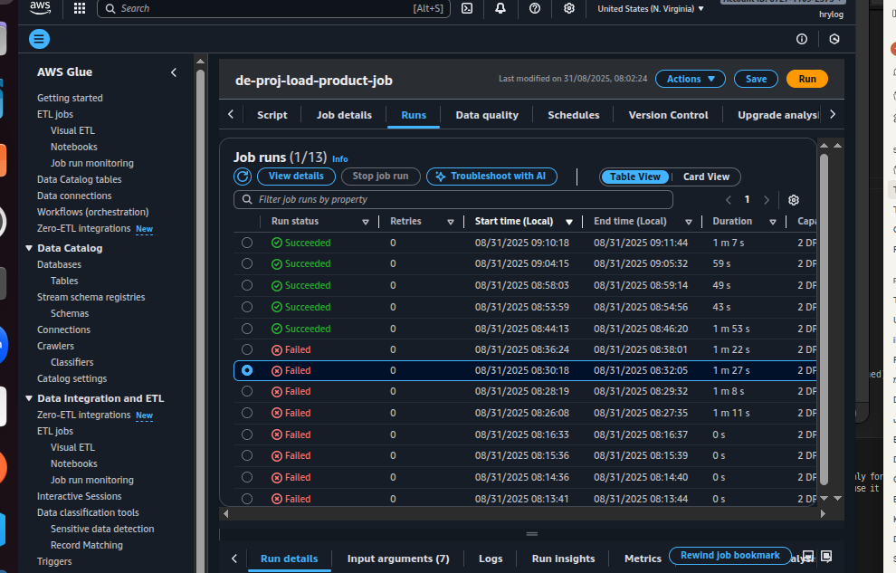
Automation with Terraform
Terraform modules for DMS, Glue, IAM, Lambda.
Reusable, reliable, redeployable infra.
Notes:
Terraform: Infrastructure as code. Root + modules (RDS, Glue, IAM, Lambda). Variables avoid hardcoding. One-click redeploy.

Slide 7
Demo – The Flow
1. Data uploaded to S3
2. Step Functions triggered
3. Glue jobs run → curated data
4. Data appears in Redshift → queries ready
Notes:
RDS Config: binlog_format=ROW, binlog_row_image=full. Enables CDC, audit trails, ETL integration.

Slide 8
Results
✅ End-to-end pipeline working
✅ Modular deployment
✅ Easy to extend
Example queries:
SELECT * FROM customers;
SELECT COUNT(*) FROM orders;
Notes:
Demo Flow: Upload data → Step Functions trigger → Glue cleans data → Redshift updated. Fully automated.

Slide 9
Challenges & Solutions
- IAM errors → solved via module
- Job dependencies → Step Functions
- Schema consistency → stored procedures
Notes:
Results: Redshift queries work (SELECT COUNT(*) FROM orders). Pipeline is end-to-end, automated, modular, extensible.

Slide 10
Future Improvements
- Monitoring with CloudWatch
- Dashboards with QuickSight
- Anomaly detection on orders
Notes:
Challenges: IAM errors fixed with Terraform IAM module. Dependencies solved with Step Functions. Schema consistency via stored procedures + RDS logging.

Slide 11
Conclusion
We built an automated, reproducible data pipeline with AWS + Terraform.
Demonstrates modern data engineering best practices.
Thank you!
Notes:
Future: Add monitoring (CloudWatch), dashboards (QuickSight), anomaly detection.

