Slide 1
Linux fundamental
Presenter: Trinh Cao Cuong
4/2024

Slide 2
Table of contents
1. process
2. Threads
3. Signals
4. Virtual memory
5. ipc

Slide 3
1.
PROCESS

Slide 4
What’s process
A process is an instance of an executing program.
From the kernel’s point of view, a process consists of:
User-space memory containing program code and variables used by that code
A range of kernel data structures that maintain information about the state of the process includes:
+ Various identifier numbers (IDs) associated with the process
+ Virtual memory tables
+ The table of open file descriptors
+ Information relating to signal delivery and handling
+ Process resource usages and limits
+ The current working directory
+ A host of other information.

Slide 5
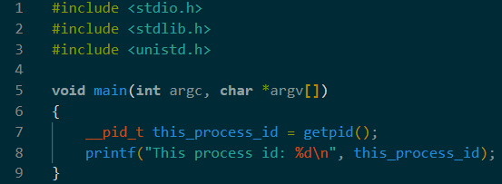
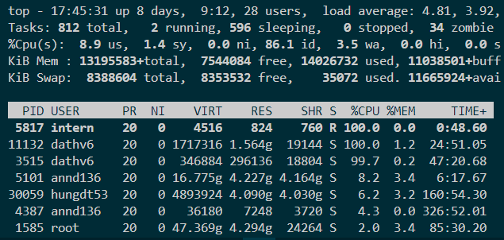
Process Identify
PID: Process ID - a positive integer that uniquely identifies the process on the system
init process (PID = 1) : can not be kill
Limits process ID < 32768 (can adjust in /proc/sys/kernel/pid_max)

Slide 6
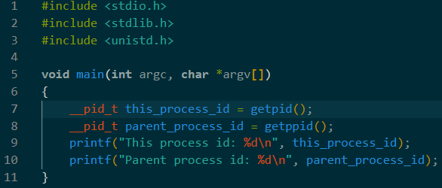
Parent Process identify
Each process has a parent—the process that created it.
A process can find out the process ID of its parent using the getppid() system call

Slide 7
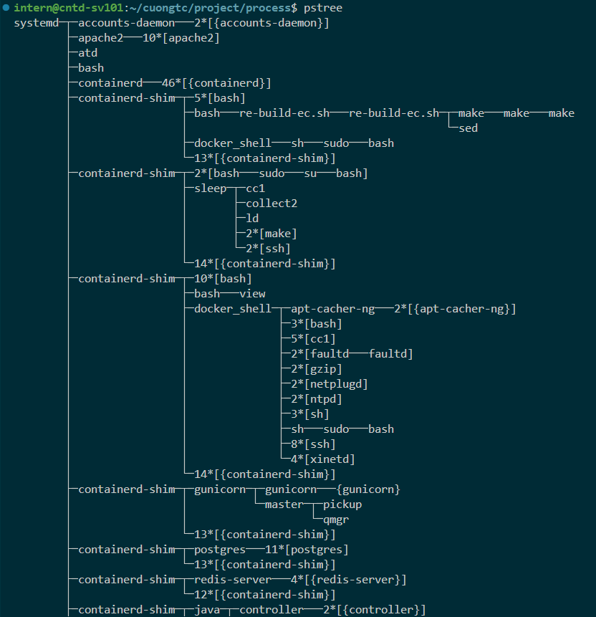
Parent Process vs process
Each process has only one parent and many child.
Init process has PID = 1 and PPID = 0
pstree: print process tree command

Slide 8
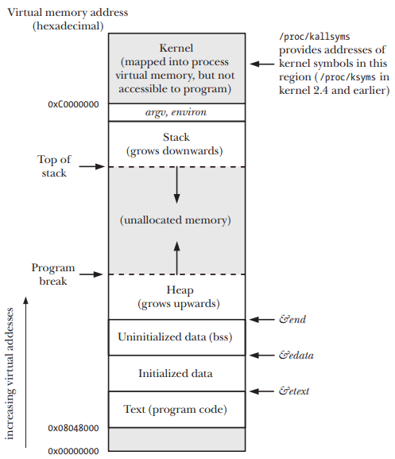
Processes: MEMory layout
The memory allocated to each process is composed of a number of parts, usually referred to as segments:
Text segment: Read-only, Shared between process
Initialized data segment: Global and static variable that are explicitly initialized
Uninitialized data segment (BSS): Not initialized data
Stack: Dynamically growing and shrinking segment containing stack frames
Heap: Dynamically memory allocated at run time

Slide 9
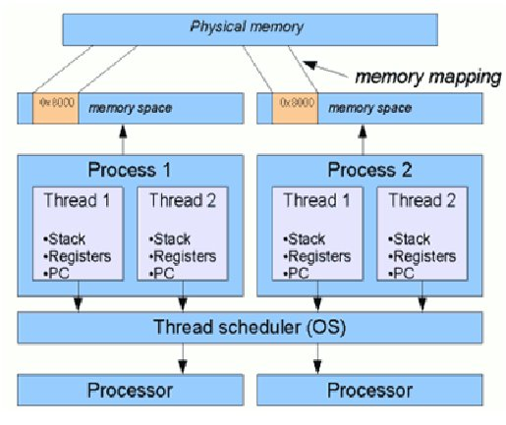
Processes: MEMory layout
Each process has it own virtual memory space, pointer, register and stack

Slide 10
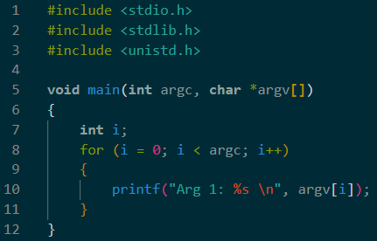
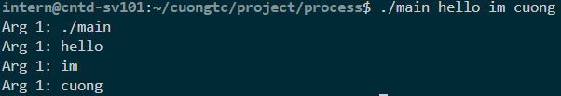
command line argument – argc, argv, env
/
proc/
[pid]/
cmdline
:command argument of process

Slide 11
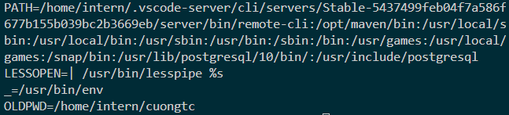


Process environment
Each process has list of environment variable.
When process created, it inherits a copy of its parent’s environment.
Show environment:
Set/Unset env:
/
proc/
[pid]/
cmdline
:command argument of process

Slide 12
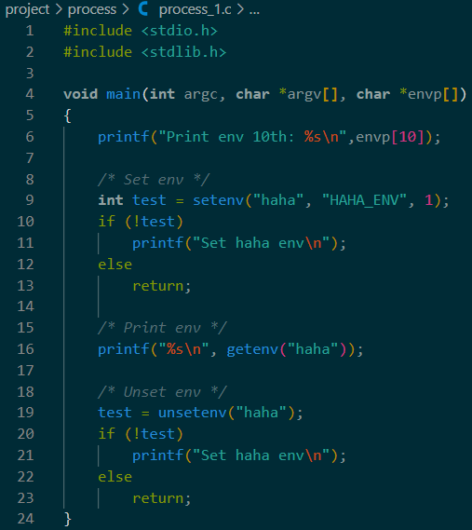
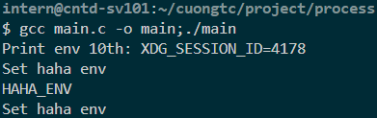
command line argument – argc, argv, env

Slide 13
PROCESS credential

Slide 14
Process credentials
Each process has a set of UIDs and GIDs (maybe refer to process credentials):
Real user ID and group ID
Effective user ID and group ID (UNIX common but Linux)
File-system user ID and group ID (Linux-specific) (same as effective)
Saved set-user-ID and saved set-group-ID
Supplementary group IDs

Slide 15
Process credentials: Real User ID and Real Group ID
The real user ID and group ID identify the user and group to which the process belongs.
When login, login shell gets its real user and group IDs.
When a new process is created (e.g., when the shell executes a program), it inherits these identifiers from its parent.
Init process
Login
Real user
/etc/passwd
New process created
inherit
…….

Slide 16
Process credentials: File-system user ID and group ID
On Linux, it is the file-system user and group IDs determine permissions when performing file-system operations such as:
Opening files
Changing file ownership
Modifying file permissions

Slide 17
Process credentials: Saved Set-User-ID and Saved Set-Group-ID
When program is executed:
If the set-user-ID (set-group-ID) permission bit is enabled on the executable, then the effective user (group) ID of the process is made the same as the owner of the executable.
If the set-user-ID (set-group-ID) bit is not set, then no change is made to the effective user (group) ID of the process.
The values for the saved set-user-ID and saved set-group-ID are copied from the corresponding effective IDs. This copying occurs regardless of whether the set-user-ID or set-group-ID bit is set on the file being executed

Slide 18
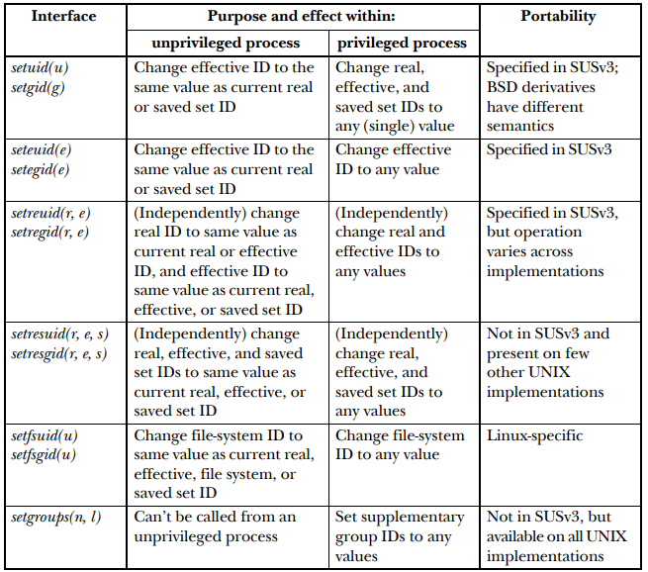
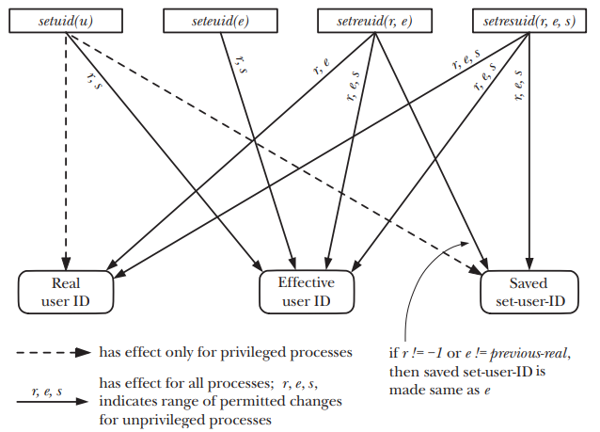
Process credentials Interface

Slide 19
PROCESS infomation

Slide 20
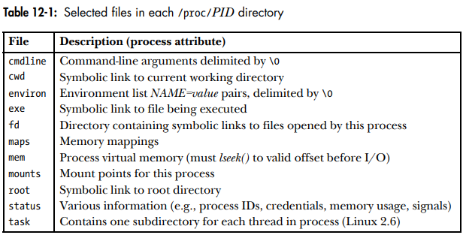
Process information
Process information provide in /proc/PID

Slide 21
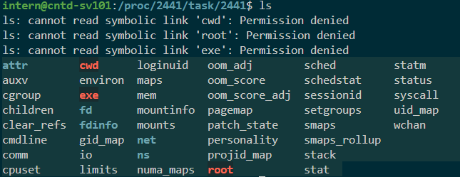
Process information
Thread of each process information provide in /proc/PID/task/TID
(TID: Thread ID)

Slide 22
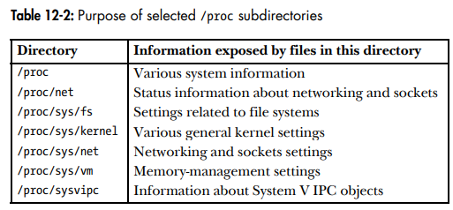
Process information
Various files and subdirectories under /proc provide access to system-wide information

Slide 23
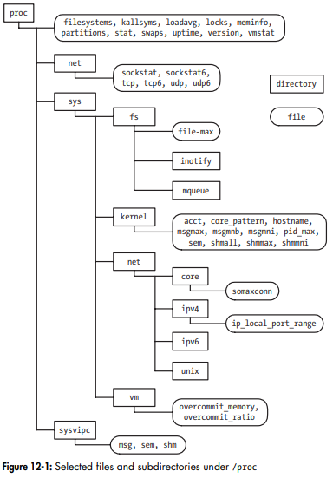
Process information

Slide 24
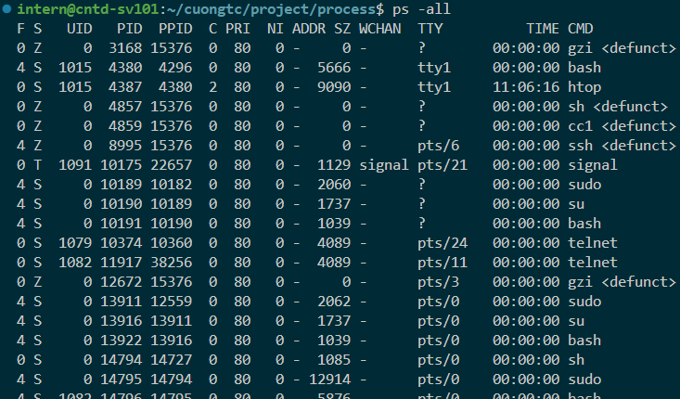
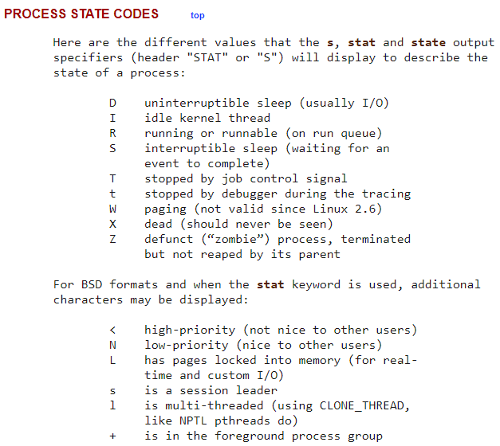
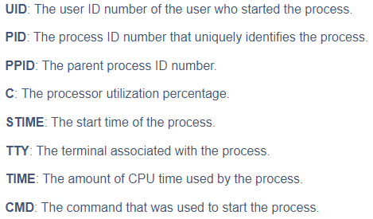
Process state
ps –all : print all process info

Slide 25
PROCESS creation

Slide 26
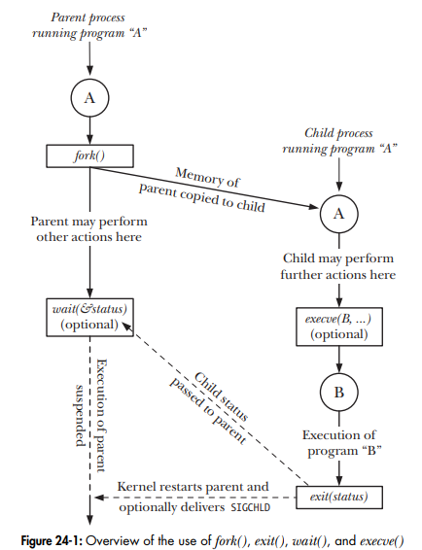
Overview of fork(), exit(), wait(), and execve()
folk() : allow parent process to create new child process (almost exact duplicate of the parent)
exit(status) : terminate a process, free all resource and return status to parent (using wait)
wait(&status) : suspend current process until its child process return status
execve(pathname, argv, envp) : execute new program (load new program to process’s memory, the existing program is discarded)

Slide 27
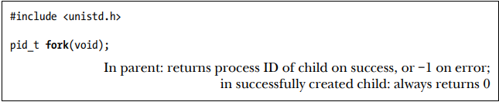
Create new process : fork()
fork() : create new child process, which is an almost exact duplicate of the calling process (parent process)
Notice: in each process, execution continues from the point where fork() returns

Slide 28
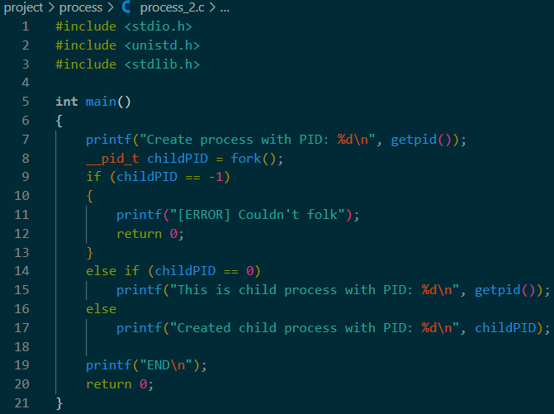
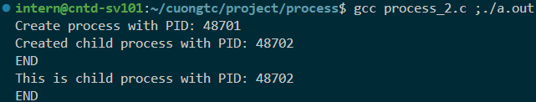
Create new process : fork()

Slide 29
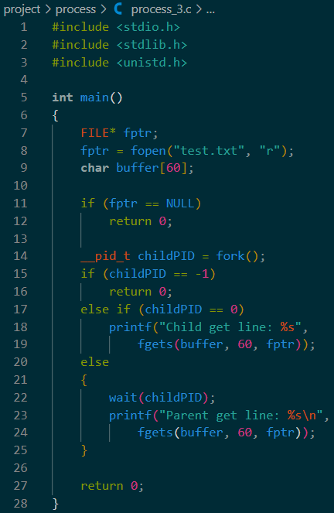
Create new process : file sharing
Attributes of an open file are shared between the parent and child.
For example, if the child updates the file offset, this change is visible through the corresponding descriptor in the parent

Slide 30



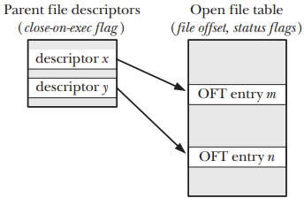
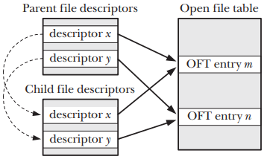
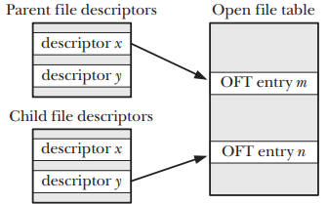

Create new process : file sharing
If file sharing is not required, after a fork(), the parent and child should use different file descriptors

Slide 31
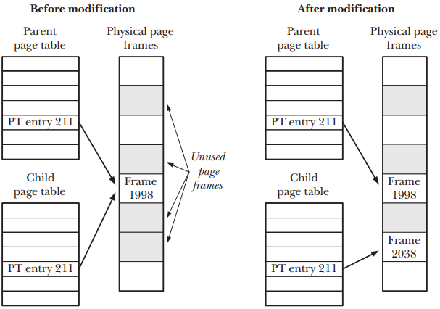
Create new process : memory semantics of fork()
fork() use two techniques to avoid such wasteful copying:
Marks the text segment of each process as read-only, the parent and child can share the same text segment
For the pages in the data, heap, and stack segments of the parent process, the kernel use copy-on-write (make a copy when modify variable)

Slide 32
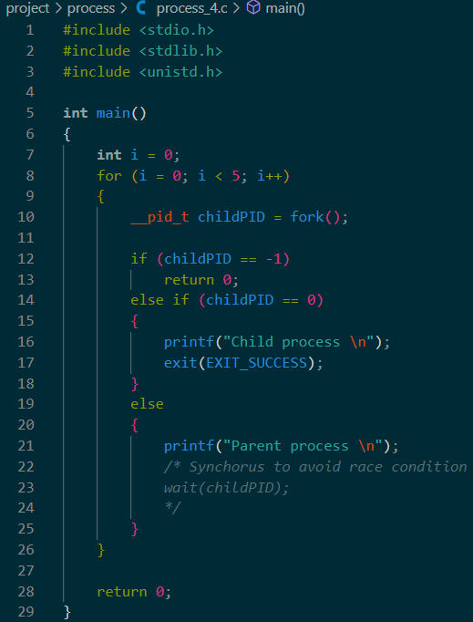
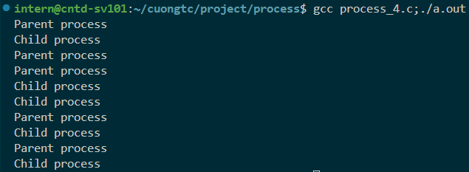
Create new process : Race conditions after fork()
After created process, 99.7% parent process will running first but 0.03% child process will running first (Race condition)
Don’t know which process is running first

Slide 33
Process termination

Slide 34

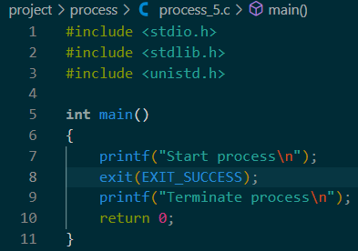

Termination process : exit()
A process may terminate in two general ways:
Abnormal: by a signal whose default action is to terminate the process (with or without a core dump)
Normally: using the _exit() system call.

Slide 35
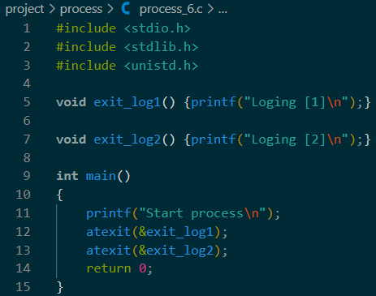
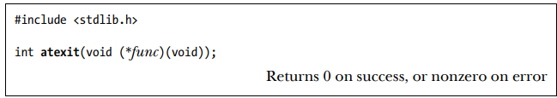

Termination process : exit handlers
Registering exit handlers to perform some actions before terminate process.
atexit() : register handler, the handler called in reverse order of registration

Slide 36
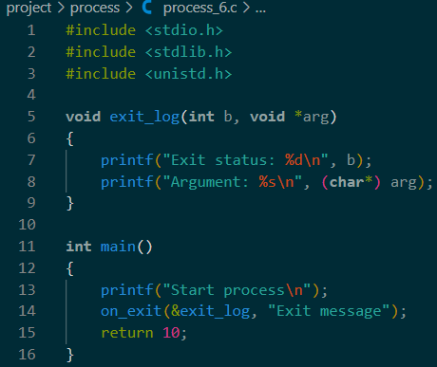
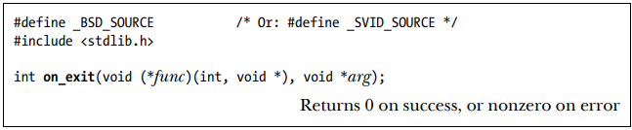

Termination process : exit handlers
Registering exit handlers to perform some actions before terminate process
on_exit() : nonstandard method but can register handler with arguments

Slide 37
Termination process : flow
Termination process occur (1):
Open file descriptors, directory streams, message catalog descriptors, and conversion descriptors are closed.
As a consequence of closing file descriptors, any file locks held by this process are released.
Any attached System V shared memory segments are detached, and the shm_nattch counter corresponding to each segment is decremented by one.
For each System V semaphore for which a semadj value has been set by the process, that semadj value is added to the semaphore value.
If this is the controlling process for a controlling terminal, then the SIGHUP signal is sent to each process in the controlling terminal’s foreground process group, and the terminal is disassociated from the session.
…

Slide 38
Termination process : flow
Termination process occur (2):
…
Any POSIX named semaphores that are open in the calling process are closed as though sem_close() were called.
Any POSIX message queues that are open in the calling process are closed as though mq_close() were called.
If, as a consequence of this process exiting, a process group becomes orphaned and there are any stopped processes in that group, then all processes in the group are sent a SIGHUP signal followed by a SIGCONT signal.
Any memory locks established by this process using mlock() or mlockall() are removed.
Any memory mappings established by this process using mmap() are unmapped.

Slide 39
Monitor child process

Slide 40
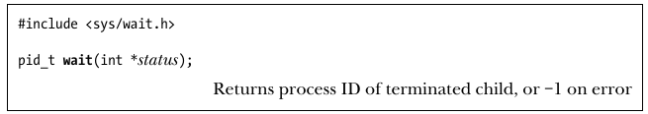
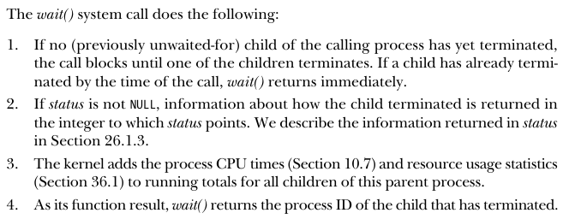
Monitor child process
Where a parent creates child processes, it is useful for the parent to be able to monitor the children to find out when and how they terminate.

Slide 41
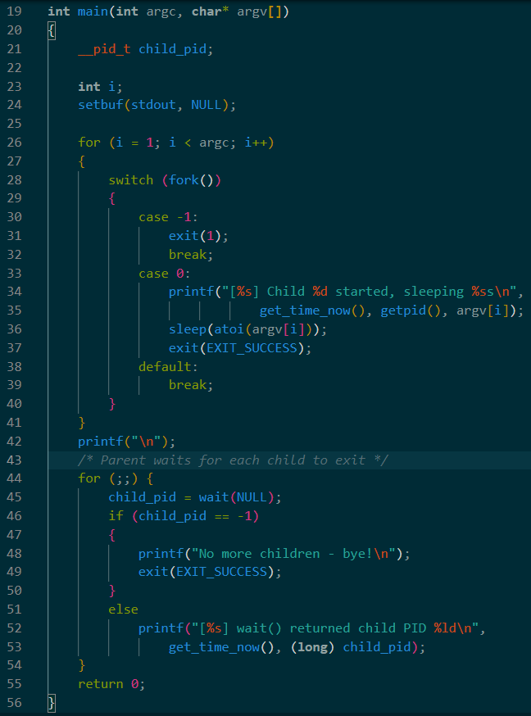
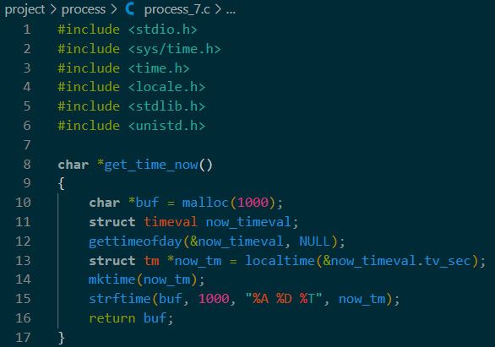
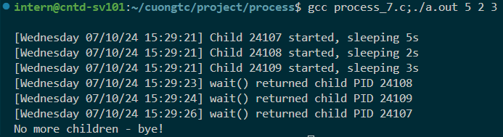
Monitor child process

Slide 42
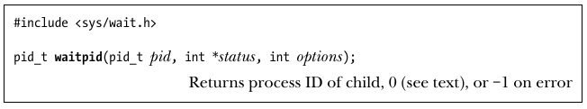
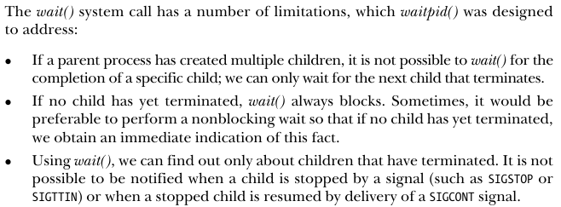
Monitor child process
Where a parent creates child processes, it is useful for the parent to be able to monitor the children to find out when and how they terminate.

Slide 43
Monitor child process : Orphan and zombie
Lifetimes of parent and child processes are usually not the same:
If parent die before child, child process become orphan process
If child die before parent wait(), child become zombie process
Orphan process:
The orphaned child is adopted by init process (PID is 1).

Slide 44
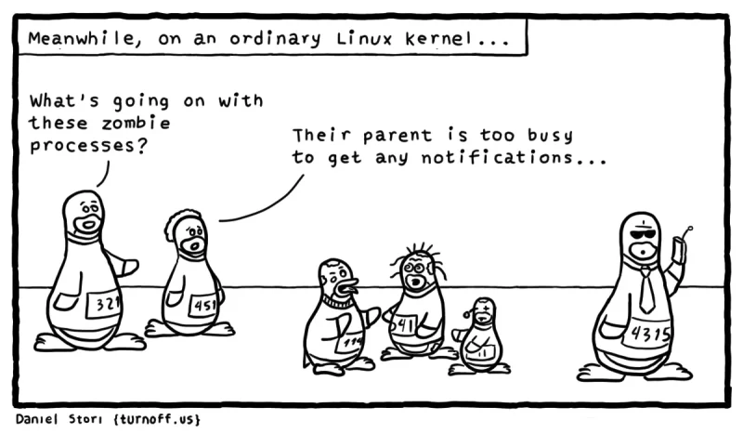
Monitor child process : Orphan and zombie
Zombie process:
The child process has finished its work, the parent should still be permitted to perform a wait() to determine how the child terminated at some later time
So, the kernel turn child into Zombie state:
Most of the resources held by the child are released back to the system to be reused by other processes
The only part is is an entry in the kernel’s process table recording : the child’s process ID, termination status, and resource usage statistics

Slide 45
Program execution

Slide 46
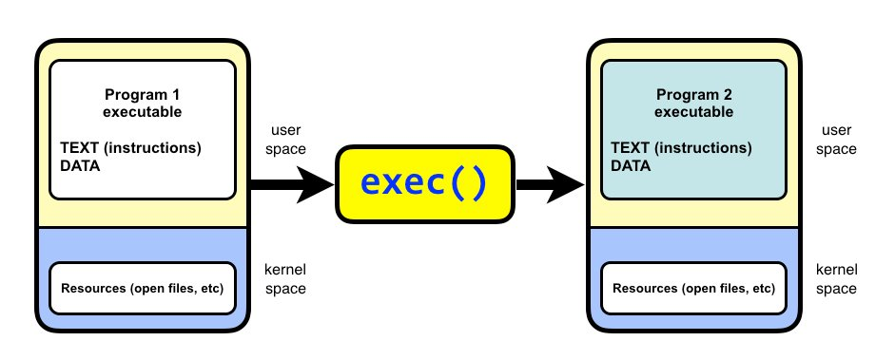
Program execution
A process can use the execve() system call to replace the program that it is running by a completely new program.

Slide 47
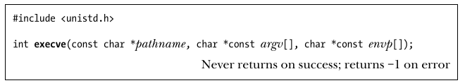
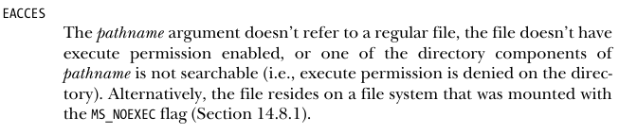
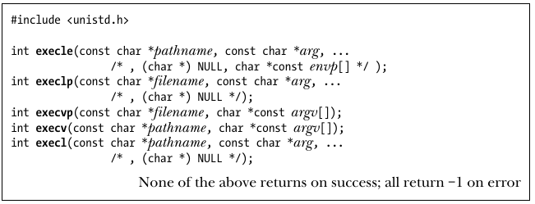
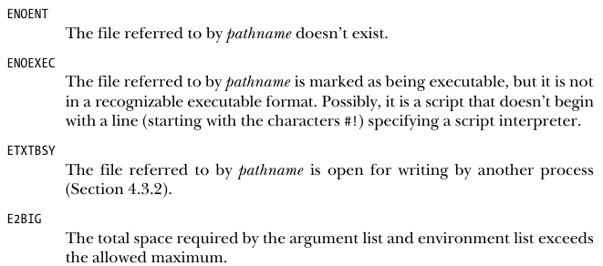
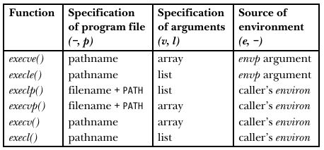
Program execution
Method: Error code:

Slide 48


Executing a Shell Command: system()
The system() function:
Allows the calling program to execute an arbitrary shell command by creates a child process that invokes a shell to execute command.

Slide 49
group, session, job control

Slide 50

group, session, job control : overview
Process groups and sessions form a two-level hierarchical relationship between processes:
A process group is a collection of related processes
A session is a collection of related process groups

Slide 51
group, session, job control : process group
A process group is a set of one or more processes sharing the same process group identifier (PGID) :
A process group has a process group leader (Which create the group and its PID become PGID)
A new process inherits its parent’s process group ID.
A process group has a lifetime: from leader create group to last process leave
A process may leave a process group either by terminating or by joining other group
Process group leader need not be a last member of group

Slide 52
PRIORITIES AND SCHEDULING

Slide 53
Process resources

Slide 54
Daemon Process

Slide 55
2.
Threads

Slide 56
Thread synchronization

Slide 57
Thread Safety
Thread local storage

Slide 58
Thread cancel

Slide 59
Posix Thread

Slide 60
3.
Signals

Slide 61
Posix Thread

Slide 62
4.
Virtual memory

Slide 63
5.
IPC

Slide 64
6.
Shared memory

Slide 65
7.
Pipes and fifo

Slide 66
8.
socket

Slide 67
9.
File system

Slide 68
10.
Device driver

