Slide 1


Team Name: RecoverLens
Team Size: 1
Problem Statement: Challenge 09, Sustaining Healthy Behaviors. Up to 70% of patients do not keep up their home rehabilitation exercise, and one setback or a few missed days often ends recovery.

Slide 2
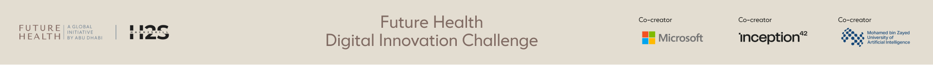
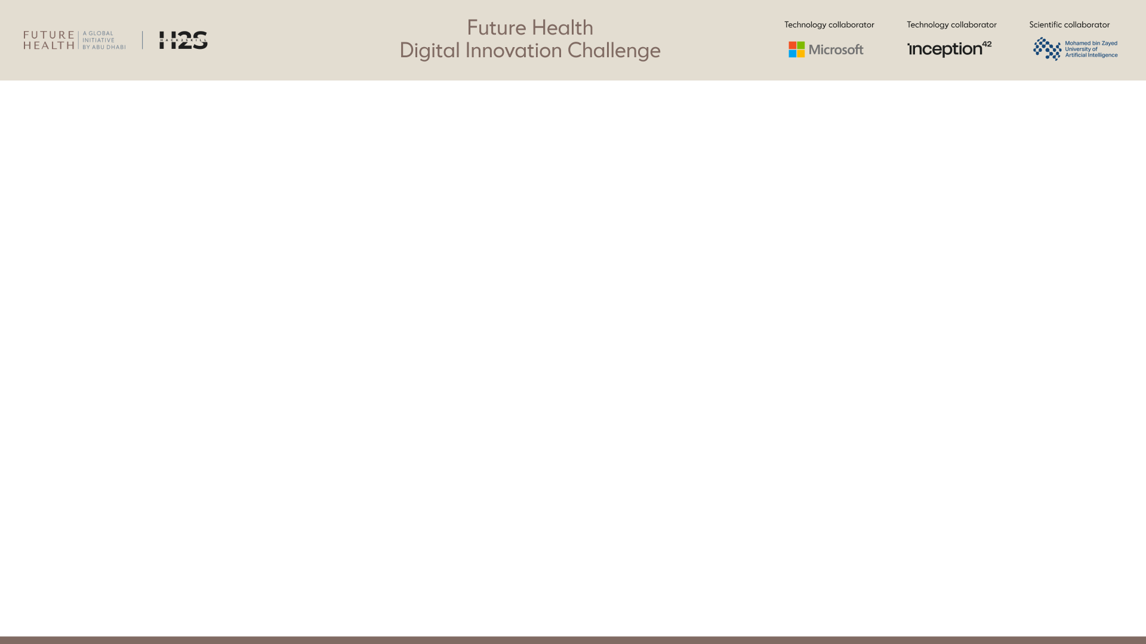
Team members*
[Name, country, role, organization, age confirmation]
S.No | Name | Country | Role | Organization | Age confirmation
1 | Harry James Makoni | Zimbabwe | Lead innovator: product, design and full-stack development | National University of Science and Technology (NUST), Zimbabwe | Confirmed: 18 or over
2
3
4
5

Slide 3
Team Capability Summary*
Maximum 1,000 characters
RecoverLens is designed, built and run by Harry James Makoni (NUST, Zimbabwe), working end to end: product and user research, React/TypeScript front end, Python FastAPI and Postgres back end, on-device computer vision (MediaPipe pose), voice coaching, and the Gemini-based adaptive coach. The working app is live at recover-lens.vercel.app: 13 rehab exercises (6 measured by the camera), sports screening, caregiver mode, physiotherapist and coach portals, and English, chiShona and isiNdebele. Engineering discipline: 191 automated front-end tests and 37 API tests, WCAG 2.2 AA accessibility checks on every screen, and safety rules in plain code that the AI cannot override. Gaps we are closing before a pilot: a registered physiotherapist to review the exercise library and safety limits, and native speakers to review the chiShona and isiNdebele text.

Slide 4
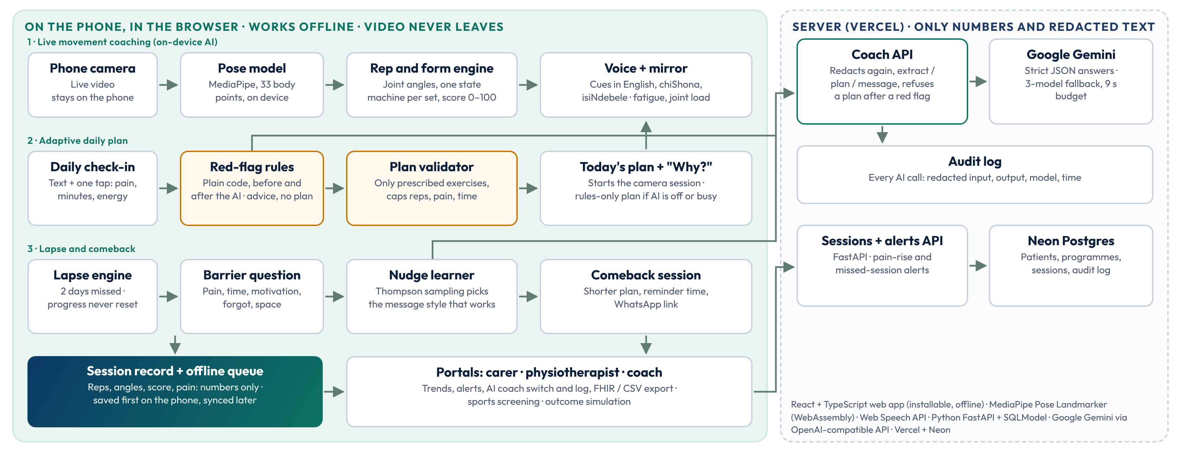
Architecture or workflow diagram*
How it works: the camera, pose model and rep counting run on the phone, so video never leaves it. The AI coach only proposes: plain-code red-flag rules run before and after it, and a validator keeps every plan inside what the physiotherapist prescribed. Without a connection or the AI, the rules plan the day and sessions sync later.

Slide 5
Target users and intended outcome*
Who it is for
Patients doing a home exercise programme after an injury or surgery, or with a long-term condition such as knee osteoarthritis. Zimbabwe first, on the phone they already have.
Carers who help someone exercise (caregiver mode: voice cues speak to the helper).
Physiotherapists who prescribe, follow up remotely and decide whether the AI coach is used.
Sports coaches who screen athletes' movement before injury.
Built for real constraints: shared phones, low data, works offline, voice and one-tap answers for low literacy, large text and high contrast (WCAG 2.2 AA), English, chiShona and isiNdebele.
Intended outcome
People keep exercising: more patients active every week through 12 weeks.
Lapses do not end recovery: after missed days a blame-free comeback asks what got in the way and offers a smaller session. Progress is never reset.
Each day fits the person: the plan adapts to pain, time and energy, inside the prescription.
Measurable recovery: range of movement and movement quality tracked against each person's own baseline.
Earlier help: physiotherapists see who is slipping, and why, before they drop out.

Slide 6
How will success be measured?*
What we measure (same in simulation and pilot)
Persistence: share of people with an active week (at least one session), at weeks 4, 8 and 12.
Return after a lapse: share of lapses followed by a session within 7 days.
Retention: share still active in week 12.
Functional change: range of movement and movement score against the person's own baseline.
Equity: gap between the most and least active groups (busy workers, low motivation, carer-dependent, low literacy, disability).
Safety: red flags caught, plans the validator changed, adverse events (target: no unsafe plan ever shown).
Where we are now
Simulated, not real people: 300 simulated people, 12 weeks, every assumption shown in the app (/outcomes).
Active in week 12: RecoverLens 69%, static plan 39%, generic reminders 39%. With every RecoverLens effect halved: 55%.
Return after a lapse: 69% vs 39% (static) and 51% (reminders).
Where it does not win: the gap between groups is wider with RecoverLens at weeks 4 and 8; it is narrowest by week 12 (8 vs 15 points). We report this.
Pilot success target: week-12 persistence at least 15 percentage points above usual care in the same clinics, with no unsafe plan shown and a usability score (SUS) of 70 or more.

Slide 7
Evidence supporting the approach*
Citations, studies, benchmarks, or prior testing.
Published evidence behind the design
The problem: up to 70% of physiotherapy patients do not fully follow their home programme (Jack et al., Manual Therapy 2010;15(3):220–228). About 2.4 billion people could benefit from rehabilitation (Cieza et al., Lancet 2020;396:2006–2017).
Named techniques: goal setting, action planning, graded tasks, self-monitoring and social support from the BCT Taxonomy v1 (Michie et al., Ann Behav Med 2013;46(1):81–95).
Adapt to the moment: just-in-time adaptive interventions (Nahum-Shani et al., Ann Behav Med 2018;52(6):446–462).
No streaks to lose: missing one opportunity did not materially affect habit formation (Lally et al., Eur J Soc Psychol 2010;40(6):998–1009).
Methods: on-device pose tracking (Bazarevsky et al., BlazePose, arXiv:2006.10204, 2020); Thompson sampling for nudges (Russo et al., Found Trends Mach Learn 2018;11(1):1–96).
Our own testing so far
Safety check with the real AI: 30 written test check-ins in three languages (not patients) through Gemini and the app's own flow: 9 red flags stopped (7 by the rules before any AI call, 2 added by the AI), 17 AI plans, 1 changed by the validator, 4 planned by the rules when the AI was busy. It found, and we fixed, a chiShona red flag the rules missed.
Rep counting: recorded and synthetic movement replays must give exactly the right count, including pauses, leaning and a camera at 4 frames per second.
Automated tests: 191 front-end and 37 API tests run before every release, including every red-flag and validator rule.
Accessibility: WCAG 2.2 AA checks on every screen at phone, tablet and desktop sizes, in all three languages.
Not yet: no study with real patients. The pilot (slide 12) is designed to measure that.

Slide 8
Data sources and legal right to use them*
List source, type, owner, sensitivity, permissions, and whether personal data is used.
Personal data today: none real. The live demo uses invented people, and visitors are asked not to enter real details. We do not train any model, and use no third-party patient datasets.
Camera video and body points: Patient; personal and sensitive. Processed on the phone only. Never stored or sent.
Session results (reps, angles, scores, pain): Patient and clinic; health data. Sent to our server for the physiotherapist. Consent in the pilot.
Daily check-in text: Patient; may be sensitive. Only with the AI coach on, after consent. Contact details removed; sent to Google Gemini; every call logged.
Pose model: MediaPipe Pose Landmarker (lite): Google; Apache 2.0 licence. Used as published. No training on patient data.
Exercise library, safety limits, translations: RecoverLens (own work). From standard home exercises; physiotherapist and native-speaker review pending.
Demo patients, athletes and simulation: RecoverLens; synthetic. Invented people and stated assumptions. No real personal data.
In the pilot: health data under Zimbabwe's Cyber and Data Protection Act [Chapter 12:07], with written consent, a clinic data agreement, and the Gemini API paid tier (Google does not use paid-tier prompts to improve its products). Patients can use rules-only mode with no text sent at all.

Slide 9
Risks and safeguards*
Privacy; security; bias; explainability; misuse; human oversight; failure modes.
Privacy: video never leaves the phone; check-in text only after consent, with a live view of exactly what is sent; contact details removed on the phone and again on the server; rules-only mode sends nothing; never shared with employers or insurers.
Security: AI key kept on the server; HTTPS; nightly demo reset protected by a secret. The demo has no sign-in; role-based sign-in with one-time codes comes before any real patient data.
Bias: pose accuracy can vary with body size, clothing, lighting, skin tone and walking aids, so the pilot reports results by group. The AI's isiNdebele used Zulu forms, so fixed translated templates are the fallback and native review is planned.
Explainability: "Why am I seeing this?" shows who made the plan (AI model or rules), the technique used, and every change the safety rules made.
Misuse: wording is observation, never diagnosis; the coach only picks from the prescribed exercises and can never add one; reps capped at +10% and cut when pain is high.
Human oversight: the physiotherapist can turn the AI off per patient and reads a log of every AI call; alerts for rising pain and missed sessions.
Failure modes: red flags (chest pain, numbness, swelling, a fall, dizziness, pain 8+) stop the plan before any AI call, and the AI can add a red flag but never clear one. AI slow or down: the rules plan the day. Offline: plan cached, sessions queued. Body not visible: counting pauses. Camera unavailable: guided timer or manual log.

Slide 10
Hardware requirements
Required if wearable, sensor, connected device, or other hardware is there. Include sourcing and safety.
No special hardware. RecoverLens runs in the web browser of a phone, tablet or laptop that people already own. There is no wearable, sensor or connected device to source.
Device: any smartphone, tablet or laptop with a camera and a current browser (Chrome, Safari or Edge). Pose tracking uses the graphics chip, with a slower fallback for older phones.
Connection: needed to open the app the first time; after that, exercise sessions work offline and sync later.
Setup: lean the phone against something stable at about waist height and stand 2 to 3 metres back so the whole body is visible. A cheap phone stand helps but is optional.
Safety: a clear floor space and, for sit-to-stand, a stable chair. Every exercise starts with "Stop if you feel sharp pain, dizziness or numbness", and a pain check-in comes before each session.

Slide 11
If the application requires login authentication, please provide valid access credentials
or enable a "Continue as Guest" option with all necessary features and functionalities accessible to guest users.
No login is needed. Every feature is open to guests.
Open: https://recover-lens.vercel.app (phone, tablet or laptop).
Viewing as (top of every screen): switch between demo patients. Language: English, chiShona, isiNdebele.
Roles, from the menu: Home (patient), Caregiver Assist, Sports Screening, Clinician Portal, Coach Portal.
Camera: allow it when asked. Video stays on your device.
Demo data resets every night. "Reset demo data" is at the bottom of the Clinician Portal. Please use invented names.
A 3-minute tour
1. Home as Tariro Moyo: Start Exercise. The camera counts reps and the voice coaches.
2. Viewing as Tendai Sibanda: the welcome-back card. Tap "No time", then make today's plan and open "Why am I seeing this?".
3. In the check-in, answer "Yes" to the red-flag question: advice, no plan.
4. Clinician Portal, Tendai: AI coach switch, AI coach log, FHIR export.
5. Clinician Portal, Outcome simulation: results labelled as simulated, and the safety check.
6. Switch the language to chiShona or isiNdebele.

Slide 12
Path to pilot and scale*
Stakeholders, integration, regulatory needs, timeline assumptions, and sustainability.
Who, how, under what rules, and who pays
Stakeholders: physiotherapy practices and hospital rehabilitation units in Zimbabwe, sports clubs and schools, workplace health programmes, patients and carers. Partners to be agreed; none signed yet.
Integration: works today with no install (web link, offline). FHIR R4 export of each patient's progress and CSV/print reports, so results can go into clinic systems.
Regulatory: positioned as wellness and recovery support, not diagnosis. To confirm with the Medicines Control Authority of Zimbabwe (MCAZ) before any clinical claim; ethics approval for the pilot; data protection under the Cyber and Data Protection Act, with POTRAZ as the authority.
Sustainability: practices, clubs and schools pay a subscription; patients whose physiotherapist uses RecoverLens use it free. Low running cost: movement AI runs on the phone, and the coach model is only called at the daily check-in.
Timeline (assumes a partner clinic agrees by early 2027)
Before the pilot: physiotherapist review of exercises and safety limits; native-speaker review; role-based sign-in; usability test with 10 to 20 people.
12-week pilot: 2 clinics, 40 to 60 patients, compared with usual care using the same measures as the simulation (persistence, return after a lapse, retention, functional change, equity, safety).
Scale: more clinics in Zimbabwe, then the region. Each language is a translation file; more exercises are configuration, not new code. Roadmap: SMS and WhatsApp reminders, and Health Connect and Apple Health through a phone app.

Slide 13
Pre-existing IP and third-party materials*
Identify ownership, licenses, open-source components, and restrictions.
Ownership and terms
Ownership: the RecoverLens code, design, exercise configurations, safety rules, translations, simulation and documentation are original work by Harry James Makoni, who owns them. Not yet released under an open-source licence.
AI-assisted development: parts of the code were written with an AI coding assistant; under that tool's terms the output belongs to the user.
Services used (not owned): Google Gemini API (Google APIs Terms and Gemini API Additional Terms), Vercel hosting, Neon Postgres. Used under their standard terms; for patient data, the paid Gemini tier.
Restrictions: none of these licences limits commercial use; attribution notices will ship with the app. Brand names belong to their owners.
Open-source components
Pose model and runtime: MediaPipe Tasks Vision and Pose Landmarker model (Google), Apache 2.0.
Front end: React, React Router, Vite, Tailwind CSS, Recharts (all MIT); Lucide icons (ISC); idb-keyval (Apache 2.0); Outfit font (SIL Open Font Licence 1.1).
Back end: FastAPI, SQLModel (MIT); Uvicorn (BSD-3-Clause); psycopg (LGPL-3.0, used unmodified as a library).
Testing: Vitest, Playwright (MIT and Apache 2.0); pytest (MIT); axe-core (MPL 2.0), used only in development.
Third-party content: none copied. Research is cited, not reproduced (slide 7).

Slide 14
Conflict of interest declaration*
Disclose relationships with organizers, partners, or judges.
No conflict of interest to declare.
Harry James Makoni has no employment, funding, family, business or advisory relationship with the organisers (Future Health, Hack2skill), the partners shown on this template, or the judges.
RecoverLens uses Google Gemini, Vercel and Neon as ordinary customers, with no sponsorship or partnership.
RecoverLens has also been entered in the TENT Gig 2026 and the Fifth ATU Africa Innovation Challenge. Neither gives any party rights in this entry.

Slide 15
RecoverLens in one minute
An AI rehabilitation mirror that turns a phone into a home physiotherapy coach, and keeps people going when life gets in the way.
Sense: the camera counts reps and checks form on the phone, with voice coaching in three languages.
Adapt: a daily check-in fits the session to pain, time and energy, inside the prescription.
Re-engage: after missed days, a blame-free comeback with a smaller session. Progress is never reset.
Prove: persistence, return after a lapse and recovery, measured the same way in simulation and in the pilot.
Key facts
Live app: recover-lens.vercel.app, no login.
Exercises: 13 (6 measured by the camera, 7 guided timers), plus sports screening.
Languages: English, chiShona, isiNdebele; more are translation files.
Safety: red flags and a validator in plain code; the AI proposes, the rules decide.
Privacy: video never leaves the phone; AI coach only with consent; rules-only mode.
Quality: 228 automated tests; WCAG 2.2 AA.
Additional Slide

Slide 16


