Slide 1

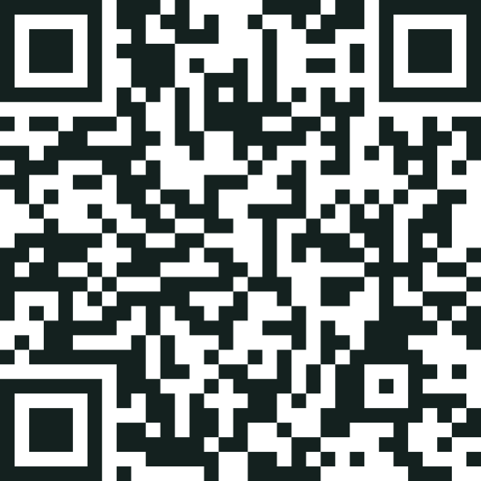
When a story is corrected, every copy should know.
Scan now: a live Story Passport
Vimba is a public record for news in Zimbabwe. A newsroom registers each story once; a QR code then tells readers whether it was corrected, and one approval fixes every copy, in every language.
Harry James Makoni & Fabulous Lashidi · Vimba Labs · Track 7: Digital Media Trust & RegTech · ZMC-NUST Media Innovation Hackathon 2026
Notes:
(0:00–0:20 · 20 seconds)
Good day, ladies and gentlemen. I’m Harry James Makoni, and this is my partner, Fabulous Lashidi. Our idea: when a news story is corrected, every copy of it should know. Please scan this code now. It opens a live Story Passport. Keep it open: before we finish, it will change.

Slide 2

One story spreads across newsrooms.
Its correction can stop at the source.
THE PROBLEM
A fictional example
Smaller newsrooms republish it
still 12 schools
A newsroom reports that floods closed
12 schools
Radio stations translate it
still 12 schools
The source corrects the figure to
Readers forward graphics on WhatsApp
still 12 schools
2 schools
Who tells everyone else?
Readers also need a private way to report errors and track the response.
Notes:
(0:20–0:48 · 28 seconds)
One example, all the way through. Say The Herald reports that floods closed 12 schools, then corrects it to 2. But smaller newsrooms have republished it, radio stations have translated it, and readers are forwarding the graphic on WhatsApp. They all still say 12. Who tells everyone else? And the reader who spots the error has no private way to report it and track the response.

Slide 3
Complaints are rising, led by accuracy
THE NEED IS GROWING
+26% in one year
39 complaints in 2024, up from 31 in 2023
Accuracy and fairness
the largest share of complaints
Redress is hard to get
from online platforms and news aggregators
Small newsrooms have no affordable tool
Complaints received by the Voluntary Media Council of Zimbabwe (VMCZ)
so accountability is slow, invisible and enforced from outside, instead of practised by newsrooms themselves.
Source: Voluntary Media Council of Zimbabwe (VMCZ), complaints received in 2023 and 2024
Notes:
(0:48–1:10 · 22 seconds)
And the need is growing. The Voluntary Media Council of Zimbabwe received 39 complaints in 2024, up from 31. Accuracy and fairness were the largest share, and redress from online platforms was hard to get. Small newsrooms have no tool for this, so accountability gets enforced from outside. For media freedom, newsrooms should practise it themselves.

Slide 4
Register the story once.
The correction follows every copy.
WHAT’S NEW
01
02
03
A living QR code
Challenge privately
Fixes follow the claim
The newsroom registers each version once. Its signed QR code always shows the latest status, even in print.
Readers quote the exact sentence on WhatsApp or the web, in English, chiShona or isiNdebele, and get a receipt.
Each fact is linked in every copy, so one approval corrects them all and alerts every partner.
English · chiShona · isiNdebele · Vimba never judges truth: editors decide
Notes:
(1:10–1:30 · 20 seconds)
What’s new: the correction follows the claim, not the web page. The newsroom registers the story once, and each version gets a signed passport whose QR code always shows the latest status, even in print. Readers challenge one sentence privately, in three languages. One approval fixes every copy. Vimba never decides what’s true: editors do.

Slide 5
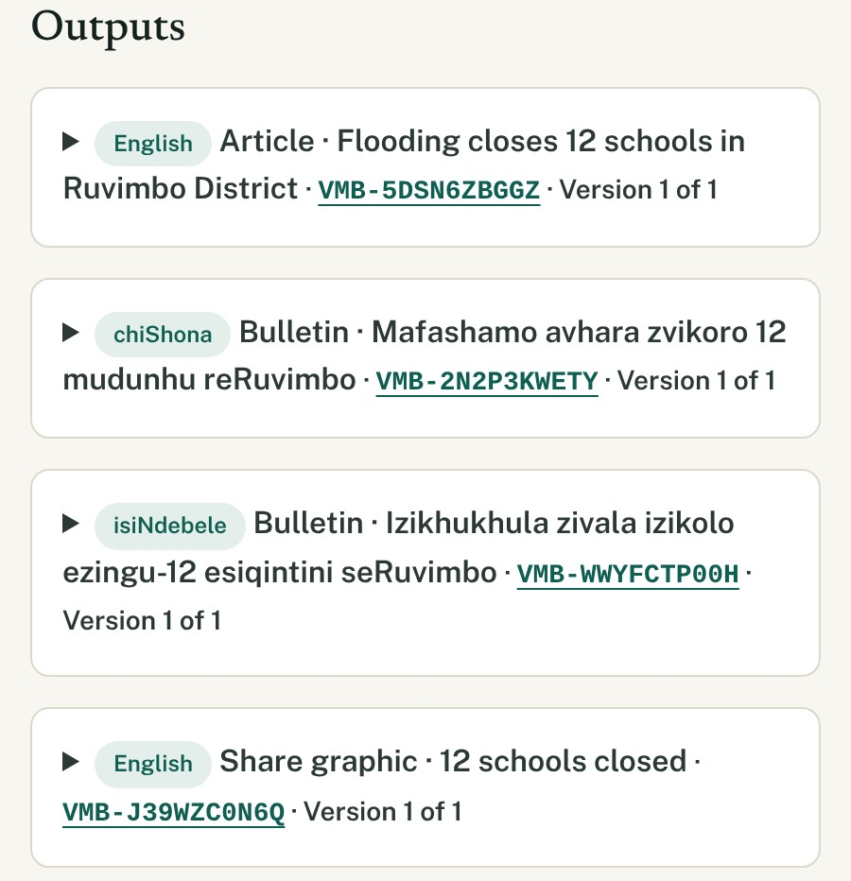
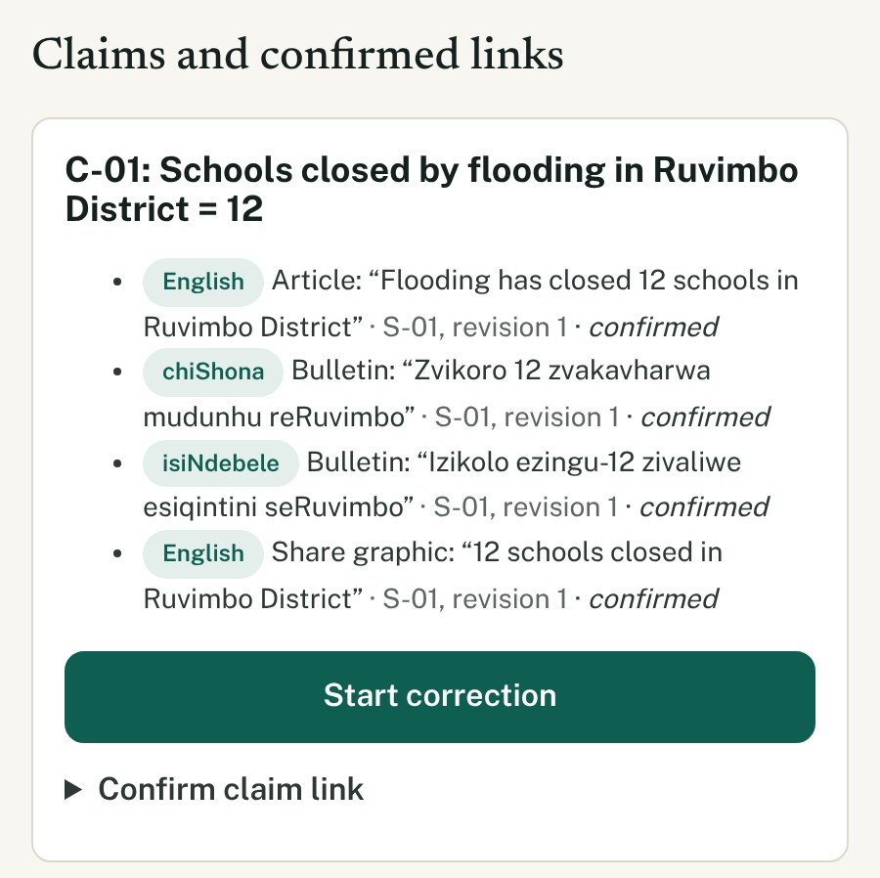
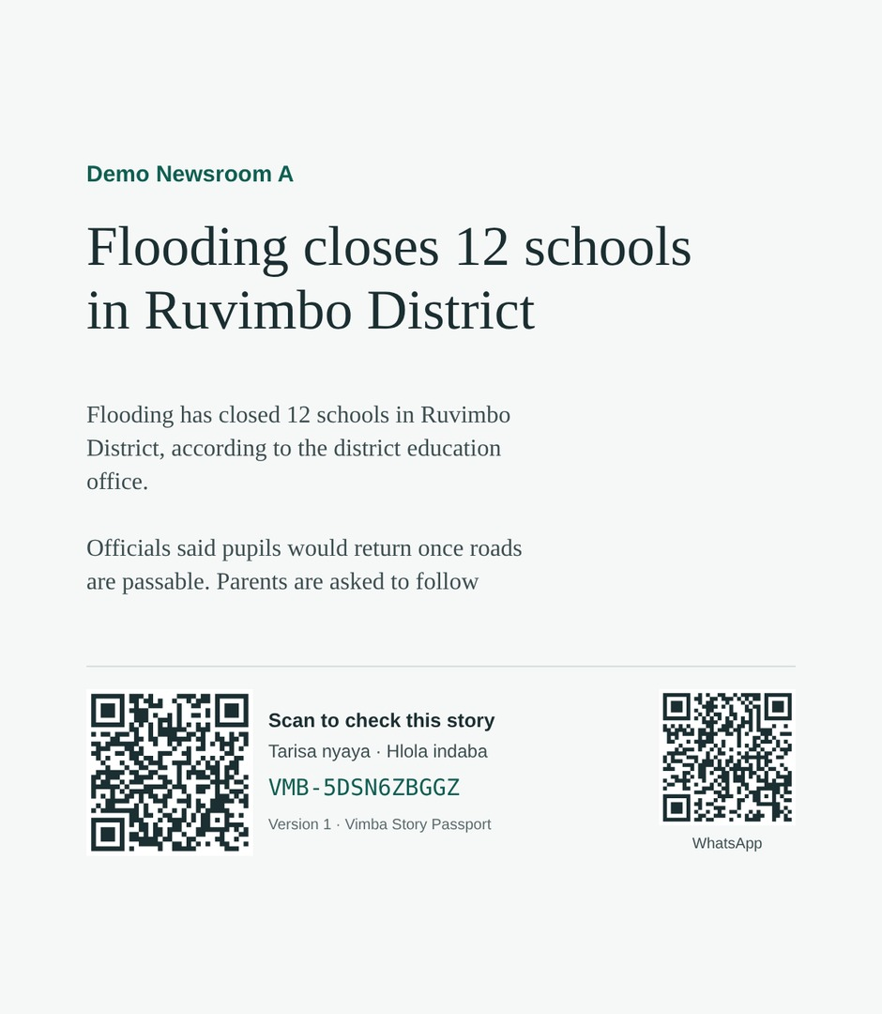
Register the story and every copy, once
STEP 1 · THE NEWSROOM
Registered: article, bulletins, graphic
Linked: “12 schools” in every copy
Published: signed, with a QR code
Real screens from the working system (demo newsroom) · sources stay private to the newsroom
Notes:
(1:30–1:50 · 20 seconds)
Here it is in the real system. The Herald registers the story and every copy: the English article, the Shona and Ndebele bulletins, the share graphic. It links the key fact, 12 schools, to the exact sentence in each. Publishing signs each version and gives it a passport and a QR code.

Slide 6
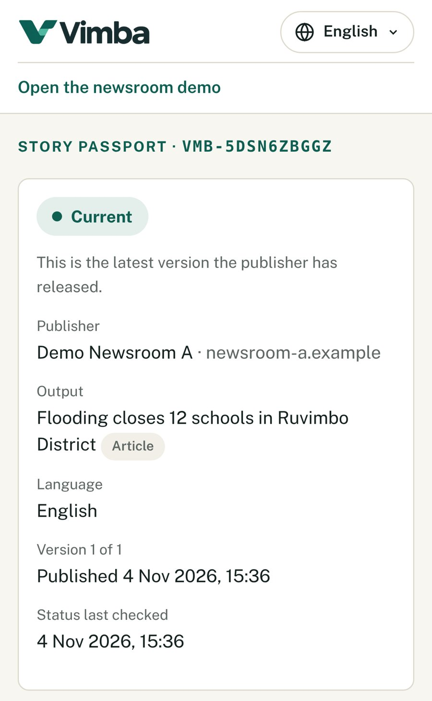
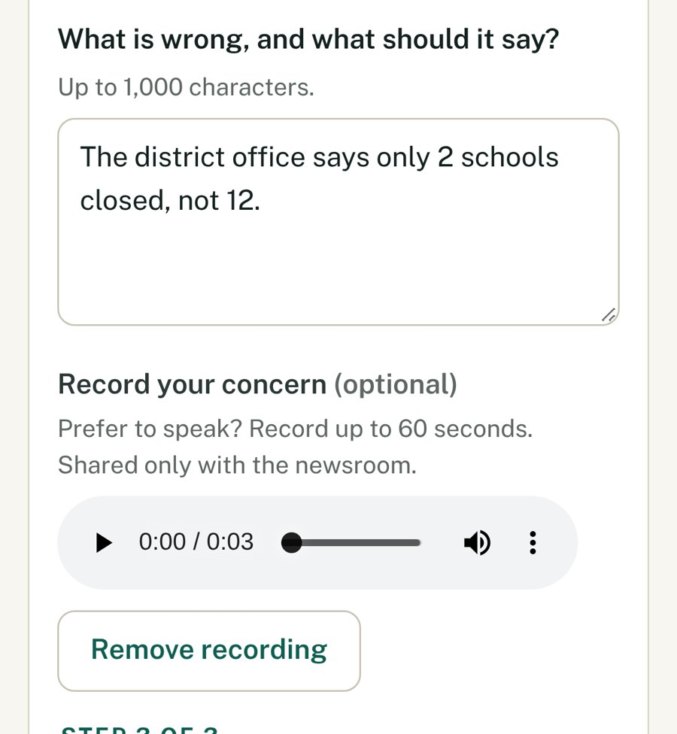
Check any story, then challenge one sentence
STEP 2 · THE READER
HLOLA VMB-WWYFCTP00H
Iphasiphothi yeNdaba yeVimba
“Izikhukhula zivala izikolo ezingu-12 esiqintini seRuvimbo”
Inguqulo 1 ku-1 · 4 Lwezi 2026
Isimo: Yamanje.
Kuhlolwe khathesi.
Vula iphasiphothi
Scan: status Current, signed
Complain privately: type it or record it
Or on WhatsApp, in isiNdebele: “Status: Current”
Real screens and replies from the working system · vimba-platform.vercel.app
Notes:
(1:50–2:07 · 17 seconds)
Now the reader. She scans and sees the status first: Current, and signed. No app, no login. To challenge a sentence, she quotes it privately, by typing, or by recording her voice on the web. On WhatsApp it works in three languages. That’s access to information.

Slide 7
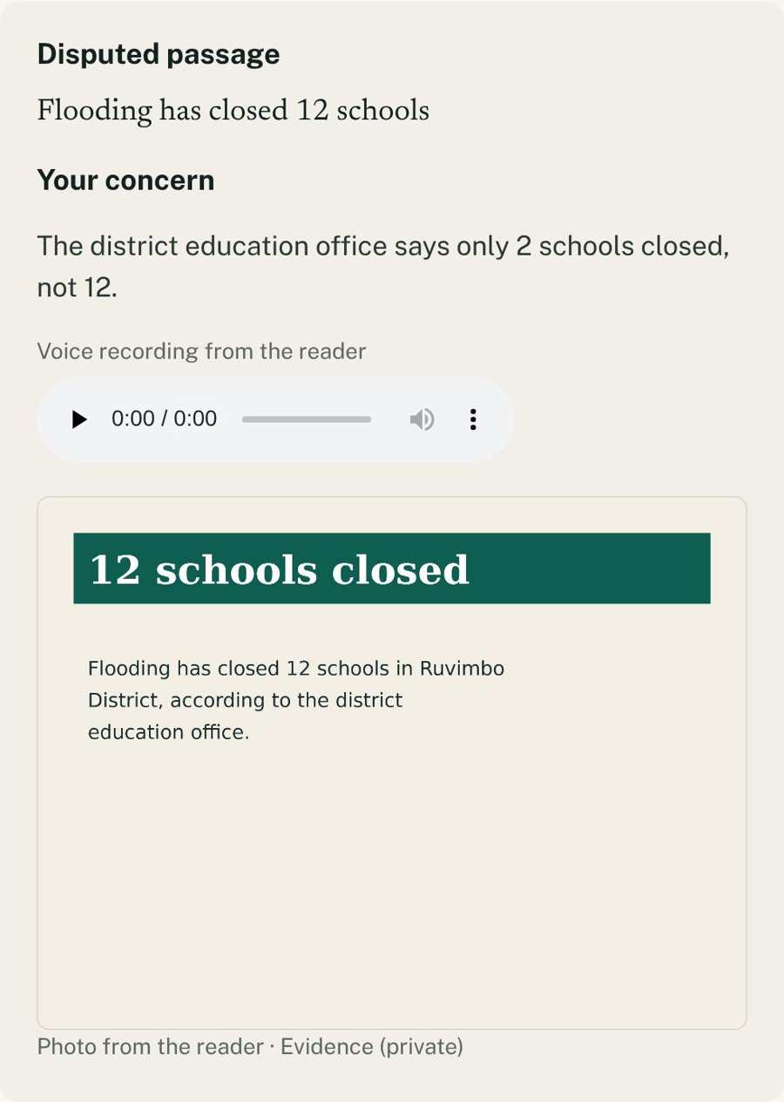

Fix the claim once. Every copy follows.
STEP 3 · THE EDITOR
Copy | Before | After approval
English article | closed 12 schools | closed 2 schools
chiShona bulletin | Zvikoro 12 zvakavharwa | Zvikoro 2 zvakavharwa
isiNdebele bulletin | Izikolo ezingu-12 zivaliwe | Izikolo ezi-2 zivaliwe
Share graphic | 12 schools closed | 2 schools closed
Partner newsrooms | Notified at once | Publish their own fix
One approval signs a new version of every copy in one step. If anything fails, nothing is published.
The case: sentence, voice note, photo
Each change note is written in the copy’s own language · Vimba never edits another newsroom’s site
Notes:
(2:07–2:28 · 21 seconds)
The editor sees every complaint, from the web and WhatsApp, on one desk. Because the claim was linked at registration, Vimba already knows every copy that carries it. The editor checks a before-and-after for each, in each language, and approves once. If anything fails, nothing is published. Partners are notified and publish their own fix.

Slide 8
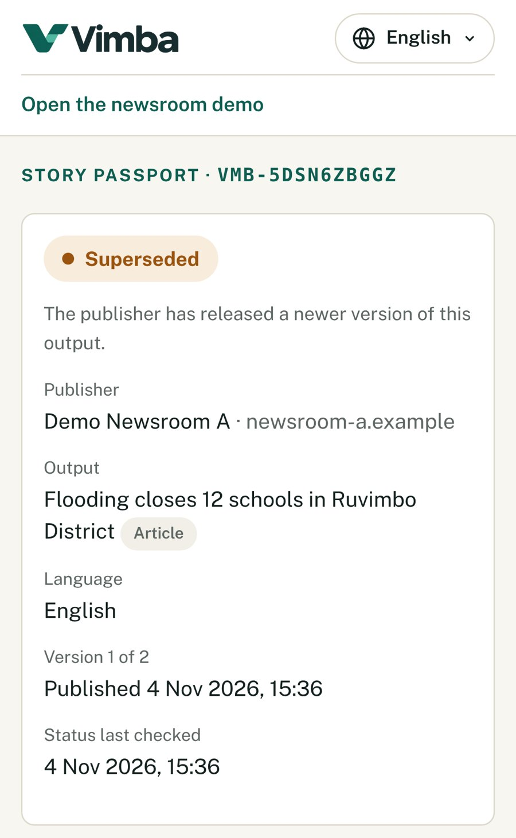
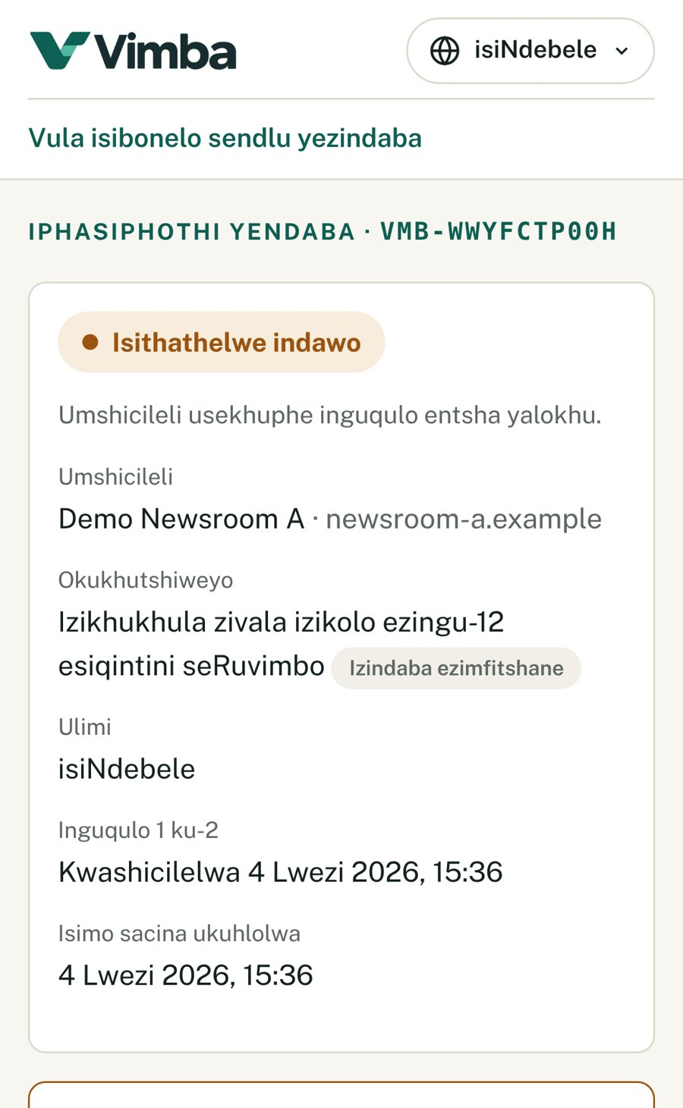
The same printed code now says Superseded
STEP 4 · THE RE-SCAN
HLOLA VMB-WWYFCTP00H
Iphasiphothi yeNdaba yeVimba
Inguqulo 1 ku-2 · 4 Lwezi 2026
Isimo: Isithathelwe indawo.
Inguqulo 2: Kulungisiwe: izikolo ezi-2, hatshi ezingu-12.
Kuhlolwe khathesi.
Vula iphasiphothi
English: Superseded
isiNdebele: Isithathelwe indawo
WhatsApp: “Superseded. Version 2: 2 schools, not 12.”
Real screens and replies from the working system, after one approval
Notes:
(2:28–2:40 · 12 seconds)
And here’s the moment that matters: the same printed code now says Superseded, in every language. Ask on WhatsApp, and the answer is corrected too: two schools, not twelve.

Slide 9
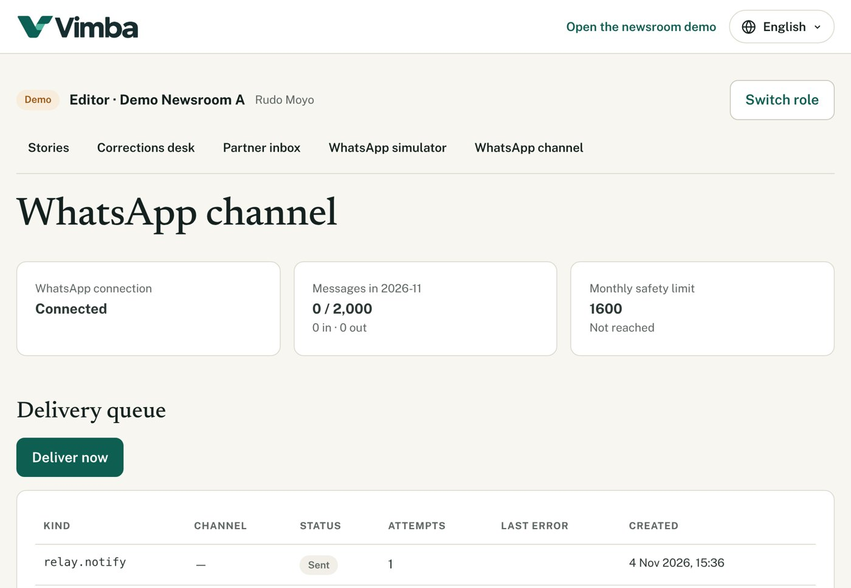
Working today, and cheap to run
BUILT AND TESTED
63
<$100
automated tests, incl. newsroom privacy
a year to run a pilot
3
Ed25519
languages on every screen and reply
signed versions anyone can verify
Ready-made: Next.js, Vercel and Neon hosting, the WhatsApp Cloud API through Kapso.
Ours: signatures, newsroom isolation, the one-step correction, the WhatsApp assistant.
Usage and cost, tracked live. First limit at 10 newsrooms: the free WhatsApp allowance.
Reader phone numbers encrypted (AES-256-GCM), never logged · each newsroom walled off by row-level security
Notes:
(2:40–2:58 · 18 seconds)
All of this works today, and it’s responsible by design: every version is signed with Ed25519, each newsroom is walled off by row-level security, reader numbers are encrypted, and no AI decides what’s true. 63 automated tests check it. A pilot costs under 100 dollars a year.

Slide 10
Free for readers. Grows with every partner.
IMPACT, SUSTAINABILITY AND SCALE
SOCIAL IMPACT
SUSTAINABILITY
SCALABILITY
Readers and newsrooms
Institutions, not readers
Through the network
Readers check and complain free, privately, in their language. People harmed by an error get a route to an outcome.
A ZMC-supported pilot, then group licences for organisations such as ZBC, Zimpapers and ZIANA. Grants keep community radio free.
Every partner that receives a correction is a newsroom that can join. A new language is one file of nearly 400 phrases.
Our ask: a ZMC-supported 90-day pilot with one newsroom and one republication partner, on real stories.
We will report how fast every copy was corrected and every complaint answered.
Editorial control stays with each newsroom
Notes:
(2:58–3:20 · 22 seconds)
The impact: readers check and complain free, privately, in their own language. It’s sustainable: institutions pay, from a ZMC-supported pilot to group licences for ZBC, Zimpapers and ZIANA. And it scales through the network: every partner we notify is a newsroom that can join. Our ask: a 90-day pilot with one newsroom and one partner, on real stories.
Time check: if you are past 3:20, go straight to the demo.

Slide 11
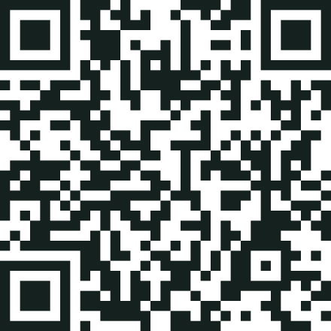
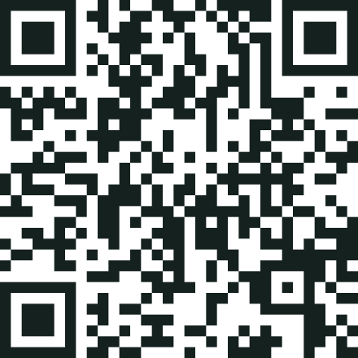
The passport you scanned is about to change
LIVE DEMO
1
Check: the story says Current, and signed
Open a live passport
Check on WhatsApp
2
Challenge: a reader quotes the sentence, with a voice note
Try it now, on your phone
3
Approve once: every copy, in all three languages
4
Re-scan: the same code now says Superseded
Accountability that travels with the story.
Vimba Labs · vimba-platform.vercel.app · WhatsApp +1 202 443 4476 · Tatenda · Siyabonga · Thank you
Notes:
(3:20–4:00 · 40 seconds)
Now let’s change that passport, live. [Switch to the browser.] A reader has challenged our sentence with a voice note. [Play two seconds.] Here is the editor’s fix in all four copies, in English, Shona and Ndebele. One approval. [Click Approve and release correction.] Now refresh the passport on your phone: it says Superseded. That’s Vimba: accountability that travels with the story. Tatenda, siyabonga, thank you.
Set up 10 minutes before:
1. Sign in as Editor. On the Stories page, press Reset demo, so the passport shows Current.
2. As a reader, open vimba-platform.vercel.app/p/VMB-5DSN6ZBGGZ, tap Request a correction, quote “Flooding has closed 12 schools” and record a short voice note.
3. As Editor, open the case, start a new correction, change 12 to 2 in all four copies with a change note in each language, and save it. Do not approve.
4. Keep three tabs ready: the case, the correction with its Approve button, and the passport.
If the internet fails: go to the next slide and play the 36-second recorded demo. It narrates itself; then say “Tatenda, siyabonga, thank you.”

Slide 12
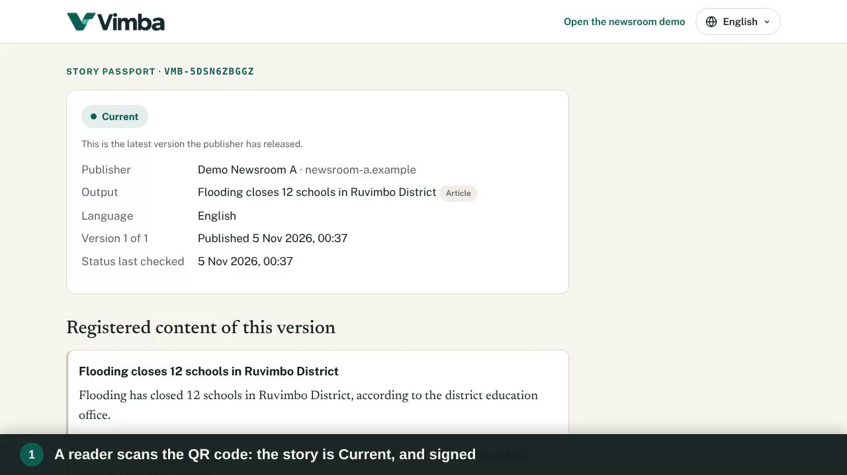
The whole journey, in the real system
RECORDED DEMO · BACKUP
0:36
Tap to play · 36 seconds, cut from one live run of vimba-platform.vercel.app
Notes:
(3:20–4:00) Backup for the live demo: if the venue internet fails, tap the video to play it. It runs 36 seconds, narrates itself and ends on “Accountability that travels with the story.” Then say: Tatenda, siyabonga, thank you.

Slide 13
Ready for your questions
BACKUP · QUESTIONS WE EXPECT
How is this different from a correction note?
Who decides what is true?
What stops spam or abuse?
A note fixes one web page. Vimba links the claim in every copy, language and partner republication, and the same printed QR code shows the fix.
The newsroom’s editors. Vimba signs and records what they approve. A complaint never changes a story’s public status on its own.
Complaints are private and tied to an exact sentence. WhatsApp has rate limits and a monthly cap, and similar complaints are grouped.
Is readers’ data safe?
Why would a newsroom pay?
What is not built yet?
Phone numbers are encrypted and never logged. Each newsroom’s records are walled off by row-level security in the database.
A traceable record of every correction, complaints handled privately before they escalate, and every copy fixed in one step.
CMS plug-ins, a +263 number and .co.zw address, and voice notes on WhatsApp (voice works on the web today). The pilot adds them.
Backup slide, hidden in the slideshow: open it only if the judges ask
Notes:
Backup for questions. Hidden in the slideshow, so the live demo stays the last slide shown.

