Slide 1
W++
cook greet(name):
yap("gm, " + name)
greet("world")
A programming language that reads like group chat
and runs like Python.
The Mavericks
Harry Noble · Jinoy Fredy
Muthoot Institute of Technology & Science, Kochi
wplusplus.vercel.app
Notes:
W++ is a programming language where every keyword is Gen Z slang. It is a real language implementation - it has its own lexer, parser and AST - that happens to be completely unserious. There is a live playground you can try.

Slide 2
The problem that doesn't exist
Programming languages are written in the vocabulary of 1970s computer science.
Traceback (most recent call last):
File "grades.py", line 12,
in average
return total / len(marks)
~~~~~~^~~~~~~~~~~~
ZeroDivisionError: division by
zero
Nobody talks like that. An entire generation is asked to write return when they mean spill, and to type False when they clearly mean cap.
And when your code breaks, Python hands you a wall of traceback instead of simply telling you it is a skill issue.
Notes:
Set up the joke. The premise is that programming vocabulary is dated, and that Python's error messages are unhelpfully verbose.

Slide 3
The solution nobody asked for
Nineteen keywords. That is the whole language.
cook def
spill return
yap print
dm input
bodycount len
bet if
plotwist elif
nah else
spam for
grind while
dip break
skrrt continue
nocap True
cap False
npc None
squad list
tea dict
cult set
range range
Everything else is ordinary Python - classes, generators, f-strings, the whole standard library.
Notes:
Read a few aloud - cook, yap, bet, dip. Then make the important point: only these nineteen words changed. Everything else is Python, which is why real programs work.

Slide 4
A real program
The same thing, before and after the compiler.
W++
generated Python
cook check_vibe(name):
bet name == "Claude":
spill "W AI"
nah:
spill "Mid"
username = dm("Who are you? ")
yap(check_vibe(username))
def check_vibe(name):
if name == "Claude":
return "W AI"
else:
return "Mid"
username = input("Who are you? ")
print(check_vibe(username))
Python runs the result. W++ has no runtime of its own.
Notes:
This is the official example from our language spec. Point out cook, bet, nah, spill and dm on the left, and what each became on the right.

Slide 5
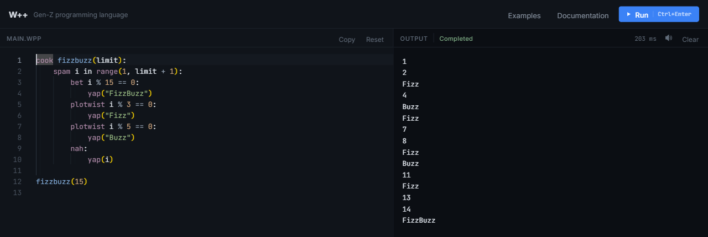
The playground
Write W++, press Run. In the browser, no install.
wplusplus.vercel.app
Notes:
Switch to the live site here if the wifi allows. FizzBuzz is in the Examples menu and runs in milliseconds.

Slide 6
“Isn't this just find-and-replace?”
No. And here is how you can check.
python wpp.py --tokens what the lexer saw
python wpp.py --ast the syntax tree the parser built
python wpp.py --emit the Python the backend generated
Notes:
This is the question every judge asks. Say it before they do. The three commands are the answer: each stage of the compiler can be printed.

Slide 7
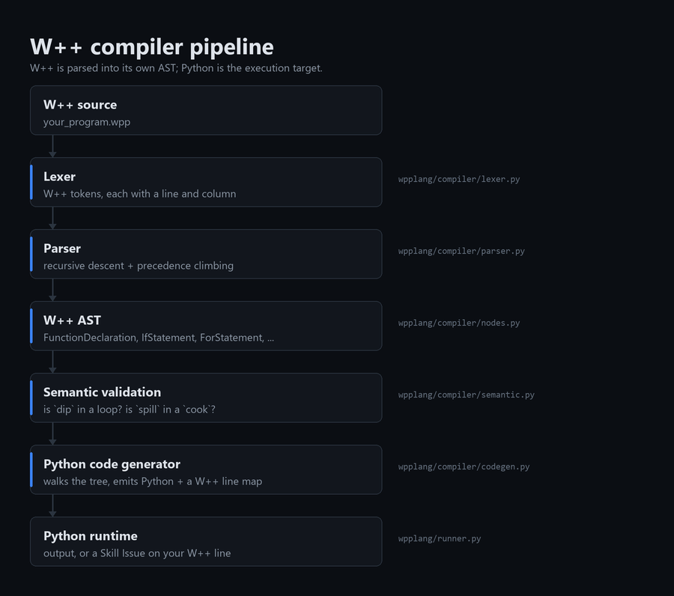
How it actually works
Lexer
W++ tokens, each with a line and column. A keyword inside a string is never a keyword, because the scanner returns the whole literal as one token.
Parser
Recursive descent for statements, precedence climbing for expressions. Produces a W++ syntax tree.
Semantic pass
Is dip inside a loop? Is spill inside a cook? Errors that need a view of the whole tree.
Code generator
Walks the tree and emits Python, remembering which W++ line produced each Python line.
Notes:
Four stages, each with one job. Python is the target we compile to, not what W++ is.

Slide 8
It really is parsed
python wpp.py --ast
cook check_vibe(name):
bet name == "Claude":
spill "W AI"
Program
FunctionDeclaration
name='check_vibe'
keyword='cook' @1:0
params: name
body:
IfStatement @2:4
condition:
Comparison ==
Identifier name
Literal "Claude"
body:
ReturnStatement
keyword='spill'
becomes a tree of W++ constructs, each remembering where it came from
Notes:
Every node knows the W++ keyword that created it and the line and column it came from. That is what makes the next slide possible.

Slide 9
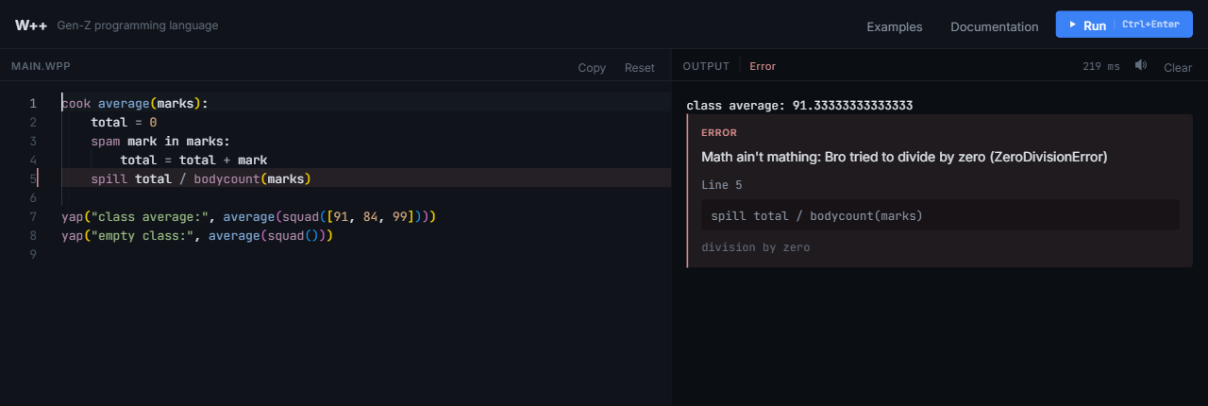
Errors speak W++
The Skill Issue Protocol - and it points at your line, not generated code.
Line 5 is the W++ line the author wrote. The compiler keeps a map from generated Python back to the source, so no message ever mentions code nobody typed.
Notes:
Seven error types get their own message. The interesting part is not the joke wording, it is that the line number is right: a runtime failure knows only the generated Python line, and the source map turns it back.

Slide 10
It runs in two places
One codebase. The interface cannot tell them apart.
Locally
In your browser
A small Python server runs each program in its own child process, with a timeout.
The same compiler runs under Pyodide - CPython on WebAssembly - inside a worker. No backend at all.
So the playground deploys as static files, and it is safe to make public: there is no server executing anyone's code.
wplusplus.vercel.app
Notes:
The browser engine is why we can host it at all. Your own browser runs your own code, so there is nothing of ours to attack.

Slide 11
How we know it works
252
19
0
automated tests, standard
library only
keywords, each tested in
its own context
dependencies for the
language itself
The check that made the rewrite safe
W++ started as a single regular-expression pass. When we replaced it with the compiler, we kept the old translator as a test oracle. Both target Python, so for any program they both accept, the two must generate Python that parses to the same tree. They agree on every one - and the check found two real bugs in the rewrite that we would otherwise have shipped.
Notes:
If you have time for one engineering detail, make it this one. We used the old implementation as an oracle for the new one, comparing parsed Python rather than text. It caught a bug where a nah attached to a loop was being claimed by an inner bet, which silently changed what programs meant.

Slide 12
W++
spam vibe in range(3):
yap("thank you")
bet questions:
spill "ask away"
A real compiler frontend, for a language whose
break statement is called dip.
Try it
wplusplus.vercel.app
Code
github.com/harrynoble/wplusplus
Learn it
docs/WPP_Guide.pdf - 57 pages
Notes:
Close on the live link. Offer to run anything they want to see.

