Slide 1


Student Performance Prediction Using Machine Learning
Identifying At-Risk Students Through Data-Driven Intelligence
Harivdan Narayanshastri
Roll No : 10
Division : A
Year : FY
Semester : 1
Subject: MIT21PC02 : Artificial Intelligence and Machine Learning (AI & ML)

Slide 2

The Challenge
Educational institutions lack timely, data-driven tools to identify struggling students before performance declines become critical.
Manual Evaluation
Late Intervention
Time-intensive, reactive assessments
Issues discovered after damage is done
Limited Insight
No predictive patterns or early warnings

Slide 3


Our Objectives
Enable Action
Early Detection
Empower educators with insights for timely, targeted interventions
Predict Performance
Identify at-risk students before critical performance drops occur
Deploy ML models to forecast student outcomes with accuracy

Slide 4

Literature & Current Gaps
Existing research shows promise but reveals critical limitations:
Current Limitations
Research Gaps
Small, limited datasets reduce generalization
Multi-institutional data integration
Accuracy plateaus around 75-80%
Real-time prediction capabilities
Black-box models lack interpretability
Actionable, explainable recommendations
Minimal teacher-facing tools
Scalable deployment frameworks

Slide 5






Proposed ML Solution
A comprehensive system capturing student data across multiple dimensions for integrated, real-time prediction:
Preprocessing
Evaluation
Data Collection
Model Training

Slide 6
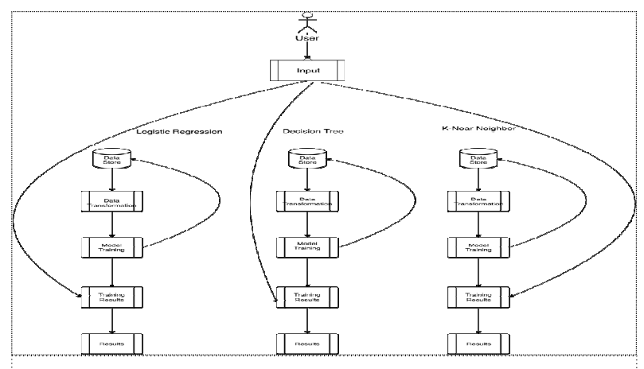
Research has shown that architecture can be improved to date.

Slide 7
Methodology: End-to-End Workflow
01
02
03
Data Collection
Preprocessing
Model Training
Extract student records: attendance, grades, assignments, engagement metrics, demographic factors
Clean data, handle missing values, normalize features, select high-impact predictors
Train ensemble algorithms with cross-validation; compare Logistic Regression, Decision Trees, Random Forest
04
05
Evaluation
Deployment
Measure accuracy, precision, recall, F1-score; validate on held-out test sets
Launch intuitive dashboard for administrators and teachers to monitor predictions and take action

Slide 8









AI/ML Technical Component
Combining multiple machine learning approaches for robust, interpretable predictions:
Decision Trees
Random Forest
Interpretable rules showing which factors matter most
Ensemble strength reducing overfitting and increasing accuracy
Logistic Regression
Neural Networks
Probabilistic approach enabling confidence scores on predictions
Advanced pattern recognition for complex, non-linear relationships

Slide 9
Key Performance Metrics
Measuring model effectiveness across critical dimensions:
92%
88%
85%
0.87
Target Accuracy
Precision
Recall
F1-Score
Overall prediction correctness on validation data
Minimizing false positives in at-risk identification
Catching majority of truly at-risk students
Balanced measure of precision and recall

Slide 10

Impact & Implementation
Immediate Benefits
Future Research
30-40% earlier intervention timing
Multi-year longitudinal studies
Reduced achievement gaps through proactive support
Cross-institutional model validation
Data-driven resource allocation
Explainable AI transparency improvements
Improved graduation rates
Integration with adaptive learning platforms

Slide 11
Reference
Student Performance Prediction using Machine Learning
International Journal of Engineering Research & Technology
Prediction of Students’ Performance using Machine learning
IOP Conf. Series: Materials Science and Engineering
Predicting Students ’ Performance Using Machine Learning Algorithms: A Review
Asian Journal of Research in Computer Science
STUDENT PERFORMANCE PREDICTION USING MACHINE LEARNING TECHNIQUES
International Research Journal of Modernization in Engineering Technology and Science

Slide 12


Conclusion
Our machine learning initiative fundamentally transforms education from a reactive to a proactive model. By identifying each student's unique potential, we empower educators to intervene effectively and early, leading to significant improvements in student outcomes, reduced achievement gaps, and higher graduation rates.
Next Steps: Pilot program across 5 schools, quarterly model refinement, stakeholder feedback integration, and scalable deployment by next academic year.

