Slide 1
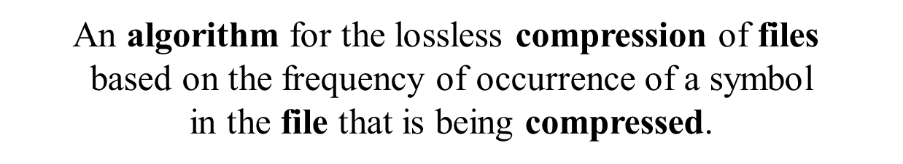
HUFFMAN FILE COMPRESSION ALGORITHM

Slide 2


Compression
Definition
  Reduce size of data
  (number of bits needed to represent data)
Benefits
  Reduce storage needed
  Faster in transmission

Slide 3
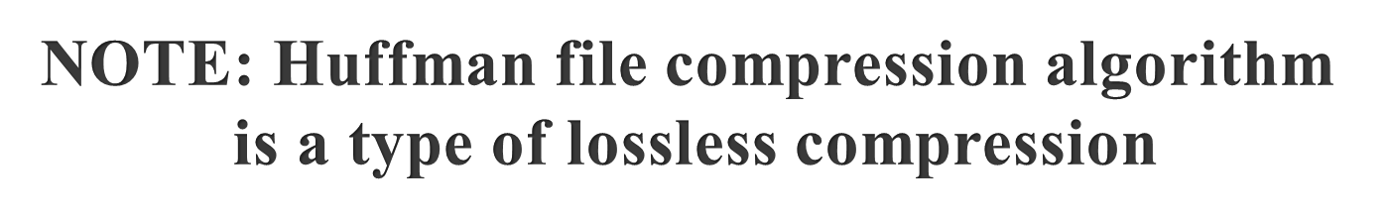
Types of Compression
Lossless
  Preserves all information
  Exploits redundancy in data
  Applied to general data
Lossy
  May lose some information
  Exploits redundancy & human perception
  Applied to audio, image, video

Slide 4
Data Structures used -
HashMap
  Used to store character and their frequencies
  Used to store character and their generated codes
  Used to store code and their respective characters
ArrayList
  To build min Heap

Slide 5

Data Structures used -
Binary (Huffman) Tree
  Used to generate Huffman code
  Edge ⇒ code
  0 for each right and 1 for each left
  Leaf ⇒ symbol
  Path to leaf ⇒ encoding
  Example
    A = “110”, B = “10”, C = “0”
Priority Queue
  To build binary tree efficiently
  It is used to give least frequency mostly efficiently
D
A
1
0
B
C
1
0
1
0

Slide 6
Huffman File Compression Algorithm Overview
Encoding Algorithm
  Calculate frequency of each symbol in the input file and store the character and its frequency in a hashmap
  Create a Min Priority Queue from this information
  Create Binary Tree by removing two minimum elements from the Priority Queue and add a new element to priority queue with frequency as the sum of these two and set them as the left and right child of this element
  Traverse the Binary Tree to each character and generate code

Slide 7
Huffman File Compression Algorithm Overview
Encoding Algorithm
  Assign a 0 for each right and 1 for each left and add to the code string at each step.
  Store the code generated and their respective characters in a hashmap
  Now read the input file character by character , search the code assigned for this character and write the code in the encoded file
  Repeat this for complete input file

Slide 8
Huffman encoding example- 1
A
C
E
H
I
3
5
8
2
7

Slide 9
Huffman encoding example- 2
A
H
C
E
I
3
2
5
8
7
5

Slide 10
Huffman encoding example- 3
A
E
I
H
8
7
3
2
C
5
5
10

Slide 11
Huffman encoding example- 4
E
I
A
H
8
7
3
2
C
5
15
5
10

Slide 12
Huffman encoding example- 5
A
H
E = 01
I = 00
C = 10
A = 111
H = 110
3
2
C
E
I
1
0
5
8
7
5
1
0
1
0
10
15
1
0
25

Slide 13
Huffman encoding example- 6
Huffman code
Input
  ACE
Output
  (111)(10)(01) = 1111001
E = 01
I = 00
C = 10
A = 111
H = 110

Slide 14
Huffman Code Algorithm Overview
Decoding
  Create a reverse hashmap of code with their respective character
  Read encoded file and recognize the code
  Use the stored information from hashmap and find the corresponding character
  Write the decoded character in the decoded file
  Repeat this for complete input file

Slide 15
Huffman Decoding Example- 1
A
H
1111001
3
2
C
E
I
1
0
5
8
7
5
1
0
1
0
10
15
1
0
25

Slide 16
Huffman Decoding Example- 2
A
H
1111001
3
2
C
E
I
1
0
5
8
7
5
1
0
1
0
10
15
1
0
25

Slide 17
Huffman Decoding Example- 3
A
H
1111001
A
3
2
C
E
I
1
0
5
8
7
5
1
0
1
0
10
15
1
0
25

Slide 18
Huffman Decoding Example- 4
A
H
1111001
A
3
2
C
E
I
1
0
5
8
7
5
1
0
1
0
10
15
1
0
25

Slide 19
Huffman Decoding Example- 5
A
H
1111001
AC
3
2
C
E
I
1
0
5
8
7
5
1
0
1
0
10
15
1
0
25

Slide 20
Huffman Decoding Example- 6
A
H
1111001
AC
3
2
C
E
I
1
0
5
8
7
5
1
0
1
0
10
15
1
0
25

Slide 21
Huffman Decoding Example- 7
A
H
1111001
ACE
3
2
C
E
I
1
0
5
8
7
5
1
0
1
0
10
15
1
0
25

Slide 22
Huffman Code
Approach
  Statistical frequency of symbols is used
  Variable length encoding of symbols
  Use fewer bits to represent frequent symbols
  Use more bits to represent infrequent symbols
A
A
B
A
A
A
B
A

Slide 23
Huffman Code Properties
Prefix code
  No code is a prefix of another code
  Example
    Huffman(“I”) ⇒ 00
    Huffman(“X”) ⇒ 001 // not legal prefix code
  Can stop as soon as complete code found
  No need for any marker
Nondeterministic
  Multiple Huffman coding possible for same input
  If more than two trees with same minimal weight

Slide 24
Limitations
Due to variable length code that is generated it becomes difficult to decode the file
File compression is least significant in terms of size when the size of input file is small

Slide 25


