Slide 1
This is a BIKE sales analysis

Slide 2
Instructions of this module
We would analysis the data and try to know the insights and what this data says about the bike sales

Slide 3

Hello!
I am Biswarup Ghosh
We would see a project of Bike sales

Slide 4
1.We would the struckture of this data first
Let’s start with the Data

Slide 5

As we can see that outliers are there at the first and at the end of this picture

Slide 6
Now we would treate the outliers so that the module that we would build that would be perfect.
If we don’t treate the outliers then our module can be up to our expectation.

Slide 7

As you now can see that we have fixed the outliers.
The outliers those were there earlier those have been fixed now..
It means our data is good to use

Slide 8
This is a slide title
We would consider the “selling_price” column as our dependent variable.
And then we would divide the data into two parts one is “Traning_data” and the other one is “Testing_data”.
And we would split the data in the ratio of 7:3, means the “Traning_data” would have the 70% value and the Testing_data would have 30% value.

Slide 9
we would divide the data into parts
One would be called Traning_data and the another one would be called Testing_data.

Slide 10

As we can see that the “Traning_data” contains 70% of the data.
And the “Testing_data” contains 30% of the data.

Slide 11
You can also split your content
White
Is the color of milk and fresh snow, the color produced by the combination of all the colors of the visible spectrum.

Slide 12
In two or three columns
Yellow
Is the color of gold, butter and ripe lemons. In the spectrum of visible light, yellow is found between green and orange.
Blue
Is the colour of the clear sky and the deep sea. It is located between violet and green on the optical spectrum.
Red
Is the color of blood, and because of this it has historically been associated with sacrifice, danger and courage.

Slide 13

A picture is worth a thousand words
A complex idea can be conveyed with just a single still image, namely making it possible to absorb large amounts of data quickly.

Slide 14

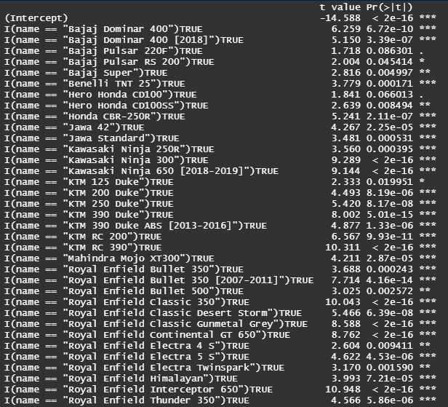
As we cann see that in this data the “KTM RC 390” and the “Royal Enfield Interceptor”, “Royal Enfield Classic 350”. Are impacting in a good way in our sales.

Slide 15
As we can see the Yearly_selling_price of Royal Endfield Classic 350 is higher in every year

Slide 16
Note!
Just like the Royal Enfield Classic 350 The bikes which are significant, those help to increase the sales.

Slide 17
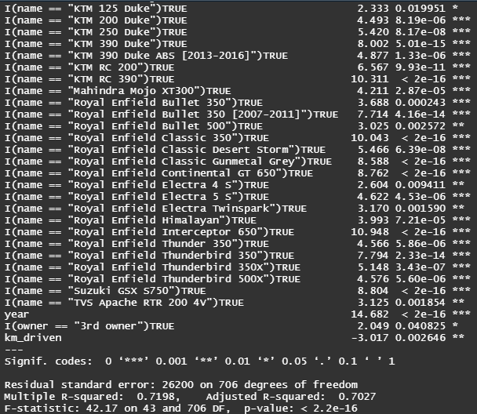
As well as the p-value shows that the module is good to be used.
But the Km_driven data is negetive it means that it effects in out sales in a bad way.

Slide 18
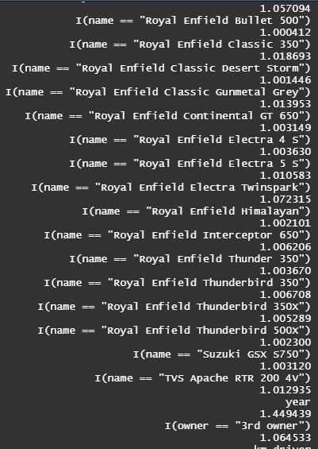
We have done the “vif()” test to check weather the module is good or not, but it shows that the module is good to use

Slide 19

We have done the “dwt ()” test as well to check weather the module is good or not, but it shows that the module is good to use

Slide 20
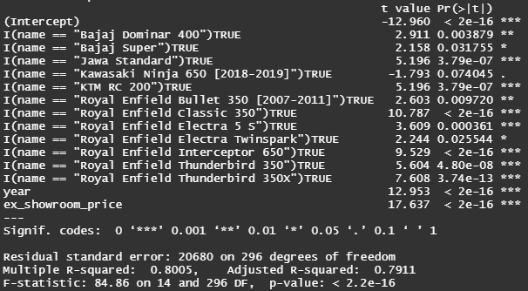
But the values those were significant at the previous module some of them are not significant in this testing Module that’s the reason we had to remove those and as because we consider the testing module as the final model of all so that’ s the reason we had to be careful into this case.

Slide 21
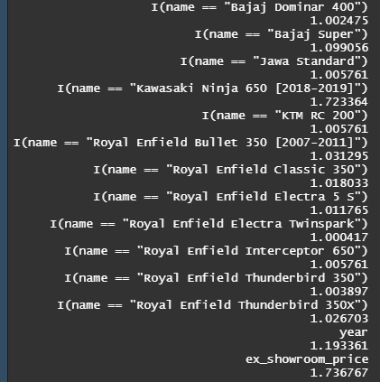
We have done the “vif()” test as well and as it shows that the module is good and all the variables those are there in this module are good that’s the reason we have chosen this module as the perfect one.
But in our terms there is not anything called perfect module because everything depends on data and as well as tuning of module.

Slide 22

And in the testing module the “dwt()” test shows that the module is good as well, so we can use or keep this module for this analysis.

Slide 23
These bikes are almost new

Slide 24
Top 10 best bikes with best deal for buying

Slide 25
These are the Top 10 bikes which most of the people have liked to buy.

Slide 26
These bikes are not providing very good sales and very bad deal to buy

Slide 27
This is prediction vs actual sales.

Slide 28
Thanks!

