Slide 1
Sentiment Analysis
Using Movie Reviews Data to Classify Twitter tweets
Team :: harrypotter0
Member :: Akash Kandpal

Slide 2
Problem
How can a machine interpret Human sentiments ? Which features to use?
Solution ::
Classifying tweets in different classes according to the sentiment expressed by them ::
Positive (class A , 1),Negative(class B, 0),Neutral (Class C, 0<x<1)
Notes:
1. Subjective vs objective information
2. Essentially the same as other information retrieval tasks, but with some additional challenges as we will see

Slide 3
Terms
Corpora -
body of text. ex: medical journals, presidential speeches, English language
Lexicon -
words and their meanings .
Token -
Each "entity" that is a part of whatever was split up based on rules
Notes:
1. Subjective vs objective information
2. Essentially the same as other information retrieval tasks, but with some additional challenges as we will see

Slide 4
Motivation
Twitter is a popular microblogging website.
Each tweet is 140 characters in length .
Tweets are frequently used to express a tweeter's emotion on a particular subject.
There are firms which poll twitter for analysing sentiment on a particular topic.
It is a rapidly expanding service with over 200 million active users with more than 300 million tweets per day so I thought it is better to use it for Sentiment analysis .
Notes:
Review info from blogs, newsgroups, etc
Consumer attitudes towards
-company’s products
-competitor’s products
Politics
-can form basis of policy decisions

Slide 5
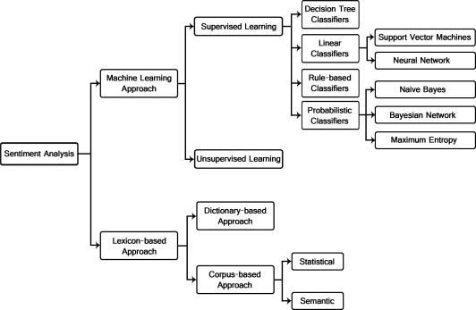
Sentiment classification techniques
Notes:
Machine learning
Strengths:
-perform fairly well within a given domain with sufficient training data
Weaknesses:
--in a given domain tends to overfit training data; hard to transfer learning to other domains
--need training data
Unsupervised
Strengths
--domain independent; prior polarity
--may aid machine learning techniques
weaknesses:
--when used alone, does not perform as well as machine learning w/in a given domain

Slide 6
Approach Towards Problem Solving
Tokenize words and sentences
Stop Words removal
Stemming and Lemmatizing tokens
POS tagging(noun , pronoun)
Chunking and Chinking of data
Tuples formation of Movie Reviews Data.
Choosing a particular model(or classifier) and train the data on it .
Continued on next page
Notes:
Machine learning
Strengths:
-perform fairly well within a given domain with sufficient training data
Weaknesses:
--in a given domain tends to overfit training data; hard to transfer learning to other domains
--need training data
Unsupervised
Strengths
--domain independent; prior polarity
--may aid machine learning techniques
weaknesses:
--when used alone, does not perform as well as machine learning w/in a given domain

Slide 7
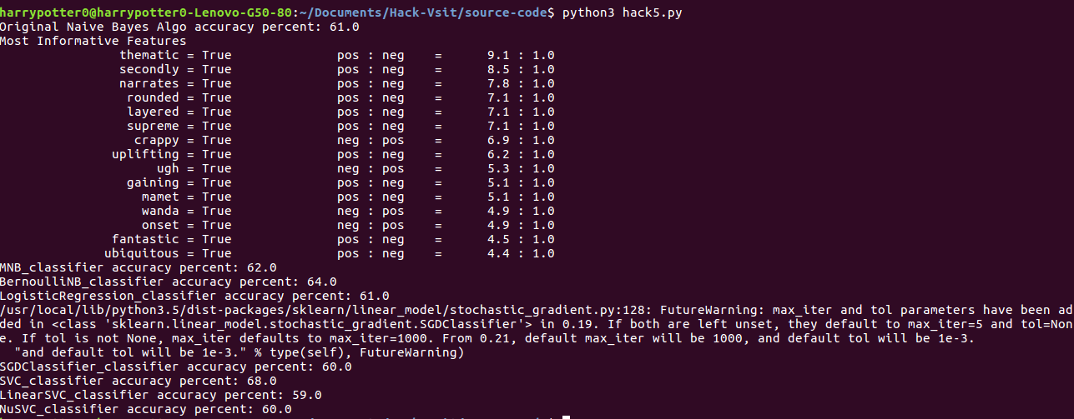
Using many models and check for the best approach by testing it on 1/10th data.
Continued on next page
Notes:
Machine learning
Strengths:
-perform fairly well within a given domain with sufficient training data
Weaknesses:
--in a given domain tends to overfit training data; hard to transfer learning to other domains
--need training data
Unsupervised
Strengths
--domain independent; prior polarity
--may aid machine learning techniques
weaknesses:
--when used alone, does not perform as well as machine learning w/in a given domain

Slide 8
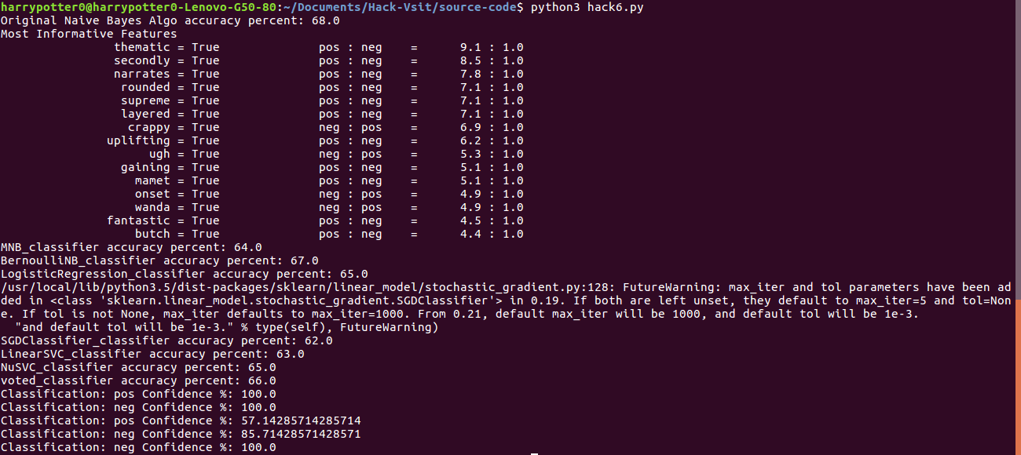
Forming a new classifier on the basis of votes and predicting the confidence on that classification
Continued on next page
Notes:
Machine learning
Strengths:
-perform fairly well within a given domain with sufficient training data
Weaknesses:
--in a given domain tends to overfit training data; hard to transfer learning to other domains
--need training data
Unsupervised
Strengths
--domain independent; prior polarity
--may aid machine learning techniques
weaknesses:
--when used alone, does not perform as well as machine learning w/in a given domain

Slide 9
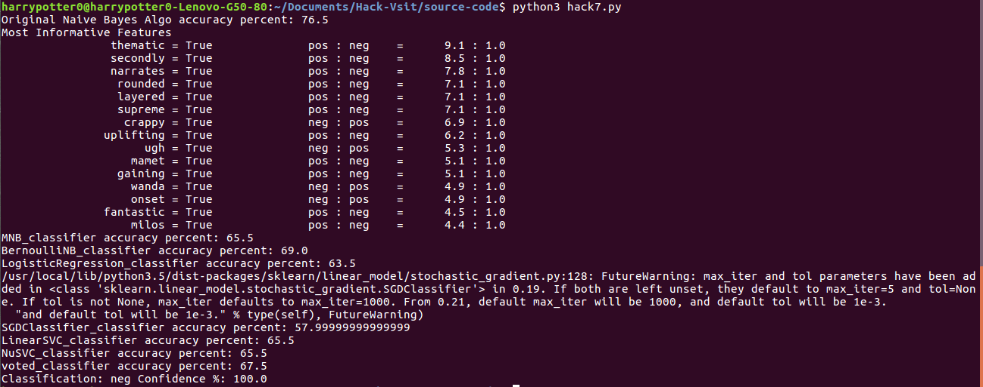
Investigating the bias .
Continued on next page
Notes:
Machine learning
Strengths:
-perform fairly well within a given domain with sufficient training data
Weaknesses:
--in a given domain tends to overfit training data; hard to transfer learning to other domains
--need training data
Unsupervised
Strengths
--domain independent; prior polarity
--may aid machine learning techniques
weaknesses:
--when used alone, does not perform as well as machine learning w/in a given domain

Slide 10
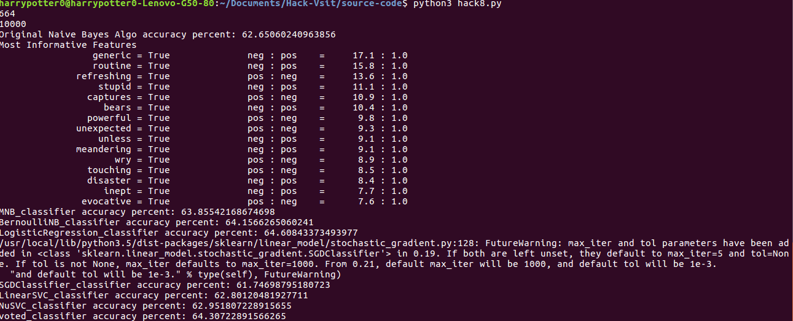
Increased the datasets from 1000 to 5302 labeling the data as positive and negative.
Continued on next page
Notes:
Machine learning
Strengths:
-perform fairly well within a given domain with sufficient training data
Weaknesses:
--in a given domain tends to overfit training data; hard to transfer learning to other domains
--need training data
Unsupervised
Strengths
--domain independent; prior polarity
--may aid machine learning techniques
weaknesses:
--when used alone, does not perform as well as machine learning w/in a given domain

Slide 11
Approach continued....
Creating a module for sentiment analysis and setting “adjective “ as a feature .
Pickle used to save trained classifiers which saves me 30 mins every time I train a previously trained model .
Save tweets which have confidence more than 80% in “twitter-out.text”.
Continued on next page
Notes:
Machine learning
Strengths:
-perform fairly well within a given domain with sufficient training data
Weaknesses:
--in a given domain tends to overfit training data; hard to transfer learning to other domains
--need training data
Unsupervised
Strengths
--domain independent; prior polarity
--may aid machine learning techniques
weaknesses:
--when used alone, does not perform as well as machine learning w/in a given domain

Slide 12
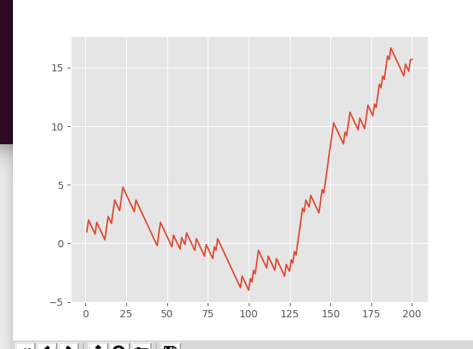
Graphing live data on a particular topic :)
Continued on next page
Notes:
Machine learning
Strengths:
-perform fairly well within a given domain with sufficient training data
Weaknesses:
--in a given domain tends to overfit training data; hard to transfer learning to other domains
--need training data
Unsupervised
Strengths
--domain independent; prior polarity
--may aid machine learning techniques
weaknesses:
--when used alone, does not perform as well as machine learning w/in a given domain

Slide 13
Challenges Encountered
Unstructured and unlabelled data .
Twitter dataset could not be generated as it required more time ,so used movie review datasets instead.
Notes:
“[it] avoids all cliches and predictability found in Hollywood movies”
“avoids” reverses polarity of “cliches” and “predictability”
Thwarted expectation:
“This film should be brilliant. It sounds like a great plot, the actors are first grade, and the supporting cast is good as well, and Stallone is attempting to deliver a good performance. However, it can't hold up"
“unpredictable”: good for movie plot, bad for car steering

Slide 14
Application
Consumer information
  Product reviews
Marketing
  Consumer attitudes
  Trends
  Stocks Prediction
Politics
  Politicians want to know voters’ views
  Voters want to know politicians’ stances and who else supports them
Social
  Find like-minded individuals or communities
Notes:
Review info from blogs, newsgroups, etc
Consumer attitudes towards
-company’s products
-competitor’s products
Politics
-can form basis of policy decisions

Slide 15
Conclusion
Many improvements can be done on this model :0
With much more labeled data more accuracy can be generated .
We have worked with simplest uni-gram. models,we can improve these models by adding extra info.
Notes:
Review info from blogs, newsgroups, etc
Consumer attitudes towards
-company’s products
-competitor’s products
Politics
-can form basis of policy decisions

Slide 16
References
B. Pang, L. Lee, and S. Vaithyanathan, “Thumbs up? Sentiment classification using machine learning techniques,” in Proc Conf on Empirical Methods in Natural Language Processing (EMNLP), pp. 79–86, 2002.
Esuli A, Sebastiani F. SentiWordNet: A Publicly Available Lexical Resource for Opinion Mining. In: Proc of LREC 2006 - 5th Conf on Language Resources and Evaluation, 2006.
Zhang E, Zhang Y. UCSC on TREC 2006 Blog Opinion Mining. TREC 2006 Blog Track, Opinion Retrieval Task.
Devitt A, Ahmad K. Sentiment Polarity Identification in Financial News: A Cohesion-based Approach. ACL 2007.
Bo Pang , Lillian Lee, A sentimental education: sentiment analysis using subjectivity summarization based on minimum cuts, Proceedings of the 42nd Annual Meeting on Association for Computational Linguistics, p.271-es, July 21-26, 2004.

Slide 17
THANK-YOU
Q & A

