Slide 1
Diabetes Detector
Using Gaussian Classifier and K-means to classify patents.
Team :: harrypotter0
Member :: Akash Kandpal

Slide 2
Problem
Manual labour to classify Patients .
Many features to predict by the classifier .
Solution ::
Classifying patients records according to the nature showed by them.
Tech Used :
Keras
Scikit learn
Matplotlib
Tensorflow as backend
Notes:
1. Subjective vs objective information
2. Essentially the same as other information retrieval tasks, but with some additional challenges as we will see

Slide 3
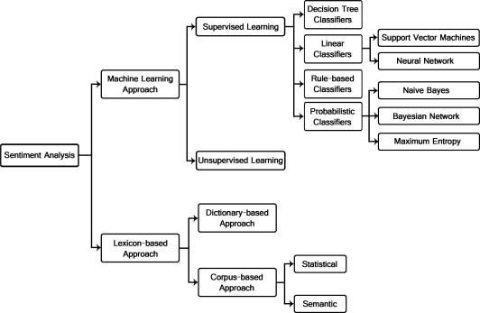
Classification Techniques
Notes:
Machine learning
Strengths:
-perform fairly well within a given domain with sufficient training data
Weaknesses:
--in a given domain tends to overfit training data; hard to transfer learning to other domains
--need training data
Unsupervised
Strengths
--domain independent; prior polarity
--may aid machine learning techniques
weaknesses:
--when used alone, does not perform as well as machine learning w/in a given domain

Slide 4
Approach Towards Problem Solving
Preprocess the data .
Choosing a particular model(or classifier) and train the data on it .
Pickle the trained model to reduce time taken per run.
Displayed the results .
Continued on next page
Notes:
Machine learning
Strengths:
-perform fairly well within a given domain with sufficient training data
Weaknesses:
--in a given domain tends to overfit training data; hard to transfer learning to other domains
--need training data
Unsupervised
Strengths
--domain independent; prior polarity
--may aid machine learning techniques
weaknesses:
--when used alone, does not perform as well as machine learning w/in a given domain

Slide 5
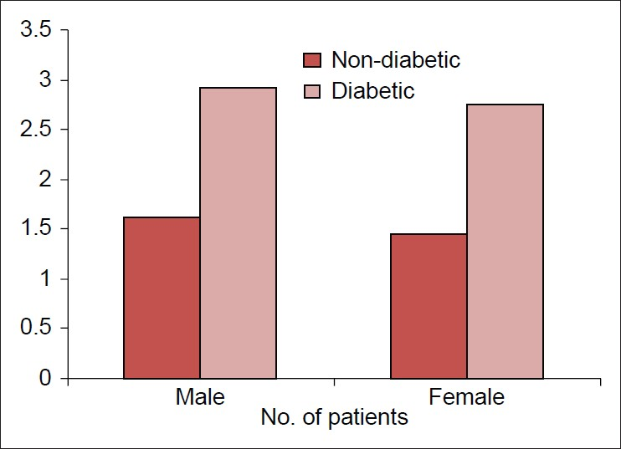
Stats of India

Slide 6
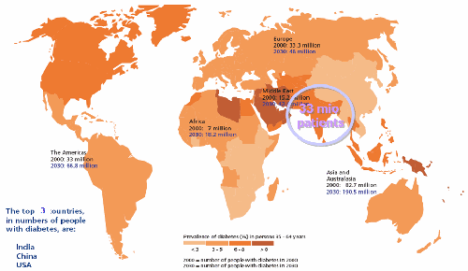

Slide 7
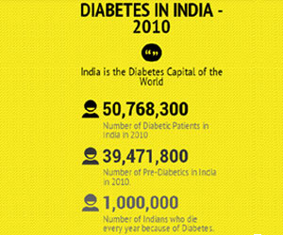

Slide 8
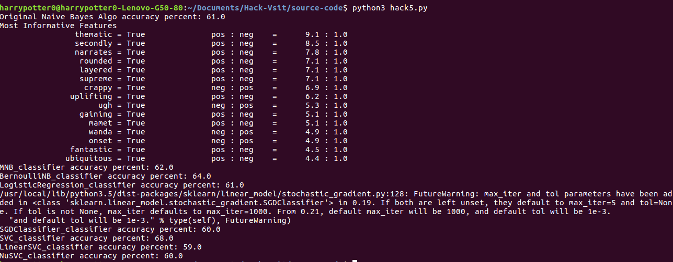
Using many models and check for the best approach by testing it on 1/10th data.
Continued on next page
Notes:
Machine learning
Strengths:
-perform fairly well within a given domain with sufficient training data
Weaknesses:
--in a given domain tends to overfit training data; hard to transfer learning to other domains
--need training data
Unsupervised
Strengths
--domain independent; prior polarity
--may aid machine learning techniques
weaknesses:
--when used alone, does not perform as well as machine learning w/in a given domain

Slide 9
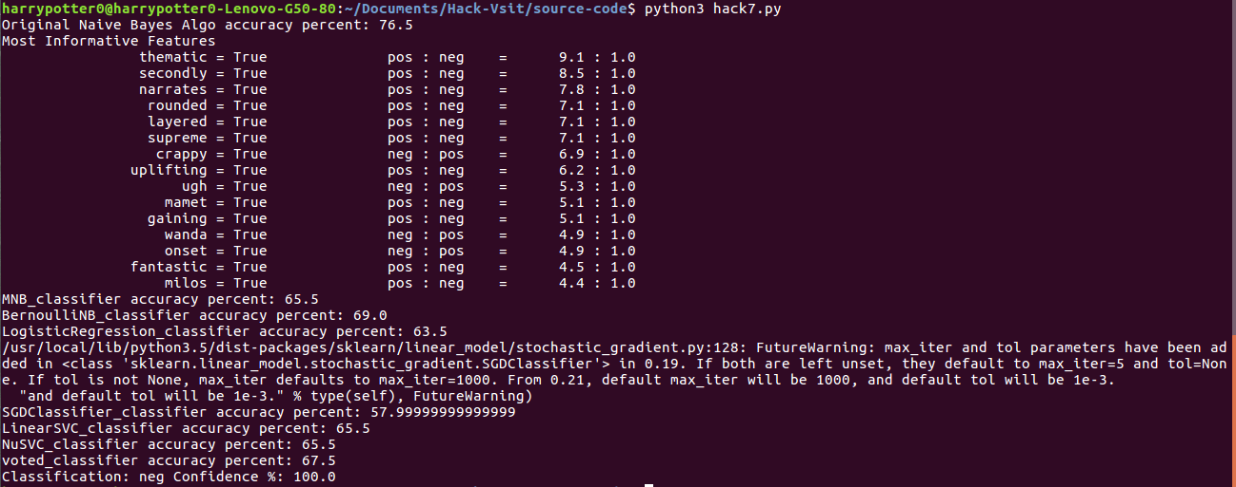
Investigating the bias
Continued on next page
Notes:
Machine learning
Strengths:
-perform fairly well within a given domain with sufficient training data
Weaknesses:
--in a given domain tends to overfit training data; hard to transfer learning to other domains
--need training data
Unsupervised
Strengths
--domain independent; prior polarity
--may aid machine learning techniques
weaknesses:
--when used alone, does not perform as well as machine learning w/in a given domain

Slide 10
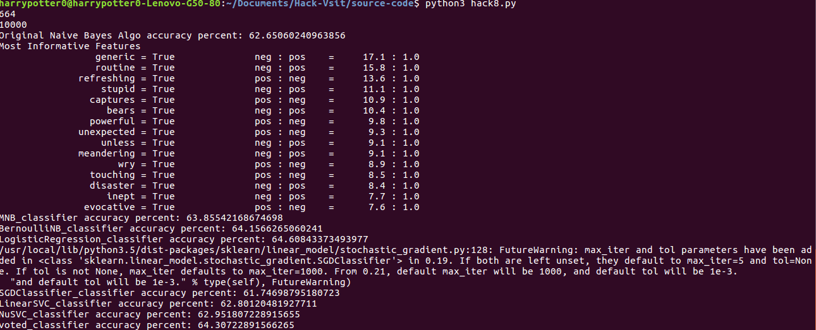
Increased the datasets from 1000 to 5302 labeling the data as positive and negative.
Continued on next page
Notes:
Machine learning
Strengths:
-perform fairly well within a given domain with sufficient training data
Weaknesses:
--in a given domain tends to overfit training data; hard to transfer learning to other domains
--need training data
Unsupervised
Strengths
--domain independent; prior polarity
--may aid machine learning techniques
weaknesses:
--when used alone, does not perform as well as machine learning w/in a given domain

Slide 11
Conclusion
Many improvements can be done on this model :0
With much more labelled data more accuracy can be generated .
Github Repo is available here .
Notes:
Review info from blogs, newsgroups, etc
Consumer attitudes towards
-company’s products
-competitor’s products
Politics
-can form basis of policy decisions

Slide 12
References
B. Pang, L. Lee, and S. Vaithyanathan, “Thumbs up? Sentiment classification using machine learning techniques,” in Proc Conf on Empirical Methods in Natural Language Processing (EMNLP), pp. 79–86, 2002.
Esuli A, Sebastiani F. SentiWordNet: A Publicly Available Lexical Resource for Opinion Mining. In: Proc of LREC 2006 - 5th Conf on Language Resources and Evaluation, 2006.
Zhang E, Zhang Y. UCSC on TREC 2006 Blog Opinion Mining. TREC 2006 Blog Track, Opinion Retrieval Task.
Devitt A, Ahmad K. Sentiment Polarity Identification in Financial News: A Cohesion-based Approach. ACL 2007.
Bo Pang , Lillian Lee, A sentimental education: sentiment analysis using subjectivity summarization based on minimum cuts, Proceedings of the 42nd Annual Meeting on Association for Computational Linguistics, p.271-es, July 21-26, 2004.

Slide 13
THANK-YOU
Now some demo

