Slide 1
Embedded and Real-Time Systems (EENG 34030): Main Problem Submission Group XX
Name and UserID
Name and UserID
Name and UserID

Slide 2
This template is a guidance of the material you should prepare for the assessment and the questions you are going to get from the assessors. You should expect probing questions to make sure you are showing your own work and no plagiarism has taken place.
Make sure you have your own version of the DetectorBus from the Cortex-M0 lab that triggers an “led” signal when you read specific data from “ahbrom.vhd”. This can be anywhere in your design as long as the “led” is visible in the waveform viewer. The memory contents are the same as in the Cortex-M0 lab, so you should also try to replace the default trigger with your Group number in HEX.

Slide 3
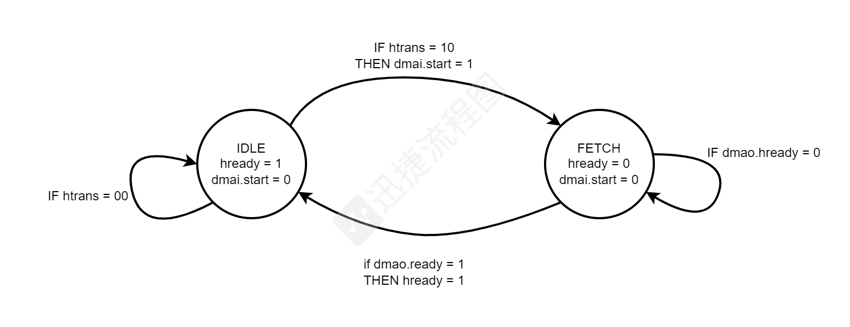
State machine flowchart:

Slide 4
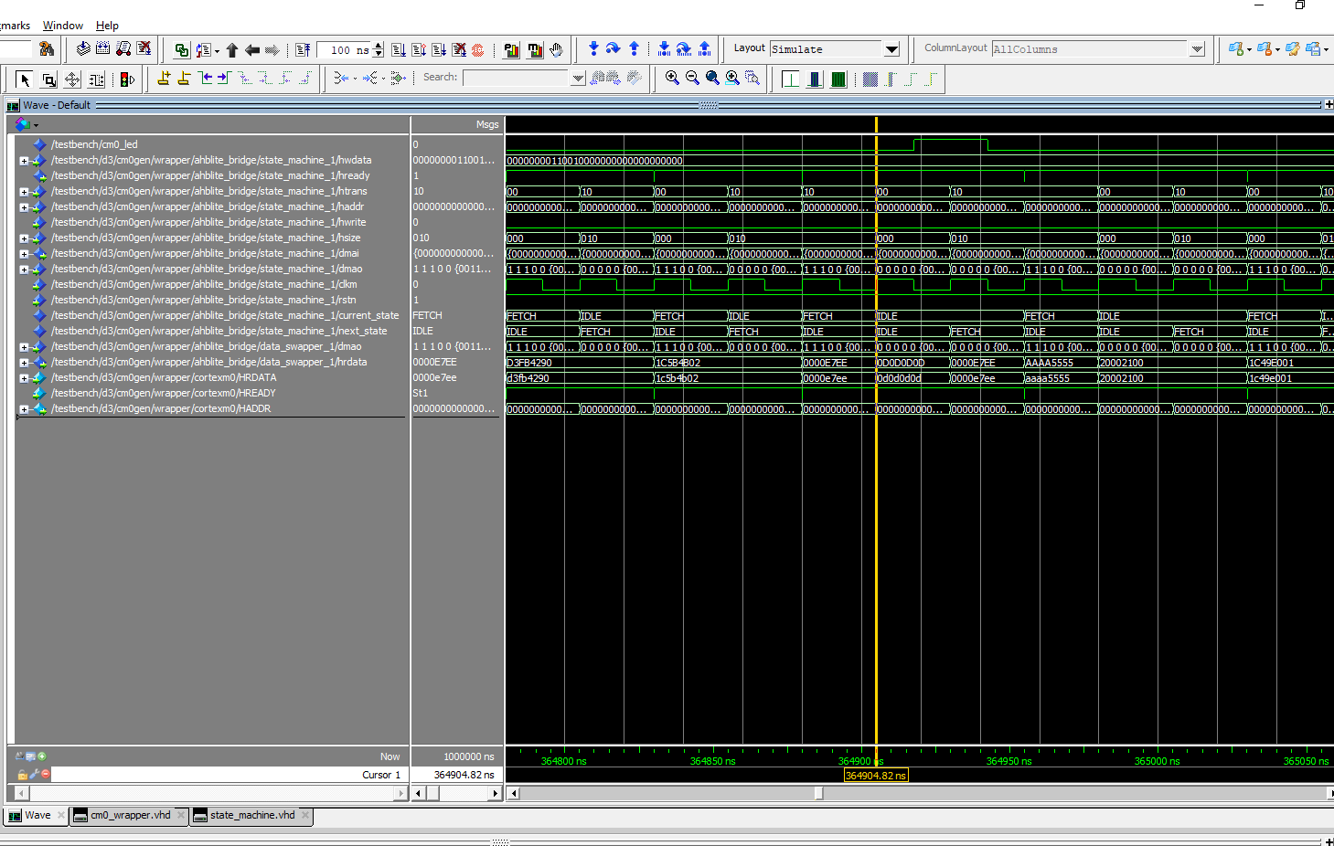
Screencap of simulation waveform:

Slide 5
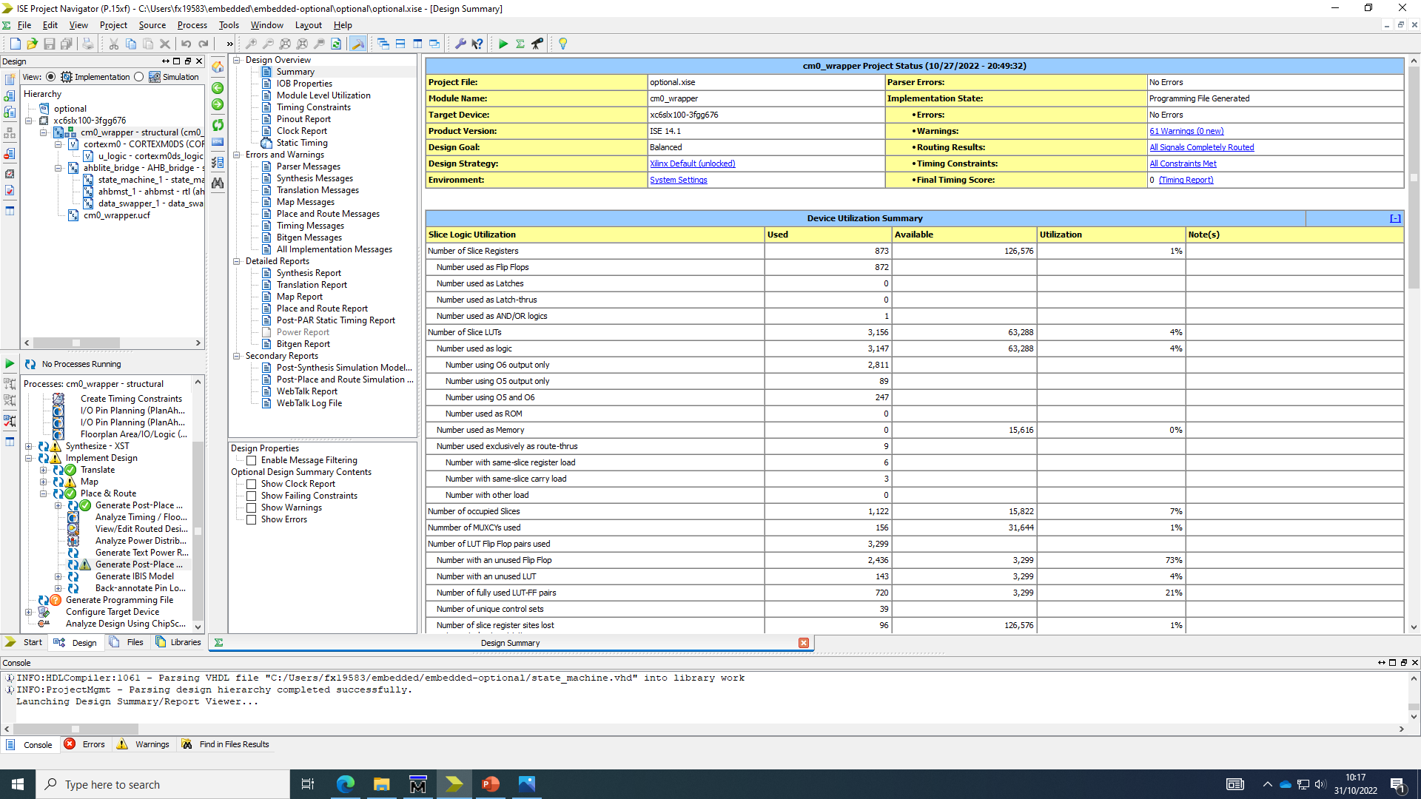
FPGA Implementation Details Table:

Slide 6
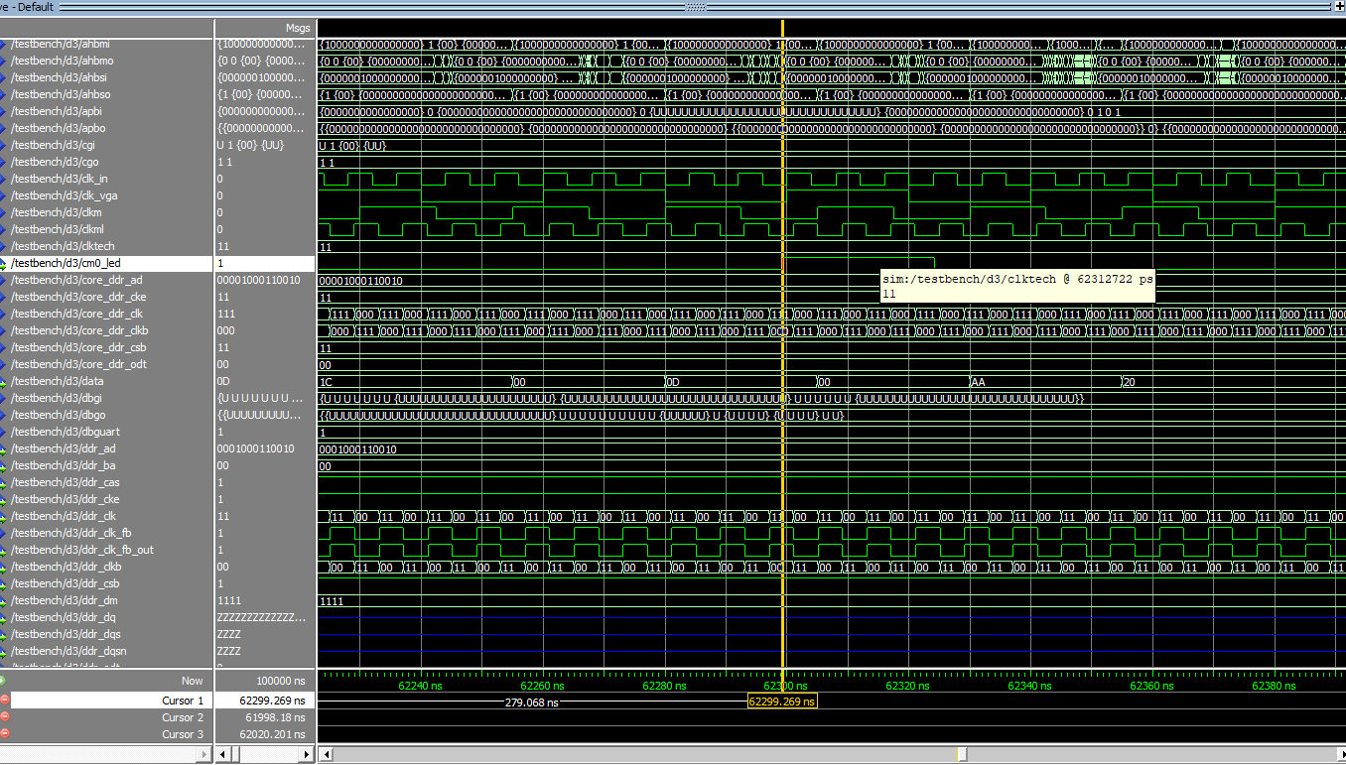
Screencap of waveform with delays:

Slide 7
Design Checklist:
Check swapper and state machine VHDL code, check clock usage and correct combinational and sequential processes.
Verify VHDL code for hierarchy that should include AHB bridge, processor etc. Check components inside AHB bridge are correctly connected and look complete.
Show that the simulator compiles the VHDL code without errors.

Slide 8
Design Checklist:
Show that the simulator loads the system VHDL without errors and testbench starting.
Show that the Cortex-M0 processor is running without entering undefined states.
Show that the processor is running continuously without halting after some time.
Show that the data patterns that trigger the led blinking appear in the HRDATA signal (your group number).

Slide 9
Design Checklist:
Show that the data patterns in HRDATA signal that trigger the led blinking are repeating periodically. (It should repeat once every ~62000 ns)
Show that the data patterns in HRDATA that trigger the led blinking repeating periodically are connected to a new user defined output in the testbench such as led.

Slide 10
Implementation Checklist:
Check Vivado/ISE project for code completeness and correct Leon3 library set up. Does your design satisfy timing constraints?
Check the implementation reports and FPGA Implementation Details Table.
Show the simulation of the netlist with additional timing data (SDF files) working correctly with led blinking repetitions.

