Slide 1
Enhancing Doctor Status Re-Validation in Customer Claims STP Process

Slide 2
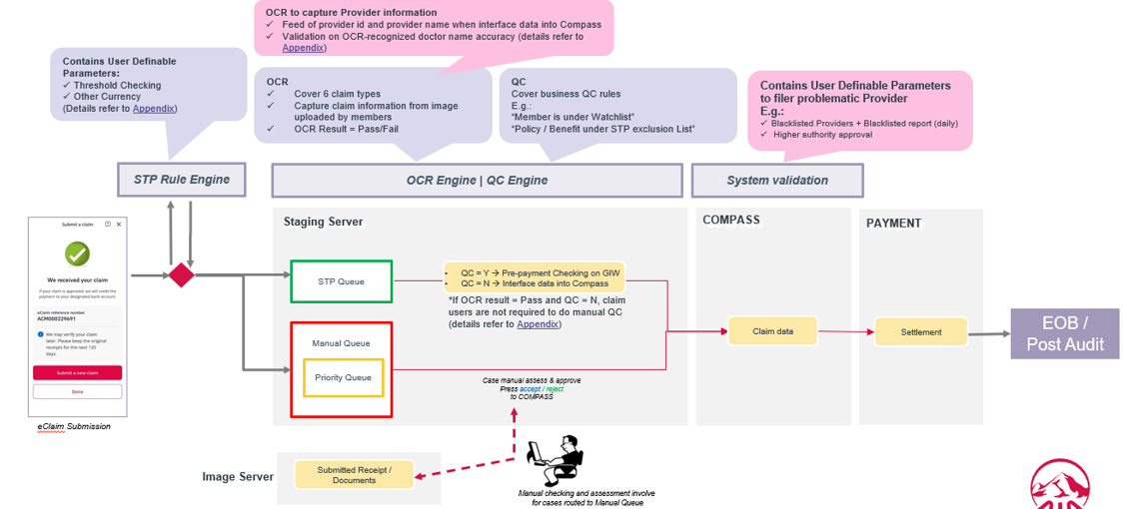

Current STP Workflow Overview

Slide 3
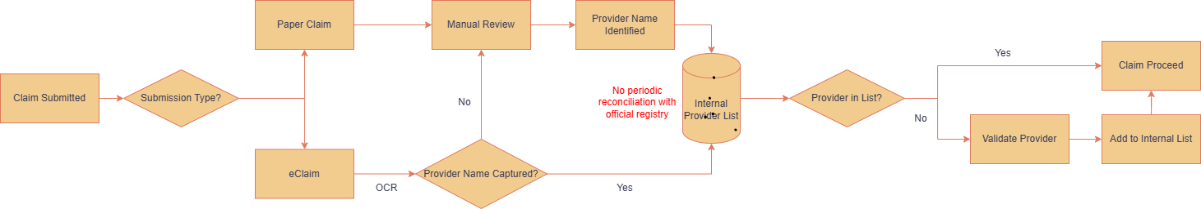
Provider Validation Logic
Validation occurs at onboarding only.

Slide 4
Control Gap – No Ongoing Status Re-Validation
Once added to internal doctor list, provider status is not periodically reconciled against the official medical registry.
Therefore, status changes after onboarding may go undetected.
Retired
Banned
License expired
Other reasons

Slide 5

Risk Implications
Reliance on static internal list.
Potential outdated provider status.
Exposure to compliance and audit findings.
Process design does not ensure ongoing eligibility.

Slide 6
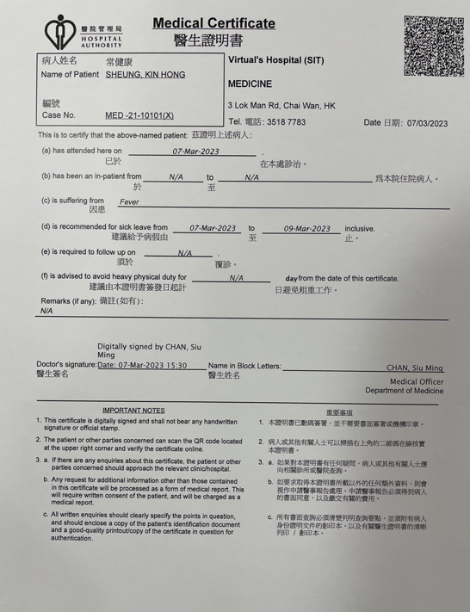
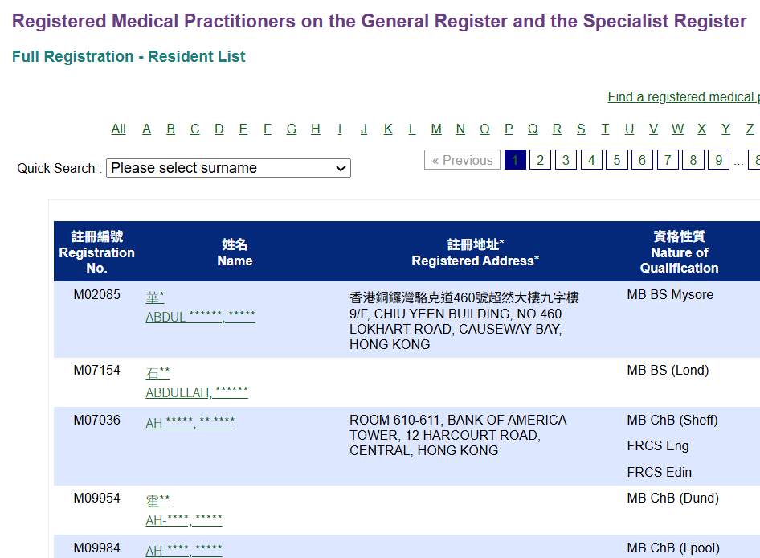
Proposed Automated Solution
1. Fetch all registered provider daily and store it locally
2. OCR extracts provider names from scanned documents

Slide 7
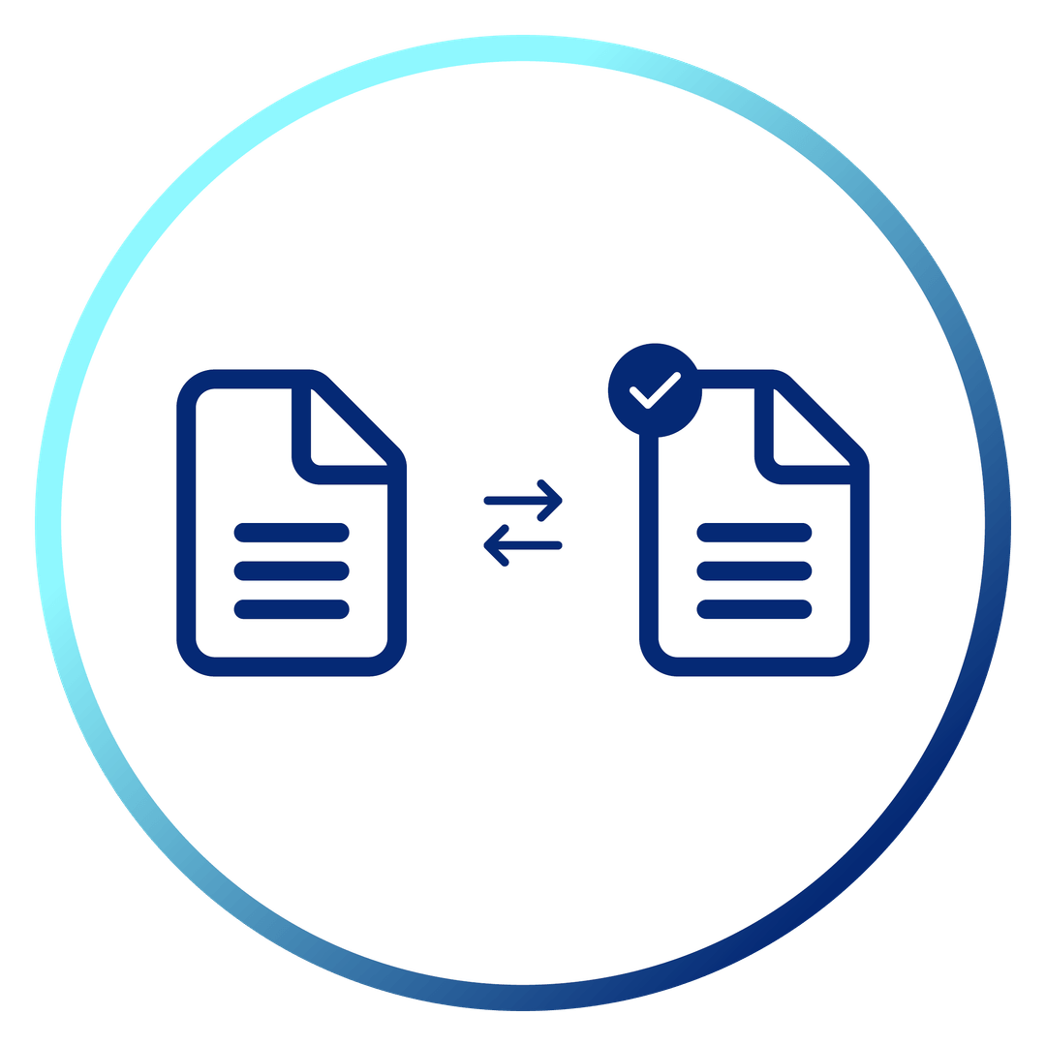
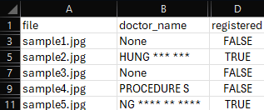
3. Names are matched against registered doctor list
4. Results exported for audit and analytics
7

Slide 8



Business Value
Eliminates manual checking
Ensures consistent verification
Scales to high claim volumes

Slide 9
Thank You

