Slide 1
Can OCR Rules Replace Azure OpenAI?
Medical receipt extraction benchmark
9 receipts · 6 fields · rules vs AI extraction
Notes:
Question: is OCR with hand-written extraction rules enough to replace Azure OpenAI (AOAI) for medical receipts, and what value does AOAI add? Every number comes from the saved benchmark results. Source: python/receipt_ocr_benchmark/results/v2/scores_improved and scores_aoai_improved (summary.csv, detail.csv), results/v1_heldout, and extraction JSON.

Slide 2
Executive Summary
OCR + rules is not enough to replace AOAI across varied receipts.
96.1%
Azure DI + AOAI (prompt v2)
Development result
51.0–70.6%
OCR + multilingual rules
51.0% PaddleOCR Light · 70.6% Azure DI
Retrospective baseline
Why AOAI may still be needed
Fewer rules to write and maintain for new layouts and scenarios
Can potentially extract more fields for analytics (not yet benchmarked)
Rules remain fine for simple, clearly labelled checks
Notes:
Azure DI + AOAI with prompt v2: 96.1% (49/51). OCR + general multilingual rules: 51.0% with PaddleOCR Light and 70.6% with Azure DI (26/51 and 36/51). Rules must be written and maintained for every new label, language and layout; AOAI works from plain-language instructions and could extract further fields (potential, not yet benchmarked). Limits of this evidence: 9 receipts and 51 fields, 7 of them printed, fictional test receipts. 96.1% (prompt v2) is a development result: the prompt was refined after reviewing these receipts. 51.0–70.6% (multilingual rules) is a retrospective baseline: common Chinese labels were added after these receipts were examined, though fixed before scoring. Neither is independent validation: only 4 unseen handwritten receipts exist, and on all 4 Azure DI misread the year 2026 as 2020. Prices are not confirmed. Source: python/receipt_ocr_benchmark/results/v2/scores_improved and scores_aoai_improved (summary.csv, detail.csv), results/v1_heldout, and extraction JSON.

Slide 3



What We Compared
For each of the 9 receipts, we extract 6 key fields and compare the results across 3 approaches.
1. Read the text (OCR)
2. Find the fields
PaddleOCR Light + rules
PaddleOCR Light
open source, own compute
Hand-written rules
6 fields
Azure DI + rules
Azure Document Intelligence
cloud OCR
Hand-written rules
6 fields
Azure DI + AOAI
Azure Document Intelligence
cloud OCR
Azure OpenAI instructions
6 fields
9 receipts: 7 printed test receipts (English, bilingual, Chinese layouts) and 2 from the first benchmark round.
6 fields: doctor, registration no., patient, receipt no., service date, total.
51 of 54 possible fields were scored. 3 receipts do not contain a doctor registration number, so those fields were excluded.
English
Bilingual
Chinese
Notes:
9 receipts: 7 printed, fictional test receipts photographed with a phone (English, bilingual and Traditional Chinese layouts) and 2 receipts from the first benchmark round. Six fields: doctor, registration number, patient, receipt number, service date, total. 51 of 54 possible fields were scored: 3 receipts do not contain a doctor registration number, so those fields were excluded. Azure OpenAI deployment: gpt-5-mini. Source: python/receipt_ocr_benchmark/results/v2/scores_improved and scores_aoai_improved (summary.csv, detail.csv), results/v1_heldout, and extraction JSON.

Slide 4
Rules vs AOAI on the Same Receipts
MEASURED · DEVELOPMENT SET
Multilingual OCR rules reached 51.0–70.6%; Azure DI + AOAI reached 96.1%.
Multilingual rules*
General rules with common Chinese labels
No receipt-specific rules
To close the gap, rules would need
New labels and layouts written by hand
Retesting every receipt after each change
* Retrospective baseline † Development result (prompt refined on these receipts) Neither is independent validation. 9 receipts, 51 fields.
Notes:
Accuracy = correct fields / 51 on the 9 receipts. Multilingual rules = general extraction rules with common Traditional and Simplified Chinese labels and basic bilingual handling (python/receipt_ocr_benchmark/docs/MULTILINGUAL_BASELINE.md); a retrospective baseline. AOAI = prompt v2, a development result: the prompt was refined after reviewing these receipts. Remaining rule errors need new label types, labels inside lines, layout logic or OCR-tolerant matching; PaddleOCR Light also loses fields because its OCR glues words and mixes characters in bilingual labels. Limits of this evidence: 9 receipts and 51 fields, 7 of them printed, fictional test receipts. 96.1% (prompt v2) is a development result: the prompt was refined after reviewing these receipts. 51.0–70.6% (multilingual rules) is a retrospective baseline: common Chinese labels were added after these receipts were examined, though fixed before scoring. Neither is independent validation: only 4 unseen handwritten receipts exist, and on all 4 Azure DI misread the year 2026 as 2020. Prices are not confirmed. Source: python/receipt_ocr_benchmark/results/v2/scores_improved and scores_aoai_improved (summary.csv, detail.csv), results/v1_heldout, and extraction JSON.

Slide 5
The Key Difference: Maintenance
MEASURED · DEVELOPMENT SET
Rules need us to anticipate every case in code. AOAI can often cope through plain-language instructions.
Manual extraction rules
AOAI extraction
A new label, language or layout appears
A developer anticipates it and writes rule code
Retest every receipt; a change can break a working one
New wording appears
Often handled by the existing instructions
If not: refine the instructions in plain language, rerun
Seen in this benchmark
69 → 225 label phrases written by hand
1 correct field broken by a rule change
Seen in this benchmark
One prompt revision: 4 fields fixed, 0 broken
Where rules were enough: a yes/no check for a diagnosis comment under clear labels. Rules matched AOAI on 13/13 receipts (development result).
Notes:
Rules: to handle these 9 receipts the label vocabulary grew from 69 to 225 hand-written phrases (Chinese and bilingual labels, distractor labels, layout handling), and one change broke 1 field that was already correct. AOAI: one prompt revision fixed 4 fields and broke 0. Whether AOAI copes with layouts it has not seen is expected, not proven: it has not been tested on enough unseen receipts, still makes mistakes and needs testing and monitoring. Diagnosis-comment check (results/diagnosis): rules matched AOAI on 13/13 receipts, because the comments sat under clear labels. Source: python/receipt_ocr_benchmark/results/v2/scores_improved and scores_aoai_improved (summary.csv, detail.csv), results/v1_heldout, and extraction JSON.

Slide 6
Advantages and Disadvantages
Rules win on cost, auditability and predictability; AOAI on accuracy, maintenance and flexibility.
 | OCR + rules | Azure DI + AOAI | Evidence
Cost | + PaddleOCR: own compute, no API fee (Azure DI: page fee) | − Azure DI page fee + ~962 input / 243 output tokens per receipt | Prices to confirm
Speed | PaddleOCR 13.9 s (CPU) · Azure DI 3.8 s | 6.4 s per receipt | Measured
Accuracy | − 51.0–70.6% with multilingual rules (retrospective) | + 96.1% with prompt v2 (development result) | Measured
Maintenance | − New labels, languages and layouts need code and a full retest | + Many changes made in plain-language instructions; still retest | Measured / expected
Flexibility | − Finds only what it was written for | + New fields can be requested in the prompt (not yet benchmarked) | Expected
Auditability | + Every result traceable to a rule | − Harder to explain; keep quoted evidence and logs | Expected
Reliability | + Same input, same output | − Can return a confident wrong value (e.g. a sub total as the total); model updates need retesting | Measured / expected
Green = stronger side. Multilingual rules include common Chinese labels (retrospective baseline). Expected = not measured here.
Notes:
Measured: accuracy (multilingual rules 51.0–70.6%, retrospective baseline; AOAI prompt v2 96.1%, development result); speed per receipt (PaddleOCR Light 13.9 s on Azure ML CPU, Azure DI 3.8 s, Azure DI + AOAI prompt v2 6.4 s incl. network); AOAI prompt v2 tokens per receipt (962 input, 243 output); rule effort (69 -> 225 label phrases) and the vet invoice sub-total error. Prices are not confirmed. Flexibility, auditability and model-update effects are expectations. Limits of this evidence: 9 receipts and 51 fields, 7 of them printed, fictional test receipts. 96.1% (prompt v2) is a development result: the prompt was refined after reviewing these receipts. 51.0–70.6% (multilingual rules) is a retrospective baseline: common Chinese labels were added after these receipts were examined, though fixed before scoring. Neither is independent validation: only 4 unseen handwritten receipts exist, and on all 4 Azure DI misread the year 2026 as 2020. Prices are not confirmed. Source: python/receipt_ocr_benchmark/results/v2/scores_improved and scores_aoai_improved (summary.csv, detail.csv), results/v1_heldout, and extraction JSON.

Slide 7
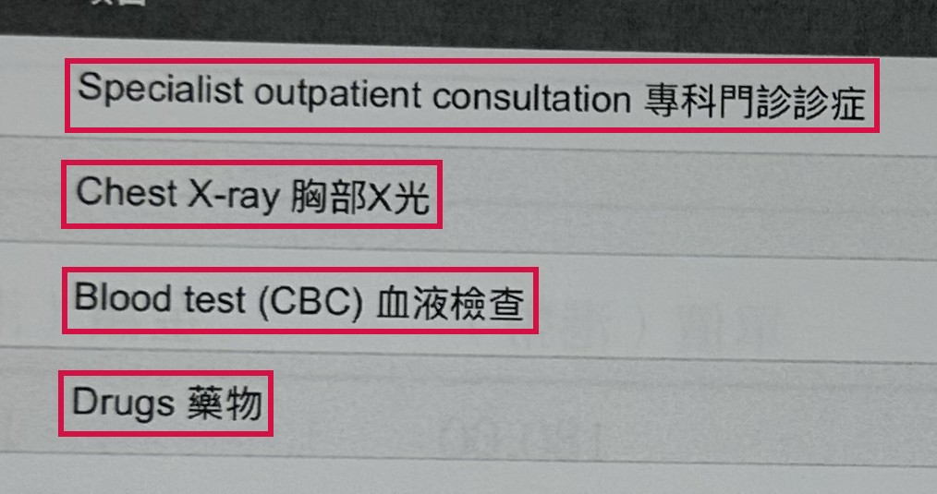
Beyond Six Fields: From Receipts to Insights
POTENTIAL · NOT YET TESTED
Today we extract 6 fields. AOAI could also capture what was treated, tested and prescribed.
1. What the receipt shows
2. What AOAI could extract
3. What we could analyse
Item | Type | HK$
Specialist consultation | Consultation | 950.00
Chest X-ray | Test | 620.00
Blood test (CBC) | Test | 380.00
Drugs | Medication | 245.50
Cost by treatment
Spend on consultations, tests and medicines
Provider comparison
Typical charges per test across providers
Trends over time
Which treatments and medicines are rising
Unusual claims
Combinations or amounts that stand out
Illustration typed from the receipt text, not AOAI output
Potential, not yet tested. Only the 6 current fields have been benchmarked. Diagnoses, symptoms, treatments and medications would need a pilot.
Notes:
Potential only: extracting these details has not been built or tested. Left: a real line-item section of a hospital receipt in our benchmark. Middle: an illustration of the structured data AOAI could return, typed by us from that receipt's OCR text (checked in the saved Azure DI output); it is not AOAI output. Where receipts show them, diagnoses and symptoms could be captured the same way. Rules would need new labels and logic for each such detail. Right: examples of analytics this would enable. A pilot would need ground truth, accuracy targets, a privacy review and cost checks.

Slide 8
Recommendation
Use rules for simple, labelled checks. Use AOAI where receipts vary or richer data is needed.
Simple OCR rules are sufficient when…
Layouts are few, known and stable
Fields have clear printed labels
The question is simple, e.g. is a diagnosis comment present?
No API fee and fully traceable output are required
AOAI adds real value when…
Providers, layouts and languages vary (Chinese, bilingual)
Fields lack consistent labels: names with titles, totals vs subtotals
We want less scenario-specific code to maintain
Richer medical data is wanted (potential, not yet benchmarked)
1. Freeze
the rules and AOAI prompt v2
2. Validate
30+ unseen, real, anonymised receipts; count rule changes
3. Pilot extra fields
medications, treatments, symptoms, diagnoses with ground truth
4. Confirm cost
Document Intelligence pages and gpt-5-mini tokens
Evidence so far: 9 receipts; results are development or retrospective, not yet validated on unseen receipts.
Notes:
Rules are sufficient where layouts are few and stable, fields have clear labels and the question is simple (for example whether a diagnosis comment is present). AOAI adds value where providers, layouts and languages vary, where fields lack consistent labels, and potentially for richer medical data (not yet benchmarked). Next steps: freeze the rules and prompt v2; test on 30+ unseen, real, anonymised receipts and count the rule changes needed; pilot medications, treatments, symptoms and diagnoses with ground truth; confirm prices. Limits of this evidence: 9 receipts and 51 fields, 7 of them printed, fictional test receipts. 96.1% (prompt v2) is a development result: the prompt was refined after reviewing these receipts. 51.0–70.6% (multilingual rules) is a retrospective baseline: common Chinese labels were added after these receipts were examined, though fixed before scoring. Neither is independent validation: only 4 unseen handwritten receipts exist, and on all 4 Azure DI misread the year 2026 as 2020. Prices are not confirmed. Source: python/receipt_ocr_benchmark/results/v2/scores_improved and scores_aoai_improved (summary.csv, detail.csv), results/v1_heldout, and extraction JSON.

