Slide 1
Medical Receipt OCR Benchmark
Traditional OCR with rules vs Azure AI extraction
Version 2 results · 9 receipts · 51 scored fields
Notes:
Purpose: decide whether Azure Document Intelligence plus Azure OpenAI is worth its cost and complexity compared with OCR plus fixed rules. All figures come from the Version 2 benchmark results. Source: python/receipt_ocr_benchmark/results/v2/scores_improved (detail.csv, summary.csv) and extraction JSON.

Slide 2
Business Problem and Objective
Every medical claim needs the same few fields from a receipt; we tested how well that can be automated.
THE QUESTION
Is Azure Document Intelligence + Azure OpenAI worth its extra cost and complexity?
Compared with open-source OCR plus fixed extraction rules that run on our own compute.
SIX FIELDS PER RECEIPT
Doctor name
Registration number
Patient name
Receipt number
Service date
Total amount
JUDGED ON
Accuracy
Speed
Reliability
Cost
Maintenance effort
Notes:
We focus on six fields a claim needs. The question is not only accuracy but also cost, speed, reliability and how much ongoing effort each option needs.

Slide 3
Methodology
Two steps per receipt: read the text (OCR), then find the six fields. We changed one step at a time.
STEP 1 · READ THE TEXT (OCR)
STEP 2 · FIND THE SIX FIELDS
1
PaddleOCR Light
Open-source OCR, small model
Rules: original, then improved
9 receipts
51 fields scored
Red = paid Azure call
2
PaddleOCR Heavy
Open-source OCR, large model
Rules: original, then improved
Azure DI
Cloud OCR (prebuilt-read)
Rules: original, then improved
3
4
Azure DI + AOAI
Cloud OCR (prebuilt-read)
Azure OpenAI gpt-5-mini (prompt unchanged)
Notes:
9 receipts, 51 fields that exist on them (fields not printed on a receipt are excluded). Three OCR engines feed the same fixed rules; the fourth approach replaces the rules with Azure OpenAI. The improved rules were written after examining these receipts, so their scores are tuned results. Source: python/receipt_ocr_benchmark/results/v2/scores_improved (detail.csv, summary.csv) and extraction JSON.

Slide 4
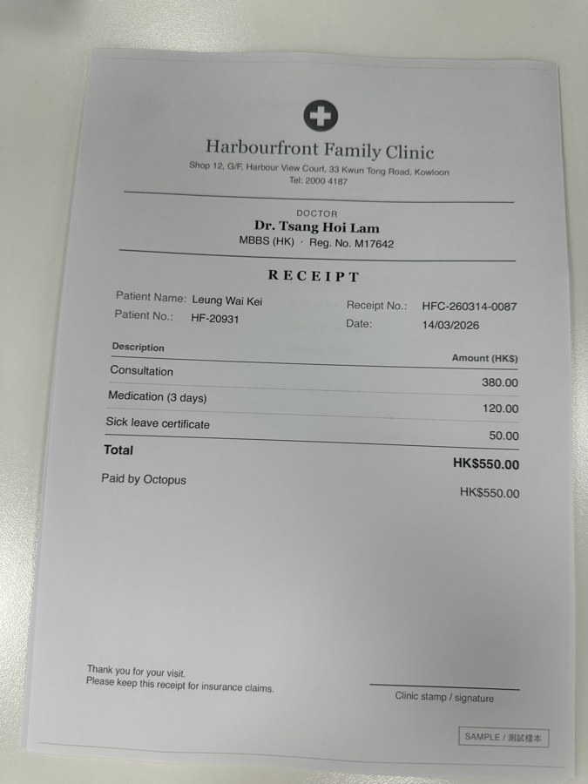

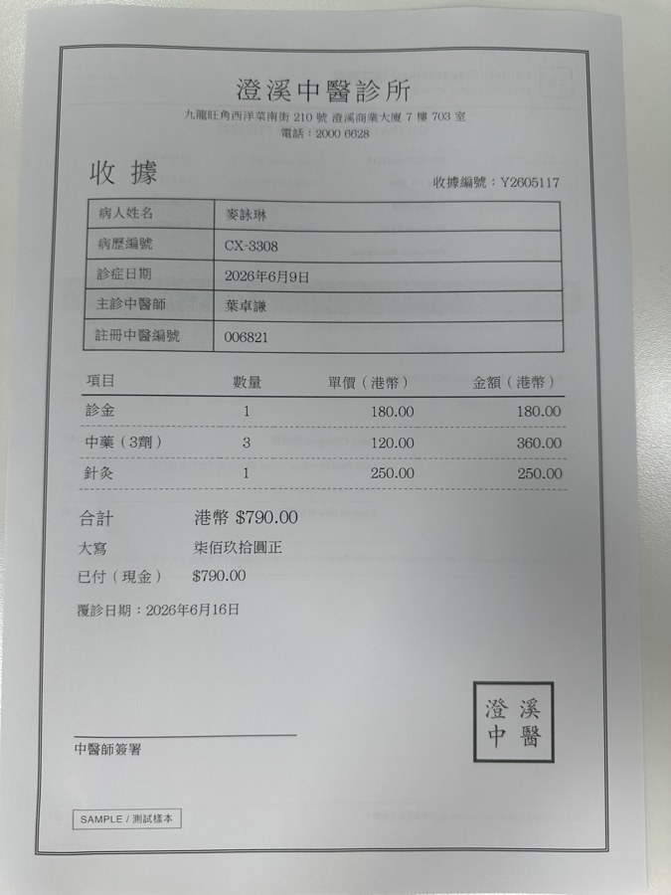
The Receipts: Different Layouts and Languages
Seven new printed receipts photographed by phone, plus two receipts carried over from Version 1.
ALL NINE RECEIPTS
English: GP, specialist, physiotherapy
Bilingual: hospital, dental, medical centre
Traditional Chinese: Chinese medicine
From Version 1: vet invoice, NZ pharmacy
Several include distractors such as referring doctors, issue dates, patient numbers, insurer payments and balances.
GP clinic · English
Hospital invoice · bilingual
Chinese medicine · Chinese
Notes:
Shown: three of the nine benchmark images. The full set: GP clinic, specialist, hospital invoice, Chinese medicine, dental, physiotherapy, medical centre (new, photographed); a vet invoice and a New Zealand pharmacy receipt (from Version 1). Images: python/receipt_ocr_benchmark/data/receipts_v2/printable_images.

Slide 5
Accuracy with the Original Rules
Azure DI + AOAI 88.2%; the three rule-based approaches 29.4–41.2%.
TWO DIFFERENT STEPS
Text recognition (OCR)
Azure DI and PaddleOCR Light read almost every value correctly on the new receipts.
Field extraction
The original rules only knew English labels and missed bilingual and Chinese layouts. This is where most errors came from.
9 receipts, 51 applicable fields. Source: python/receipt_ocr_benchmark/results/v2/scores_improved (detail.csv, summary.csv) and extraction JSON.
Notes:
Accuracy = correct fields / fields that exist on the receipts. The OCR engines read most of the text correctly; the original fixed rules then failed to pick the fields on new, bilingual and Chinese layouts (see FINAL_ANALYSIS.md). Source: python/receipt_ocr_benchmark/results/v2/scores_improved (detail.csv, summary.csv) and extraction JSON.

Slide 6
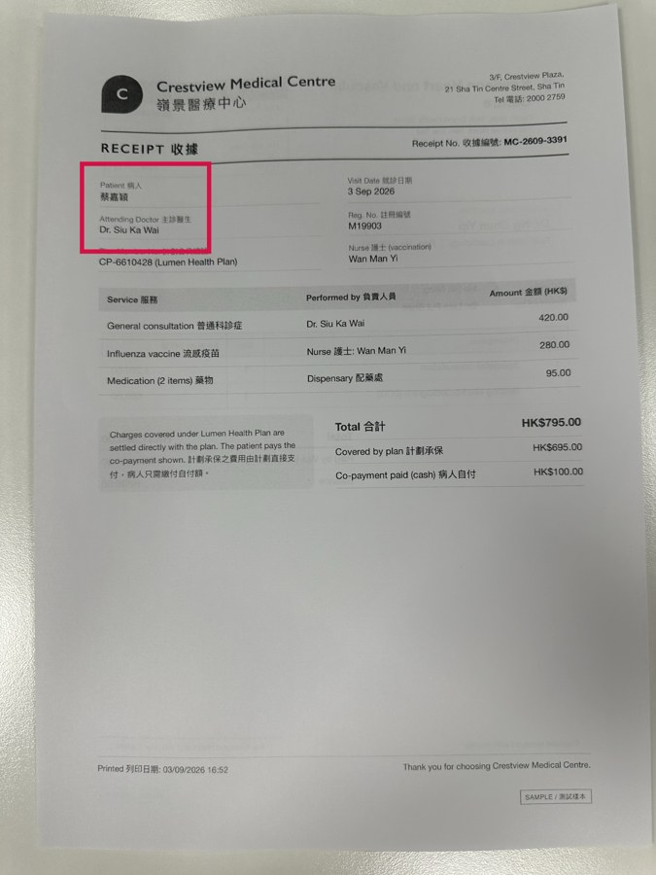
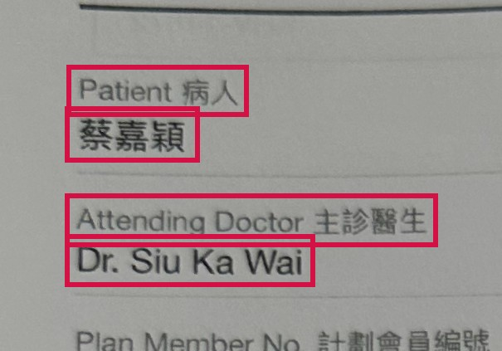
Example 1: Bilingual Labels (Medical Centre)
The original rules read the Chinese half of a label as the value; the improved rules and AOAI do not.
Field | Correct value | Original rules (PaddleOCR Light) | Improved rules (PaddleOCR Light) | Azure DI + AOAI
Patient | 蔡嘉穎 | ✗ 病人 | ✓ 蔡嘉穎 | ✓ 蔡嘉穎
Doctor | Dr. Siu Ka Wai | ✗ (not found) | ✓ Dr. Siu Ka Wai | ✓ Dr. Siu Ka Wai
Reg. no. | M19903 | ✗ (not found) | ✓ M19903 | ✓ M19903
Receipt no. | MC-2609-3391 | ✗ (not found) | ✓ MC-2609-3391 | ✓ MC-2609-3391
Service date | 2026-09-03 | ✗ (not found) | ✓ 2026-09-03 | ✓ 2026-09-03
Rules shown on PaddleOCR Light text; Azure DI with the original rules made the same patient error. ✓ correct · ✗ wrong or missing.
Notes:
Receipt8 (medical centre). Labels such as 'Patient 病人' put the value in a separate block. The original rules took the Chinese label '病人' as the patient's name and missed other fields; Azure DI with the original rules also returned '主診醫生' as the doctor. The improved rules strip label translations; AOAI read the text correctly with its unchanged prompt. Values from detail.csv, checked against the extraction JSON. Source: python/receipt_ocr_benchmark/results/v2/scores_improved (detail.csv, summary.csv) and extraction JSON.

Slide 7
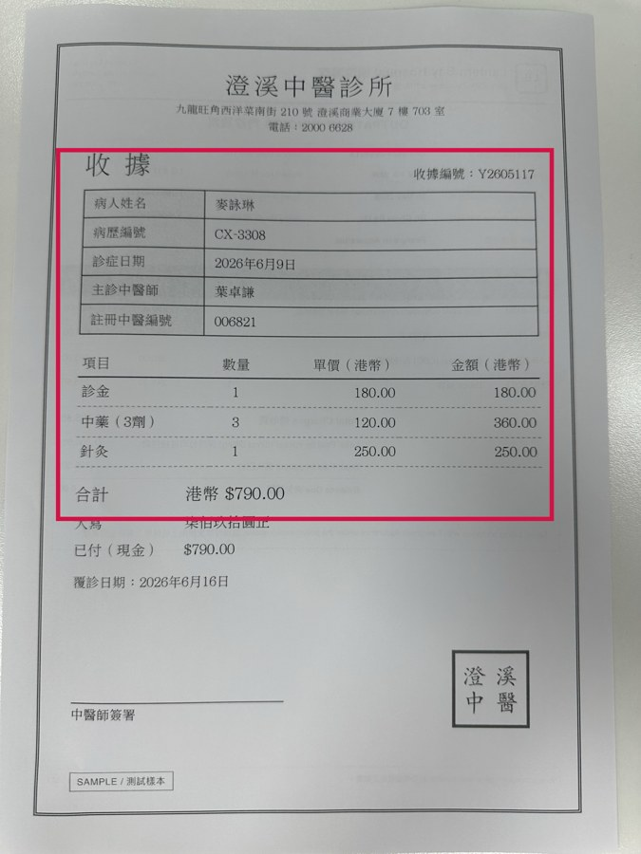
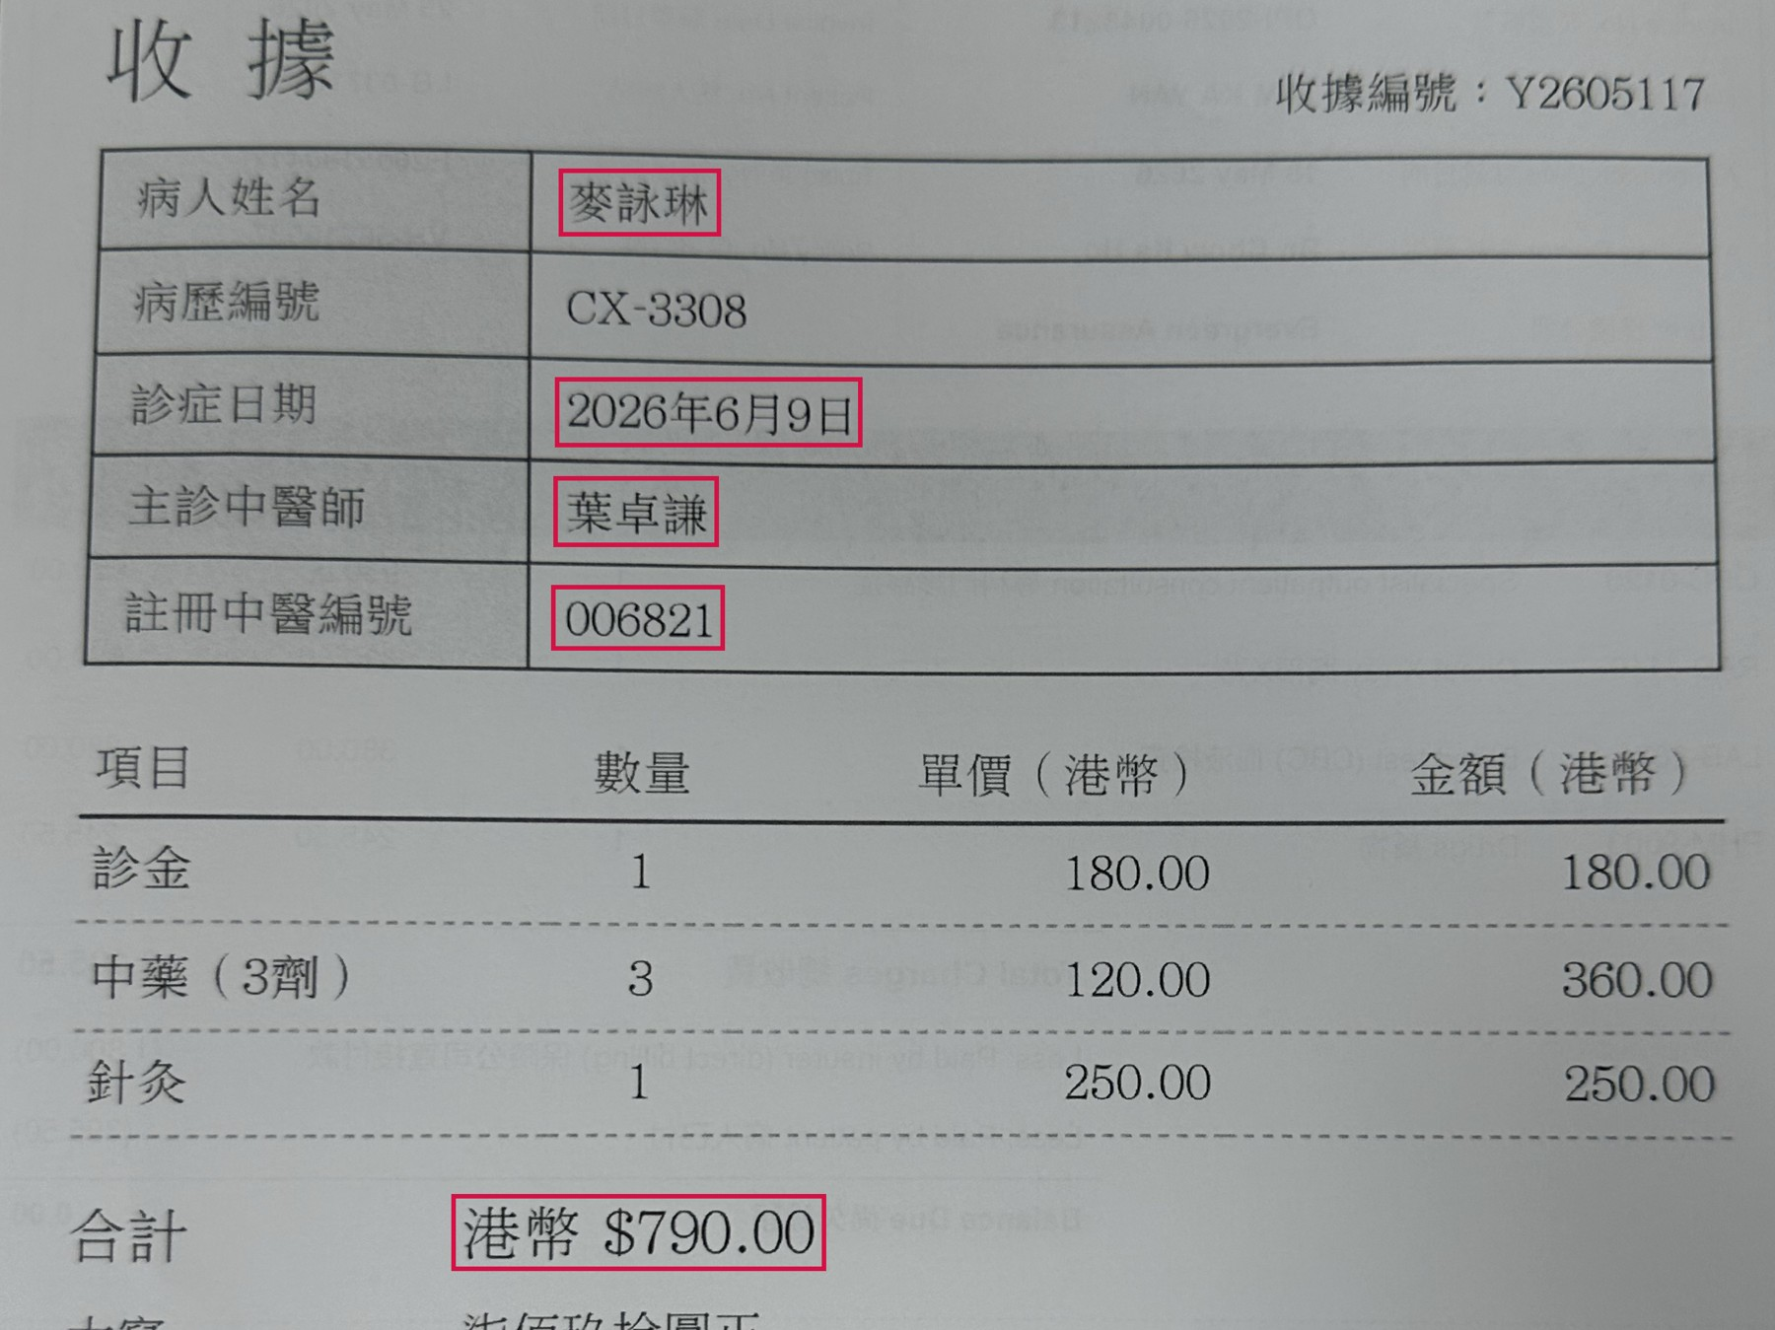
Example 2: Chinese-Only Receipt (Chinese Medicine)
The original rules found nothing; the improved rules and AOAI found all six fields.
Field | Correct value | Original rules (PaddleOCR Light) | Improved rules (PaddleOCR Light) | Azure DI + AOAI
Patient | 麥詠琳 | ✗ (not found) | ✓ 麥詠琳 | ✓ 麥詠琳
Doctor | 葉卓謙 | ✗ (not found) | ✓ 葉卓謙 | ✓ 葉卓謙
Reg. no. | 006821 | ✗ (not found) | ✓ 006821 | ✓ 006821
Service date | 2026-06-09 | ✗ (not found) | ✓ 2026-06-09 | ✓ 2026年6月9日
Total amount | 790 | ✗ (not found) | ✓ 790.0 | ✓ 790.0
Rules shown on PaddleOCR Light text; Azure DI and Heavy behaved the same. ✓ correct · ✗ wrong or missing.
Notes:
Receipt4 (Traditional Chinese medicine). Every value was read correctly by the OCR, but the original rules only knew English labels. The improved rules add Traditional Chinese labels (病人姓名, 主診中醫師, 註冊中醫編號, 診症日期, 合計) and Chinese dates. AOAI's date is shown as it returned it (2026年6月9日); the scorer reads it as the same date. Source: python/receipt_ocr_benchmark/results/v2/scores_improved (detail.csv, summary.csv) and extraction JSON.

Slide 8
Accuracy Before and After Improving the Rules
Improved rules lifted PaddleOCR Light to 88.2% and Azure DI to 86.3% — on the receipts they were tuned on.
7 new receipts | Correct
PaddleOCR Light (improved) | 41/41
Azure DI (improved) | 40/41
PaddleOCR Heavy (improved) | 29/41
Azure DI + AOAI | 39/41
Read with care
Equal scores here do not mean equal accuracy on unfamiliar receipts: the rules were tuned on these receipts, the AOAI prompt was not.
51 applicable fields per approach. Source: python/receipt_ocr_benchmark/results/v2/scores_improved (detail.csv, summary.csv) and extraction JSON.
Notes:
Original vs improved rules on the same OCR text; Azure DI + AOAI is unchanged. The improved rules were written after examining these nine receipts, so their scores are tuned results, not accuracy on unseen receipts. The AOAI prompt was not changed. Source: python/receipt_ocr_benchmark/results/v2/scores_improved (detail.csv, summary.csv) and extraction JSON.

Slide 9
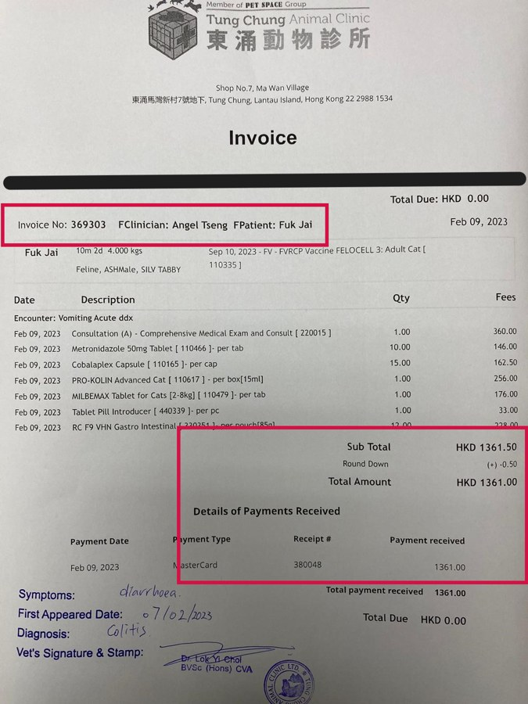

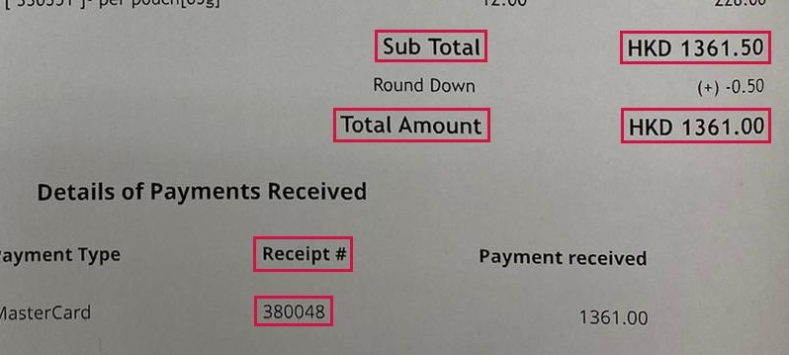
Example 3: What Still Goes Wrong (Vet Invoice)
Each approach fails differently: a rule change picked the wrong number, AOAI picked the subtotal.
Field | Correct value | Original rules (PaddleOCR Light) | Improved rules (PaddleOCR Light) | Azure DI + AOAI
Receipt no. | 369303 | ✓ 369303 | ✗ 380048 | ✓ 369303
Patient | Fuk Jai | ✗ (not found) | ✗ (not found) | ✓ Fuk Jai
Doctor | Angel Tseng, Lok Yi Choi | ✗ (not found) | ✗ (not found) | ✗ Angel Tseng
Total amount | 1361 | ✓ 1361.0 | ✓ 1361.0 | ✗ 1361.5
PaddleOCR Heavy also found almost no text on two photos (3 and 0 text blocks): an OCR failure no rule can fix. ✓ correct · ✗ wrong or missing.
Notes:
Receipt9 (vet invoice carried over from Version 1). The improved rules now reach the 'Receipt #' column in the payments table (380048) instead of the invoice number; the ground truth uses the invoice number (an open policy question). The OCR glued a stray 'F' to 'FClinician' and 'FPatient', so no rule recognises those labels. AOAI chose the sub total 1361.50 instead of the total 1361.00, and both clinicians are expected by the ground truth. Separately, PaddleOCR Heavy detected only 3 and 0 text blocks on receipts 2 and 5, so no rule could help there. Source: python/receipt_ocr_benchmark/results/v2/scores_improved (detail.csv, summary.csv) and extraction JSON.

Slide 10
Speed, Reliability and Cost
Azure DI is fastest (3.8 s); every approach processed all 9 receipts.
RELIABILITY
9 / 9
receipts processed by every approach, no failed requests
COST DRIVERS (MEASURED)
Rules: 4–10 ms of CPU per receipt
PaddleOCR: CPU time on our compute; no per-call fee
AOAI: about 602 input + 263 output tokens per receipt
Prices still to be confirmed
Times measure different things (CPU vs API call incl. network); receipts were processed one at a time.
Notes:
Average seconds per receipt. PaddleOCR = CPU on Azure ML compute; Azure = API call time including network. Rule extraction adds 4–10 ms (original rules 10.2 ms, improved 4.1 ms on average). AOAI tokens are averages over the 9 receipts. Prices (compute, Document Intelligence pages, gpt-5-mini tokens) are not yet confirmed. Source: python/receipt_ocr_benchmark/results/v2/scores_improved (detail.csv, summary.csv) and extraction JSON.

Slide 11
Key Findings and Trade-offs
Most errors came from field extraction, not OCR; better rules close the gap on known layouts.
1
OCR was mostly right
On the new receipts, Azure DI and PaddleOCR Light read almost every value.
 | PaddleOCR Light + improved rules | Azure DI + AOAI
Runs where | Our compute, offline | Azure cloud services
Per-request fee | None (compute only) | DI pages + AOAI tokens
New layouts | Needs new rules | Handled by the prompt
Main risk | Rule maintenance | Cost, model variability
2
Original rules were weak
English-only labels: 37.3–41.2% for Light and DI.
3
Rules can be improved
Tuned rules: Light 88.2%, DI 86.3%; label vocabulary grew about 3×.
4
AOAI handled new layouts as-is
88.2% with a prompt never tuned to these receipts.
5
Heavy adds nothing
Lowest accuracy and slowest (53.3 s); OCR failed on two photos.
Notes:
Findings from FINAL_ANALYSIS.md and RULES_COMPARISON.md in python/receipt_ocr_benchmark/results/v2. Source: python/receipt_ocr_benchmark/results/v2/scores_improved (detail.csv, summary.csv) and extraction JSON.

Slide 12
Recommendation and Next Steps
Keep two candidates and decide on a larger set of receipts that neither has seen.
CANDIDATE 1
PaddleOCR Light + improved rules 88.2% (tuned) · 13.9 s
Offline, no per-request charges; needs rules maintained for each new layout.
CANDIDATE 2
Azure DI + AOAI 88.2% · 6.2 s
Flexible on varied layouts with an unchanged prompt; API costs and run-to-run variability.
Limitation: 9 receipts, mostly mock and printed; the improved rules were tuned on them.
NEXT STEP 1
Freeze both
Lock the improved rules and the AOAI prompt before any new test
NEXT STEP 2
Test on unseen receipts
30+ real, anonymised receipts; count rule fixes needed per new layout
NEXT STEP 3
Confirm prices
Compute rate, Document Intelligence pages, gpt-5-mini tokens
Notes:
Nine receipts (51 fields) are not enough for a production decision, and the improved rules were tuned on them. A fair comparison freezes both candidates first, then tests on unseen, representative receipts and also counts the effort to keep rules working on new layouts. Source: python/receipt_ocr_benchmark/results/v2/scores_improved (detail.csv, summary.csv) and extraction JSON.

