Slide 1

Riley
AIA's Virtual Coworker
One coworker in Microsoft Teams, connected to AIA's data, systems, internal AI capabilities, and approved external information.
Innovation Idea Awards 2026 · Hong Kong · [Your Name]

Slide 2







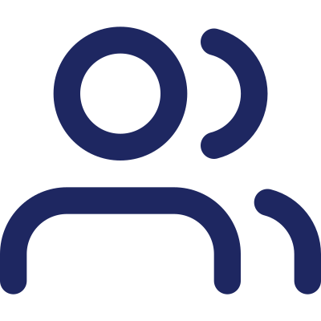


AIA is building AI everywhere.
Employees are left to connect it themselves.
JUST SOME OF WHAT'S OUT THERE TODAY
Many AIA teams are independently building their own AI tools
Employees must discover, learn, and manually combine them
This gets worse, not better, as AIA invests in more AI
Affects a large back-office population across many functions
~20% of the workweek is spent searching for information and coordinating across systems — McKinsey Global Institute

Slide 3

Ask Riley for an outcome. Riley coordinates everything underneath.
TODAY
WITH RILEY
The employee is the connector
Riley is the connector

Slide 4



One example — not the whole product
Employee asks Riley, in Microsoft Teams:
“Review the latest customer complaints, identify the most common issues, compare them with the previous quarter, research any relevant external information, prepare a management summary, and draft a presentation.”
Ask
Plan
Do
Review & Approve
Employee describes the outcome
Riley figures out what's needed
Gathers, analyzes, drafts across sources
Employee checks, corrects, approves
Illustrative example — a candidate first pilot, not a complaints-handling product.

Slide 5

Not a smarter chatbot. AIA's own layer over its own AI.
One coworker, not five tools
A multiplier on AIA's AI investment
Employees talk to Riley instead of discovering and learning every team's individual AI tool.
Every new AI capability any team connects to Riley makes Riley more capable for every employee — value compounds instead of competing.
Agent technology is evolving quickly, industry-wide. Riley's edge isn't the underlying tech — it's this AIA-specific layer, and the feedback loop on the next slide.

Slide 6


Every correction makes Riley better at AIA.
Ask
Riley Learns
Gets better
every time
Riley Delivers Work
The employee stays responsible for every result — and every correction becomes a lesson.
Employee Reviews & Corrects

Slide 7




We won't guess the impact. We'll measure it.
~20%
of the workweek lost to searching for information and coordinating across systems — McKinsey Global Institute. A large back-office population across many functions faces this today.
Active Effort per Task
Completion Time
Manual Steps Eliminated
Time employees actually spend, before vs. after
Elapsed time to a finished, approved output
Systems previously touched by hand
Rework Rate
Quality
Adoption
Share of outputs needing real correction
Vs. a human-only baseline
Employees actively choosing to use Riley
Measured on the real pilot team selected in Phase 0 — not assumed in advance.

Slide 8


A deliberately narrow start, built to prove the bigger vision.
PROVES THE MULTIPLIER
Phase 0 · Weeks 1–2
Phase 1 · Months 1–3
Phase 2 · Months 4–6
Phase 3 · Months 7–12
Select & Baseline
MVP Pilot
Prove the Multiplier
Scale
Choose a real pilot team; baseline effort, time, and manual steps.
One workflow, human-approval-gated. Measure against baseline.
Connect another AIA team's AI tool into Riley + a second workflow.
Extend across the back office and more connected AI tools.

Slide 9


Built to be approved, not just admired.
Feasibility
Governance
Lives in Microsoft Teams — reduces friction because employees already use it. Every output is reviewed and approved by the employee before action.
Human-in-the-loop at every step, with permissioned access and an approval trail throughout.
Scalability
Resources
The core Riley experience and orchestration model are reusable across markets — each market adds its own system integrations, data controls, and governance.
A pilot sponsor, a small build pod, Group Innovation Office support, and access to system owners — not a request to build an AI engine from scratch.

Slide 10
Every AIA employee could eventually have access to a virtual coworker in Microsoft Teams that can use AIA data, systems, internal AI capabilities, and approved external information to complete work on their behalf — while the employee remains responsible for review and final decisions.
The ask: one pilot team to prove Phase 1 and Phase 2.
Riley — AIA's Virtual Coworker · Innovation Idea Awards 2026

