Slide 1
Cancer Diagnosis using Automatic Mitotic Cell Detection and Segmentation in Histopathological Images

Slide 2
INTRODUCTION
Cancer is the second most common disease in India.
Cancer is a general term used to refer to a condition where the body’s cells begin to grow and reproduce in an uncontrollable way.
80 – 90% cancer are due to our habits and activities
Cancer involves almost every parts of the body
Cancer cells multiply in an uncontrollable & haphazard manner

Slide 3
SCENARIO
Cancer is the cause of 12% of all deaths
In India 1.5 – 2 million estimated cancer cases at any point of time
Every year 8 lakhs new cases are detected in India
Every year 5.5 lakhs cancer patients die in our country

Slide 4
Clonal expansion
The genetic material (DNA) of a cell sometimes will become broken or modified, manufacturing mutations that have an
effect on traditional cell growth and division.
Once this happens, cells don't die once they ought to and new cells also start accumulating (Tumor)
Tumors are classified as:
Benign tumors are not cancerous. Cells in benign tumors don't unfold to alternative components of the body.
Malignant tumors are cancerous. Cells in these tumors will invade close tissues and unfold to alternative components of the body.

Slide 5
The greatest need we have today in the human cancer problem, except for a universal cure, is a method of detecting the presence of cancer before there are any clinical signs of symptoms
Sidney Farber (The Emperor of All Maladies, Siddhartha Mukherjee)
Early detection of cancer greatly increases the chances for successful treatment. There are two major components of early detection of cancer:
Education to promote early diagnosis and screening.

Slide 6
IMAGE DATA
Database collected contains a set of 5 breast cancer biopsy slides.
The slides of MITOS dataset have been scanned by two different equipment: a scanner A, a scanner H
Scanner A has 0.2456 μm per pixel resolution.
Scanner H has a slightly better resolution of 0.2273 μm (horizontal) and 0.22753 μm (vertical) per pixel, so a scanner H pixel is not precisely a square.

Slide 7
Histopathological image
Histopathology refers to the microscopic examination of tissue in order to study the manifestations of disease.
It is terribly helpful in creating a diagnosing and in deciding the severity and progression of a sickness.
It also used to understand the normal structure and function of different tissues is essential for interpreting the changes that occur during disease.

Slide 8
For the diagnosis of cancer, there are various types of screening tests such as digital rectal exam, MRI, endoscopy, and colonoscopy.
Histopathological examination is the most reliable procedure and considered as the gold standard for cancer diagnosis and grading.
In this examination, pathologists should be able to identify the changes in cellular structures and the deformations in tissue distribution, but tissue preparation procedures such as staining and sectioning operations may introduce noise and artifacts to the image.
To improve the reliability of cancer diagnosis, it is important to develop computational tools for automated cancer diagnosis that operate on quantitative measures.
Histopathological image (a) a healthy tissue, (b) a cancerous tissue.

Slide 9
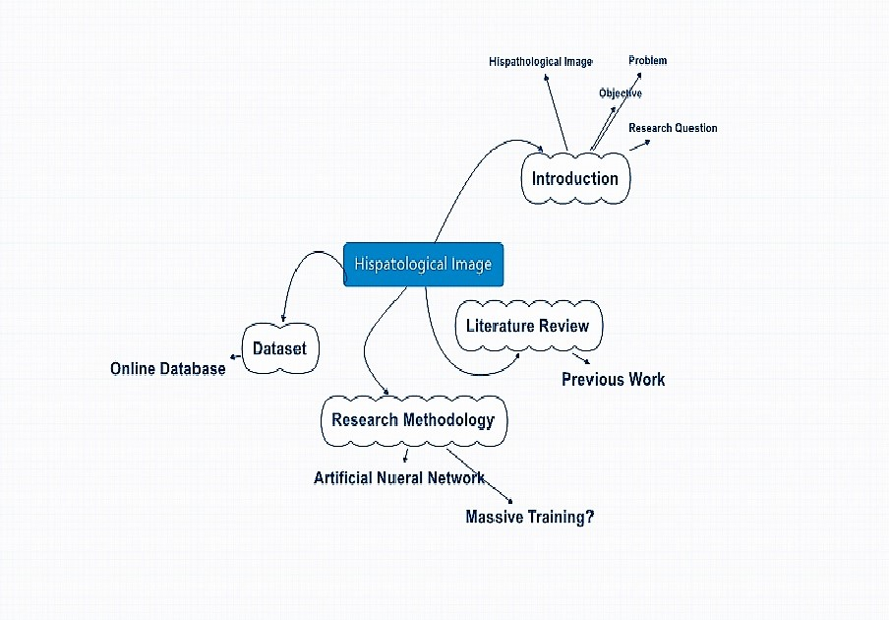
Diagnosis using Histopathological Image

Slide 10
PROPOSED METHODOLOGY
The aim of the proposed method is automated cancer cell detection and segmentation in multispectral histopathological images and to reduce the workload of the pathologists.
The objective of this project is to detect and segment the mitotic cells in the high resolution multispectral image by digital image processing techniques.
This proposed work consists of four modules:
Preprocessing
MC detection extraction and segmentation
Feature extraction
MC classification

Slide 11
The pre-processing steps are as follows:
Conversion of RGB image into gray scale image.
Resizing the grayscale image suitable for further processing.
Removal of noise by filtering and Histogram equalization.
Segmentation performed to detect and segment the mitotic cell candidates region.
The segmentation steps are as follows:
Bayesian modeling for posterior map generation
Mitotic cell candidate’s detection
Intact mitotic cell candidate’s regions segmentation
Overall block diagram of proposed method.

Slide 12
Preprocessing
Gray scale conversion:
The grayscale image generally has the highest contrast between structures even in the presence of different backgrounds.
Hence the first step in Pre-processing is to choose grayscale channel.
Filtering the image:
Noise reduction is one of the relevant approaches that are used to eliminate the stain artifacts.
We use Median Filter here, which preserves edges while removing noise.
As edges are great important here to detect tissue cells

Slide 13
Contrast Enhancement
Contrast enhancements improve the perceptibility of objects in the scene by enhancing the brightness difference between objects and their backgrounds.
We use Histogram Equalization here, which adjusts the image intensities to enhance contrast.
Histogram Equalization implies mapping one distribution to another distribution so the intensity values are spreaded over the whole range

Slide 14
Detection and Segmentation
The goal of this module is to detect and segment the MC candidates regions.
There are three steps in this module as follows:
Best-fitted ellipse calculation
An ellipse is fitted based on the boundary points of a candidate region using the direct least-squares fitting algorithm
Local-region determination
A local circular area with an enlarged radius (2 × Lj) is determined to recover the intact nuclei.

Slide 15
Local threshold calculation
Here we use Otsu thresholding method to calculate the local threshold (denoted as T local) for this local circular area
Local area segmentation
The local threshold T local is used to segment its corresponding local area into nuclei and background region
Here we assume that that the intensity value in the nuclei region is lower than the background

Slide 16
Features extraction
The main aim of here is to extract all the features that contribute discrimination information for the final MC detection
Two commonly used texture-based features, Tamura textures and Haralick-based textures are extracted to measure the textural information on the surface of the regions
Dimension features extracted from the candidate regions and also consider the surrounding area of the candidate regions

Slide 17
Classification
The final module of proposed method is classification of MC.
The classification framework that can deal with the imbalanced class distribution is employed to address the grade of cancer after MC detection
Here we use Convolutional Neural Networks.
Finally we get two sets of images, one which has cancer cells and the other which doesn’t.

Slide 18
Conclusion
Automated analysis tools are a crucial step towards a more objective basis for tumor prognosis.
The plan of proposed method is to perform the study of Convolutional Neural Networks classifier on cancer diagnosis after segmentation and feature extraction steps in histopathological image.
The evaluation on the MITOS-dataset shows convincing accuracy with good localization properties given the rather small number of annotated examples.

Slide 19
References
Dataset - http://ludo17.free.fr/mitos_2012/download.html
Cancer Diagnosis using Automatic Mitotic Cell Detection and Segmentation in Histopathological Images by Logambal.G , Saravanan.V
Open Cv - http://docs.opencv.org/3.2.0/
Learning-based mitotic cell detection in histopathological images - http://anker.iwr.uni-heidelberg.de/publications/mip/techrep/sommer_12_learning-based.pdf
https://en.wikipedia.org/wiki/Histopathology
Anna Henrik Israyelyam MD, The development of molecular diagnostics for breast cancer, Yerevan state medical university, pp.1-26, August 2003.

