Slide 1
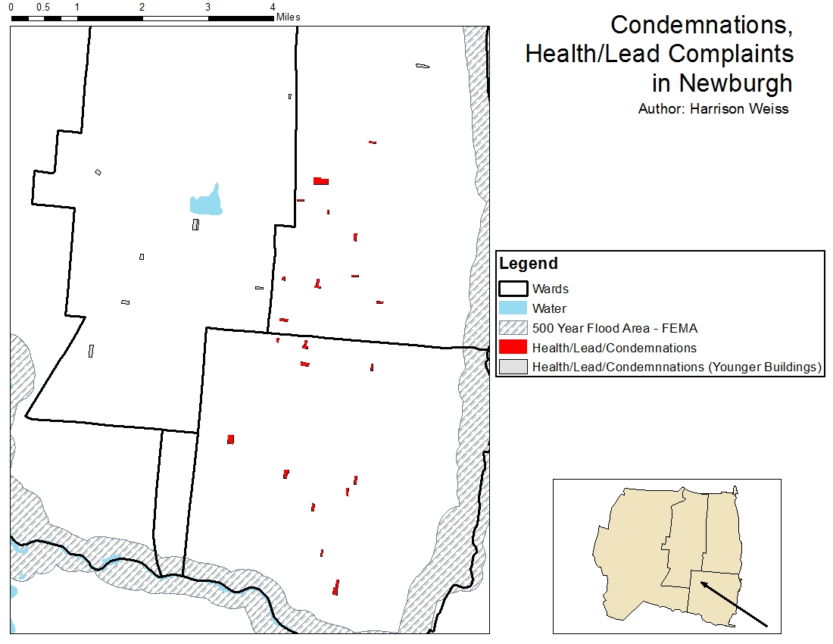
Age of Buildings and the Frequency of Incident Reports of Health Hazards and Condemnations in Newburgh, NY
Harrison Weiss
Introduction:
Newburgh, NY has a population density of 7,463 per square mile, significantly higher than the national average (Areavibes).
Complaints are reported to the city and recorded in a manner that allows us to map them according to location in the city.
Total Number of Buildings Condemned and Health/Lead Reports:
33
Total Number of OLD Buildings Condemned and Health/Lead Reports:
22
Results and Discussion:
According to zoning information, the reported condemnations and health/lead reports come from Residential areas. The oldest buildings in the city are located with the lower-right corner of the city (Church).
Initially, it was believed that health/lead and condemnation reports would correlate with proximity to water and flood areas, however, after mapping, it becomes clear that is not the case. Buildings within the red rectangle are some of the oldest buildings in the city.
From this study, it appears to be that age of buildings and zoning use are most indicative of where health/lead and condemnation reports will come from. Further analyses are required to determine if this is accurate.
Objective:
To determine which buildings in the city are most likely to be condemned and report health/lead hazards.
To determine what kind of buildings are most likely to be condemned base on zoning type.
Figure 1
Notes:
https://www.areavibes.com/newburgh-ny/demographics/

