Slide 1


Find Mean, Median, Mode, Range and Quartile of data set: 60, 55, 50, 50, 40 ,45, 55 , 45, 50.

Slide 2
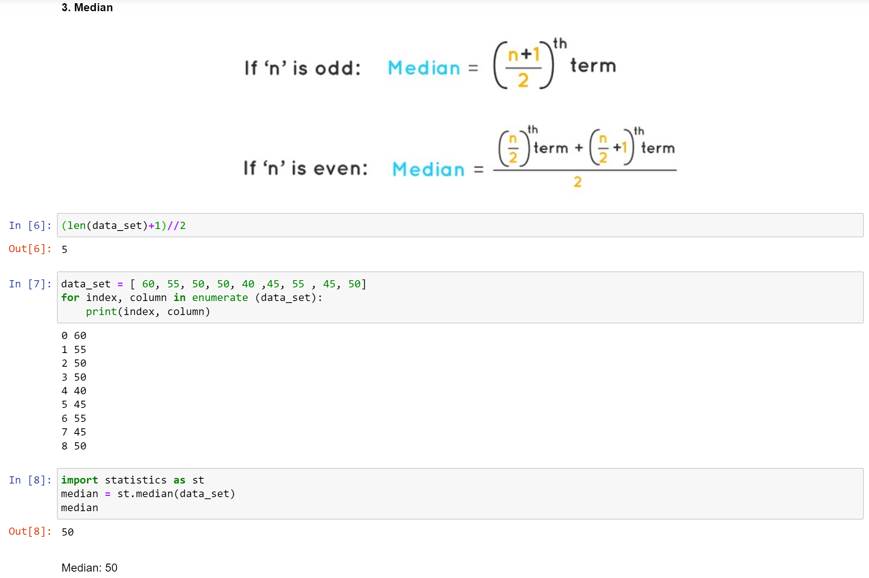

Slide 3
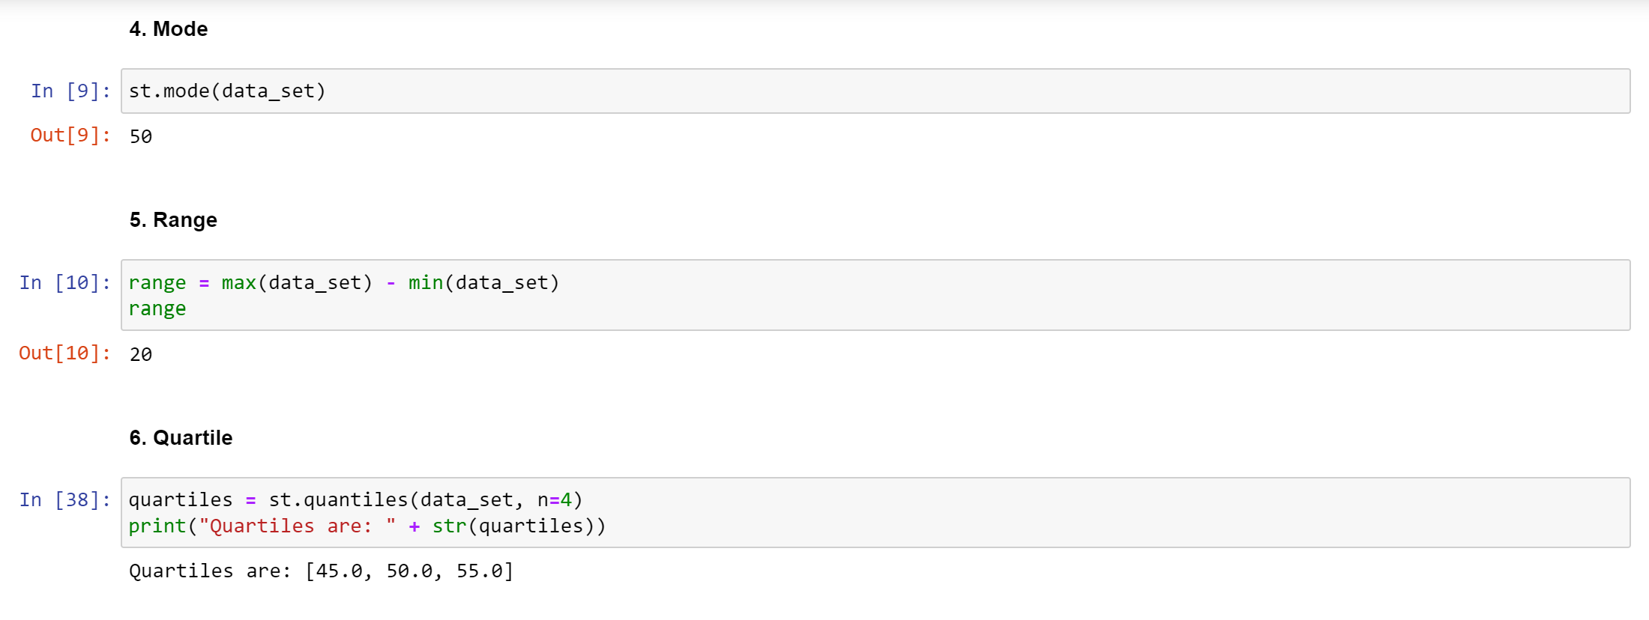
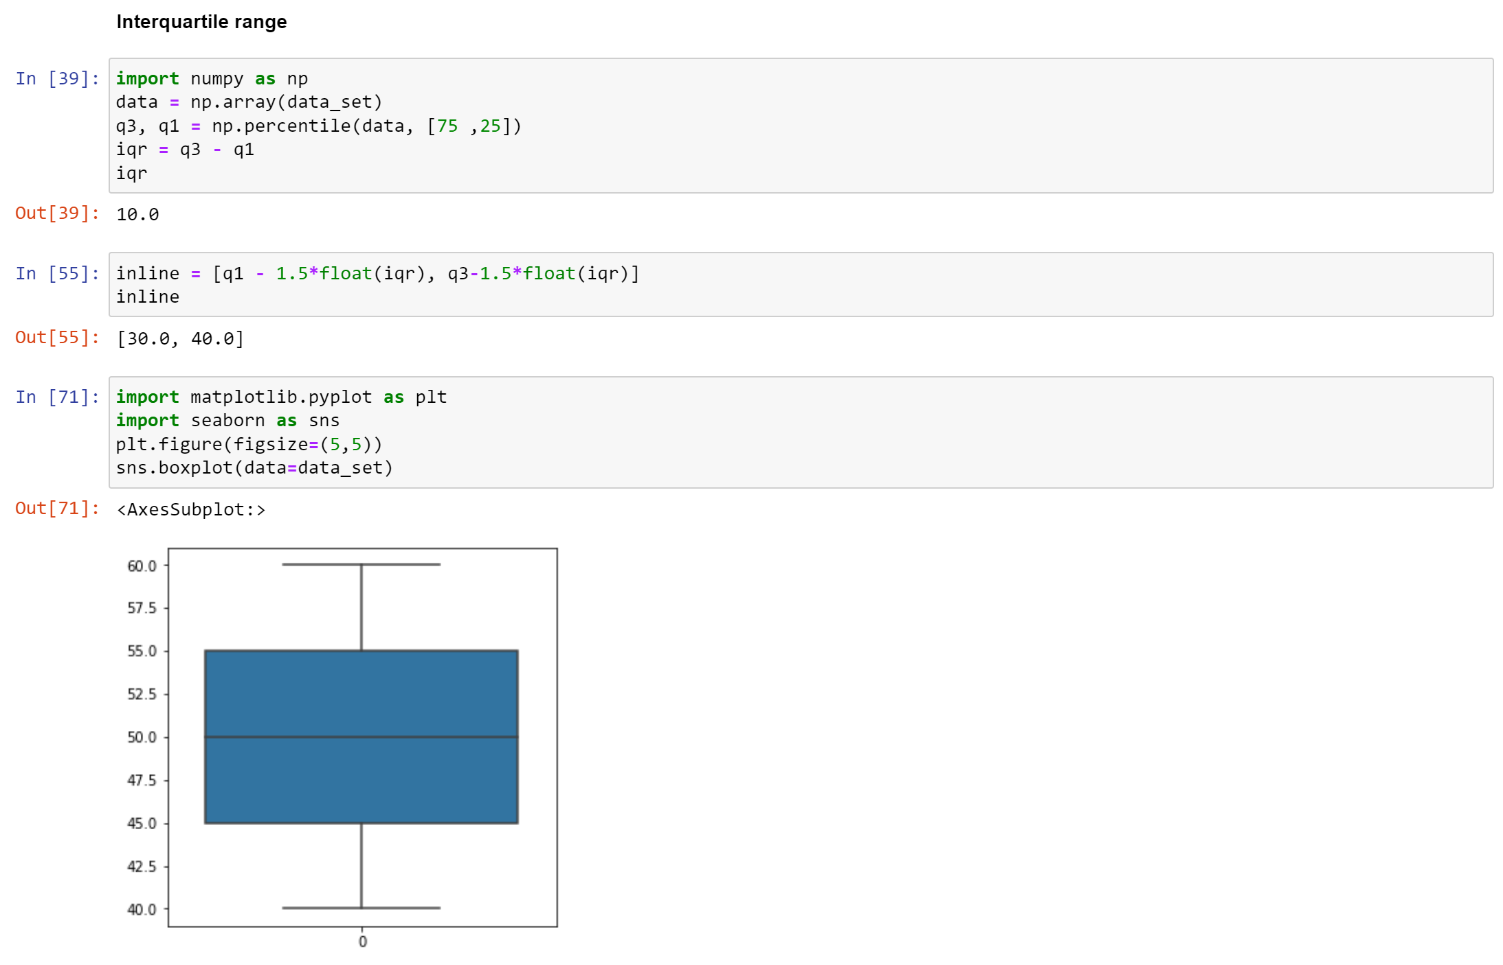

Slide 4
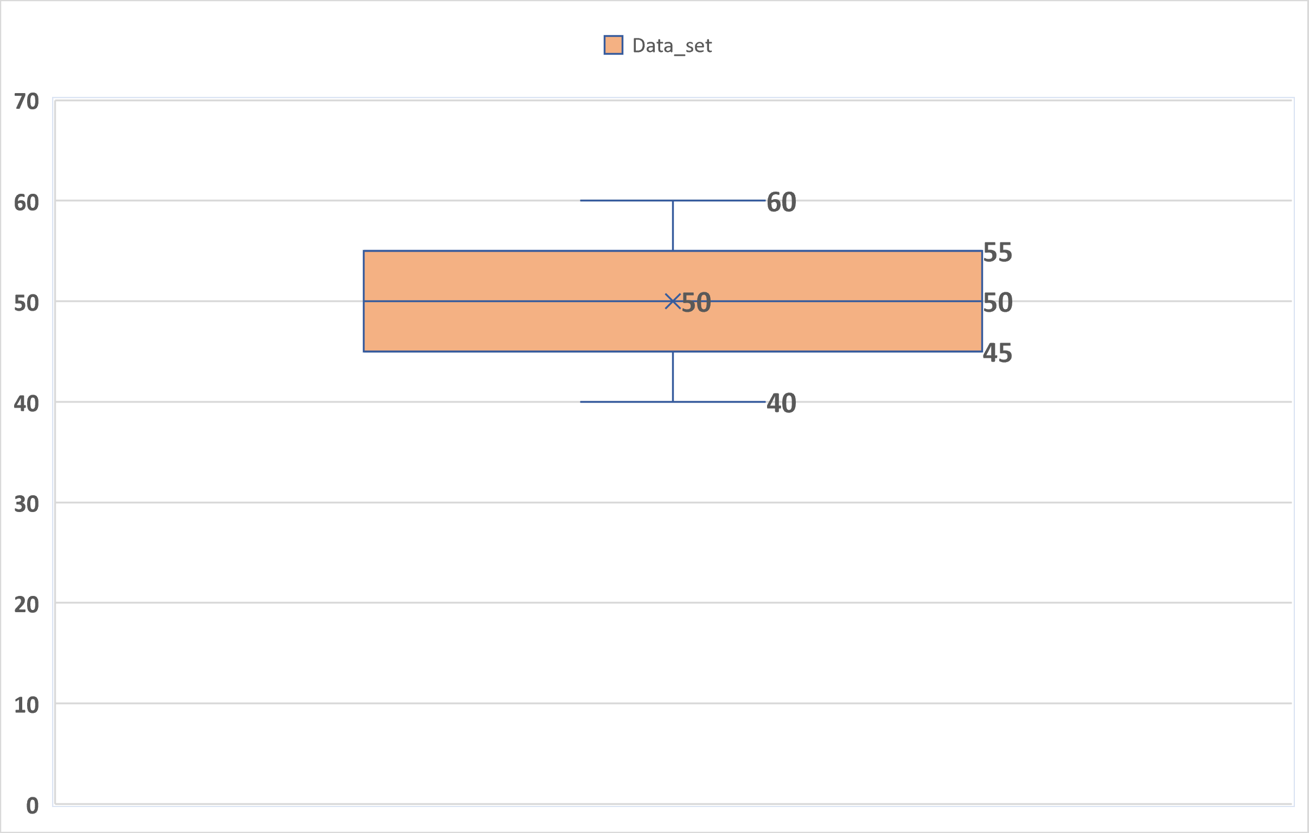

Slide 5
